Slide 1



The impact of listening
Gail Patel, Highly Specialist Physiotherapist
“If we were supposed to talk more than we listen, we would have two tongues and one ear”
Mark Twain.
Perth & Kinross Long COVID Support
Notes:
Introduce self and role: working in post-COVID services in NHS Tayside in Scotland since July 2020 and with P&K HSCP since Jan 2023.
Thank you or inviting me to speak today and it’s a pleasure to share with you a bit about my journey as a clinician using Care Opinion within our service for feedback, my experience as a responder, and considering the impact of listening within my area of work.

Slide 2
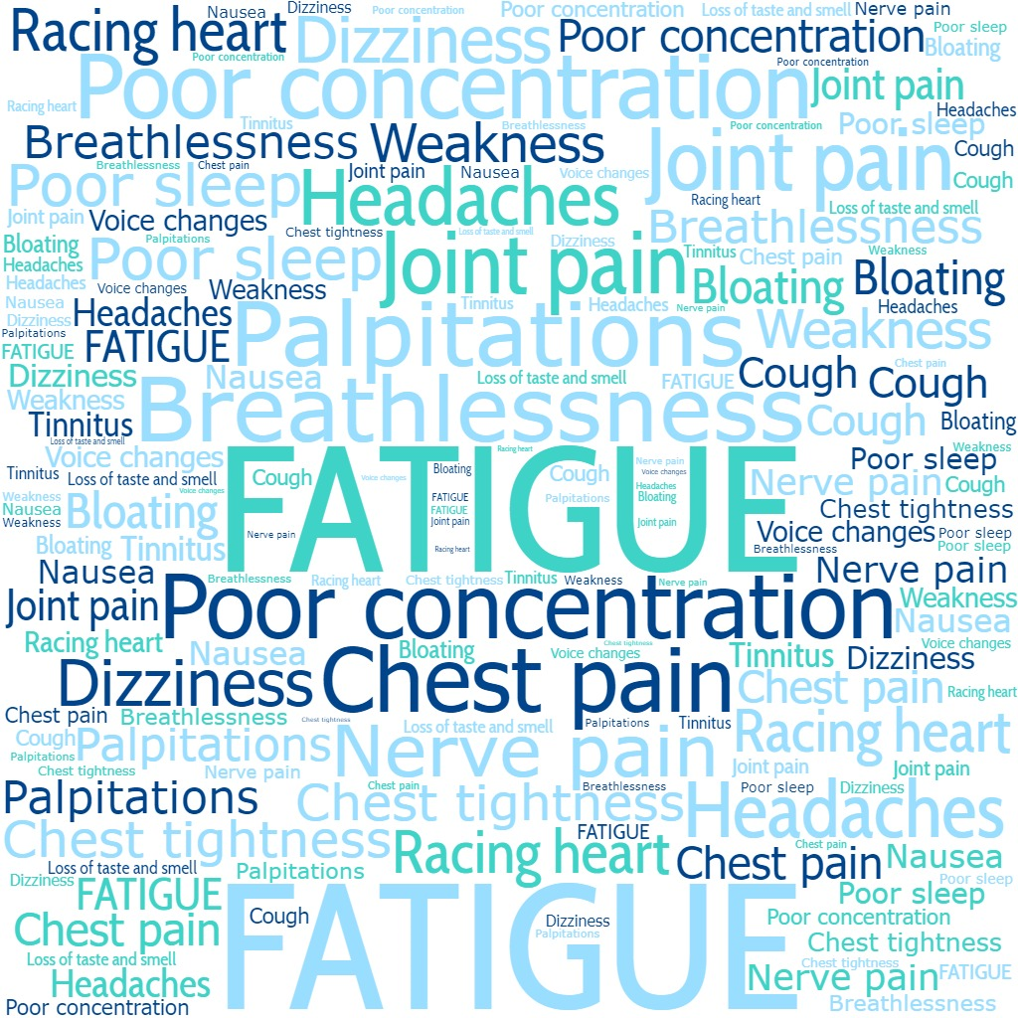

Our service
As part of our adult NHS Tayside post-COVID pathway we provide holistic assessment, symptom management, care co-ordination, onward referral, and rehabilitation where appropriate.
Confirmed or suspected Long COVID diagnosis.
Physiotherapist-led: GP’s are responsible for
appropriate medical assessment prior to referral.
Complex, multi-system condition.
Varying levels of debility & disability.
Relapsing & remitting presentation.
Deliver tailored symptom management & rehab
where appropriate.
Majority of consultations are virtual
using Near-me video platform or telephone call.
Approx. 1000 patients through NHS Tayside as a whole since July 2020
Average age 52
Female > Male
Majority patients
non-hospitalised
Average duration of illness at time of initial assessment = 14 months

Slide 3
Active listening =
“Most people do not listen with the intent to understand; they listen with the intent to reply”
Stephen Covey, 7 habits of highly effective people.
Paying attention: listen with curiosity
& don’t give advice too quickly.
With-holding judgement.
Reflecting.
Clarifying.
Empathising.
Providing feedback.
“When you are in psychological distress and someone really hears you without passing judgement on you, without trying to take responsibility for you, without trying to mould you, it feels damn good”
Carl Rogers, ”A way of being”.
Notes:
The title of this section is “the impact of listening”. This job has really made me consider my listening skills.
Research has shown that on average, clinicians interrupt patients within the first 18-23 secs of a consultation, even after asking a pt to express their concerns. Research has also shown that interrupting the patient earlier also leads to a longer consultation time overall.
AHP’s are generally “fixers” and want to problem solve in order to offer solutions/”fix” people. I’ve learnt in this job that I can’t necessarily do that – but what I can do is listen well – and this can be just as powerful & important in an individual’s recovery than offering practical strategies for symptom management.

Slide 4

Part of a Rehabilitation pathway:
Our aims
Supporting the individual to understand, manage and adapt to their symptoms.
Looking at the impact of symptoms rather than just the symptoms themselves.
Enabling individuals to live well with what can be a long-term and fluctuating condition.
“Wanting to feel heard is a natural and common desire. It stems from the need for validation, understanding & connection”
Juliet Hollingworth, “The impact of listening in communication”.
Notes:
We want to empower condition self-management where possible & appropriate.
Feeling heard & understood is a basic need for most people. Listening well to an individual’s concerns to understand the impact of their symptoms on their day-to-day life is a key part of my work.
I find that “feeling heard” is really important for building an effective therapeutic relationship with an individual, to understand their priorities, and to work in partnership with them to improve their health & quality of life.

Slide 5
Perth & Kinross Long COVID Support on Care Opinion
Sign-up
Joined April 2023
Approx 65 patients offered opportunity to share their stories
No. of stories
5 stories shared
Number of patients
Quality not quantity!
✓
Notes:
65 patients through our service since we joined Care Opinion.
Patients are informed about Care Opinion at various points during their care and again on discharge.
The Care Opinion information is also included in our generic team email signature that we send patient information from.
Looking at ways to increase our number of stories but many patients do have significant energy limitations so we need to bear this in mind. I do feel honoured & humbled when I know someone has used much-needed energy
to share feedback with us.

Slide 6
My personal journey being part of Care Opinion
Anticipated service benefits:
We were already gathering feedback from our patients prior to Care Opinion:
traditional format using Likert scales - postal or email questionnaire.
Care Opinion felt like a great way to gather feedback in one place and gather more
comprehensive qualitative feedback.
Offering an opportunity to start to see feedback themes using the visualisation tools.
Use feedback obtained as an opportunity to guide service improvement & learning.
Concerns & curiosities:
Anxieties around Care Opinion use in a single-person service; would feedback
replicate what patients told me in-person?; would this differ with the ability for people
to provide anonymous feedback?
Asking patients with significant energy limitations to give feedback in a more
free-hand format: people often describe cognitive difficulties & difficulty in
planning or processing information.
Notes:
Concerns/curiosities:
It can feel uncomfortable asking for feedback in a single-person service, particularly if you feel things haven’t gone so well but it does really add to the feedback data.
And it’s always a bonus when you anticipate feedback might not be so good and it’s actually better than you were expecting!

Slide 7
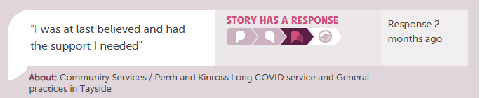
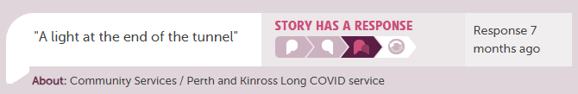
Our stories:
“I have had 3 consultations and she has made such a positive difference to my life. She has so much knowledge and understanding of the numerous effects of long covid on the body and targets me individually with person centred tips and advice”.
“advice has been valuable in my recovery and mental well being. I feel hope for the future”.
Notes:
Although we haven’t had a huge number of stories, I think the stories have given us a lot of much richer, qualitative date versus our more traditional feedback form.
Some of the story titles, and quotes from the stories hopefully demonstrate that we have listened to people’s concerns which has in turn allowed us to deliver patient-centred care to support recovery.

Slide 8
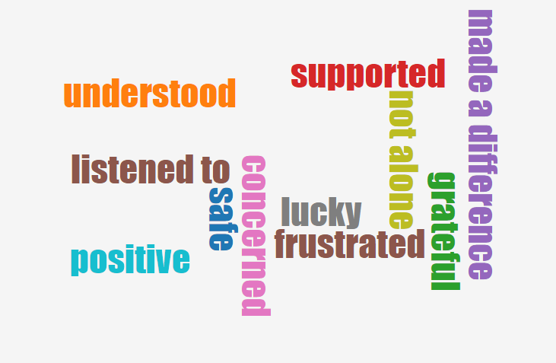
Prior to accessing our service our patients often report they have experienced:
A lack of understanding about their symptoms.
Not being believed about their symptoms by medical professionals, friends or
colleagues.
Feeling isolated.
Difficulty accessing appropriate care in a timely manner: often people have
been living with debilitating symptoms for many months before accessing our
service.
After accessing our support
How did you feel?
Notes:
Patients are often distressed by not just their symptoms, but often perceived lack of understanding or lack of access to care; they often relay experiences of a prolonged illness with multiple symptoms and complexities. Many have lost not only their health, but sometimes their jobs, social roles and in doing so feel they have also lost their identities.
Listening well to make sure I haven’t missed anything important, and to make sure I’ve understood the impact for the patient and their priorities is really key to building an effective therapeutic relationship.
Virtual appointments can sometimes add to the challenge as we lose some of that in-person interaction & can often lose a fair bit of non-verbal communication & body language on a screen that normally helps us as clnicians understand & interpret somebody’s response to our questions.
So active listening feels even more important for me in the virtual environment. For the person to feel heard & understood from their first consultation.
One of the most common things that patients tell me afterwards is that they finally feel believed and having their symptoms understood and validated is often a huge relief.
On the whole, I’ve received very positive feedback directly from patients but I was interested to see what our stories would say when people were able to post feedback anonymously. Pleasingly, our “How did you feel” Wordcloud hopefully demonstrates that we have achieved our aims of people feeling heard.

Slide 9
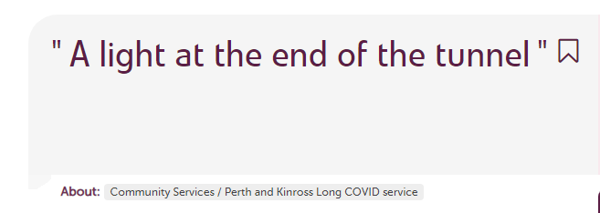
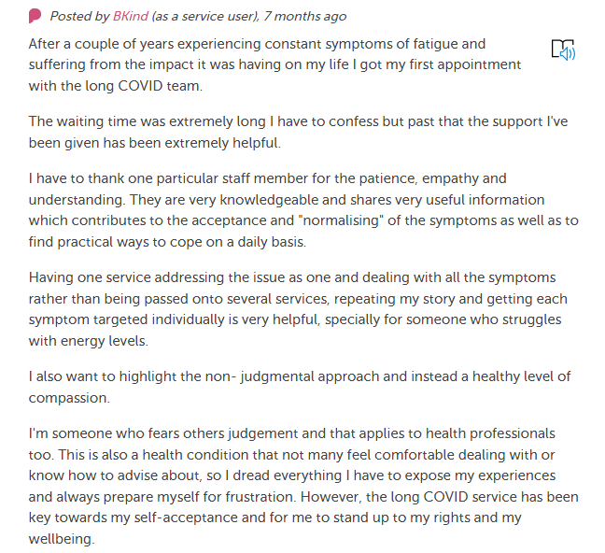
One of our stories….
Notes:
“The waiting time was extremely long I have to confess but past that the support I’ve been given has been extremely helpful”.
This particular individual had waited a number of months on our waiting list and been living with LC for 2 years.
There were multiple points made within this story so I used the Care Opinion guidance on responding to help address each point.

Slide 10
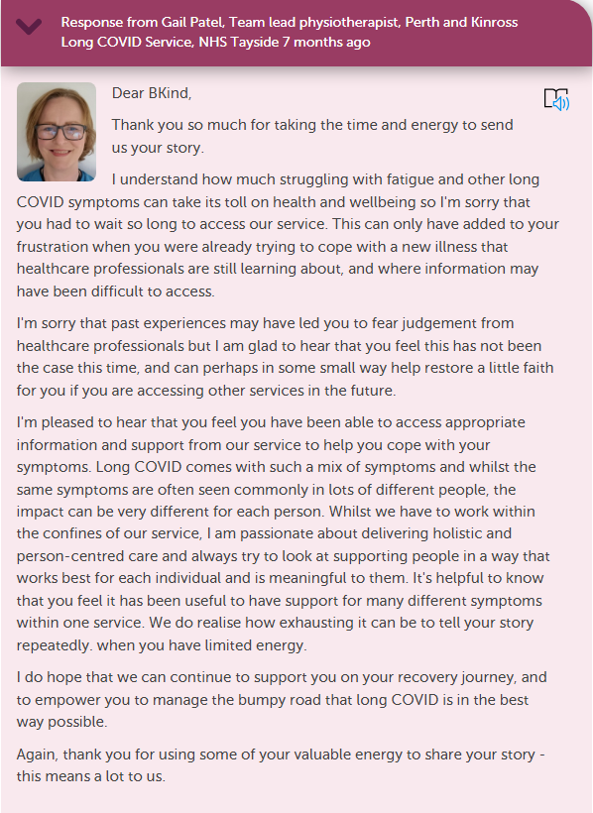
My response...
Using Care Opinion guidance for feedback:
Apologising for poor experiences.
Responding to each point of the story with empathy.
Giving personalised responses.
Reflecting on learning points.
Recognising where change(s) can be made to improve experiences.
Notes:
(Run through guidance on slide)
As always, I felt it was important to apologise for the lengthy wait, as although this wasn’t directly attributed to our service response time, it clearly impacted this individual.
And I think giving a personalised response can really help the story author feel like they have been listened to and that their story matters.
It was lovely to get feedback in this story though that despite the lengthy wait to access our support, our input was seen as valuable and offered hope to this person going forward, with “a light at the end of the tunnel”.

Slide 11
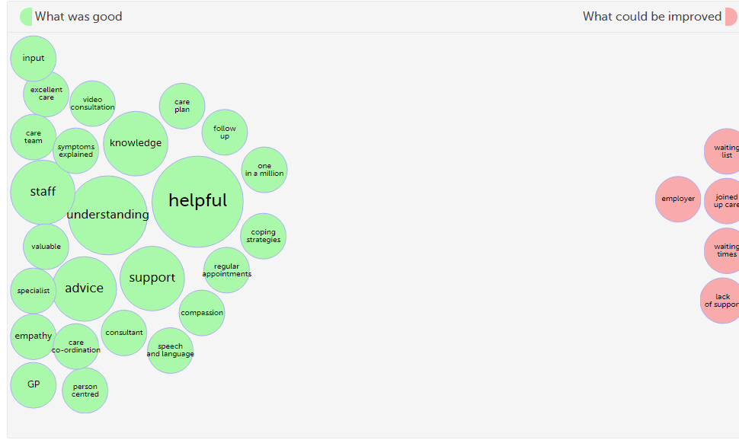

What was good?
What could be improved?
Notes:
The data visualisations allow us to instantly see not only things that have gone well, but areas for improvement.
This bubble visualisation has been created from our stories to date.
It’s helpful to see which elements of our service are particularly valued e.g., virtual consultations. Many of our patients are very fatigued so they have found it beneficial to avoid the adidtional energy burden of travelling to and from appointments.
And if there are any consistent themes versus single instances.
As from the previous story, data from our stories collectively also showed the same theme of lengthy wait times.
Some of the things that have been highlighted for improvement were outwith our control e.g., employer and a lack of support highlighted in other services that were mentioned in the stories, but it has highlighted that awareness of long COVID could be improved across services and this is a key part of our strategy this year looking at up-skilling and education of our wider workforce treating long COVID.
A lot of patients accessing our service did have a significant wait to do so in the beginning due to challenging demand versus capacity issues earlier in the development of our long COVID services and this is borne out in the story tags, with waiting list being mentioned in every story.
And changes to the service mean that we no longer have a lengthy wait time to access care, so we have also been able to demonstrate in our stories that a change has been made.

Slide 12
In summary: The impact of our stories
Allowed us to identify specific areas for improvement.
A more story-based feedback system has given us richer patient experience data.
Allowed us to see that patients clearly value and benefit from the support we offer which is helpful for future service-planning.
Notes:
Areas for improvement: waiting times; pathway and referral awareness; areas where education is needed to improve understanding; It has helped us understand what patients find useful (and not so useful) about our service in particular and how this information can be used for future service-planning.
Having that anonymity of story-telling I think gives a real honesty in the feedback too.
Seeing what we have got from our limited number of stories also drives me to try and increase our story response rate and look at ways we can do this.

Slide 13
Thank
You for listening well!
Gail Patel, Highly Specialist Physiotherapist, Perth & Kinross Long COVID Support.
gail.patel@nhs.scot

