Slide 1
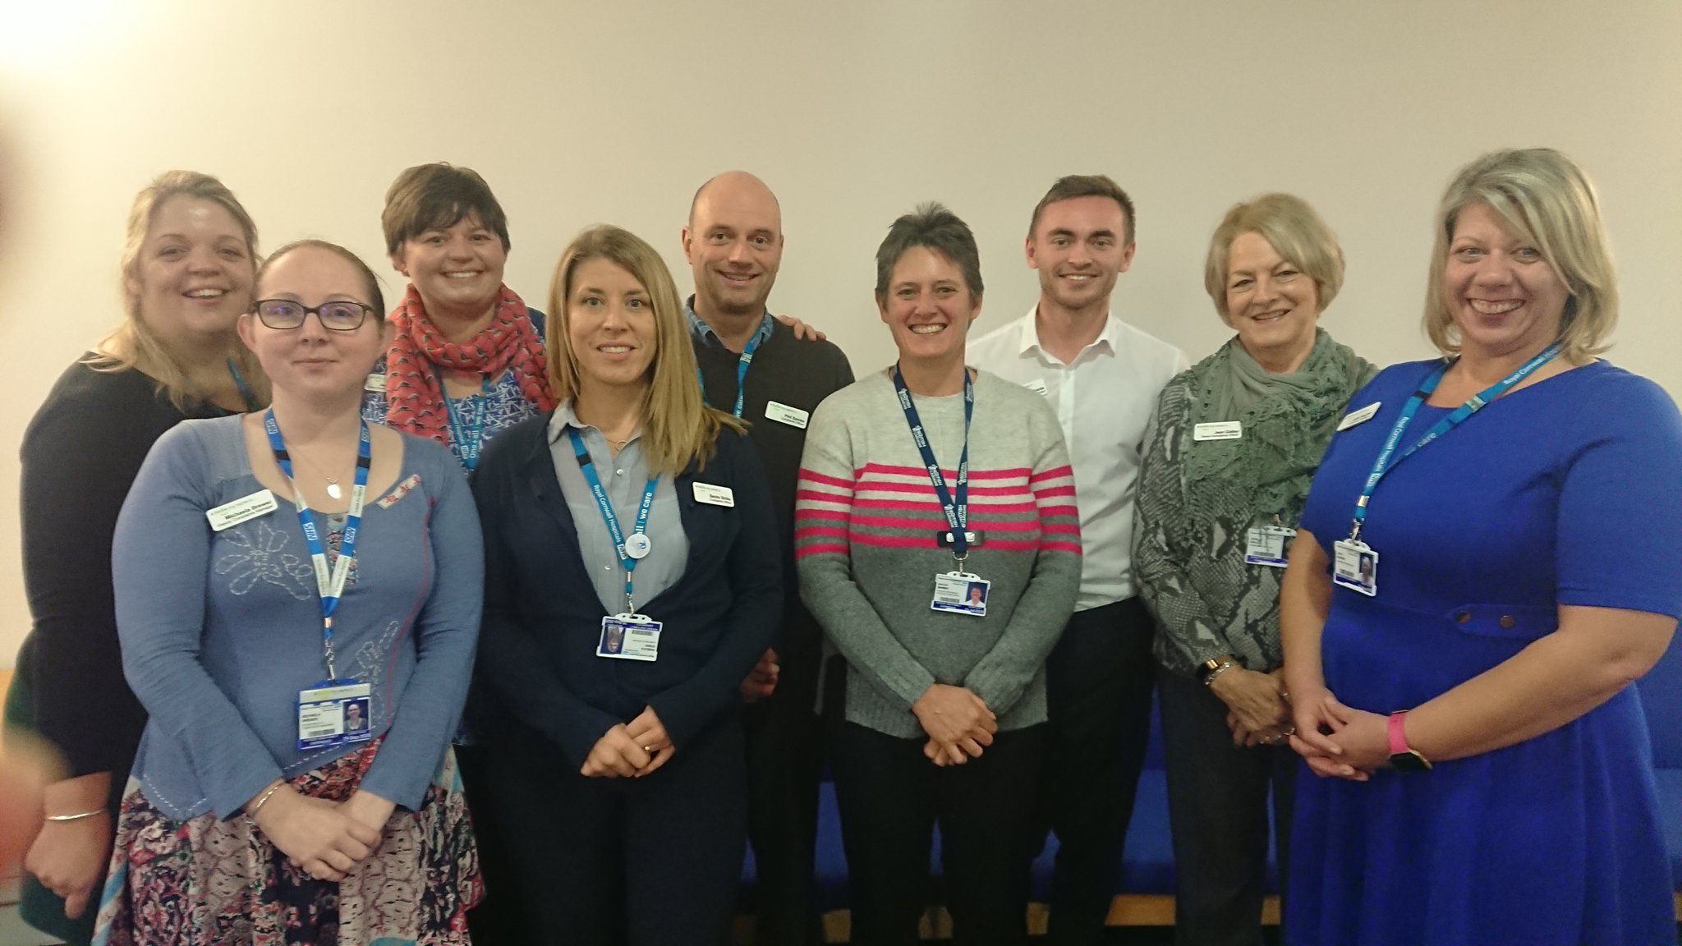
Using Care Opinion at RCHT: Starting Our Improvement Journey
Frazer Underwood
Consultant Nurse / Associate Chief Nurse and

Slide 2
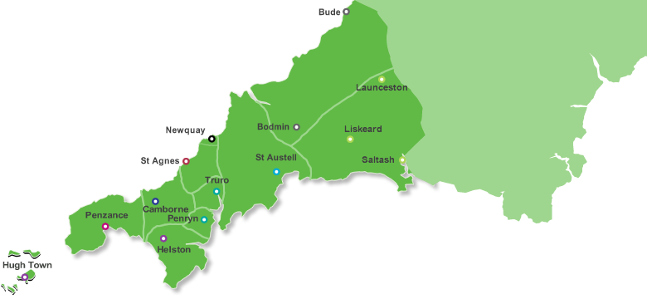

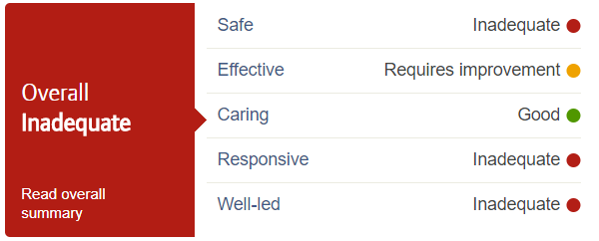
St Michael’s Hospital
Hayle
35 beds
Patient + Family Experience Team :
Nine staff members
Complaints:
380 – formal complaints
1200 – informal complaints
16 escalated to PHSO
Care opinion:
Two subscriptions
Royal Cornwall Hospital
Truro
480 beds
West Cornwall Hospital
Penzance
54 beds
2017

Slide 3
Why did RCHT subscribe to Care Opinion?
We were not a learning organisation
Clinical teams were disengaged with patient feedback
We were starting a significant improvement journey
…I saw the opportunity to link
Care Opinion into that journey

Slide 4
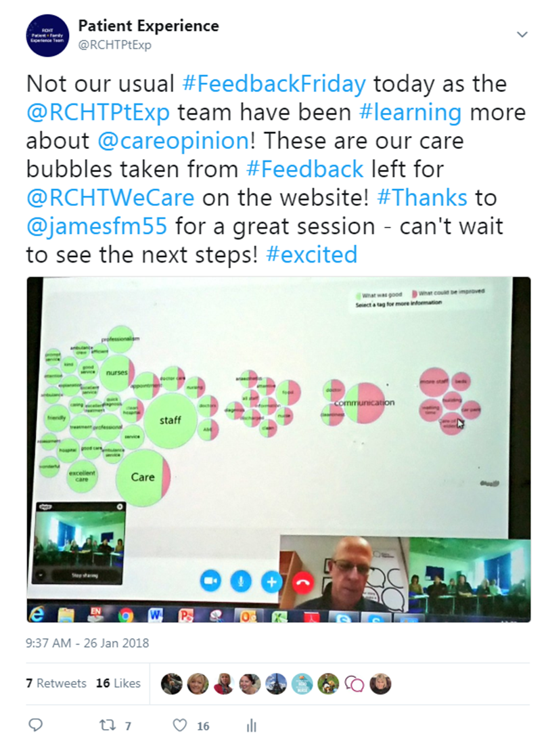
Where did I start?
Learning more…

Slide 5
And then…?
I made the connection for our Chief Nurse between patient experience and our Improvement plan
The Patient + Family Experience team took control of the existing subscriptions
Promoted the visibility of Care Opinion
and built the case for investment

Slide 6
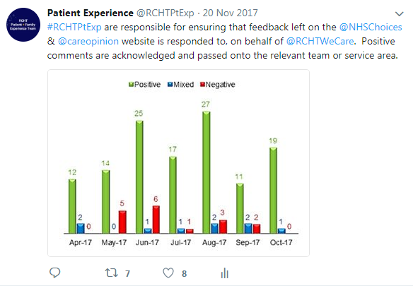
Taking Control

Slide 7
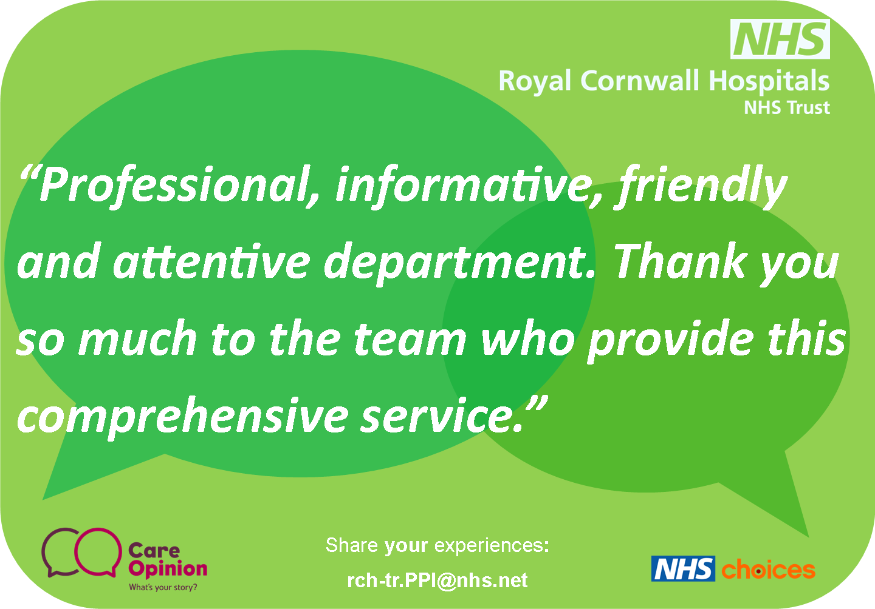

Slide 8
We then engaged the organisation
Sharing feedback with clinical teams – it’s mostly very positive
Reporting feedback into meetings from Ward-to- Board
Finding our champions to take it forward…

Slide 9
March 2018 – new subscription goes live ☺
How were staff feeling about this?
Natural worry about workload
Early adopters were enthusiastic and showed others the way
Tried to embedded

Slide 10
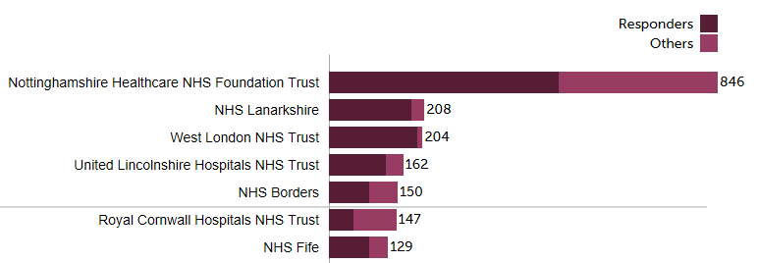
November 2018
How were staff feeling about Care Opinion now?
Embraced - and rolling out faster that we thought
Ward-to-Board engagement
A growing presence in our everyday work
6th

Slide 11
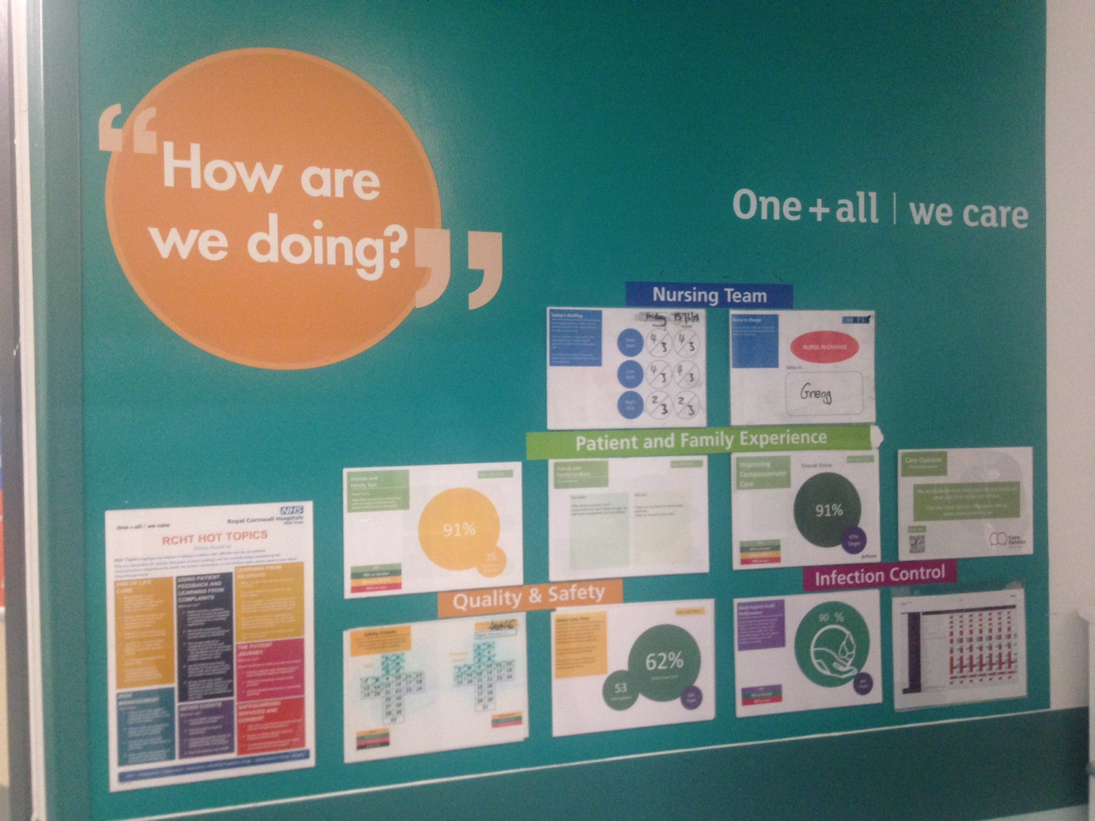

Slide 12
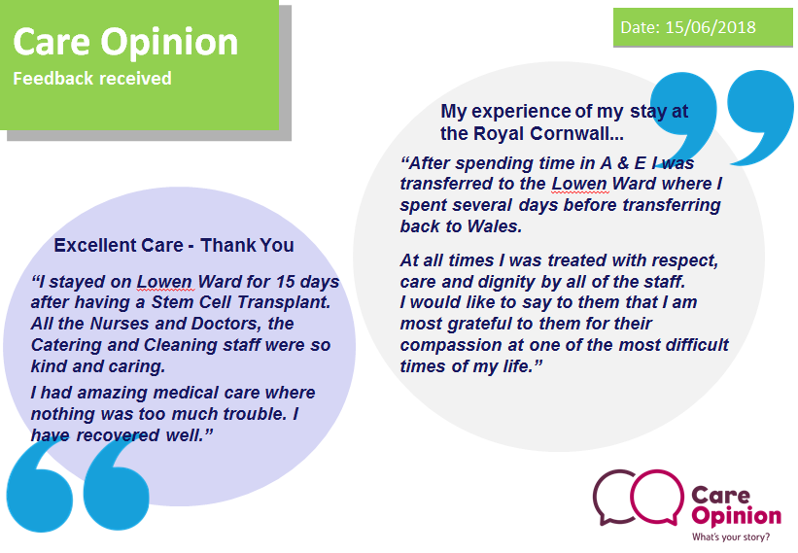
“
How are we doing?
“

Slide 13
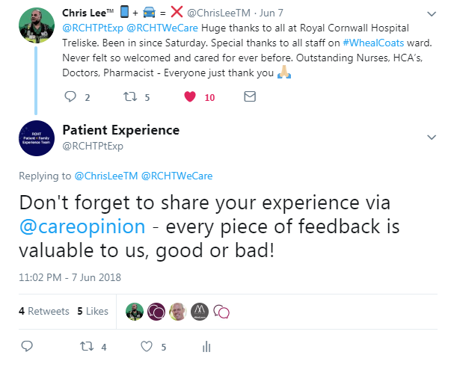


Slide 14
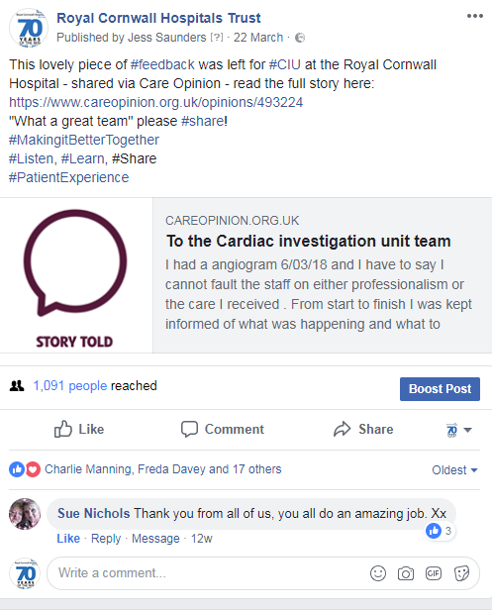


Slide 15
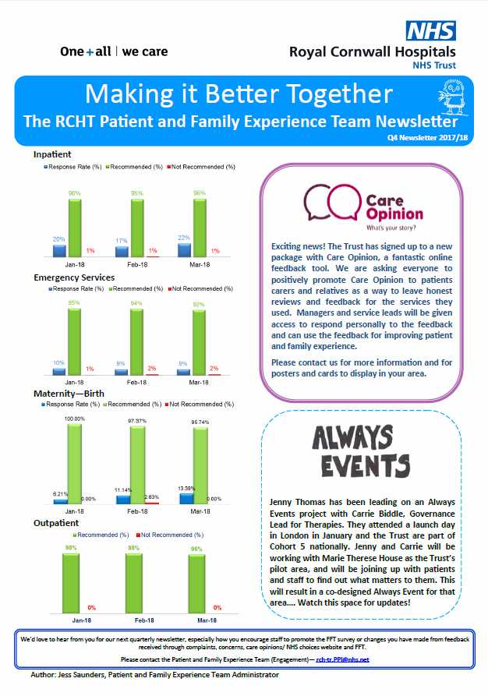
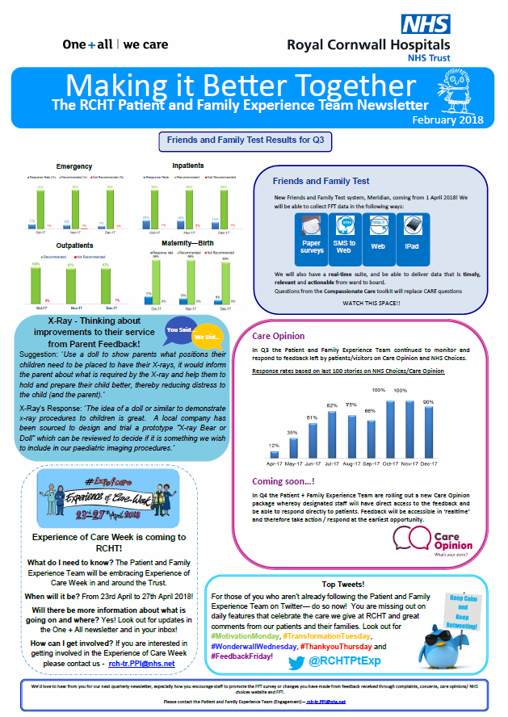

Slide 16
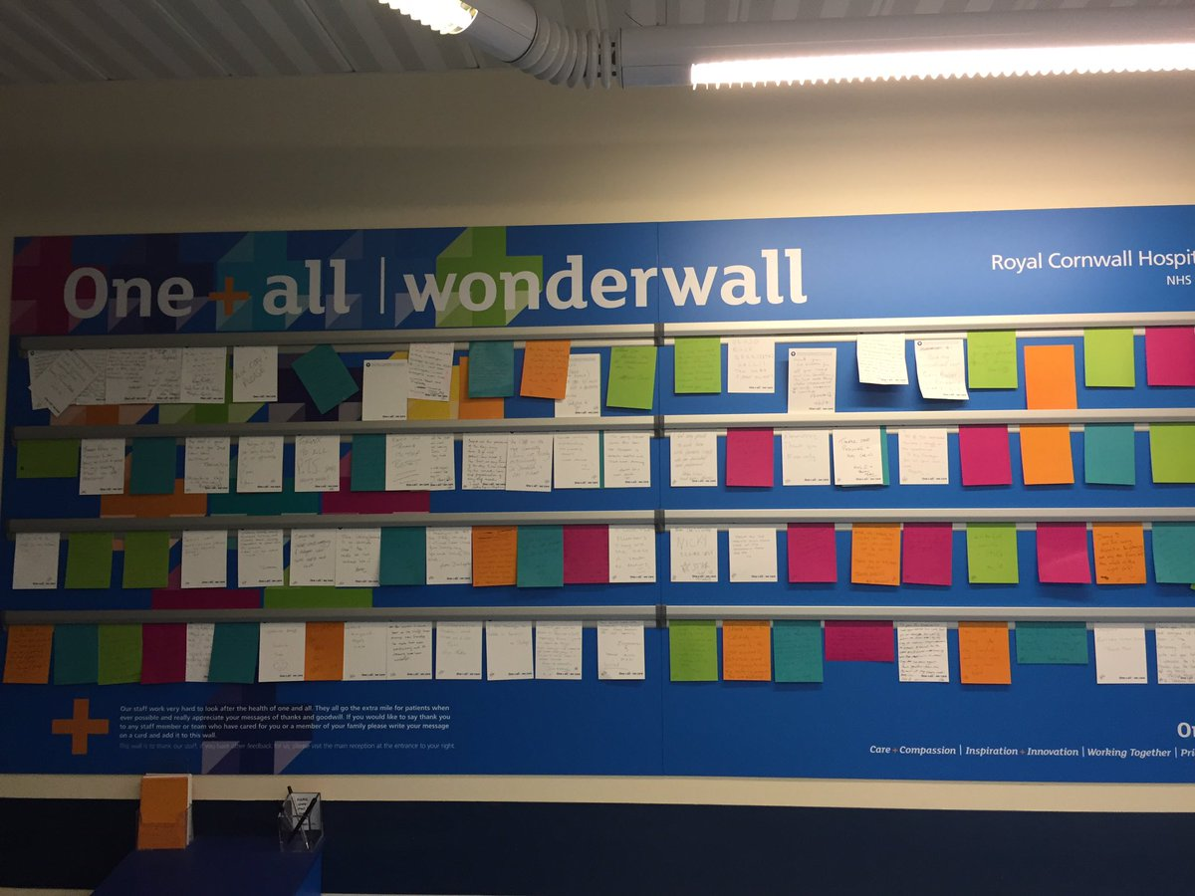
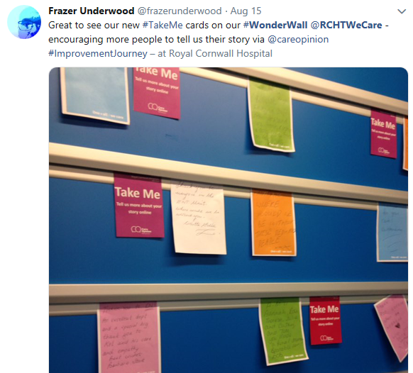

Slide 17


What are our next steps?
Our roll-out plans are now embedded in our quality improvement plan
  Ward Accreditation Programme
developments next
Promote more online feedback University of Plymouth Student Nurses

