Slide 1
‘Using humanity to change systems’ – understanding the work of online feedback moderation
Emma Berry
Aberdeen Centre for Evaluation
Notes:
Hello everyone…

Slide 2
What was this research about?
Explored the process of moderation in Care Opinion Scotland
Ethnography at Care Opinion Scotland offices
Fieldwork started in March 2020
Notes:
This research formed part of my PhD at the University of Aberdeen.
It looked to explore the process of moderation in Care Opinion Scotland. This research took an ethnographic approach which is a qualitative data collection method involving observations and interviews with the team.
Initially I started the research in person in March 2020, but due to the pandemic we moved into an online, remote approach to data collection.
This research has since been published in an academic journal, and I am going to present the key findings for you today. The paper presents three key themes, one on the process work, one on emotional labour and one on the brokerage/mediation role.

Slide 3
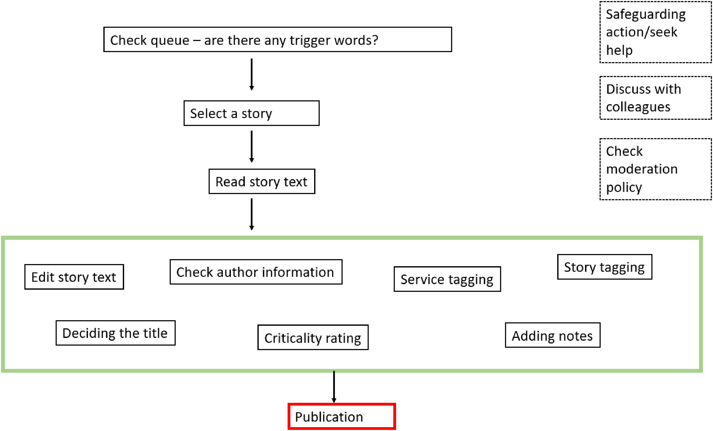
Process work
Figure from Berry et al., 2022
Notes:
The first theme from our research is on process work.
This captured the process undertaken by moderators in their role. You can see a diagram of this process on this slide.
Initially, they check the queue of unpublished stories for any trigger words (this might be words like die) to see if any urgent action is needed
They will then select a story and read through the story text. The editing stages in the green box might occur in different orders but generally they will check the wording of the story and edit if needed. They might edit it for clarity, to protect patient/staff identity or to ensure it reflects the author’s experience and not speculate on staff motives.
They will check the author information, check the service is tagged correctly and as close as possible to the service delivering care. They will check the story tags and may edit or add these if needed. They will decide on the title and give it a criticality rating. They will also generally add notes on the decision making. At the side there are the available support options for moderators, including taking safeguarding actions, discussing with colleagues and checking the moderation policy. These options may support the moderator in making their editing decisions. Once they are happy, they will then publish the story and it will go live on the website where it triggers emails to the subscribers for reply. This may also vary though depending on the criticality and approach taken regarding this.

Slide 4
Emotional labour
…it can happen, where you just have sort of one critical story after the next, and they don't have to be hugely critical… you find if you are moderating a lot of them, it's good to have a wee break from that and move on to something else… it does have an emotional impact on you. (Interview)
Notes:
The next theme was emotional labour.
We found there was considerable emotional investment for moderators reading and writing the stories. Working on these could bring up emotions and participants were aware of managing these as the quote here highlights. Although critical stories could be draining, participants also found that the positive ones could be uplifting, and they would share these within the team.
Another aspect of the emotional labour is how moderators spent time thinking about stories, the experiences of the author and how to best reflect the author's wishes. Participants discussed the importance of making sure that patients were heard, and several reasons why individuals might choose to share their story. For example, positive stories may be a way of saying thank you to staff, which they suggested can be difficult to do through other methods of feedback. And sharing negative experiences might be motivated by anger or wanting to make sure this does not happen to others.

Slide 5
Emotional labour
…so if you’ve had circumstances in your life that are either… that are upsetting, um they’re maybe in a story that you get, “I’m not saying that you can't handle that story or, but I just want you to be aware that it might be a struggle or that you mind have underlying prejudices that you’re not aware of… (Interview)
Notes:
Participants were aware that their experiences could potentially bias story moderation as this quote highlights. These experiences might be from previous jobs or from being a patient or carer. They were able to identify if they felt they needed support on moderating related stories – they could ask someone else to check their work or might choose not to moderate on one story topic at all. Participants felt the organisation aimed to foster a supportive atmosphere and they reported feeling well supported at Care Opinion.

Slide 6
Emotional labour
I am very aware of the fact that sometimes we have stories that come in that are needing action then and there, so they’re very time sensitive, um, or they could be vulnerable. They could be people who are needing help then and there, so I’m conscious to do that (Interview)
Notes:
Participants also expressed care for the authors and subscribers they worked with.
They demonstrated a sense of a duty of care for authors.
From our research, it was clear that some authors use CO as a way to seek help. These were individuals who may not know where to turn for health problems or to have their experience heard. CO aimed to support them as best as they can with their safeguarding policy.
And we observed that if safeguarding action was required for a story, the approach depended on the individual stories – some authors could be signposted to relevant resources whereas others were thought to need much more support. During the research, it was discussed that there is a need to carefully balance the response to ensure that trust and the complex relationships between CO, authors and subscriber organisations were not damaged, while ensuring that authors were cared for.
Aside from the care for authors, participants also demonstrated that they felt emotionally invested in the journey of stories. They wanted authors to get a response to their story from a subscriber and feel heard. Participants expressed a sense of satisfaction when authors received what they believed to be a ‘good’ response from subscribers, as they felt authors would be disappointed from receiving a poor one or none at all.
CO staff also demonstrated care through the relationships they built with subscriber staff. They expressed that they wanted subscriber staff to do well, and at some points felt protective of them. These relationships meant that staff knew areas of concern for boards and were mindful of this when working with them. They understood how positive feedback could make a difference to staff, especially during the challenging times such as the Covid-19 pandemic.

Slide 7
Brokering/mediation role
- negotiating and balancing between the different perspectives
SG validation of CO and reduced barriers
Amplifying author voices
Build trust with subscribers and improve engagement with feedback
Key relationships
Authors
Care Opinion
Subscribers
Scottish
Gov
Notes:
The final theme is Care Opinion’s role in brokering or mediation.
We used this idea to understand Care Opinion’s process in negotiating and balancing between the different perspectives they work with. In particular, the Scottish Government, subscribers and authors.
As some of you likely already know, CO won the Scottish Government contract for online patient feedback for NHS Scotland.
Participants discussed how this was an important moment which was believed to validate the CO platform and reduce some of the barriers seen for subscribers, such as finance.
Once CO had the support of the Scottish Government, they needed to carefully balance potentially differing viewpoints and their relationships with the Scottish Government, their subscribers and the authors that want to share their story, which may pull them in different directions. In balancing potentially competing viewpoints, CO are able to exercise a degree of power in shaping how stories are received. The research showed that they have a role in amplifying voices, so that they can be heard. Our participants noted that some stories may struggle to find their way through other feedback systems, and CO offered them a voice and a chance to be heard. Their position as a boundary spanner and having a relationship with their subscribers may help this.
Ultimately, CO wants feedback to help the NHS improve care. However, identifying a change is still challenging for subscribers and not always added back onto the CO platform. Some also explained that even though some services do not use the website mechanisms for noting changes, they could see service improvements through changes in stories, or through discussion in meetings with staff.
Although CO can use its position to support the subscribers to make changes from feedback, it appears that the decision of making changes is down to the subscribers’ decision, rather than the service users. Our participants felt that it was important for subscribers to be ready for CO, and not forced into using it. If subscribers were ‘organisationally ready’ then it may help to build trust and improve engagement with feedback.

Slide 8
Key takeaways
The process of moderation has various steps and stages before publication
There is considerable emotional labour for moderators
At times it may be hard to balance the tensions between the care for authors and subscribers as well as the need to demonstrate impact from the Scottish Government
Although CO has some control over the story editing, the opportunity to make changes from stories lies with the subscribers
Full paper: Berry E, Skea ZC, Campbell MK, Locock L. ‘Using humanity to change systems’ – understanding the work of online feedback moderation: A case study of Care Opinion Scotland. DIGITAL HEALTH. 2022;8. doi:10.1177/20552076211074489

Slide 9
Upcoming research related to CO
2 publications in draft
  1 on senior leaders’ views
  1 on using feedback for improvement in NHS Scotland
Fellowship proposal for external funding
  Exploring feedback in HSCPs and use in service integration
Get in touch: emma.berry1@abdn.ac.uk
Notes:
Thanks for listening to me today. I just wanted to highlight some upcoming work for those who may be interested.
We have 2 publications we are drafting based on some of my other PhD work – one is on the SLPM perspectives on using online patient feedback and Care Opinion in NHS Scotland. The other is exploring the unseen impact and changes of online feedback and care opinion stories, as well as the emotional labour for those who write and respond to the stories.
We are currently developing a fellowship proposal for exploring how feedback is used in HSCPs and if it can be used to support service integration
So if anyone would like to get in touch to discuss these or any other ideas, please pop me an email

Slide 10
Acknowledgements
This work formed part of a PhD fellowship with The Healthcare Improvement Studies (THIS) Institute. The fellowship was funded by the Health Foundation as part of a grant to the University of Cambridge supporting THIS Institute.
With thanks for current role funding to the Elizabeth Russell Fellowship at the University of Aberdeen
Thanks to members of the stakeholder group and Care Opinion for their input on the PhD
Thanks to participants for their time and contribution

Slide 11
Notes:
Thanks again and I look forward to your questions later in the session.

