Slide 1
Inclusion
@Inclusion_NHS www.inclusion.org
So you’ve responded to a story, what next?
Care Opinion Conference 2024
Rachael Burley

Slide 2
Introduction & Background
Inclusion – Midlands Partnership Foundation Trust
Inclusion services range from from sexual health, community substance misuse IAPT and services within prison estates.
Services within prisons range from, clinical substance misuse, MH services, psychosocial substance misuse
Prison types include
Female open & closed
Male Cat A, B, C, D
Young Offenders
Children / Young people
Foreign National

Slide 3
Introduction & Background
Processes
Protocols
Training
Safeguarding
Guidance
Communication
+
=

Slide 4
So you’ve responded to a story, what next?

Slide 5
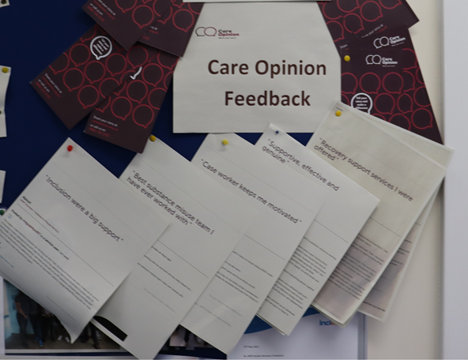
FEELING HEARD

Slide 6
Nathan says 'It is beneficial to me and others to share part of my situation and lived experience. Being in jail it is good to know that we are being heard'

Slide 7
FEELING MOTIVATED

Slide 8
HMP Swinfen Hall
Care Opinion feedback at Swinfen gave the team a boost in terms of team morale. They appreciated the feedback and the fact that it was displayed externally to the prison made them feel like it was more meaningful. They like that it is a way of sharing feedback to people outside of the establishment.
HMP Stocken
We love reading our Care Opinion stories, we share them at the team meeting monthly, It motivates us and help to remember why we do what we do.
HMP Spring Hill
As a team, we have found that the care opinion forms offer an opportunity for service users to capture a lot more of their journey - feedback tends to be more detailed and encapsulates multiple aspects of service that people have encountered. We always print out both the feedback and the response which enables our service users to see how their feedback has been responded to. This is something unique to care opinion and isn't typically something that happens with any of our other feedback mechanisms.
HMP Isle of Wight
it’s nice to get some recognition, and it helps increase motivation ‘what the jobs all about’

Slide 9
CREATING CHANGE

Slide 10
ENHANCES QUALITY AND PERFORMANCE

Slide 11
‘From a strategic viewpoint the stories shared with us from care opinion allow us to have more detail and more feedback, this is turn allows us as SLT to have more opportunity to shape services and be responsive’
Avril Culley
Deputy Head of Operations
Care opinion has empowered the workforce to be able to respond and showcase feedback. It has enabled us as leaders to share and improve the patient experience
Kayleigh Riley
Senior Cluster Manager

Slide 12
CULTURE CHANGE

Slide 13
So you’ve shared your story, what happens next?
Feeling heard
Feeling motivated
Creating change
Enhances Quality & performance
Culture change
Breakdown stigma
That’s the impact of sharing a story

