Slide 1


Framing the ‘Ask’

Slide 2

Aims:
Understand the different ways people can leave feedback on Care Opinion
What motivates people to share feedback
Explore why we find it difficult to ask for feedback
Look at various ways of ‘framing the ask’ – examples to take away.
Notes:
What do we mean by ‘Framing the Ask’. We know it can be difficult to ask for honest feedback and to ask for people to share their stories of their personal care experiences.
There are many different ways we might invite a patient, family member or carer to share their experiences through Care Opinion so that it feels more natural and comfortable for us as staff and supports the teller of the story to feel helpful and that they are doing something meaningful.
Hopefully this webinar will help with some of this and give you the confidence to know how best to ‘frame the ask’.

Slide 3

5 ways of sharing a story
Online careopinion.org.uk and careopinion.ie
Freephone 0800 122 3135 (UK only)
Freepost leaflets
Via an invitation link (kiosk/text/widget/QR code poster)
With support from volunteers
All stories are subject to moderation and are uploaded to the website
Depending which method you choose, the ‘Ask’ will vary
Notes:
Han over to Sarah for the interactive session

Slide 4


Slide 5

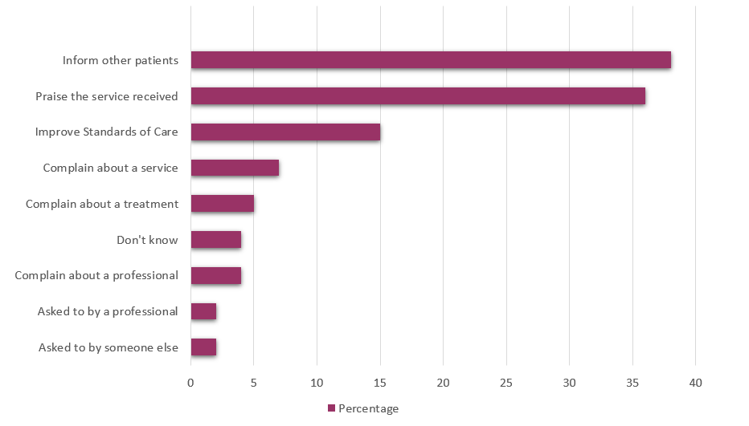
Why do people share their feedback online?
Source: Van Velthoven et al, 2018
Notes:
I think it’s important to understand the reasons why people choose to feedback online, this study from Oxford Uni a couple of years ago outlines the results from that study and what’s interesting to see is that actually the top 3 reasons are to inform other patients, praise the service and improve standards of care.
We know services like yourselves don’t have trouble generating positive feedback but maybe the challenge is teasing out what could have been better.

Slide 6


How authors feel about sharing their story on Care Opinion:
“She really does deserve praise, and I am grateful for this site where staff can be highlighted for doing a great job”
“I feel empowered and understood and believed and respected”
“I wasn’t sure if I was doing the right thing by posting on Care Opinion, but I am so glad I did, hopefully lessons will be learned from my experience”
“A necessary route for voicing opinion but without making a formal complaint”
Authors Quotes
Care Opinion author survey - 2019
Notes:
Here we have some author quotes about how they felt telling their story on Care Opinion.
This compounds what we already have learnt, that authors like the fact their can leave anonymous feedback and that sometimes going down the formal complaints route is not what they want to do, sometimes just being heard is all they need.

Slide 8

Possible reasons…
Feeling Anxious about what people would say
Not having the right words
Not knowing when is the right time
Not feeling like you have the time
Feeling like you are bothering people

Slide 9


Possible reasons…
Fear of rejection
Not wanting to ask in case you upset someone or feel like they might not want to give feedback. Feeling like it might be low down on their list of priorities.
Not understanding the importance of feedback
Show you are a listening organisation and that you use the feedback in a constructive way to learn from & improve services for others – explain why feedback is so important

Slide 10



Questioning your assumptions
Q: Would you be unhappy if you were asked for feedback about an episode of care?
Maybe put yourself in their shoes…
Role reversal
Ask yourself…how would you feel if you were asked to give feedback about your care
Don’t be afraid just ask!

Slide 11



Having confidence to ask
People love to help!
Whatever the situation, the human brain is hard wired to be social, to cooperate, to assist where we can. Being helpful strengthens our sense of self and is a path to finding meaning even in dark days.
Ask for honesty
Encourage the people you ask for feedback to be helpful over nice. Let them know you are looking to get the most out of their time and their honesty is valued and appreciated.
Explain why feedback is important
Explaining to patients/service users that all feedback is important and that on Care Opinion they can say what was good v’s what could have been better – Balanced view
Asking for feedback is a skill, and will become easier the more you do it

Slide 12

What should I include in the ‘Ask’?
Include these 3:
Explain who Care Opinion is – Independent from NHS, social enterprise /CIC, encourages social value
Explaining its safe! Always inform your
patients/service users that feedback is
anonymous
That you will get a response - This is a key
motivational factor for many people to share
their feedback, so it is always worth
mentioning in the ‘ask’

Slide 13
Possible ways to ‘Frame the ask’…
“All the staff have been so lovely….”
Thank you, I know the team will really appreciate you saying that. We do have a way to share your kind words with everyone involved using this… Would you be happy to take a few minutes to write a few lines for them all?
The link only log’s you into the site time
I’m so glad it turned out better than you thought. We find many people are sometimes nervous about coming for a minor procedure at the surgery. Would you be willing to share your experience with others via Care Opinion.
This may help reassure other patients who may also feel nervous?
“It’s not like I thought, it’s not so scary…”
“Thank you for helping me get an appointment today…”
Your welcome, that’s what I’m here for. I wonder if you would be willing to share your positive feedback on Care Opinion, I can send a link direct to your phone if that’s ok?

Slide 14
Teasing out the ‘what could be improved’…
“First class service from first class staff”
“I left feeling relaxed and valued”
The link only log’s you into the site
“and if there is one thing we could have done differently, to improve things for you or your loved ones please do mention this too”
Notes:
If someone has a complaint that makes it easy. When people are just generally appreciative, while that is reassuring and good to hear, it does not necessarily give us clues as to how we might make things even better in future. In this case a little nudge at the end might be useful, perhaps along the lines of:

Slide 15

Possible ways to ‘Frame the ask’…
“I’m not very happy about the problems I’ve had trying to book an appointment….”
Thank you for raising your concerns, however this is not something I can deal with personally but you can use Care Opinion to feedback your issues or suggestions and this feedback will be heard by the right member of staff who can respond to your feedback and also implement changes that can improve the patient experience.
The link only log’s you into the site
Overall 65% of the feedback via Care Opinion has contained no criticism at all
Notes:
I think sometimes we can be fearful of asking for feedback and assume that this will open the flood gates to people raising complaint but we have seen over the past few months of this pilot that actually when you give patients a voice the majority of the feedback is actually positive and patients wanting to say thank you

Slide 16
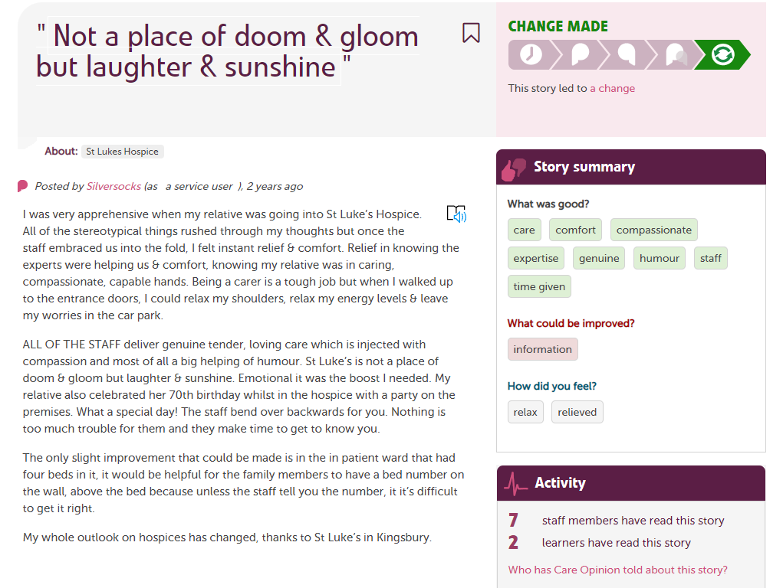
https://www.careopinion.org.uk/705289

Slide 17
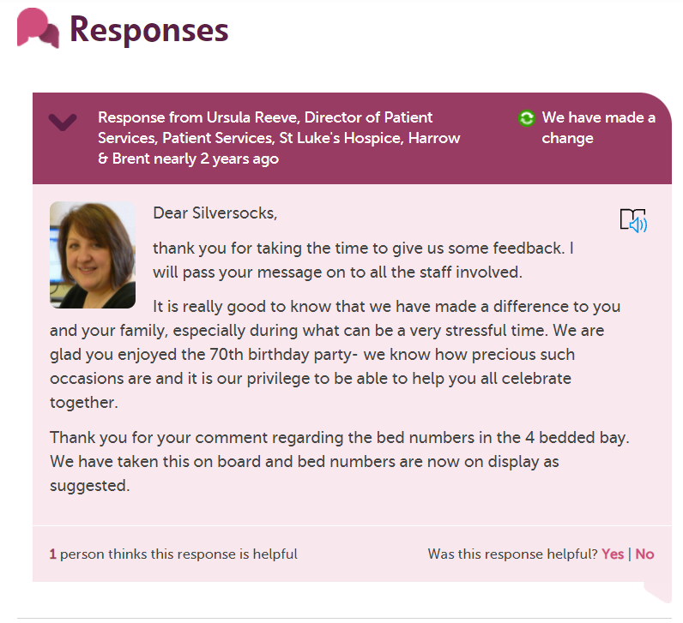

Slide 18
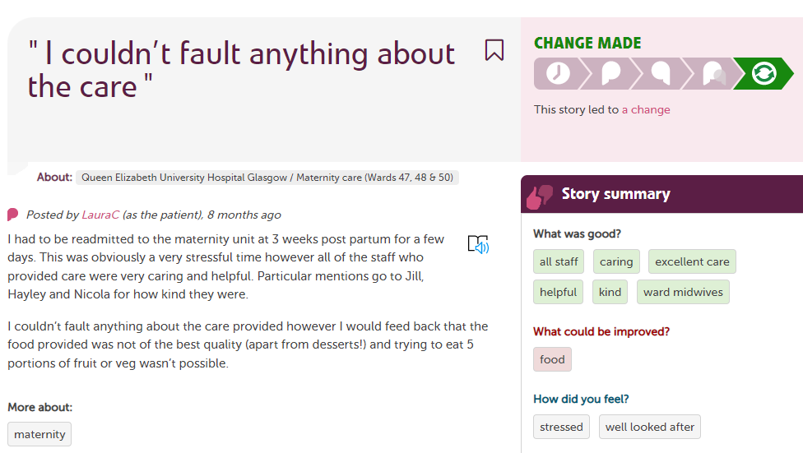
www.careopinion.org.uk/915405re | Care Opinion

Slide 19
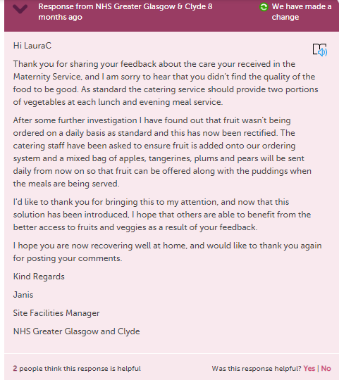

Slide 20
Future training sessions…
Responding to stories about mental health services – Recording available
How to respond well and demonstrate impact – Recording available
Encouraging feedback – Recording available
Invitation links – 12th July @11am & 18th July @ 2pm
Involving volunteer in encouraging feedback- 21st July @ 11am
Link to Care Opinion How to sessions
The link only log’s you into the site the ^{st} time
Notes:
If someone has a complaint that makes it easy. When people are just generally appreciative, while that is reassuring and good to hear, it does not necessarily give us clues as to how we might make things even better in future. In this case a little nudge at the end might be useful, perhaps along the lines of:

Slide 21
Questions/comments?
The link only log’s you into the site time
Notes:
If someone has a complaint that makes it easy. When people are just generally appreciative, while that is reassuring and good to hear, it does not necessarily give us clues as to how we might make things even better in future. In this case a little nudge at the end might be useful, perhaps along the lines of:

Slide 22
Thank
you

