Slide 1

Care Opinion
for story tellers

Slide 2

How to tell your story to Care Opinion
Website - text
Website – pictures
Kiosk - tablet
Kiosk – own phone
Leaflet
Phone

Slide 3
The “tell your story” button is visible on all pages
The website
Careopinion.org.uk
The most recent episode of care must be in the last 3 years
Authors may also have been sent a direct link to the tell your story process
This is the main way people share feedback on Care Opinion
Authors need a postcode and email address to share feedback
Stories can include the Talking Mat pictures

Slide 4



Slide 5
Additional points…
When an author shares feedback on the website, they can also choose to:
Answer some demographic information
Answer the Friends and Family Question
Rate the service 1 – 5 on some key areas
Share additional stories under the same account

Slide 6
You can lock a tablet to this page and use on a ward
Kiosk link
You can send QR codes to a kiosk link
They are created via an invitation link
This is a shortened story telling form for tablets and mobile devices
Authors need a postcode and email address to share feedback
But! They have to be linked to a single service on the service tree

Slide 7

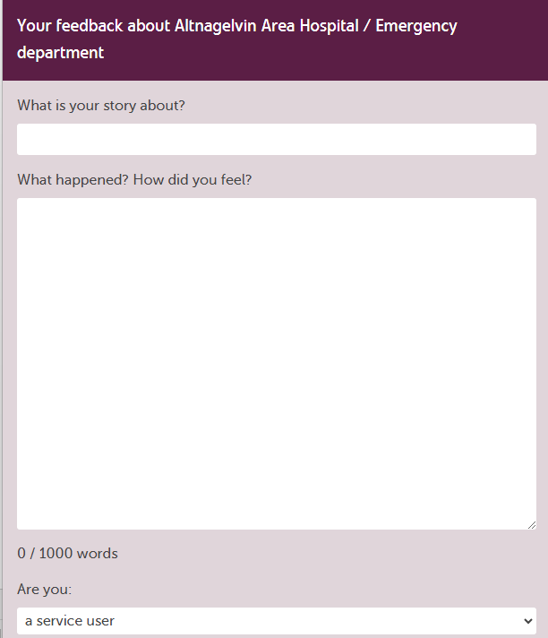
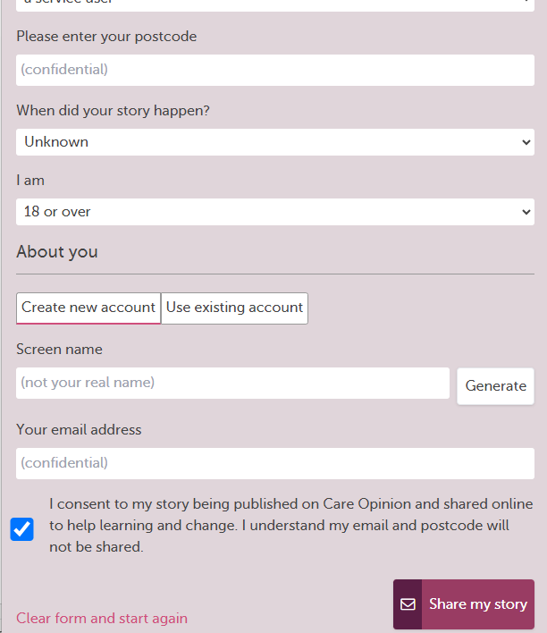

Slide 8
Additional points…
Author is not logged in so more secure on shared device
Less explanation of who Care Opinion is and does
No picture tiles
Author cannot leave demographic information, tags, or ratings

Slide 9
This should only be offered if author has no internet access
0800 phone number
The author speaks to one of the CO team to leave feedback with minimal prompts
Authors need a postcode to share feedback
Available weekdays only
Author may not have an email address and CO does not record phone numbers
Phone line available in office hours, option to leave message if staff are busy

Slide 10
Additional points…
Care Opinion may ask demographic information if it feels appropriate to do so
If other has no email they are informed what will happen to their story
Care Opinion does not ask rating information

Slide 11
Author asked for postcode and email but may not fill in
Freepost paper leaflets
Author can write or draw feedback
Slower to publish than other options but useful for forensic and prison settings
Services often have limited supply
Not as popular as online despite preconceptions

Slide 12
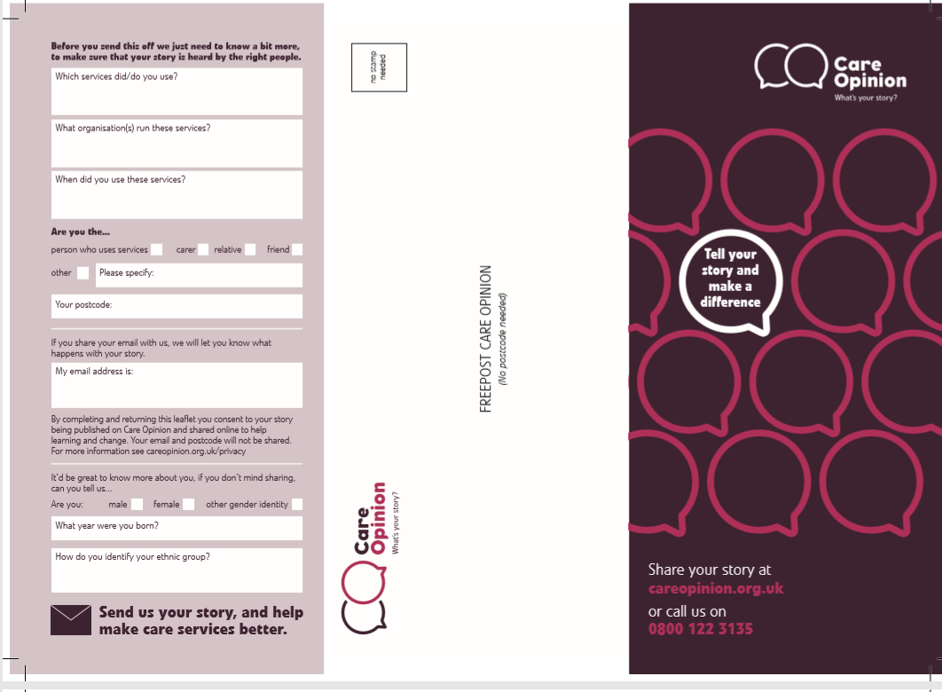

Slide 13

Care Opinion for
Young people

Slide 14
On the TYS process, link from home page
The Care Opinion Bear
Author can write or use Talking Mats picture tiles
Kiosk can have Bear theme using inivation links
Updated some of the text and pages for parents and guardians
Suite of images available for subscribers

Slide 15
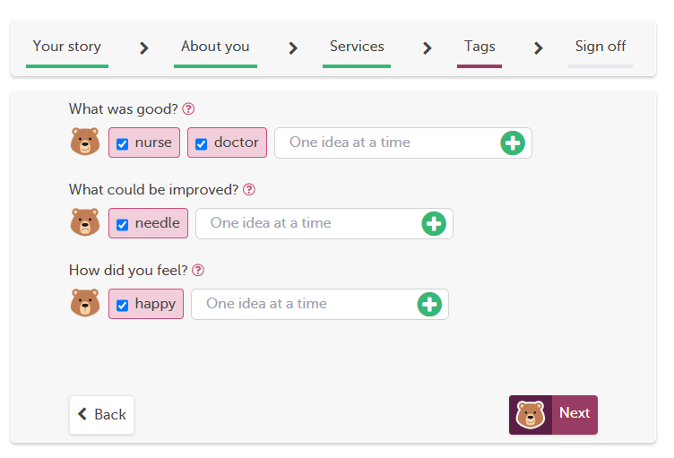
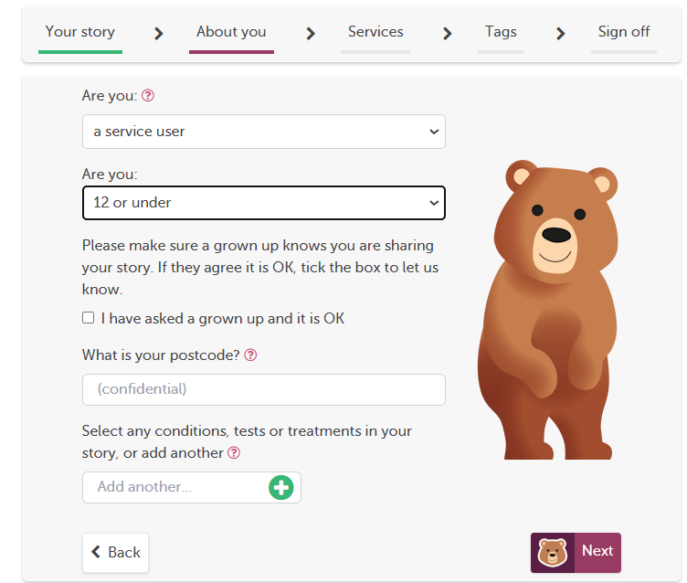
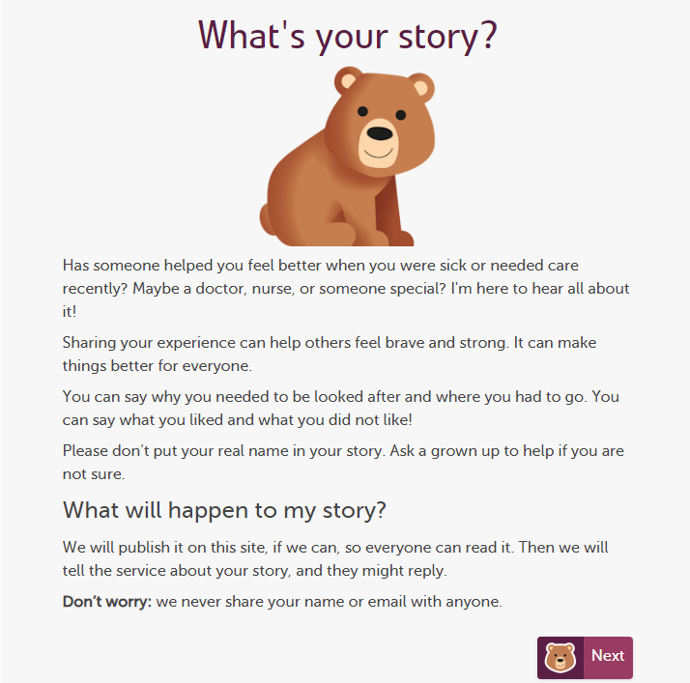

Slide 16
Thanks!
Sarah.Ashurst@careopinion.org.uk

