Slide 1




What makes an effective response?
Rebecca Baines, John Donovan, Sam Regan de Bere, Julian Archer & Ray Jones
@Rebecca_Baines_

Slide 2

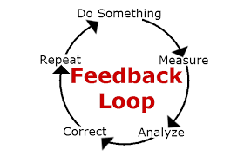

Background
Patient feedback is considered integral to professional development, patient safety and care quality.
However, limitations with some existing tools.
Care Opinion provides a unique ability to directly respond to feedback providers
But…. What makes a good response? What are patient expectations and desires? Can the way organisations respond to feedback online be improved?

Slide 3

Why is it worth exploring?
Why did we feel it was important to look at?

Slide 4

Theoretical perspective
Evidence suggests providing a bad feedback response can lead to feelings of frustration and dissatisfaction
Business literature - implications for organisational reputation, public inferences of trust and perceived responsiveness. Further complaint behaviour
Theoretical perspective: Justice Theory
Procedural
Interactional
Distributive

Slide 5
Accessibility
Perceived fairness of the outcome offered
Perceived fairness of polices and procedures used
Procedural
Distributive
Perceived efficiency
Waiting times
Justice Theory
Compensation
Courtesy
Respect
Manner in which people are treated
Interactional
Honesty
Assurance

Slide 6
Methodology
Due to resource constraints, only stories and corresponding responses made in the South West of England were included.
Mixed methodology: four inter-related stages
Systematic search of adult mental health stories published on Care Opinion
Thematic analysis of identified stories in collaboration with patient-research partner
Themes or factors considered influential discussed and refined by wider patient-carer stakeholder group (Heads Count) leading to the co-production of the framework
Finally, produced framework used to quality appraise existing responses
Mental health selected – acknowledged difficulties in satisfactorily responding to this population. More likely to maintain contact with medical services if satisfied with care. Implications for clinical relapse rates and hospital admissions/re-admissions.

Slide 7

Search strategy
2005-January 25 2017
“mental health” OR “mental ill-ness” OR “mentally ill” OR “mental” OR “pnd” OR “psychiatrist” OR “psychiatry” OR “depression” OR “anorexia” OR “anxiety” OR “eating disorder” OR “psychology” OR “psychosis” OR “psychotic” OR “ptsd” OR “self-harm.
Inclusion/exclusion: stories that discussed the treatment or diagnosis of a mental health condition, experience or service were included.

Slide 8
Results
190,345 stories published on Care Opinion - 2386 (1.25%, 2,386/190, 345) were identified as stories about adult mental health services in England. 10.3%, (245/2386) were from the South West.
74.7% (183/245) received a response from 41 different job roles or titles
24 (9.8%) had been heard but not yet responded to at the time of analysis.
Only 1.6% (n =4/245) of included responses were tagged by the organization as “may lead to a change.”

Slide 9
Thematic analysis
1. Provides a photo of responder | 11. Offers reassurance**
2. Provides responder name | 12. Tailors response
3. Names the story provider in response | 13. Offers to make contact with the story provider at a later date **
4. Identifies responder role | 14. Signposts patient to other relevant services**
5. Provides explanation of responder role | 15. Explains purposes of signposted services and why these have been suggested**
6. Explains why the responder in particular is responding | 16. Provides contact details and a named person for these services**
7. Responds within 7 days | 17. Provides opening times for suggested services**
8. Offers thanks for providing patient story | 18. Suggests more than one contact option**
9. Offers to pass feedback onwards if positive in nature* | 19. Signs off response in a polite manner
10. Provides an apology**
* Only applicable to positive/mixed stories
** Only applicable to negative/mixed stories

Slide 10
Plymouth Listen, Learn and respond framework (PLLR)
https://onlinelibrary.wiley.com/doi/full/10.1111/hex.12682

Slide 11
Themes:
Introductions:
“It’s hard to forge a trustful relationship with someone without knowing their name” (participant 3), “standard good manners” (Participant 1)
Pictures:
“That’s nice, she’s put a face to a name, nice smile, looks friendly, not like she’s going to jump down your throat in uniform” (Participant 6)
Identification and explanations of role:
Important due to complexity of healthcare service
Thanks and apologies:
Recognition of time spent providing stories
Tailoring content:
“The last thing you appreciate is a standard response, you want to be treated as an individual, given an individual response” (Participant4), patients are quick to detect “standardised” or “meaningless” responses. “It’s a couldn’t care less response. In my tray and out again, makes you question what’s the point, it’s not going anywhere?” (Participant 5)

Slide 12
Quality Appraisal

Slide 13
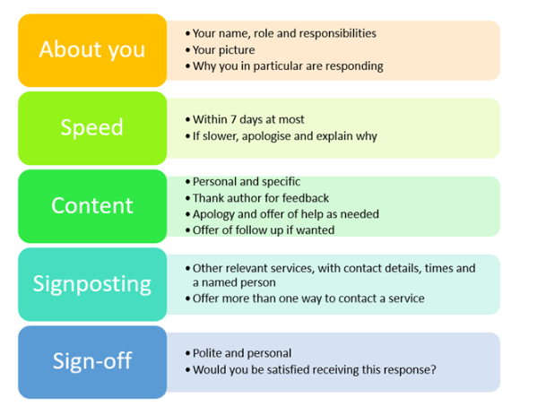
https://www.careopinion.org.uk/blogposts/698/what-do-people-want-in-a-response-to-their-fe

Slide 14
Discussion
Quality appraisal of existing responses identifies some areas of good practice, but also room for improvement…
Patients share their feedback online to improve services, praise staff members and prevent service failure for others. These may be important motivators in trying to encourage feedback engagement.
We can learn so much from patient experiences and insight – let’s start a conversation. Coulter et al., argues to ignore patient experience data when asked, is unethical.
We have a duty to listen, learn, and respond. It might just teach us something new….

Slide 15

Any questions?
Webinar:
Thursday 21st June, 2-3pm
https://attendee.gotowebinar.com/register/4973923813535225857
Rebecca.baines@plymouth.ac.uk
@Rebecca_Baines_

