Slide 1


New
features

Slide 2
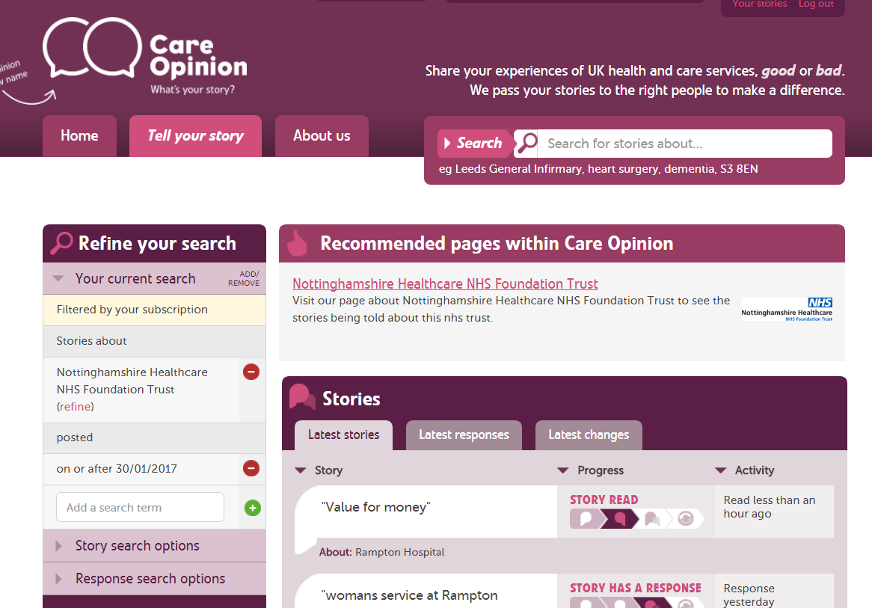
Use your specific requirements to create a report, e.g. an annual report 2017-2018

Slide 3
Existing Reports
Story and response listing
A list of the stories in your search, grouped by the service they are about
Stories in summary
summary of the stories in your search, counting stories by time, place, person, service and criticality
Response and story progress
A summary of responses and changes following the stories in your search

Slide 4
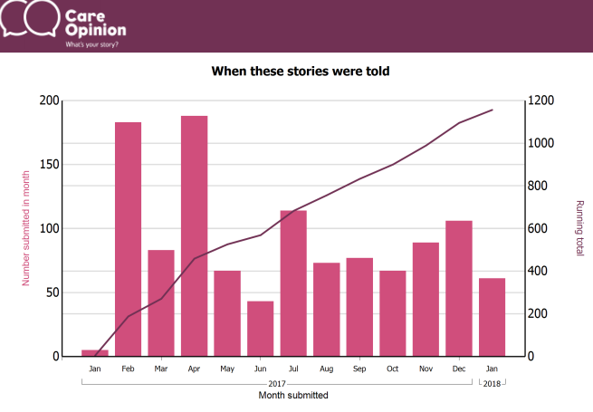

Slide 5
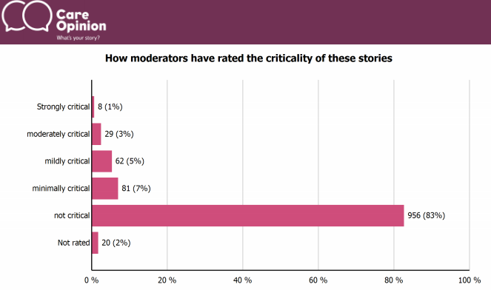

Slide 6
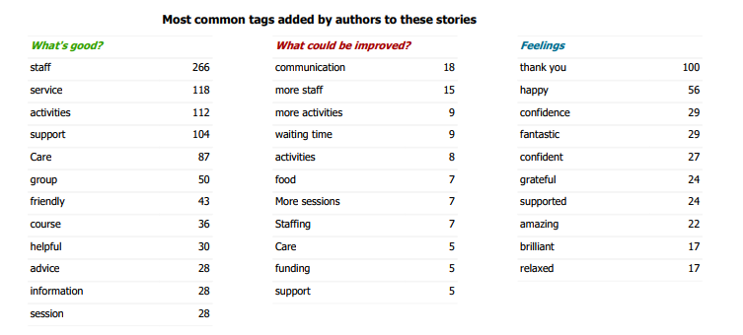

Slide 7
New reports
Story listing in a table
Table of stories suitable for export to Excel. Includes positive/negative tags, author role and changes.
Opinion authors in summary
Summary of information provided by authors, such as role, age, gender, ethnicity and disability

Slide 8
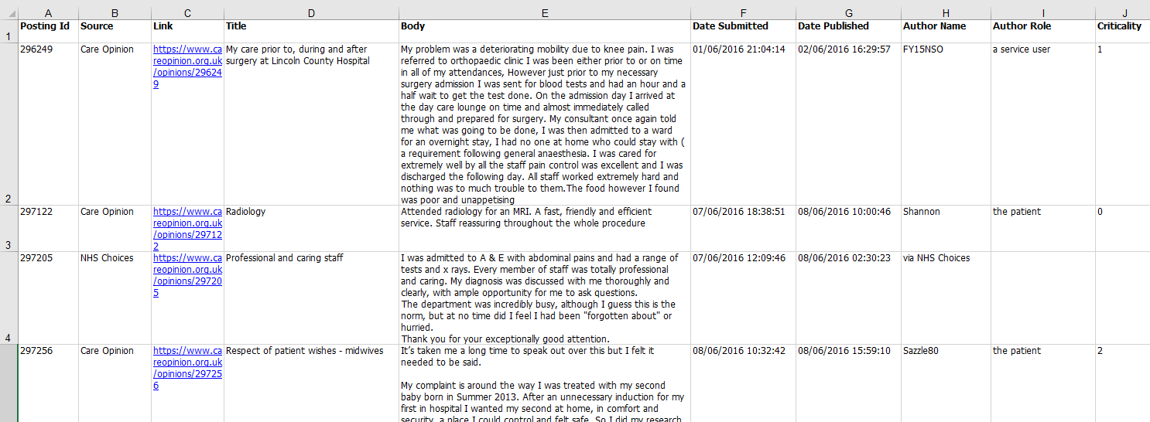

Slide 9
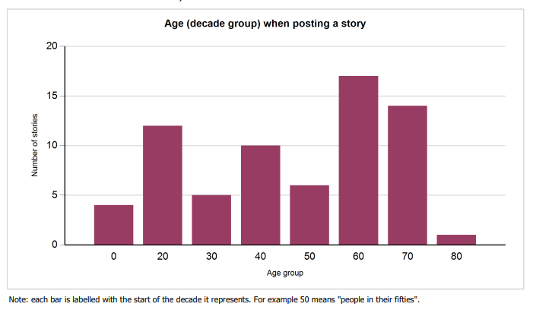

Slide 10
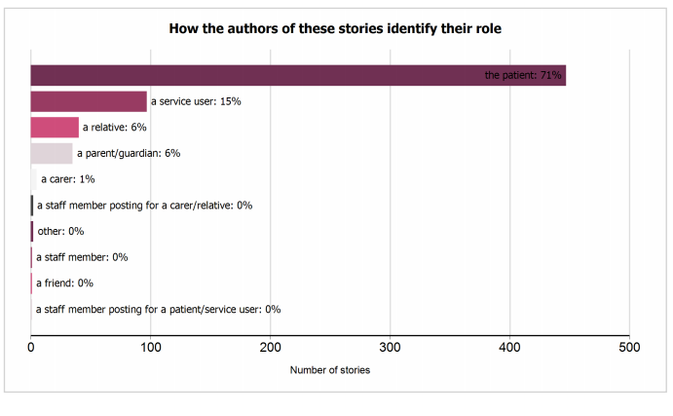

Slide 11
All reports…
Can be saved for later
Downloaded in different formats
Be tailored to specific services
Be set on a schedule (weekly, monthly etc)

Slide 12
Visualisations
Tag bubbles
Story swarms – criticality and progress
Lilly pad
Tag word clouds
Story word clouds

Slide 13
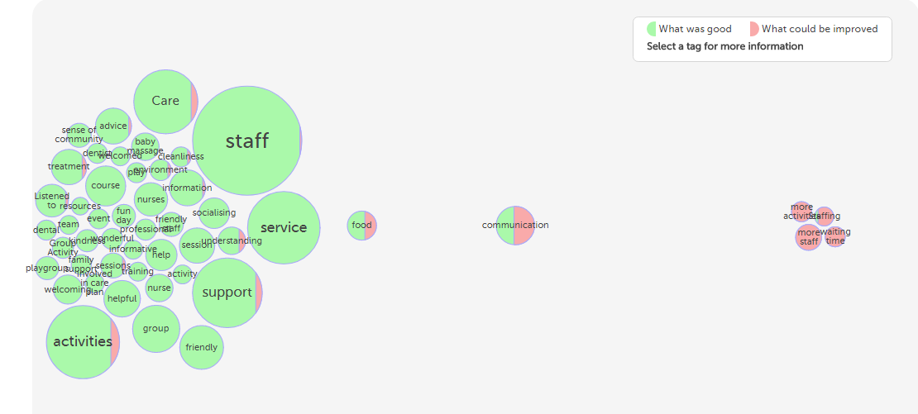
Interactive tag bubbles about All stories about Nottinghamshire Healthcare NHS Foundation Trust 2017-2018

Slide 14
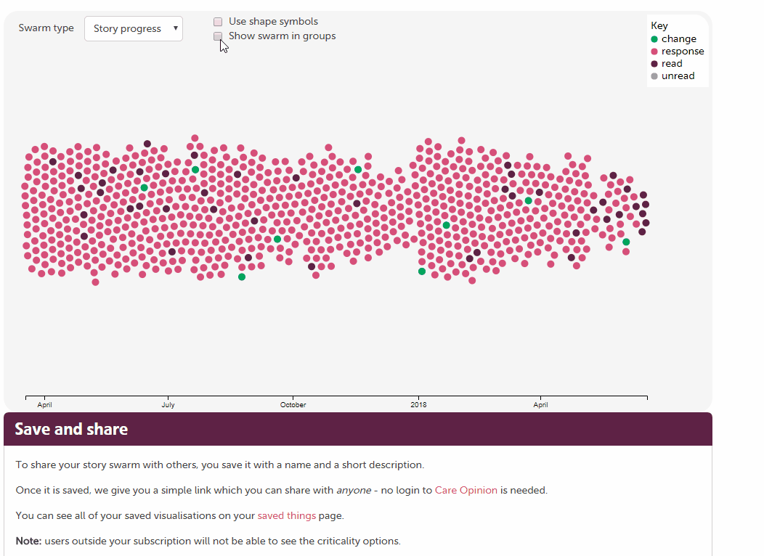

Slide 15
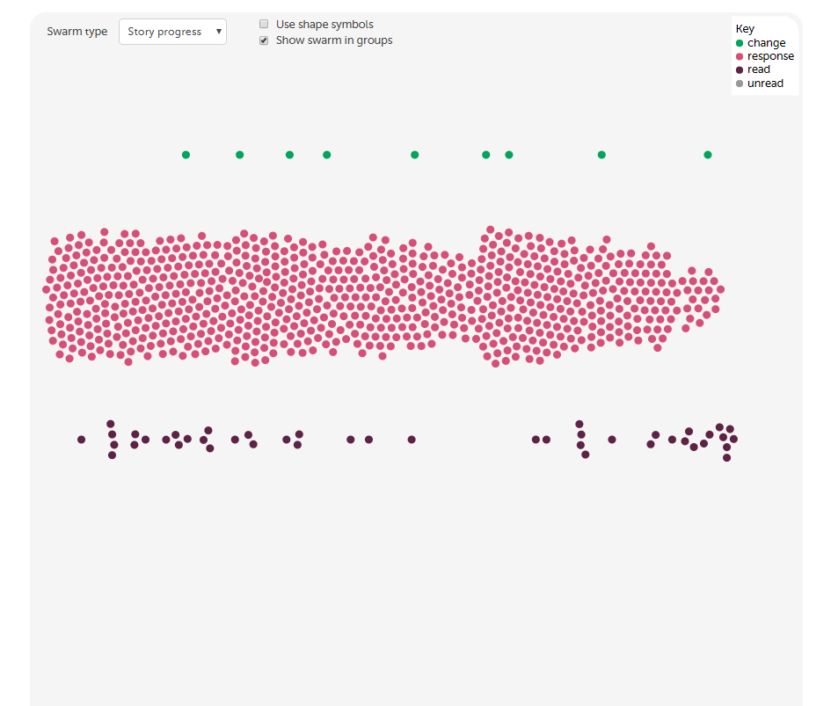

Slide 16
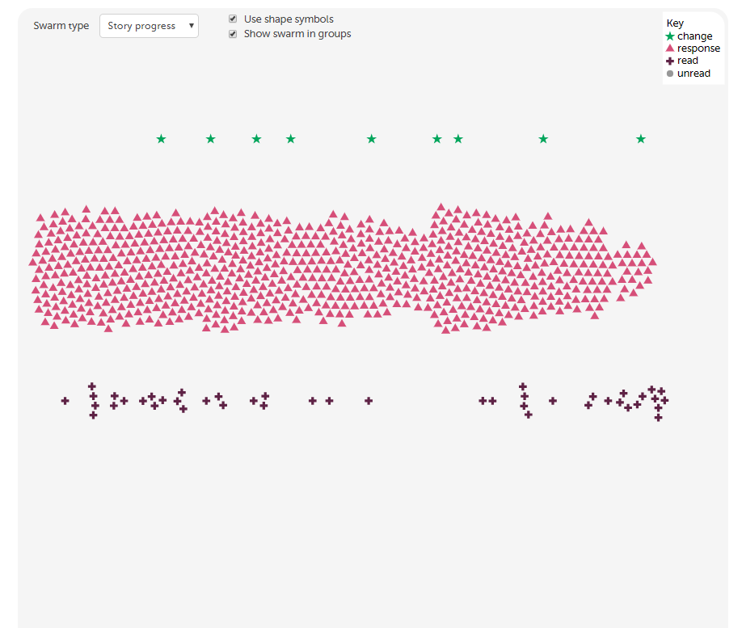

Slide 17
Subscriber tagging
Add private, subscription based or public tags to stories
Subscriber tagging allows for collaborative learning from stories.
Examples of tags that you could add: CQC domain names, stories that require a further response, names of projects or keeping track of examples you wish to use in meetings, reports, classes or case studies

Slide 18
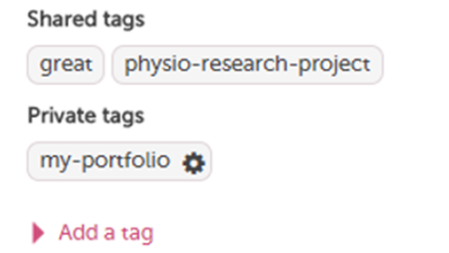

Slide 19
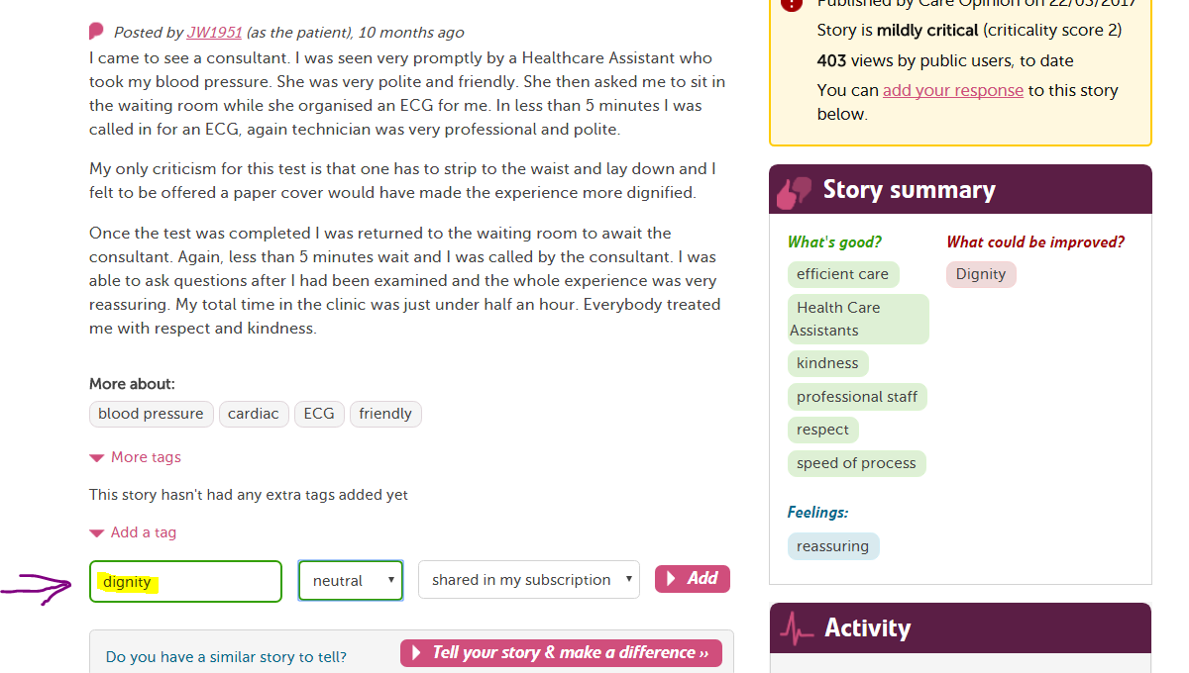

Slide 20
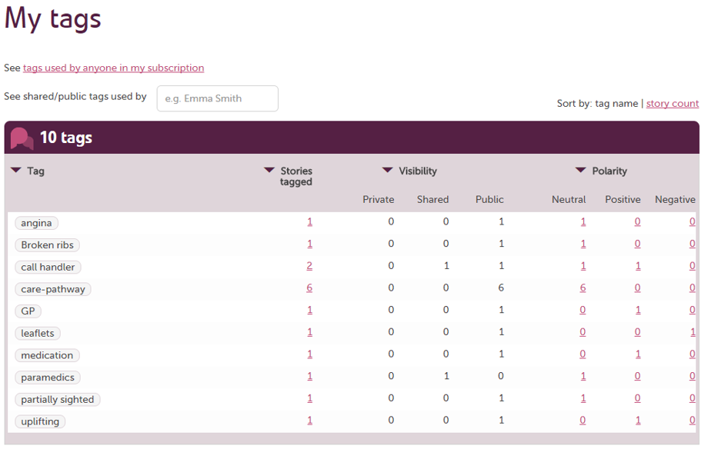

Slide 21
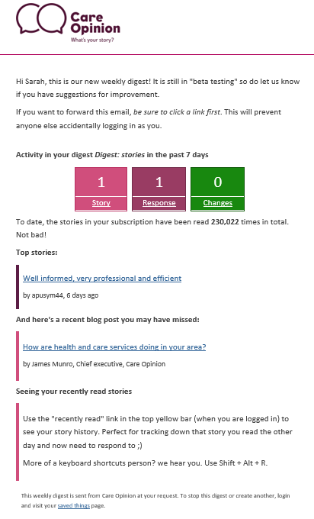
Digests - keep key staff in the loop

Slide 22
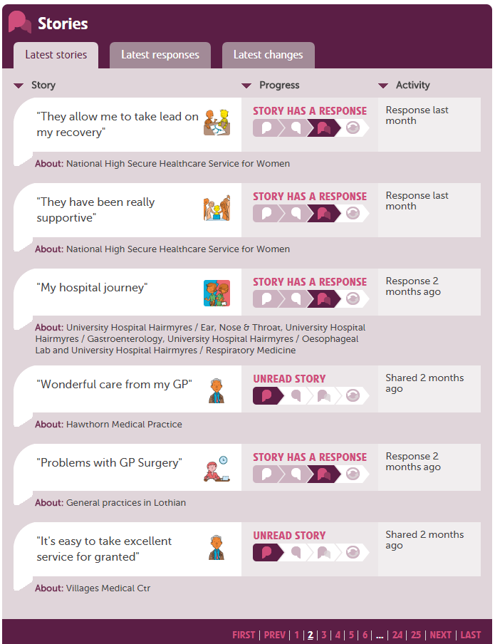

Slide 23
Any questions?
We run fortnightly training on all site features.
https://www.careopinion.org.uk/info/how-to-sessions

Slide 24
Thank
you

