Slide 1
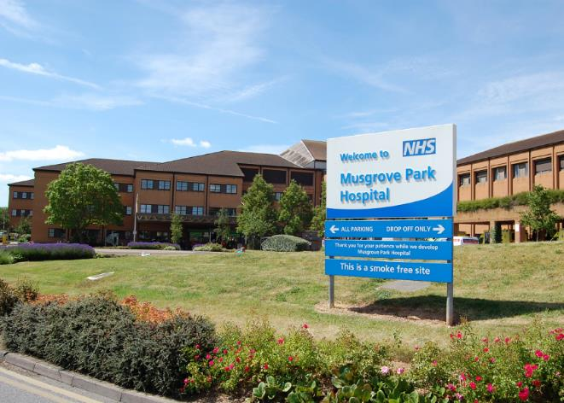
Musgrove Park Hospital

Slide 2
Our Journey

Slide 3
Fears and the Reality

Slide 4
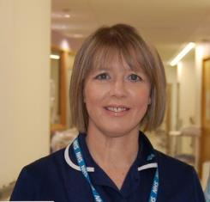
What we love
Posted by Davy Crockett (as the patient) ‘Had an operation for bowel cancer recently.
The care received from all the staff on Montacute Ward was in my opinion outstanding. I am now home today and suddenly realised that I actually miss them all.
I must mention Rachael, the ward sister, who went way beyond what could be expected in terms of care and understanding while I was going through a very difficult period of pain. I know she works very long hours but was always willing to give up her time to help you. She must play a big part in inspiring her staff to do the same.
Well done Montacute Ward, you fully deserve the awards you have received.’
Rachael Putt, ward manager for Montacute ward, replied:
‘That is so so lovely and really does make it all worthwhile!
I am truly lucky to work in the fantastic team on Montacute ward’.

Slide 5
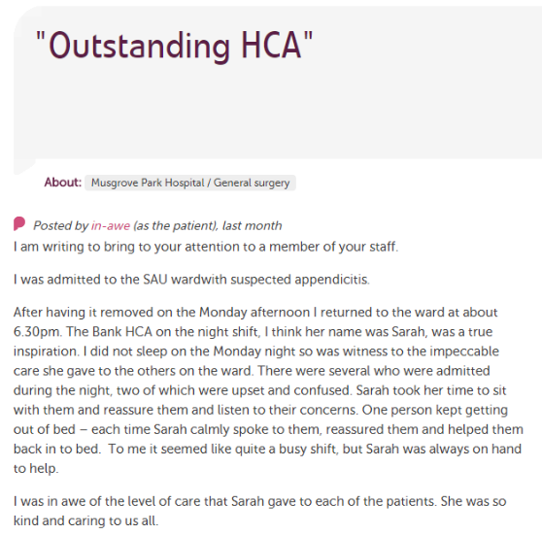

Slide 6
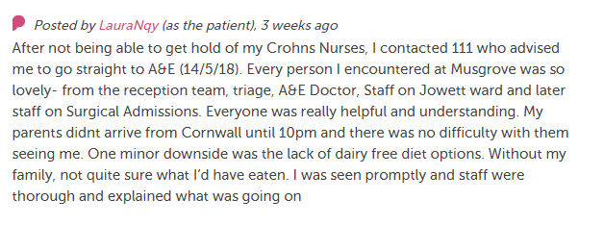
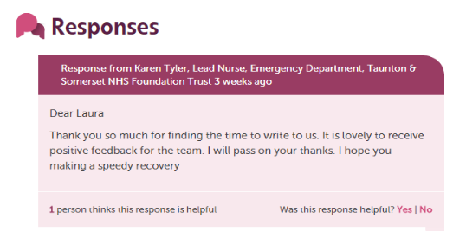
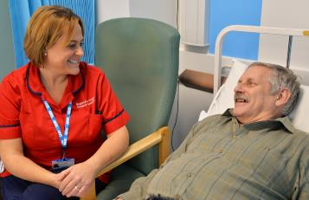

Slide 7
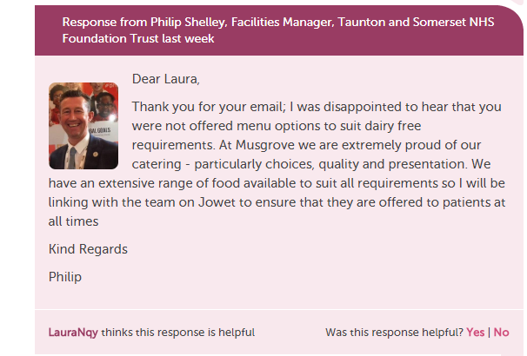

Slide 8
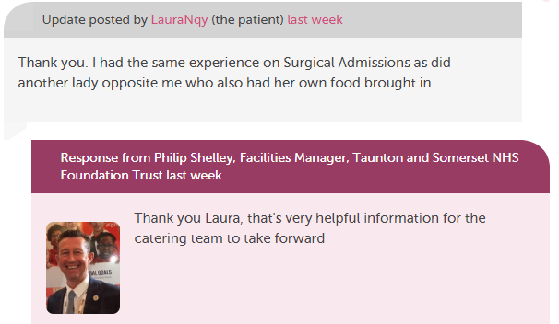

Slide 9
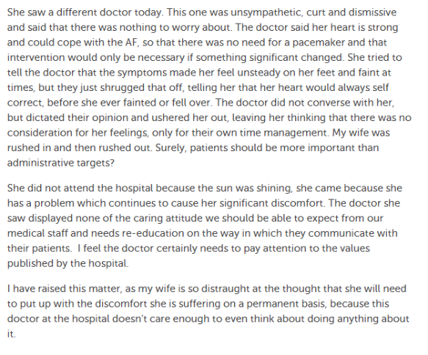

Slide 10
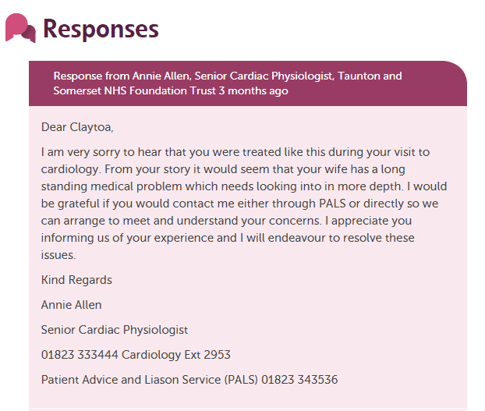

Slide 11
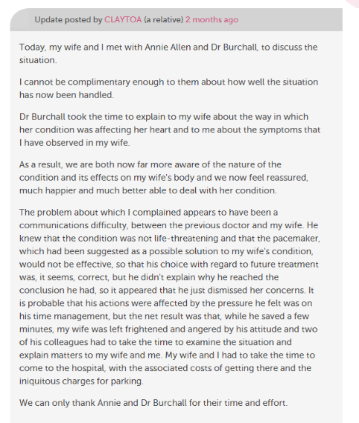

Slide 12
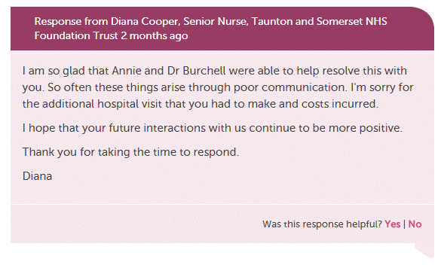

Slide 13
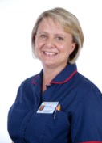
Hayley Peters, Chief Nurse
‘Care Opinion has the power to truly transform how we listen to patients…It can act as a significant lever in affirming the values and behaviours that we expect from our teams.
We must empower and trust our frontline teams to respond and in doing that they engage fully and own the feedback.
Having that platform of overwhelmingly positive feedback allows our team to embrace the arena of negative feedback, which is rare, and they connect with it fully and learn what they can do to improve. For me that’s authentic.
Dealing with it publically demonstrates our transparency and commitment to listening to and learning from feedback’.

Slide 14
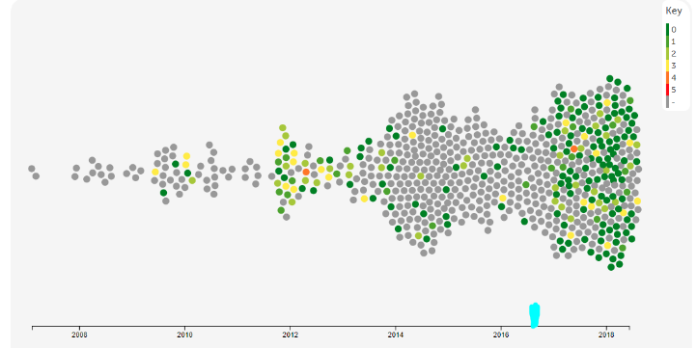
Reporting
Criticality Rating

Slide 15
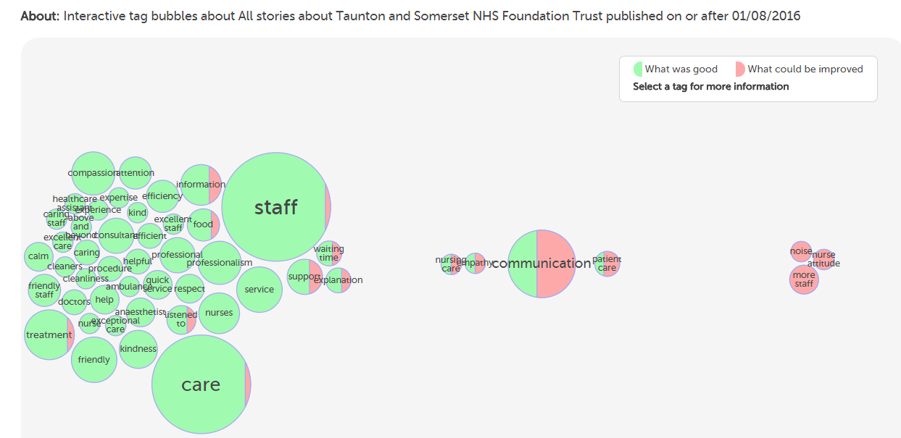

Slide 16
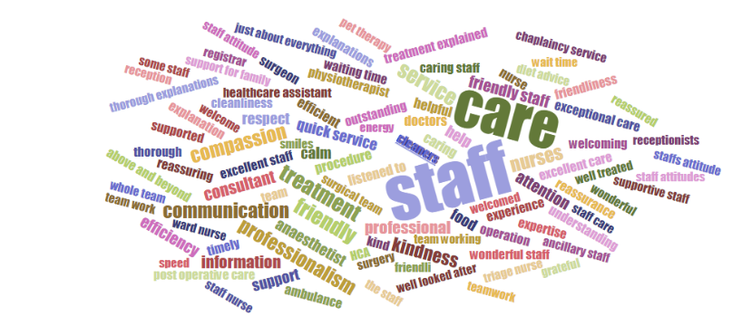
What was good?

Slide 17
Next Steps

