Slide 1

Context, mission and service
James Munro, CEO, Care Opinion CIC

Slide 2

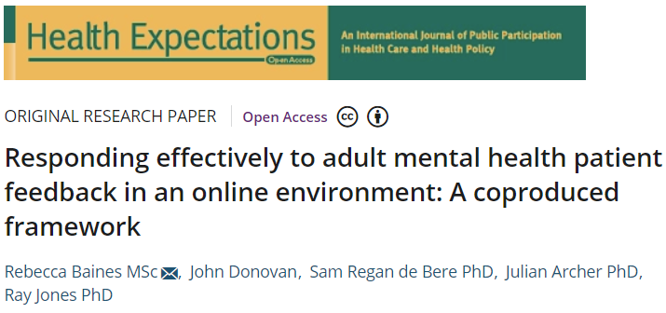


Slide 3
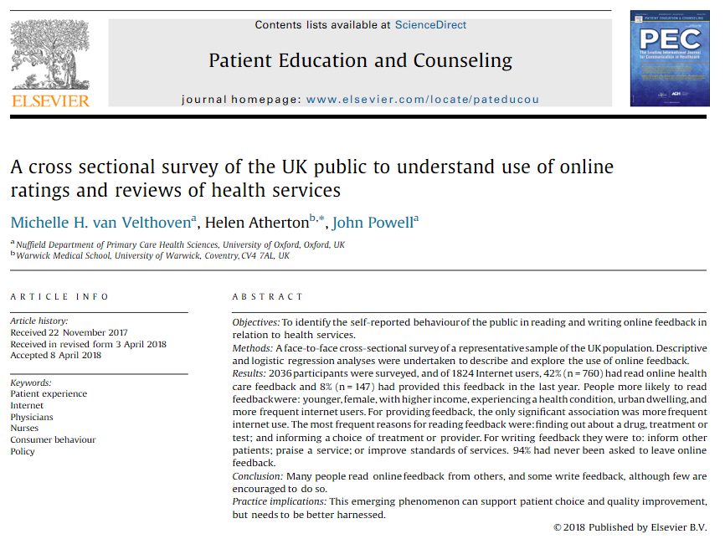

Slide 4
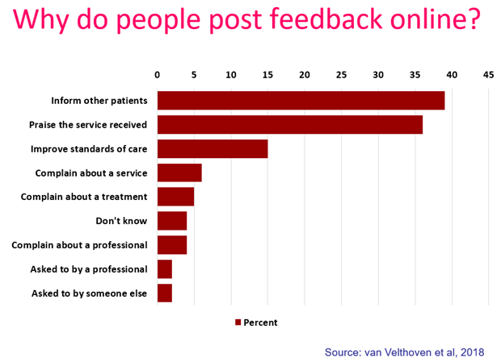

Slide 5
van Velthoven et al, 2018
“Policymakers should note that this is now a widespread phenomenon…
health services seeking to be more patient-centred and responsive to their users need to understand
how best to harness feedback…
what the opportunities are to encourage it…
how it can be used for service improvement.”

Slide 6
Vision
We want people to be able to share their experiences of health and care in ways which are safe, simple, and lead to learning and change.

Slide 7
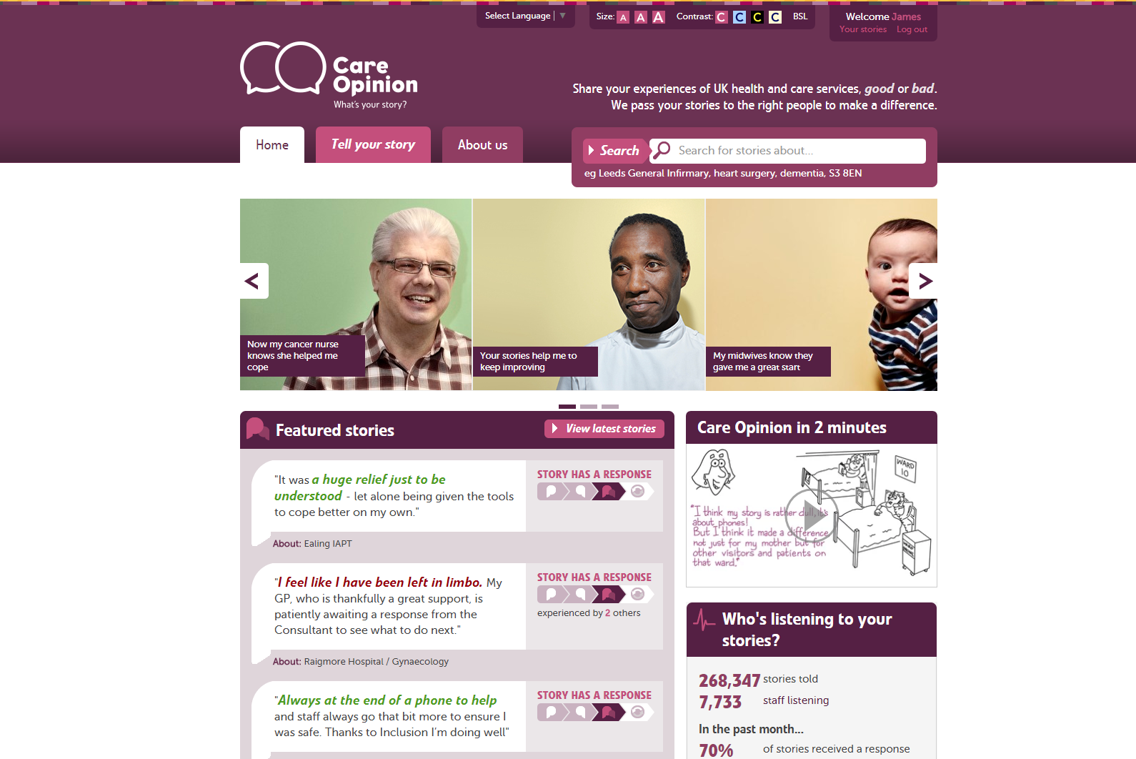

Slide 8
Mission
Our mission is to provide an online platform so that:
people can share honest feedback easily and without fear
stories are directed to wherever they can help make a difference, and
everyone can see how and where services are listening and changing in response

Slide 9
280,000
stories
8,000
staff + students listening
stories read
95 million
times
100,000
visitors per week

Slide 10
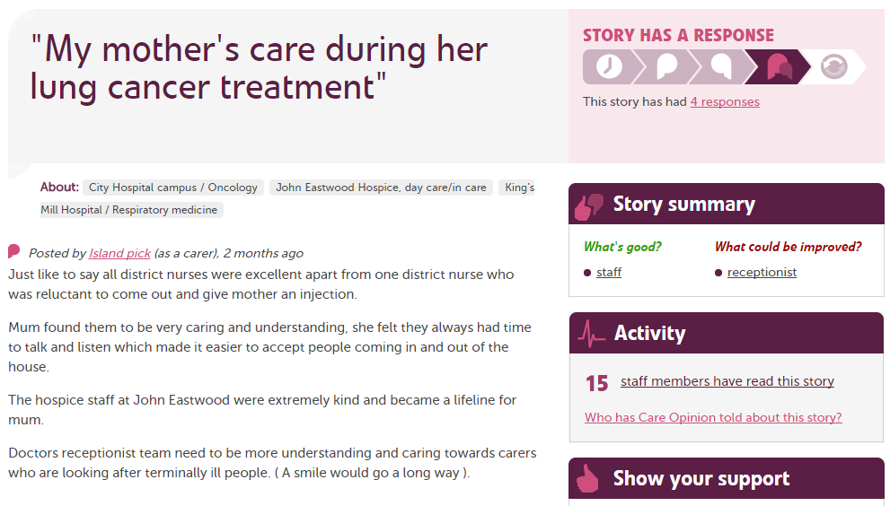

Slide 11
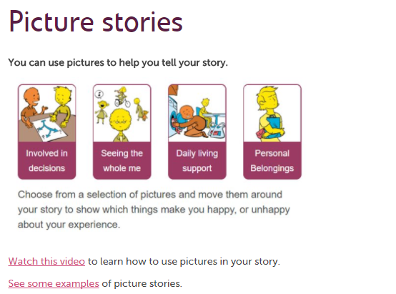

Slide 12
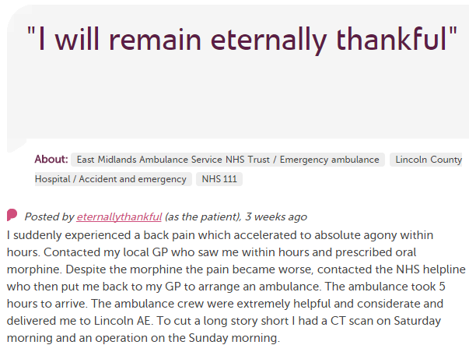











In each provider
Moderation
Clinical staff
Porters, reception, catering…
Pt exp, comms, complaints…
Alerting
CEO
Commissioners
Nursing, AHP students
Healthwatch
Researchers
Patient groups
CQC
Local authority

Slide 13
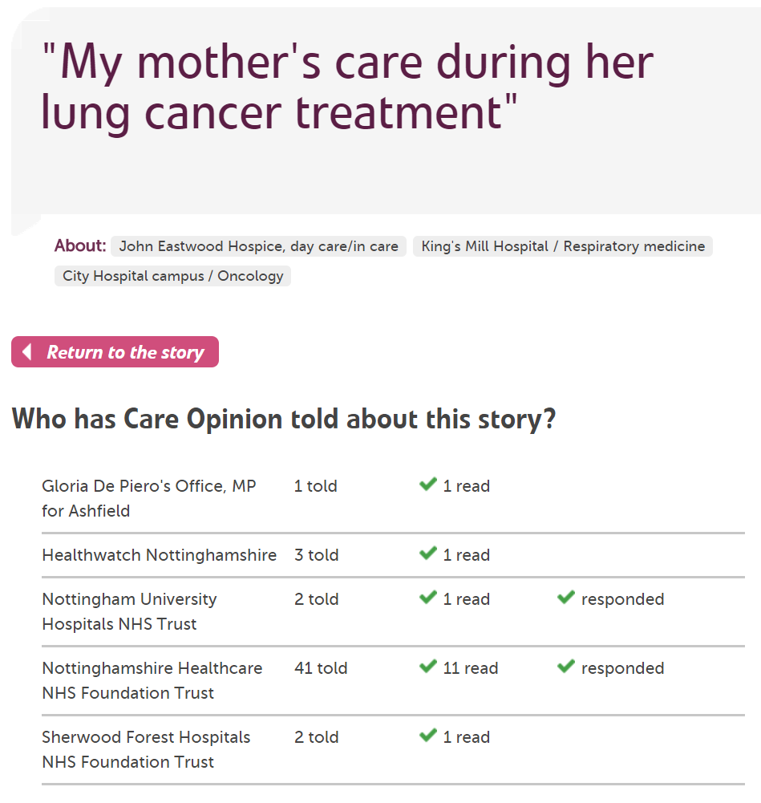

Slide 14
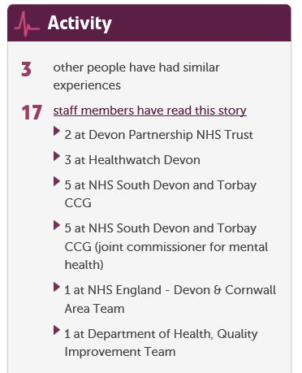

Slide 15
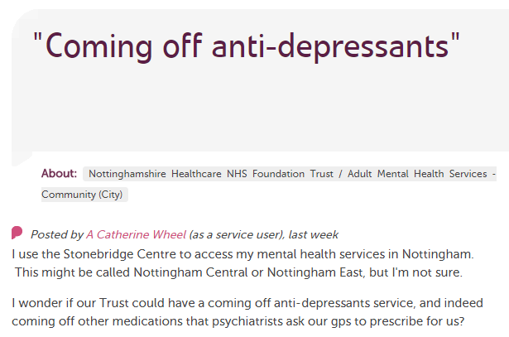
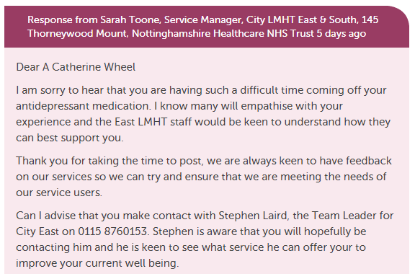
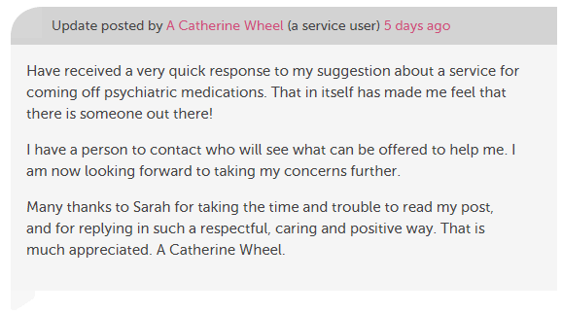
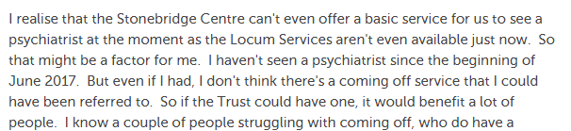

Slide 16
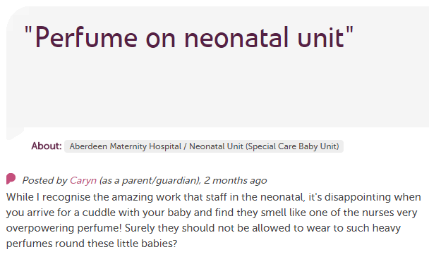
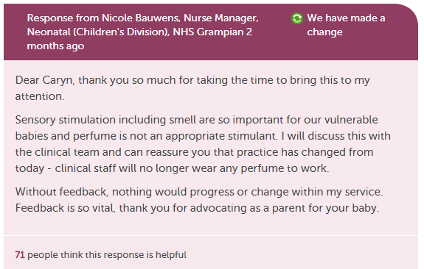
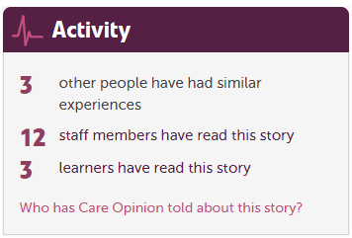

Slide 17
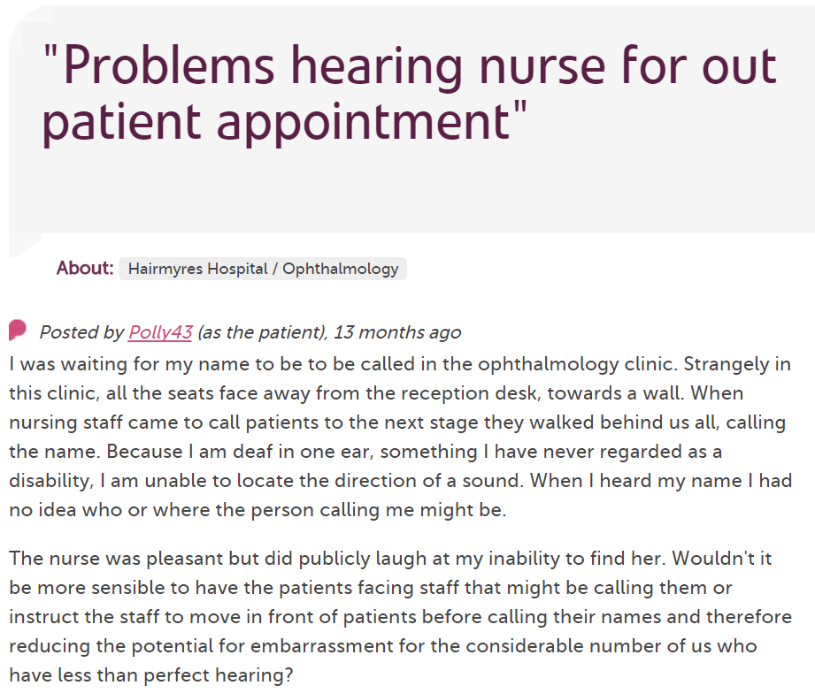
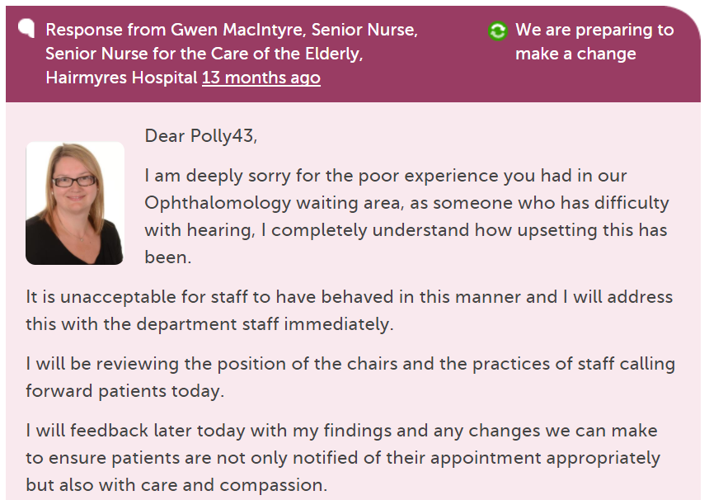
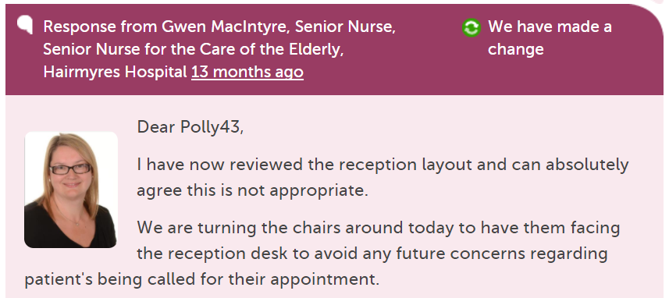

Slide 18
“It was therapeutic in healing my soul.”

Slide 19
“It was a difficult time for me to go through and Care Opinion allowed me to control the speed and words rather than be rushed through Q&As or tick box scenario where things don't quite fit.”

Slide 20
“The fact I did not have to give my name made it a lot easier to provide feedback. I find it hard to do it in person.
I would like it to make changes.”

Slide 21
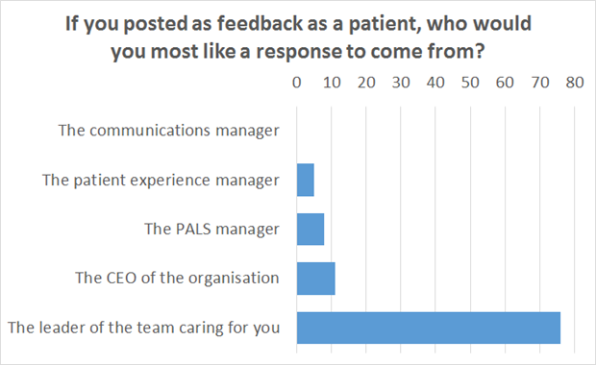

Slide 22
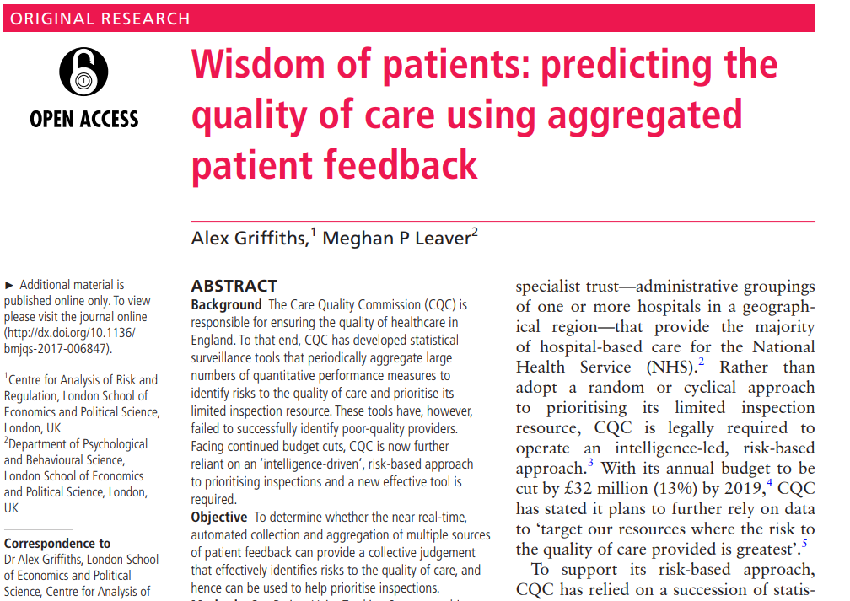

Slide 23
Hear the patient voice at every level – even when that voice is a whisper.
Don Berwick
August 2013

