Slide 1
Building a culture of listening, learning and improvement
James Munro, CEO, Care Opinion CIC

Slide 2
“As we’ve been on a journey, so have the users and carers been on a journey. They now have trust in us, to know that we do want to hear it, warts and all, and that we will work on what the issue is.”
Jenny Newman and Sue Dyke, public engagement

Slide 3
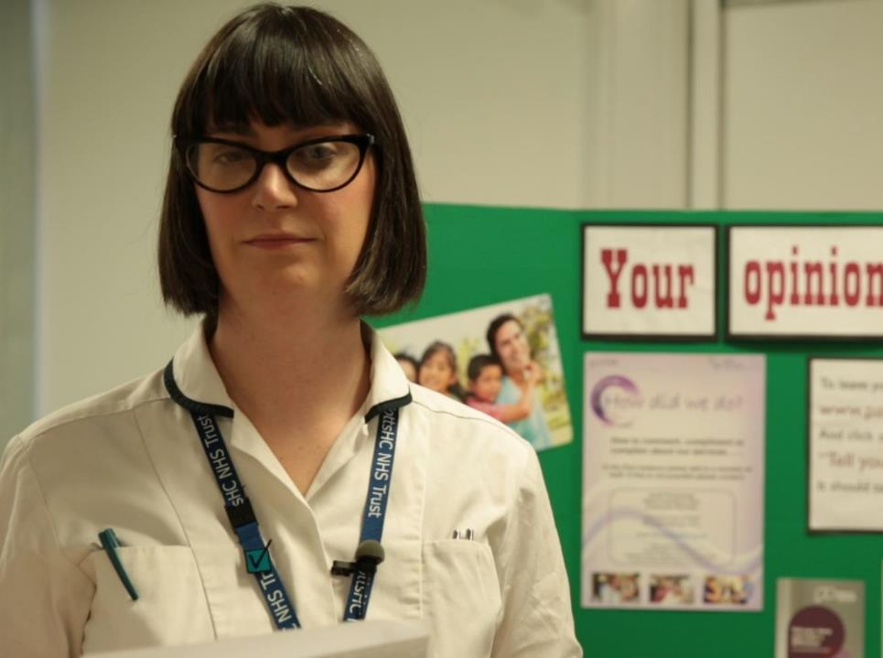
“More than just listening, it has helped us to focus on what we can change to improve our service.
We’ve learnt that Care Opinion gives patients a powerful voice, which in turn has empowered us.”
Lisa Metcalf podiatrist

Slide 4
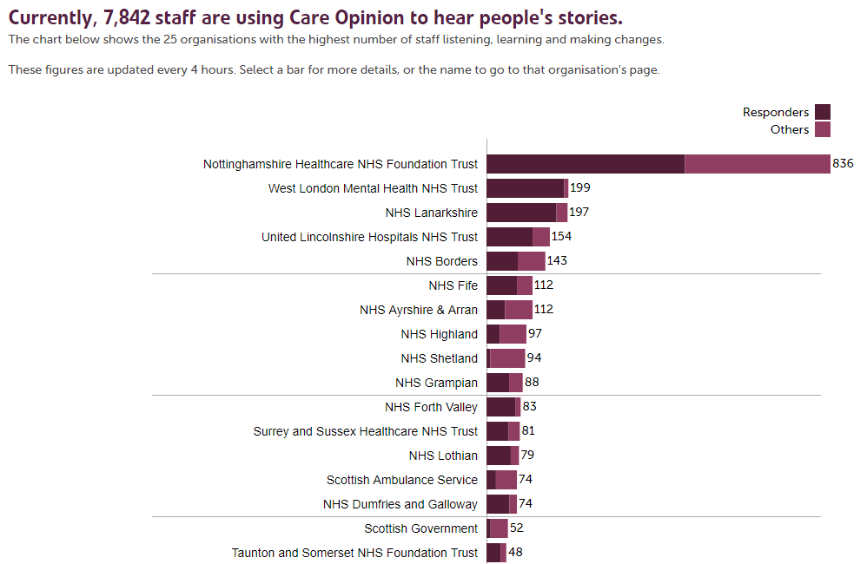

Slide 6
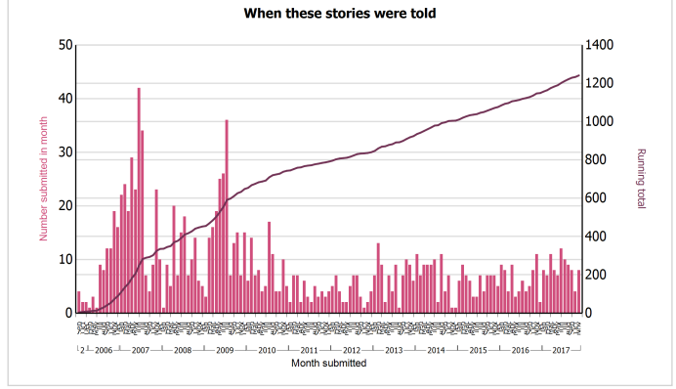
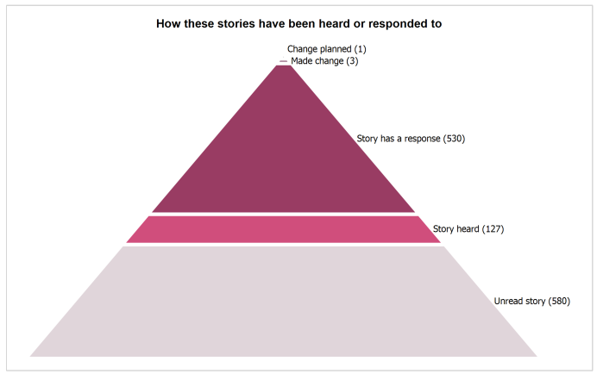
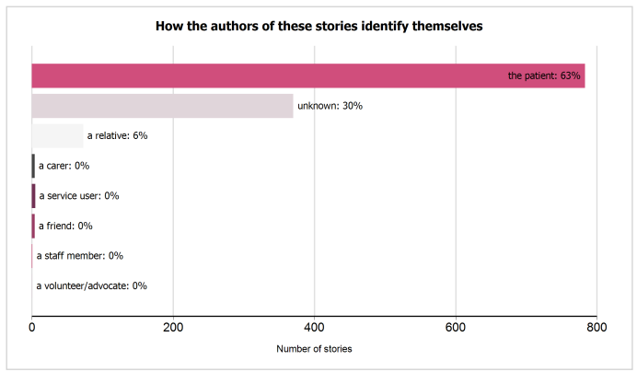
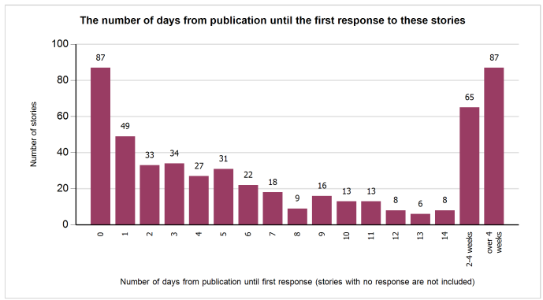

Slide 7
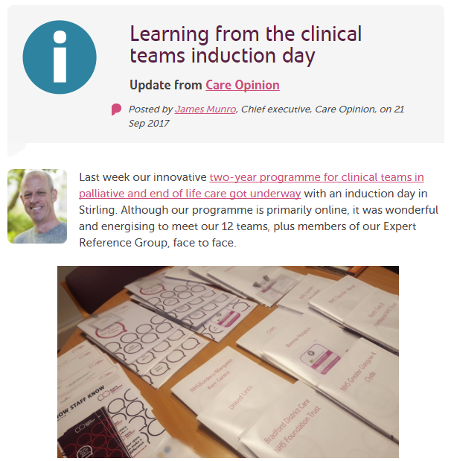

Slide 8
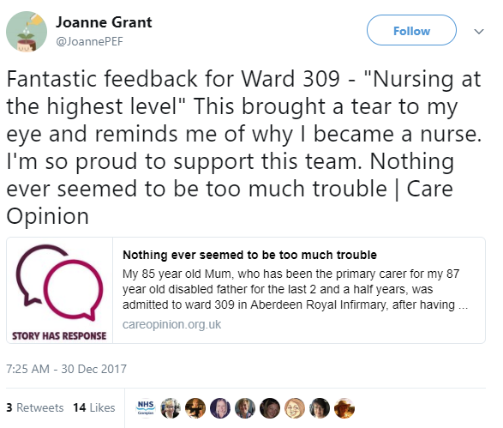

Slide 9
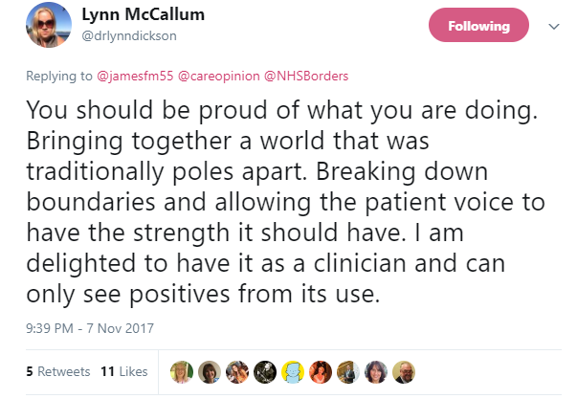

Slide 10
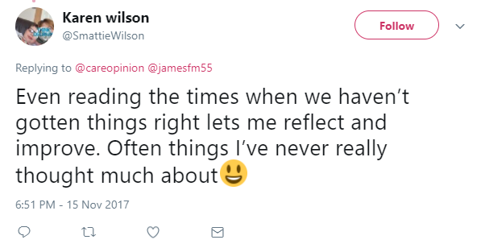

Slide 11
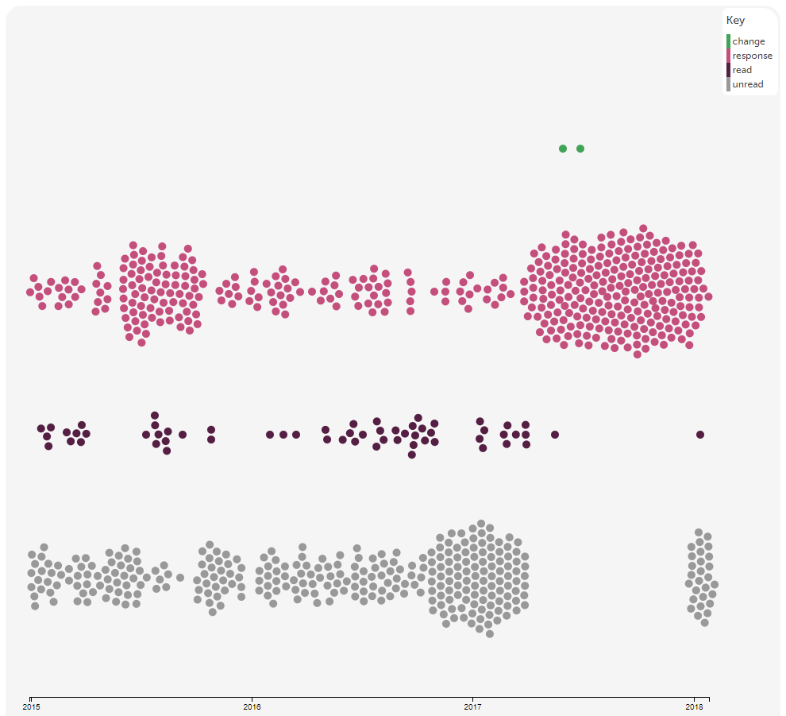

Slide 12
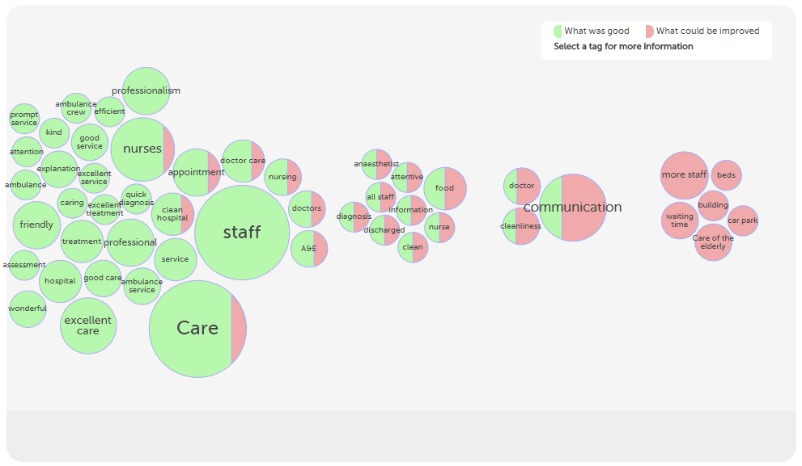

Slide 13
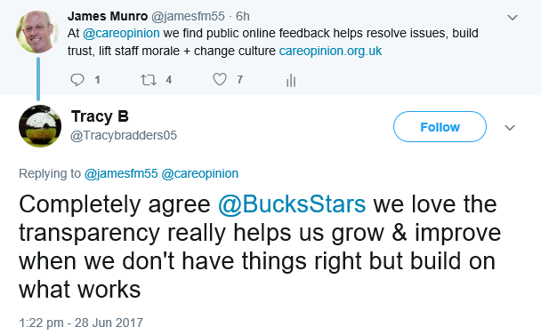

Slide 14
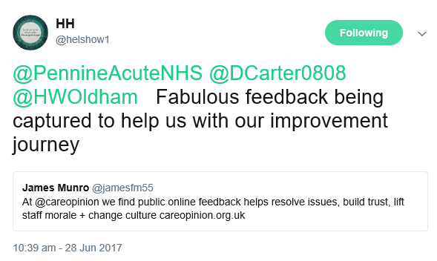

Slide 15
Real-time iHub QI study
Online feedback via Care Opinion
Structured conversations with people about their experiences of care
Care team discusses and agrees improvement opportunities
Report on progress via Care Opinion
Test and evaluate improvements
Implement and spread improvements

Slide 16
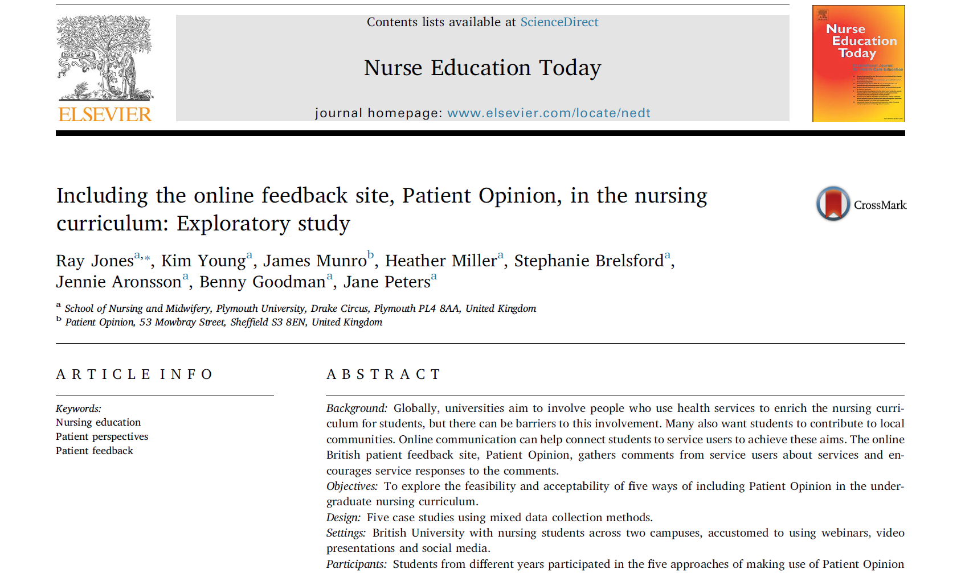

Slide 17
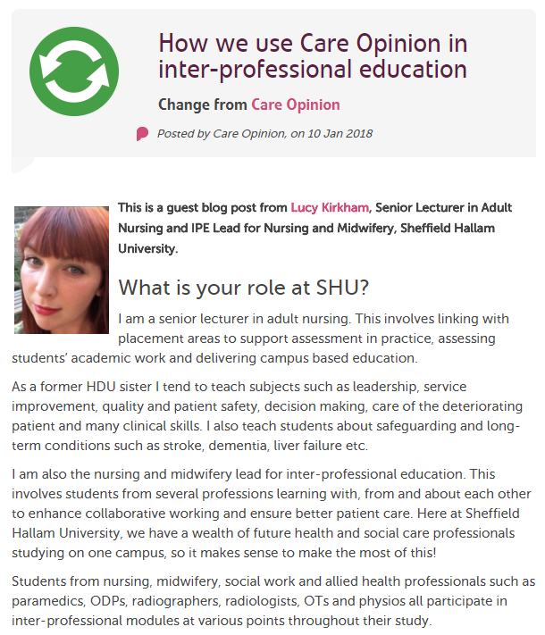

Slide 18
Coming soon… our learning app

Slide 19
Katherine Browne and Dale Shaller, 2018

Slide 20
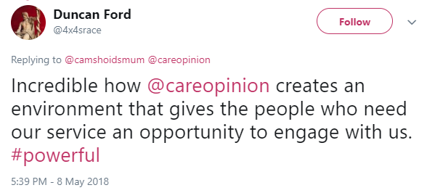

Slide 21
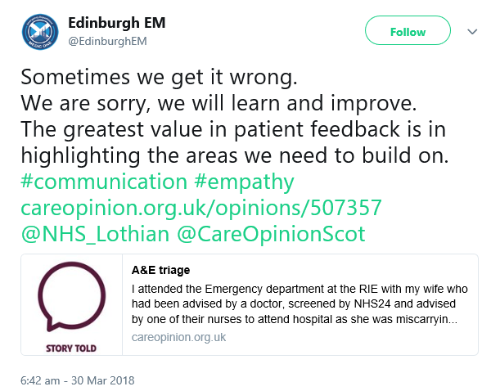

Slide 22
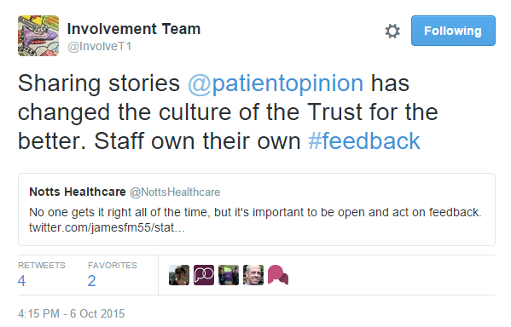

Slide 23
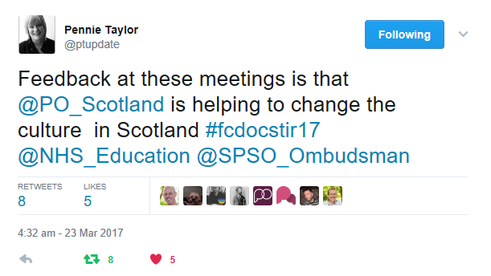

Slide 24
The plural of story isn’t data.
Lots of people
2018

Slide 25
The plural of story is culture.
Me
2018

