Slide 1
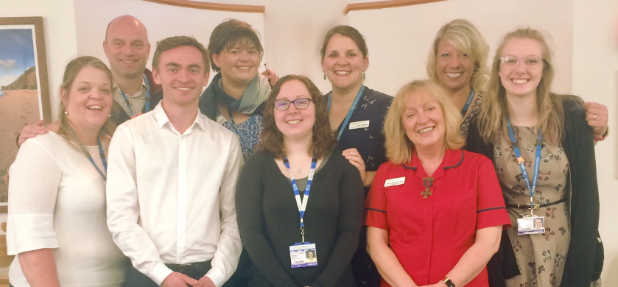
Getting started with
Care Opinion at RCHT
Frazer Underwood
Consultant Nurse / Associate Chief Nurse and
Head of Patent + Family Experience

Slide 2
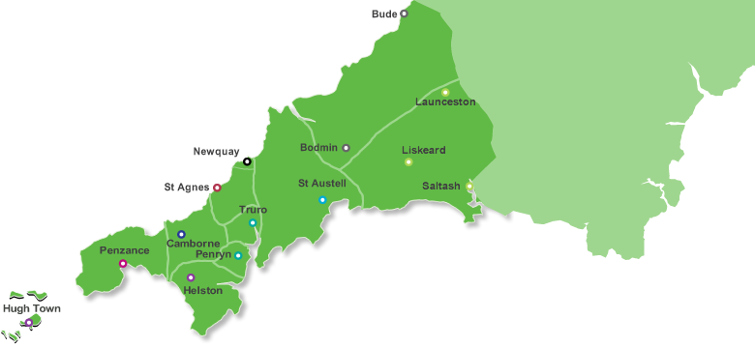

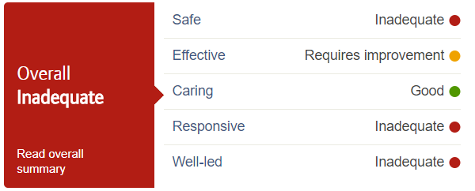
St Michael’s Hospital
Hayle
35 beds
Patient + Family Experience Team :
Nine staff members
Complaints:
380 – formal complaints
1200 – informal complaints
16 escalated to PHSO
Care opinion:
Two subscriptions
Royal Cornwall Hospital
Truro
480 beds
West Cornwall Hospital
Penzance
54 beds
2017

Slide 3
Why did RCHT subscribe to Care Opinion?
We were not a learning organisation
Clinical teams were disengaged with patient feedback
We were starting a significant improvement journey
…opportunity to link Care Opinion
into that journey

Slide 4
Where did I start?
We made the connection between patient experience and our Improvement plan for our Chief Nurse
The Patient + Family Experience team took control of the existing subscriptions
Promoted the visibility of Care Opinion
and built the case for investment

Slide 5
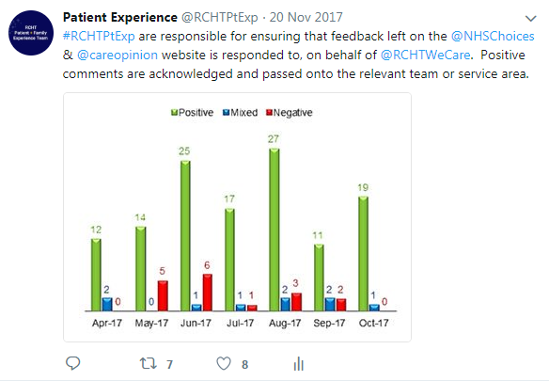
Taking Control

Slide 6


Slide 7


Slide 8
Engaging the organisation
Sharing feedback with clinical teams – it’s mostly very positive
Reporting feedback into meetings from Ward-to- Board
Finding our champions to take it forward…

Slide 9
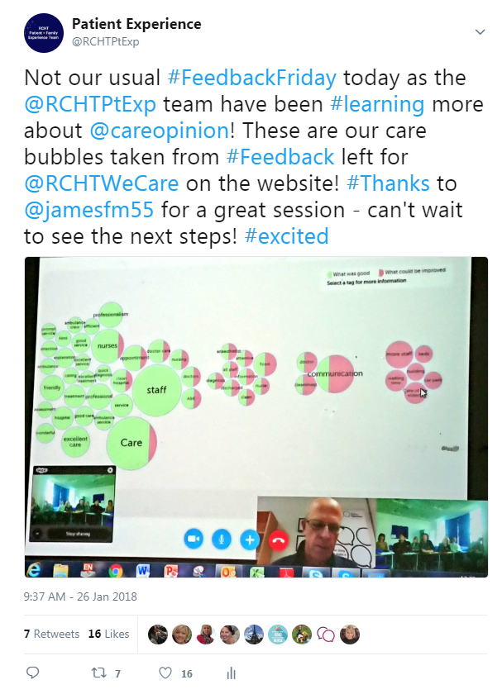

Slide 10
March 2018 – new subscription goes live ☺
How are staff feeling about this?
Natural worry about workload
Rolled-out to paediatric and gynaecology areas (early adopters)
Finding the opportunities the service gives

Slide 11
Is it a lot of work?
Not if it aligns to your Trust ambitions and values
Not of it help you achieve your improvement goals
Not if you embed it in your work plans

Slide 12
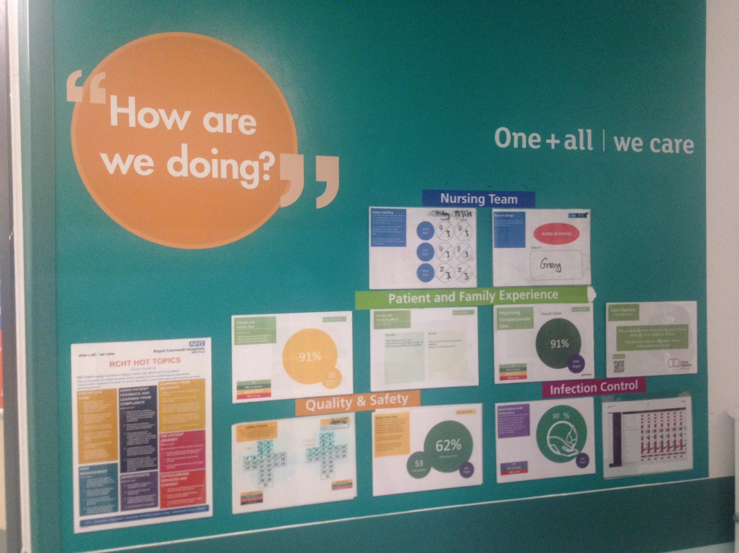

Slide 13
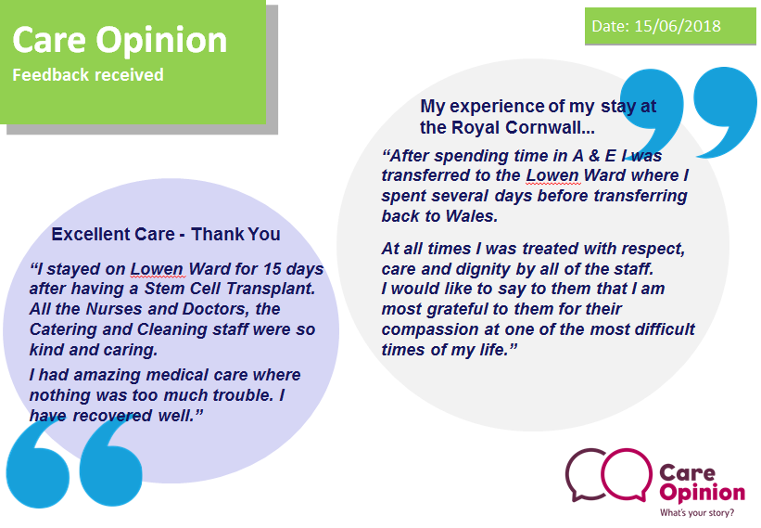
“
How are we doing?
“

Slide 14
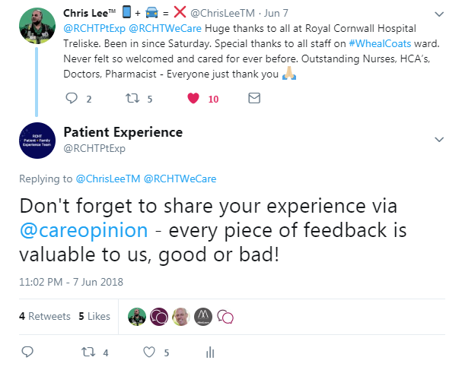


Slide 15
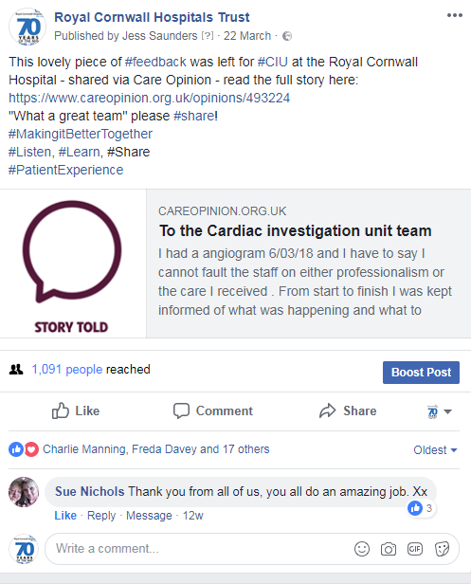


Slide 16
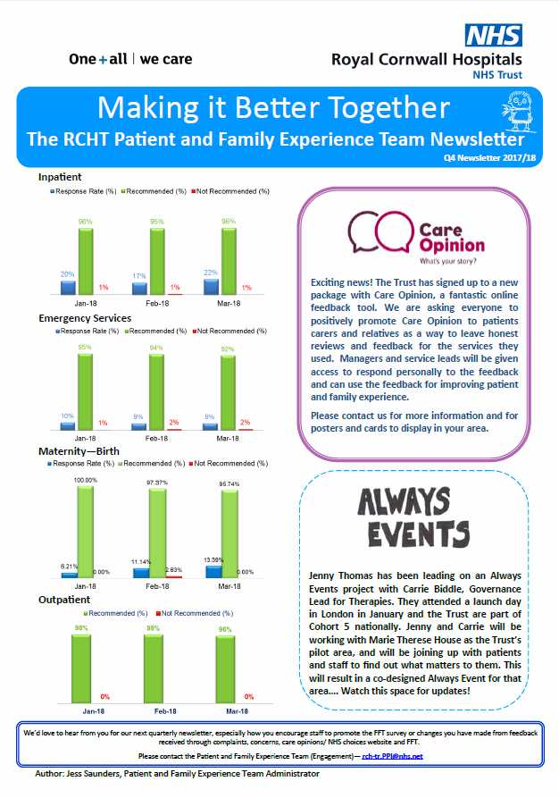
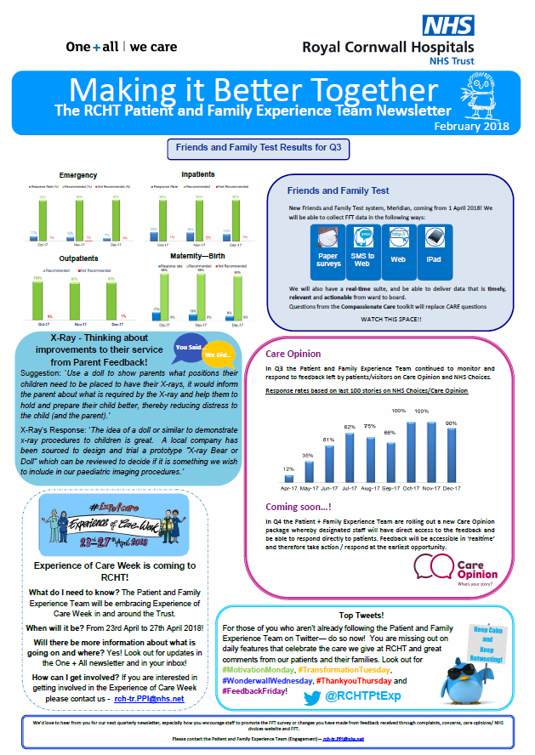

Slide 17


Slide 18

What are our next steps?
Our roll-out plans are now embedded in our quality improvement plan
We are rolling out to areas already receiving good volumes of feedback next – West Cornwall Hospital, the emergency department, ophthalmology and maternity services.
developments

Slide 19


Slide 20
Thank You
Frazer Underwood
frazer.underwood1@nhs.net
@frazerunderwood

