Slide 1
Implementing Care Opinion in
Royal Cornwall NHS Trust:
Our Improvement Journey
Michaela Brewer, Patient Engagement Manager
Jess Saunders, Patient Experience Coordinator
Dr Frazer Underwood RN, Associate Director of Nursing for Research, Innovation and Improvement

Slide 2
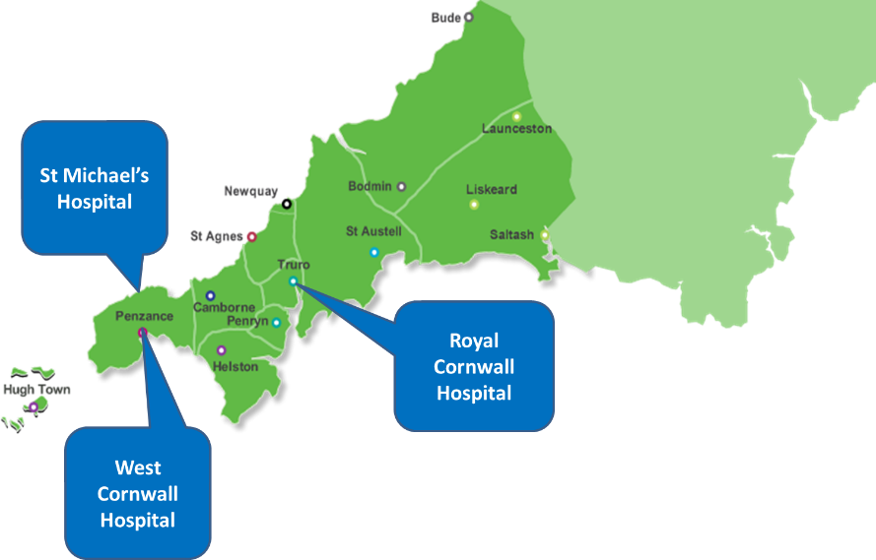
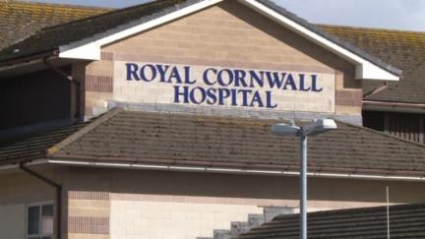
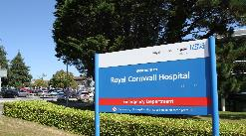

Slide 3
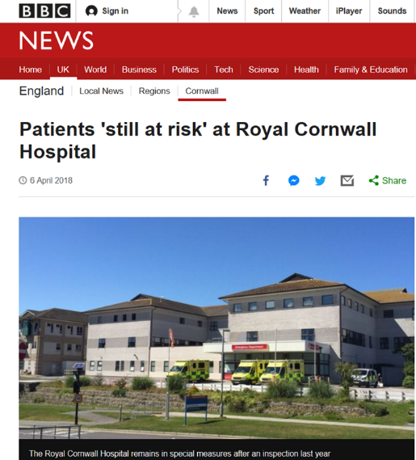
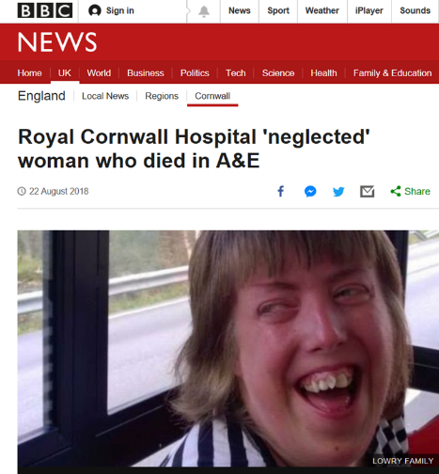
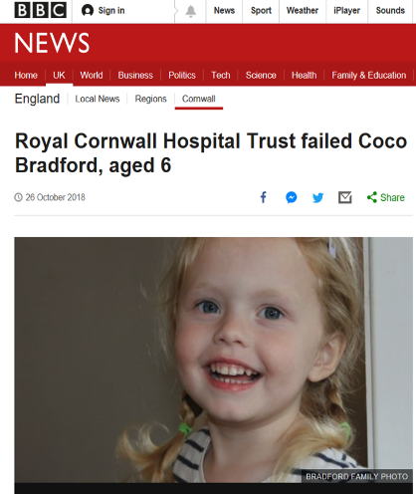
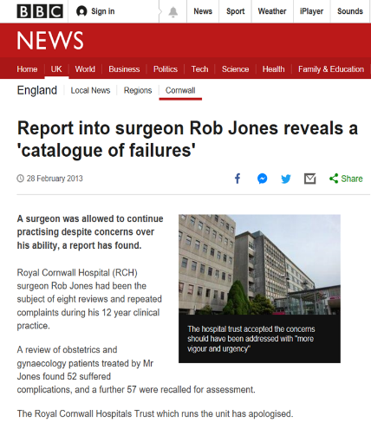
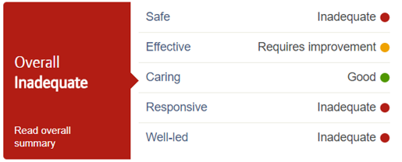

Slide 4
Why did RCHT subscribe to Care Opinion?
We were not a learning organisation
Clinical teams were disengaged with patient feedback
We were at the beginning of a significant improvement journey …

Slide 5
The Improvement Journey: Adopting Care Opinion
Connection made between patient experience and our improvement plan

Slide 6
The Patient + Family Experience Team took control of the existing subscriptions
Promoted the visibility of Care Opinion
Built the case for investment

Slide 7
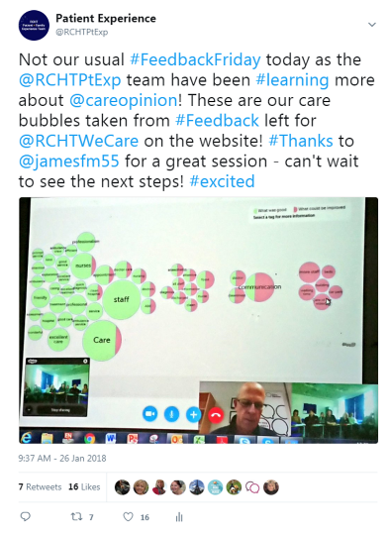

Slide 8
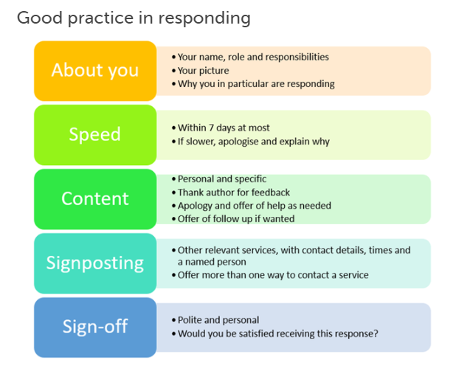

Slide 9
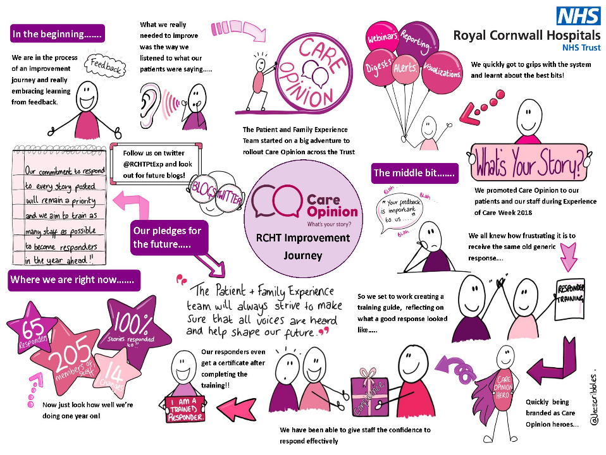

Slide 10
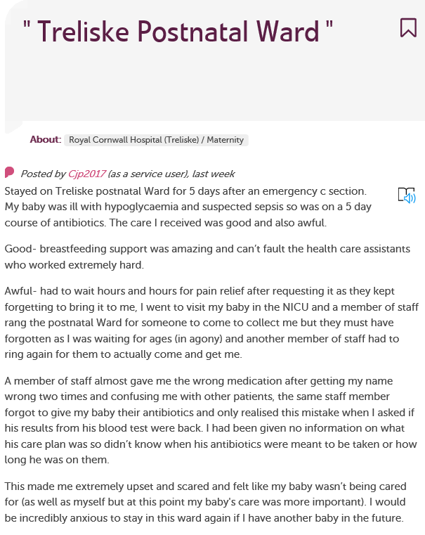
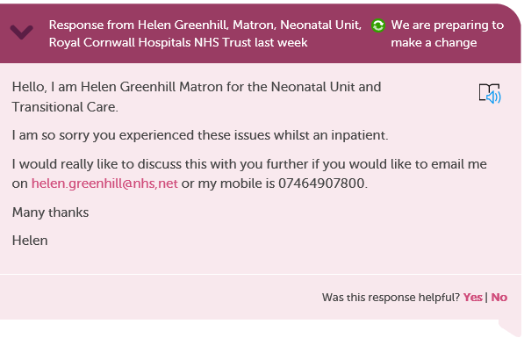
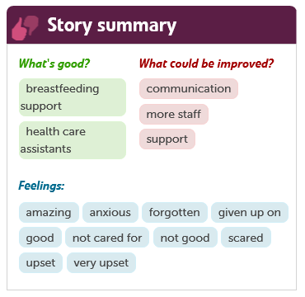
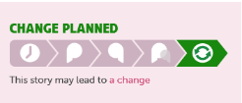
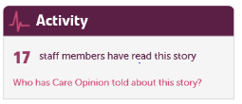

Slide 11
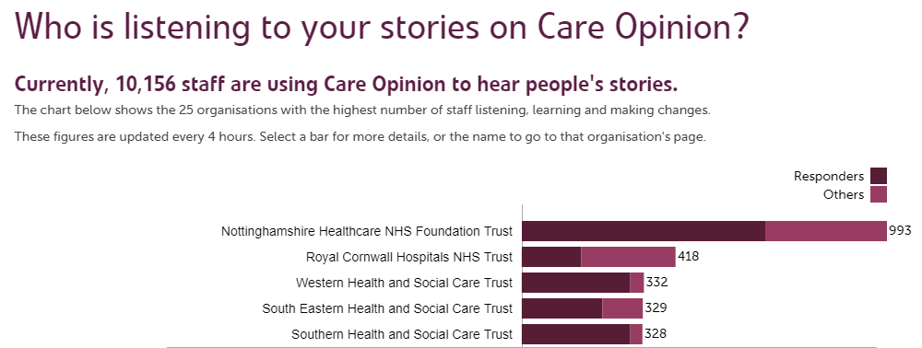
Where are we now?
418 Colleagues listening
160 trained responders
Over 2,430 stories have been told
59 stories have led to a change
We now aim for every story to receive a personal response within 7 days
RCHT are recognised nationally in being the 2nd most actively listening Trust in the UK

Slide 12
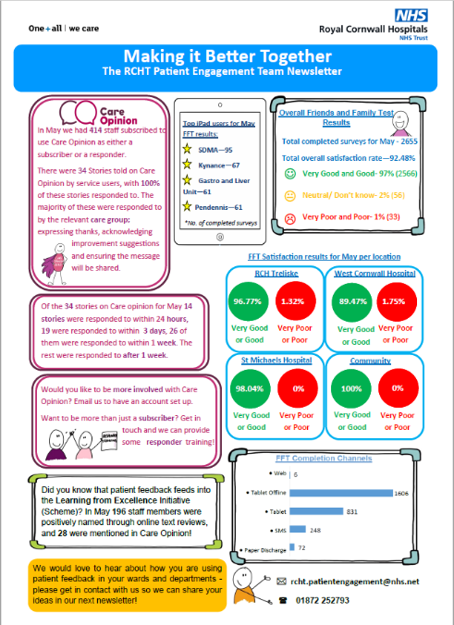
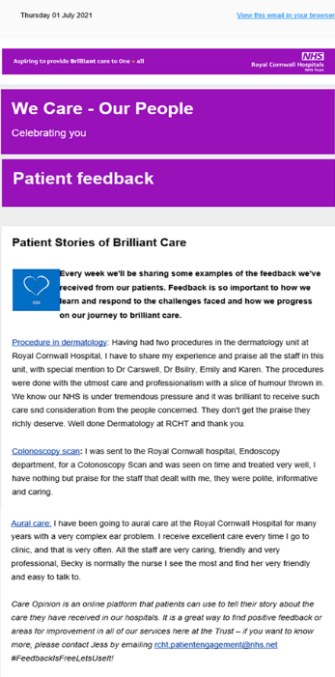

Slide 13
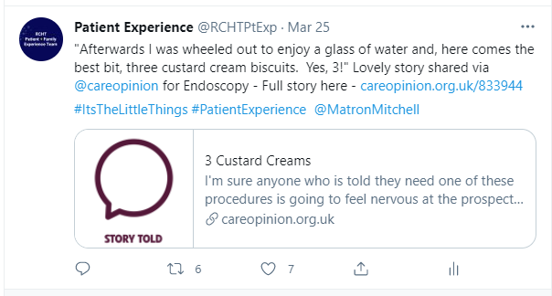
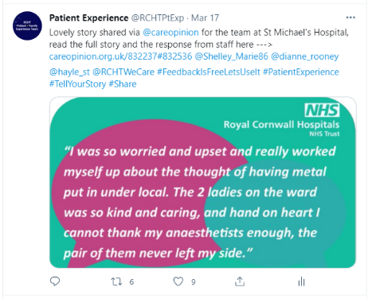
@RCHTPtExp
#FeedbackIsFreeLetsUseIt
https://www.careopinion.org.uk/ourblog

Slide 14
Emergency Department: “We would like to thank Jane M for everything she does to ensure that the patient feedback her teams receive is shared, it matters, is acted upon, makes a difference and she responds to the patient/service user direct whenever she can despite her being so busy clinically.”

Slide 15
Our Contact Details:
Michaela Brewer, Patient Engagement Manager
Email: michaela.brewer@nhs.net
Jess Saunders, Patient Experience Coordinator
Email: jess.saunders@nhs.net
@michaelajaneb
@Jecscribbles
Dr Frazer Underwood RN, Associate Director of Nursing for Research, Innovation and Improvement
Email: frazer.underwood1@nhs.net
@frazerunderwood
@RCHTPtExp
#FeedbackIsFreeLetsUseIt

