Slide 1

Change Grow Live - Birmingham
Overview
Adults
March 2015
6,500 people

Slide 2
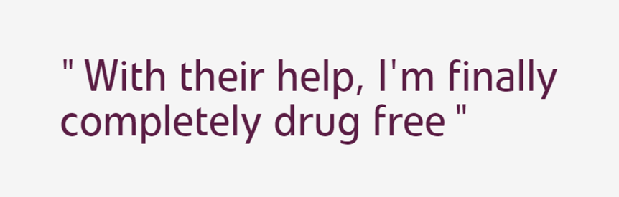
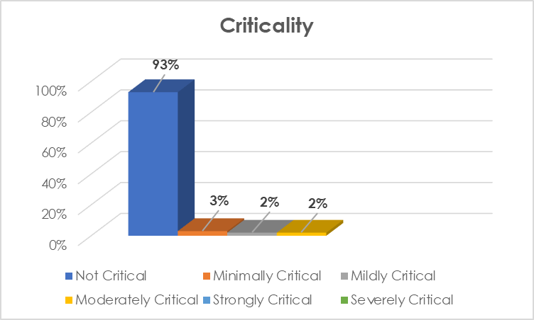
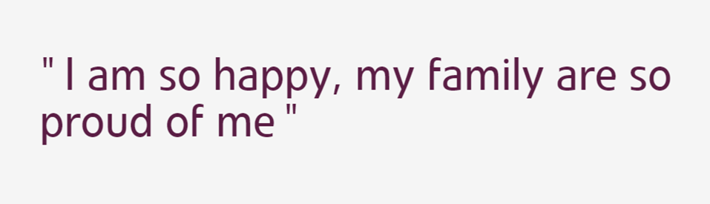
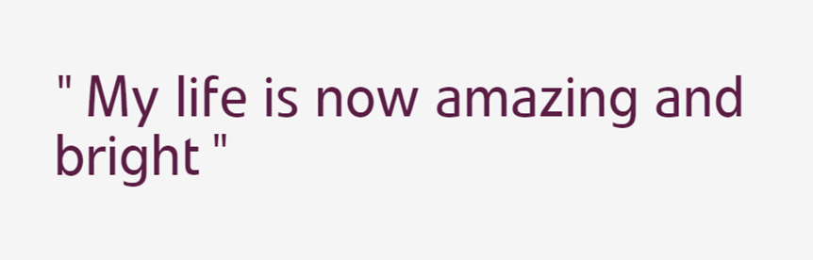
Who uses Care Opinion…

Slide 3
Why people are getting in touch…
“You saved my life, I will always be grateful, I will never forget.”
“Thank you - You truly are all diamonds.”
“I start a new job next week. I am back, my life is back. Thank you.”

Slide 4

Why Care Opinion is such a good fit…
Drugs /
alcohol
Harmful behaviour
/ consequences
Trauma
Stigma
Shame
Guilt
Judgement

Slide 5


Hearing more stories…

Slide 6
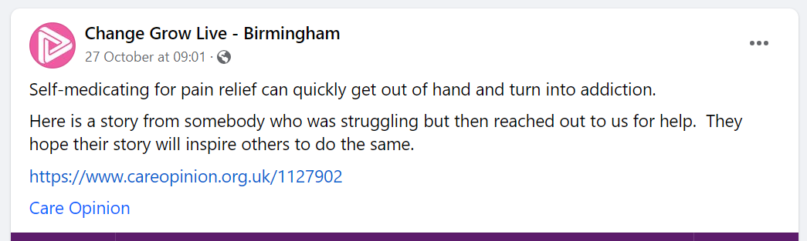


It’s not ‘just’ a platform that can help us change…
Hope

