Slide 1




Care Opinion Autumn Conference 2024
In my own words:
Being heard and making impact
Dr Catherine Labinjoh
National Clinical Advisor Realistic Medicine
Scottish Government

Slide 2
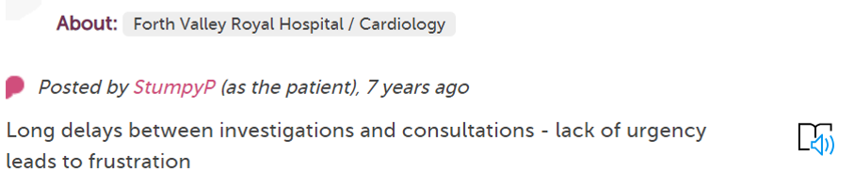
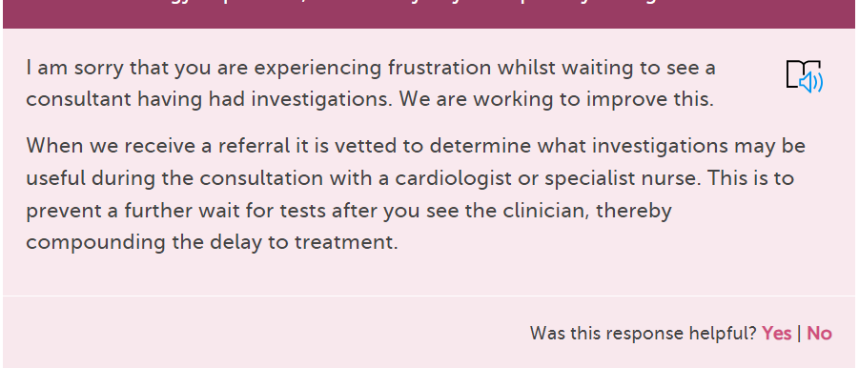

Slide 3


Slide 4
Industrialised healthcare
Response to rising demand harm and cost
Improvement approaches (manufacturing)
Patients widgets
Professionals production line workers
Caring processing
Hurry
Blur
Burden
Cruelty
Montori and Allwood BMJ 2022;379:e073444 | doi: 10.1136/bmj-2022-073444

Slide 5
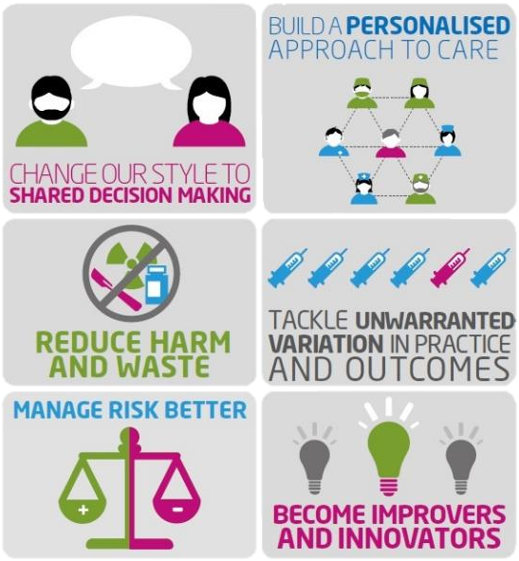


Notes:
By practising Realistic Medicine, we will address many of the challenges we face, now and in the future. But what is Realistic Medicine?
Realistic Medicine puts the person receiving health and social care at the centre of decisions made about their care. It encourages health and care colleagues to find out what matters most to people. Realistic Medicine recognises that a one size fits all approach to health and social care is not the most effective path for people or the NHS.
Here are the six key principles of Realistic Medicine:
Changing our style to shared decision-making. – we must promote more meaningful conversations that ensure people have a say in decisions about the care they receive.
Building a personalised approach to care. - We must support people to make informed choices about their treatment and care, considering what matters most to them as an individual.
Reducing harm and waste. We know that the overuse of treatment and investigation can cause harm to people. By reducing this harm and waste we can provide healthcare people really value.
Tackling unwarranted variation in practice and outcomes. Unwarranted variation is variation that cannot be explained by explicit individual need or population preferences.
Managing risk better. – Involves health and care professionals being more comfortable with not following guidelines in every situation – every person is different and sometimes they will not benefit from what the guidelines are telling us we should do. Ensuring people are fully informed and consent to treatment is a particularly important component of managing risk better
We should also continue to improve and innovate. We need to foster an environment that supports innovation in healthcare delivery.

Slide 6
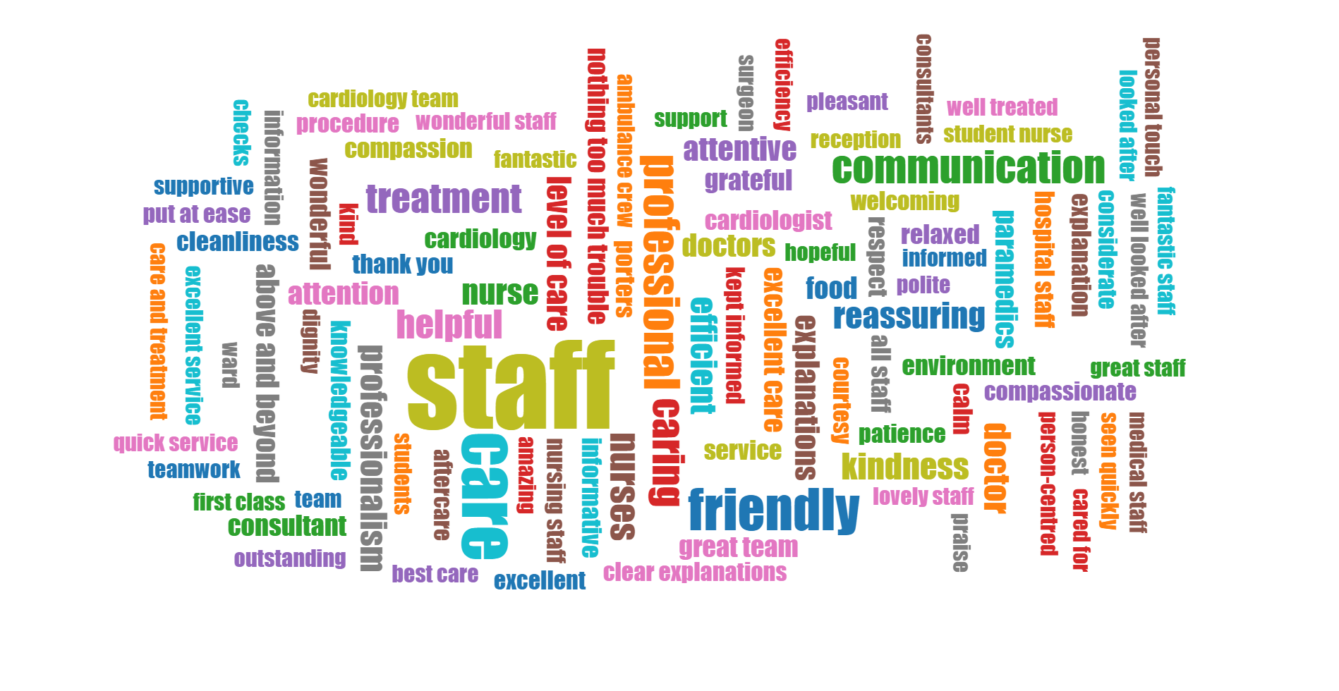
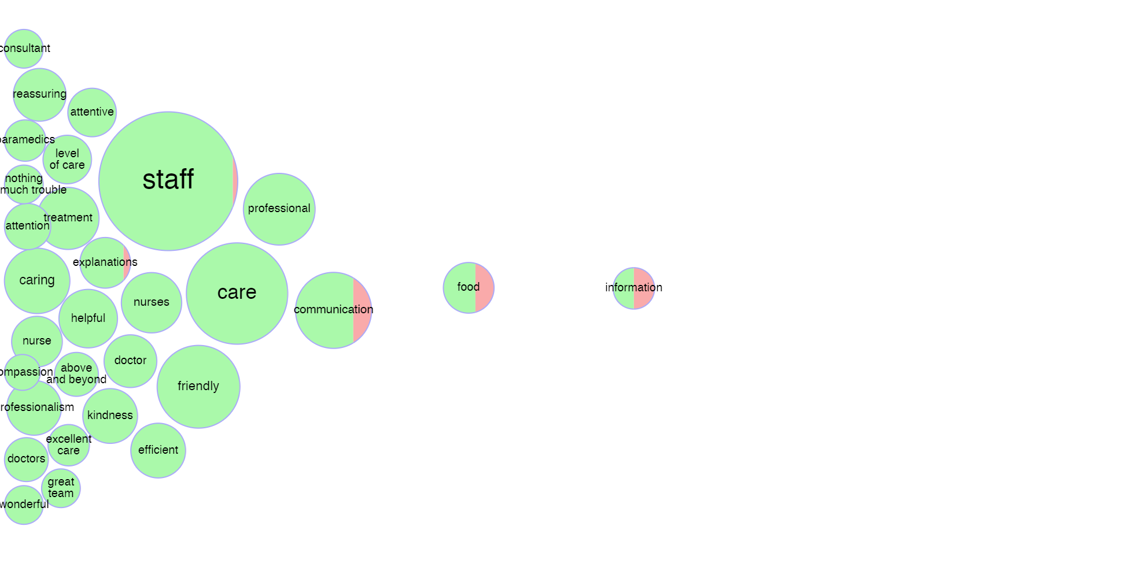
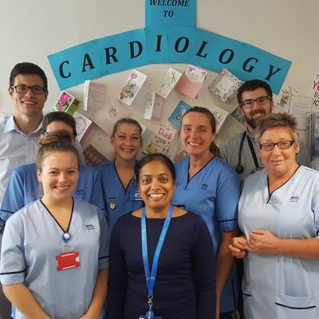
Tag Bubbles
What was Good?

Slide 7
Care Opinion Autumn Conference 2024
Thank You
Dr Catherine Labinjoh
National Clinical Advisor Realistic Medicine
Scottish Government

