Slide 1
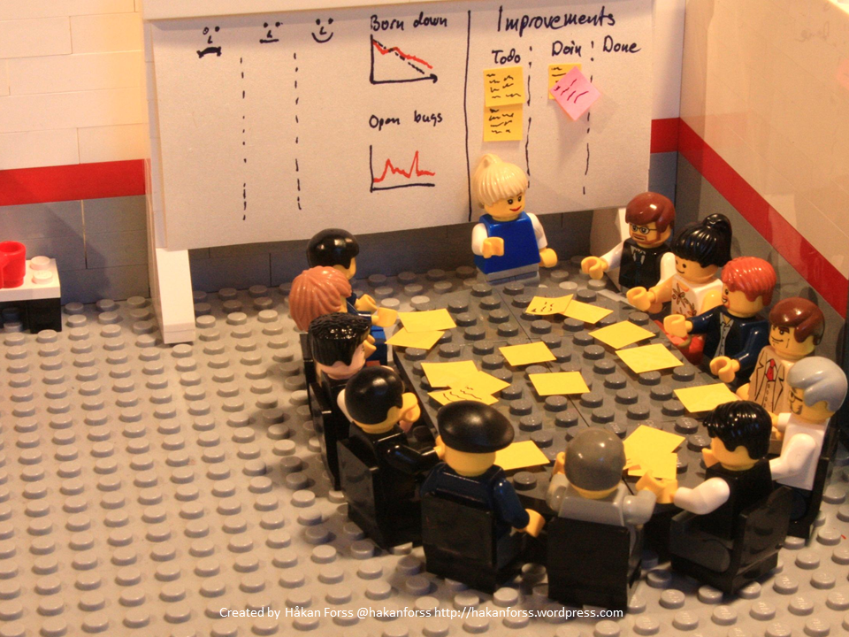
Online feedback in Primary Care Listening to patients – improving care
Caroline Millar
Lay Board Member
City and Hackney GP Confederation

Slide 2
City and Hackney GP Confederation – who we are
A social enterprise (CIC) since 2014 not NHS
42 practices/307k patients – universal coverage (incl. two private providers)
Practices pay £1 per patient membership fee
14 contracts worth £14m from the CCG and Hackney Council to run extended services
Executive and staff of around 20
Clinical Board (4 GPs, Practice Manager, Practice Nurse, & 2 lay members)

Slide 3
City and Hackney GP Confederation – what we do
Delivering contracts – ensuring full coverage – monitoring and supporting performance
Service redesign to improve ‘out-of-hospital’ services
Workforce development – capacity and capability
Spearheading the ‘GP at scale’ model nationally
Developing a neighbourhood model for the delivery of services as part of drive towards better integrated care
Quality Improvement, staff support and training
Research and innovation

Slide 4
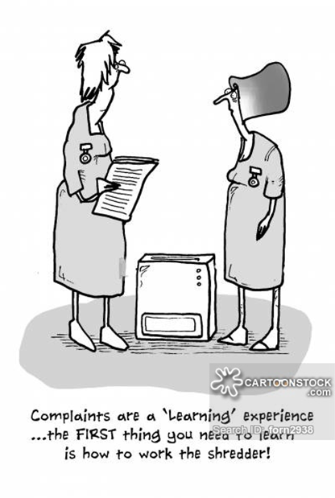
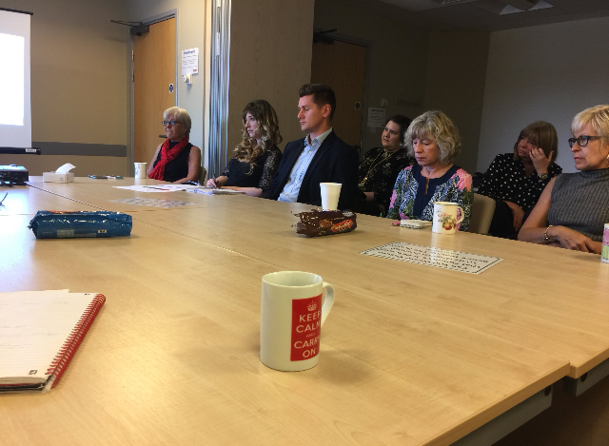
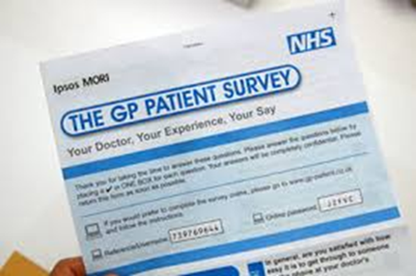
Why we want to change the way patient feedback is done

Slide 5
Improving and increasing engagement – aims for 2018/19
Change the way we collect and respond to patient and carer feedback on Confederation contracts
Develop a new approach to patient and public engagement/involvement in primary care
Work in partnership with other organisations to improve healthcare across the patch and avoid duplication
Engage with more and different people
Learn from feedback and show that we have done so
Start to think about how to improve complaint handling (staged process? Mediation?)

Slide 6
Scoping exercise - patient engagement (and PPGs)
Six month project begun in June 2018 to establish where we are now and what we need to do next, which includes:
Practice self-assessment
Patient group self-assessment
Baseline data for patient feedback
Interviews with key players
Literature review

Slide 7
Practice concerns
No time or energy to take on something new
Anxiety about staff being identified
Perceived imbalance of power between patient and responder
Will just increase complaints and damage staff morale
What’s wrong with NHS Choices?
CQC looks at Choices star ratings

Slide 8
Care Opinion in GP practices in C&H – the pilot
Paid for by Confederation, not practices
Nine practices volunteered for pilot
Leadership – Confed Board and senior staff, GPs, Practice Managers
Significant support from Care Opinion
CO widgets on the website, cards, posters etc
Regular reporting to practices and Confederation
Ongoing training and support for staff responders
Built into wider QI work

Slide 9
Where we are now (June-October 18)

Slide 10
Where we are now
Many complaints still about access and changes to access but recent new appointment systems beginning to make a difference
Response rates are increasing slowly but need a boost
As yet no evidence of changes being made in response to feedback
Some frustration that so few patients are using it
GPs starting to hand out cards
Link being sent with appointment follow-up texts
Pilot to be extended from six months to one year for
May try to add more practices to the pilot

Slide 11
Next steps
Give PPGs access to CO data to inform their work
Allow others to respond – PPGs, Confed, CCG?? Aim for 100% response rates and more change
Build CO into new models of patient engagement across the new neighbourhoods
Share data with other providers and patient groups
Persuade other healthcare providers to join us by signing up – a single route for all feedback on health in H&C?
Raise awareness of CO across Hackney
Confederation staff support to practices using CO
Monitor progress and impact

