Slide 1
Notes:
Welcome and Housekeeping

Slide 2
Starting a ripple: An introduction to Care Opinion – A tour of the site and Key Features
Agenda
Intro to Care Opinion – About us
Live Site Tour
A sample of Key Site Features
Q&A – Your chance to ask any questions or pop them into the chat!
Notes:
Introduce Session 1 and Tracy

Slide 3
Who is
Care Opinion began in 2005
Care Opinion is a value driven non-profit social enterprise, based in Sheffield and Stirling
We provide a feedback website for people to share their experiences of health & care in ways that are safe & simple and lead to learning and change
We value people’s honest experiences of care, we believe working together, we can all help make care better
Care Opinion Vision, Mission & Values

Slide 4
Stories – it’s about the conversation
How does it work in practice?
Moderation principles

Slide 5
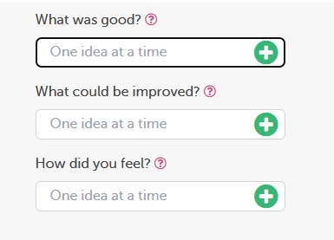
Tell your story: the process?

Slide 6
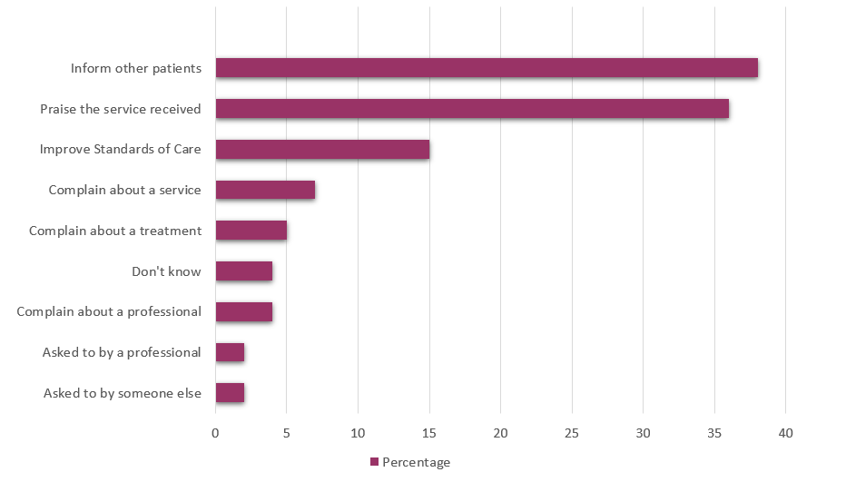
Why do people share their feedback online?
Source: Van Velthoven et al, 2018

Slide 7
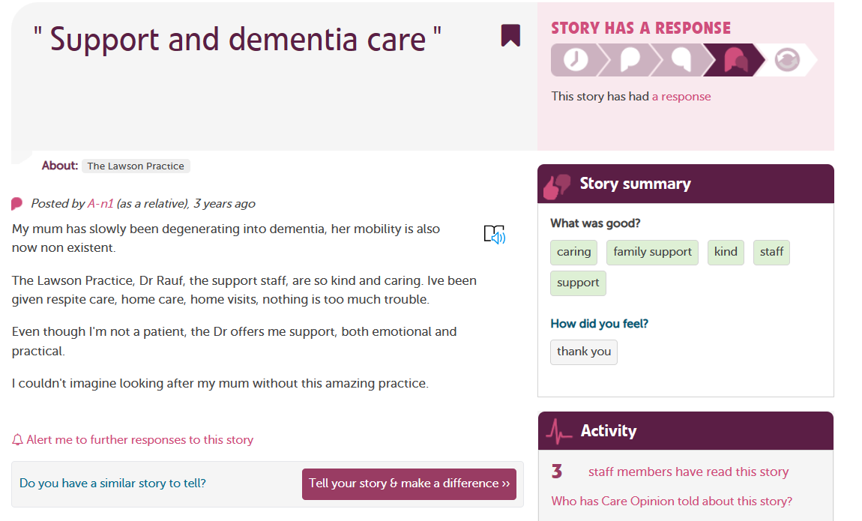

Slide 8
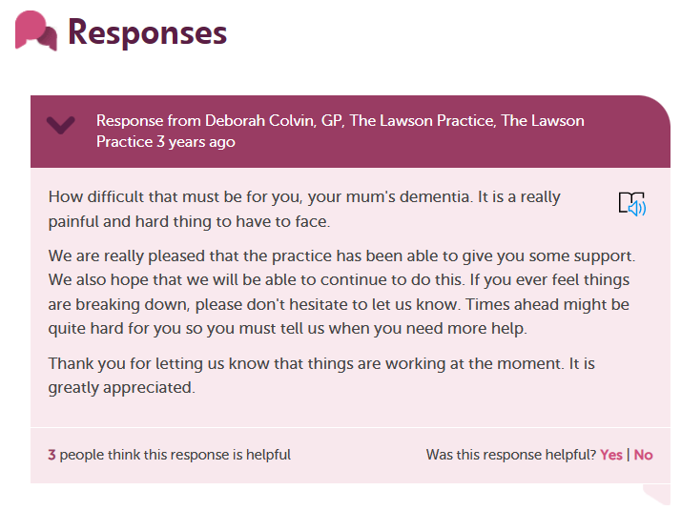

Slide 9
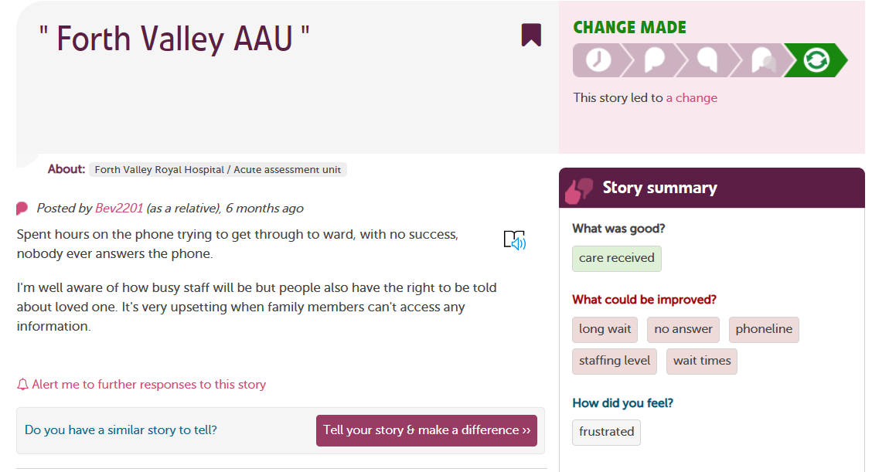

Slide 10
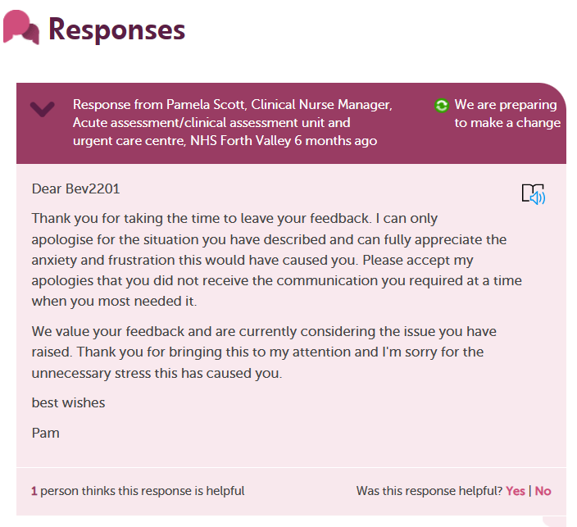

Slide 11
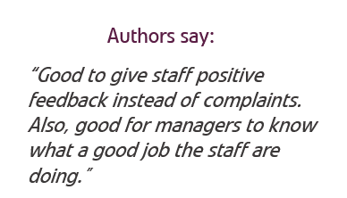
The power of people’s stories – The ripple effect

Slide 12
Key Feature – Bookmarked Stories

Slide 13
Key Feature – Invitation Links
One of the simplest ways to invite people to share their stories on Care Opinion is just to provide a link to the site.
Care Opinion has this feature built in and is called “Invitation links“
What does an invitation link do?
An invitation link allows you to:
Create a bespoke link(s) about the service you work in
Choose between different work-flows on the Care Opinion site: kiosk links or QR codes to share with people using services
keep track of which stories came via which invitation links, and run reports and visualisations easily
Combine with Friends & Family Test (FFT) question & even link out to an additional survey!
More information about Invitation Links

Slide 14
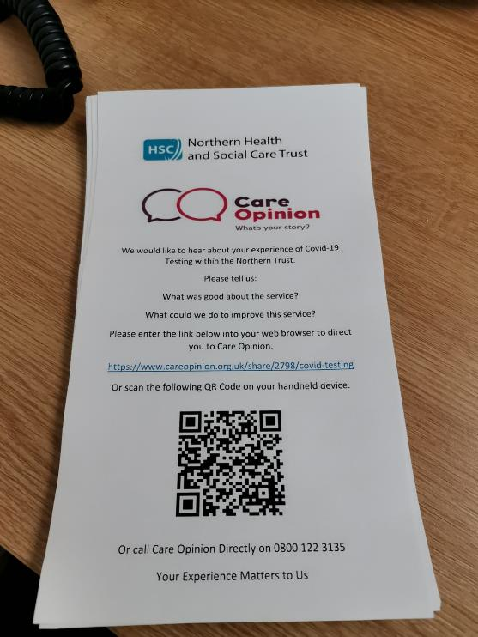
How can I use an invitation link?
Invitation links can be added to most correspondence
that you have with patients and/or service users.
Here are some ideas:
Emails
Texts – appointment reminders etc
Letters
On staff email footers
As a QR code on posters & leaflets
Social Media
On a tablet or Ipad

Slide 15
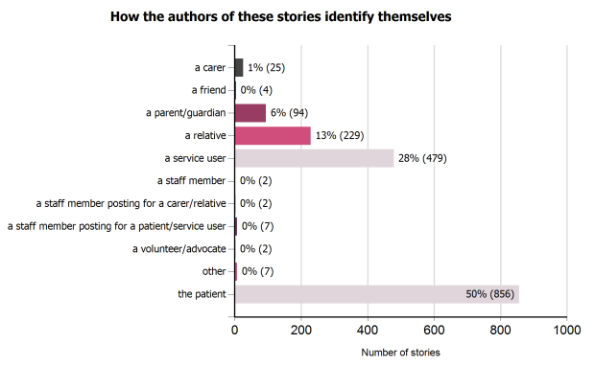
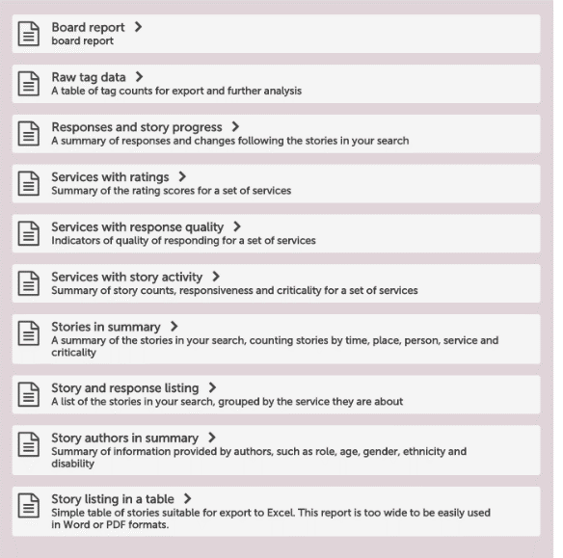
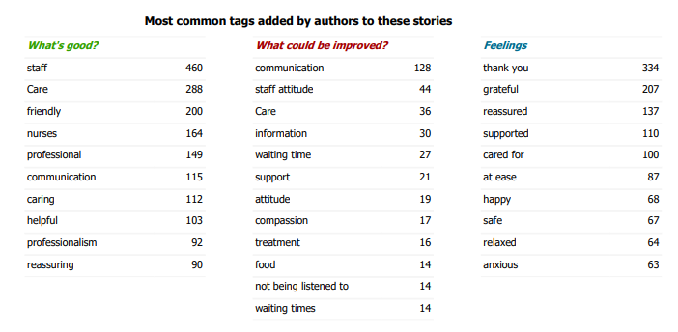
Reports

Slide 16
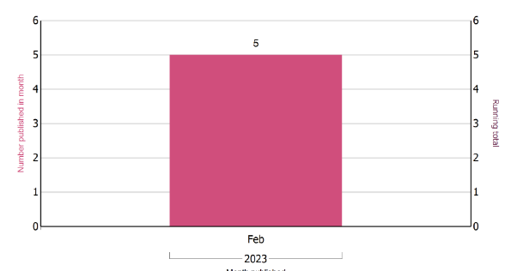
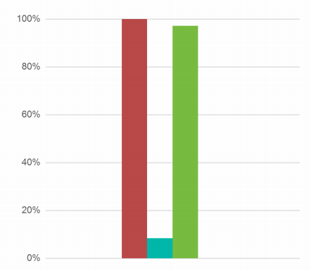
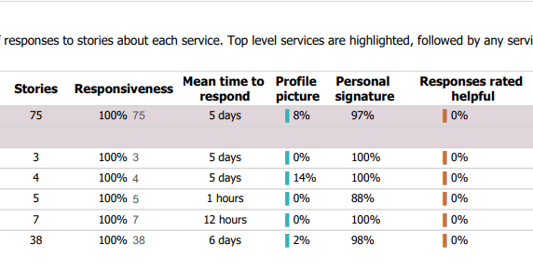

Slide 17
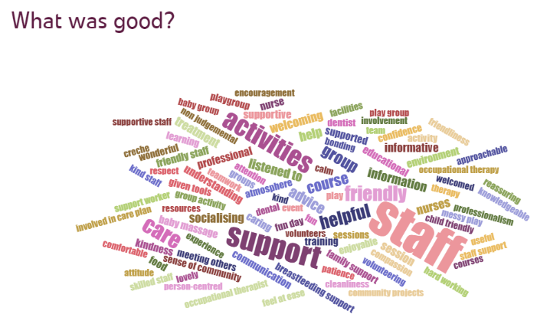
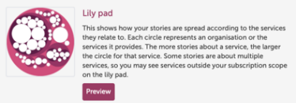
Visualisations
From your searches, you can create and display information in a variety of ways, including;

Slide 18
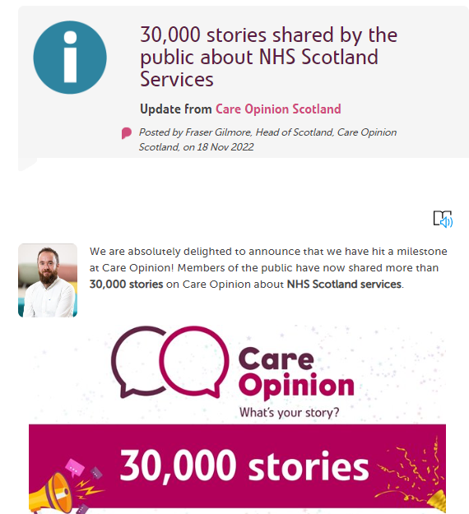
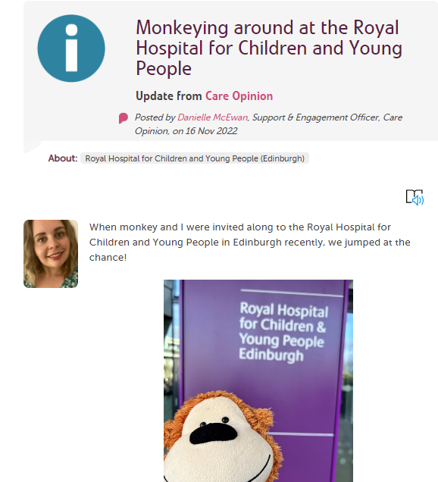
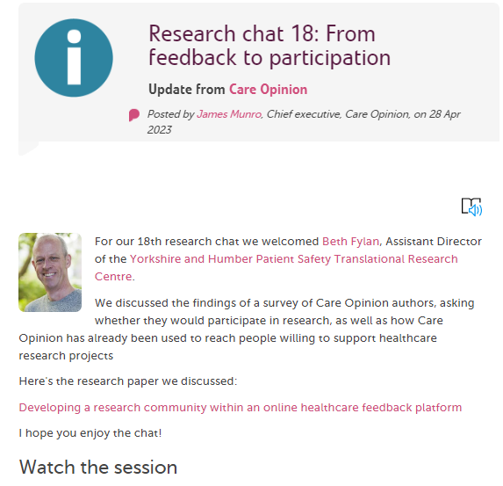
Blogging

Slide 19
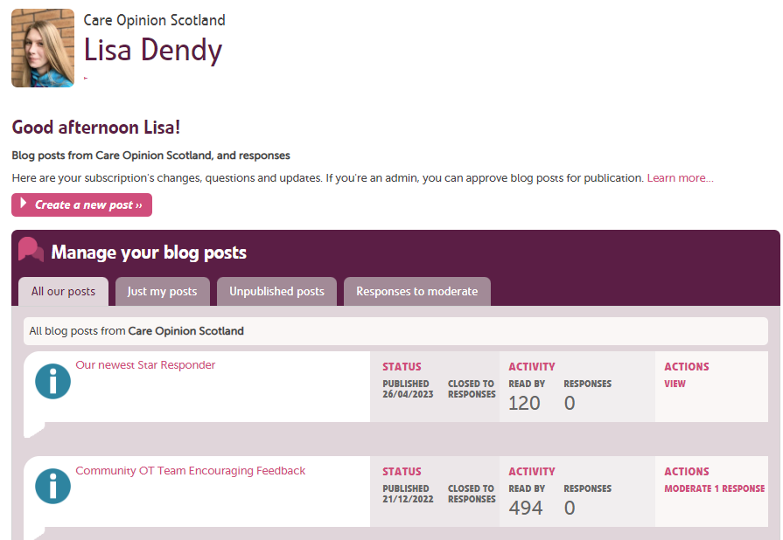
Create a new blog here

Slide 20
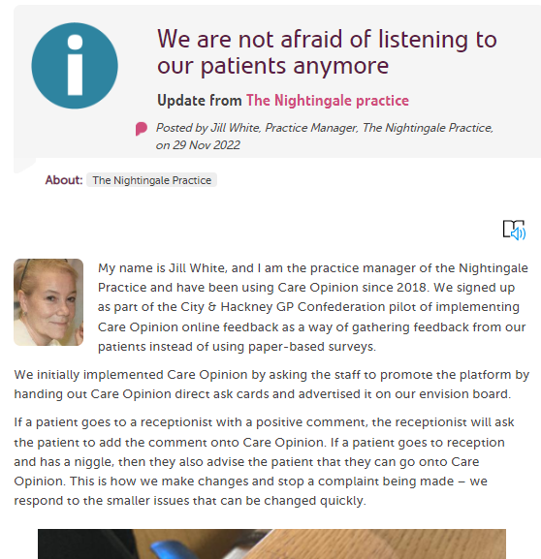
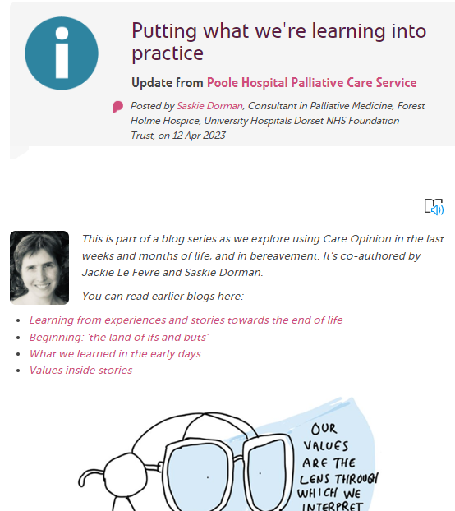
Examples of Subscriber Blogs on Care Opinion:

Slide 21
Subscribing to Care Opinion
This Care Opinion Conference is there to share the innovative work of our Subscribers and Research Partners. We hope it's been helpful to you and perhaps inspired those not already working with us to explore ways to get involved. All queries welcome!
https://www.careopinion.org.uk/info/all-about-subscribing
subscriptions@careopinion.org.uk

