Slide 1
Care Opinion: The impact of listening at Devon Sexual Health Service
April Brooks
Lead Nurse

Slide 2
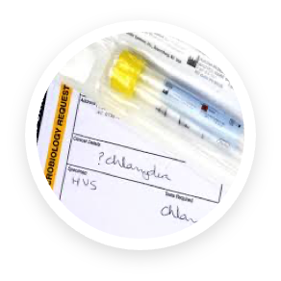
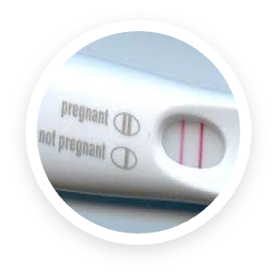
Devon Sexual Health
Notes:
Sexual health ‘invisible population’ – frequently underserved and unheard
Confidential service ‘sexual health patients don’t complain’
Large clinic population – big service!

Slide 3
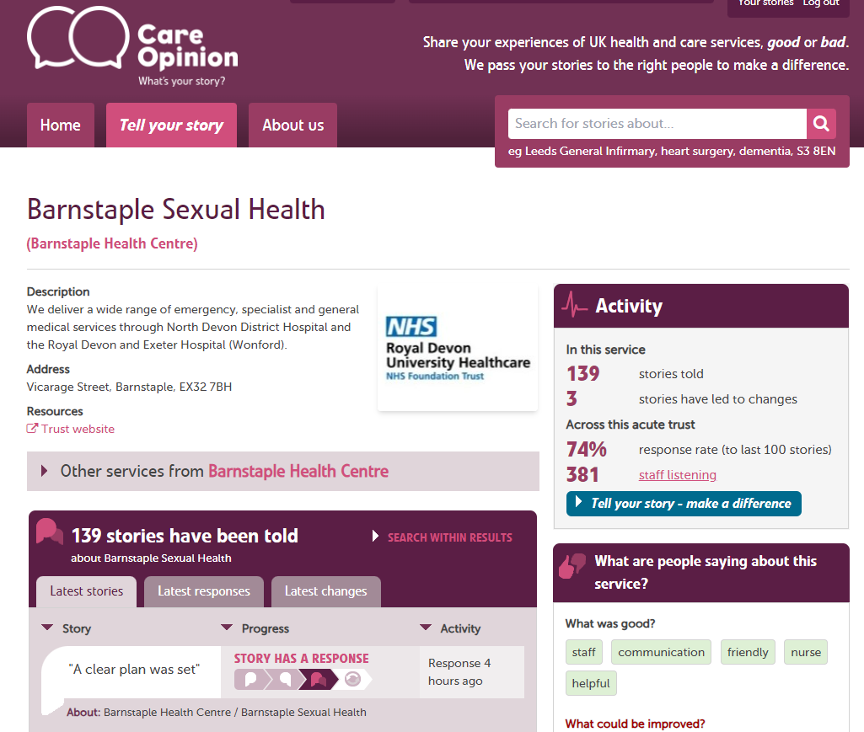
We value patient feedback
Notes:
Family & Friends test feedback
Thank you to Lisa Townsend, RDUH Patient Experience Feedback Lead – made process easy
Utilised text option via EPR to seek feedback from patients
Care Opinion started in the service in September 2023
To date: 275 via Exeter, 139 Barnstaple

Slide 4
Impact
Staff
Patients
Service
Notes:
Staff: CPD, positive engagement about their work. Make time to read and provide feedback – monthly round up.
Patients: clearly keen to provide feedback. Made it easy to do via text / online system – no paper and pens! Nerve-wracking to attend for the first time – can see what other patients say. Feedback about service changes – e.g. online booking system
Service: Governance reporting, in-house and to our commissioners. Identify local themes (e.g. difficulty accessing services via GPs). Comparison to other services in UK (students). Social media positive messaging. Notice board in waiting room.

Slide 5
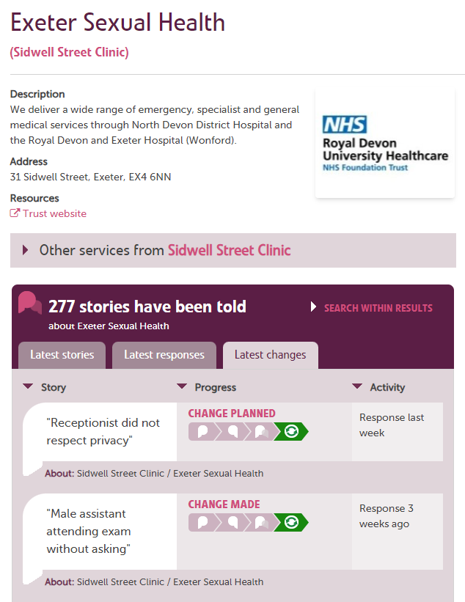
Service Improvements
Notes:
Engaging with patients and listening to their voices has made our service better:
Appointment booking
Consenting and how this is managed
Procedure information – improved PIL

