Slide 1
Looking at care opinion from both sides
Anne Cooper
NON-executive director
Care opinion

Slide 2

My experience of responding to feedback
Notes:
Tend to be defensive, the no apology apology, investigate facts but pay little attention to feelings, overly focussed on the negative.
Don’t say ‘I’m sorry you felt that way’
Don’t say ‘your experience doesn’t tally with the facts’

Slide 3
Can feedback give insights?
‘Unsolicited web-based ratings of care, though potentially prone to many biases, are correlated with surveys of patient experience. They may be useful tools for patients when choosing health care providers and for clinicans to improve the quality of their services’
Greaves et al 2012

Slide 4
Is it valuable?
‘Patients who offer unsolicited opinions about their care may be providing richer feedback’
Greaves et al 2012

Slide 5
Responding to feedback
‘Organisational responses can have profound implications for public inferences of trust, perceived responsiveness, organisational reputation, consumer satisfaction and further complaint behaviour’
                Baines et al 2018

Slide 6
How to respond
Who
Title
Thank you
Address concerns
Signpost to specific information
Sign off properly
From coproduced Listen, Learn and Resopond Framework, Baines et al 2018

Slide 7
What to do with what you learn
Believe it can make a difference to listen
Empowered to make changes
Positive change culture

Slide 8
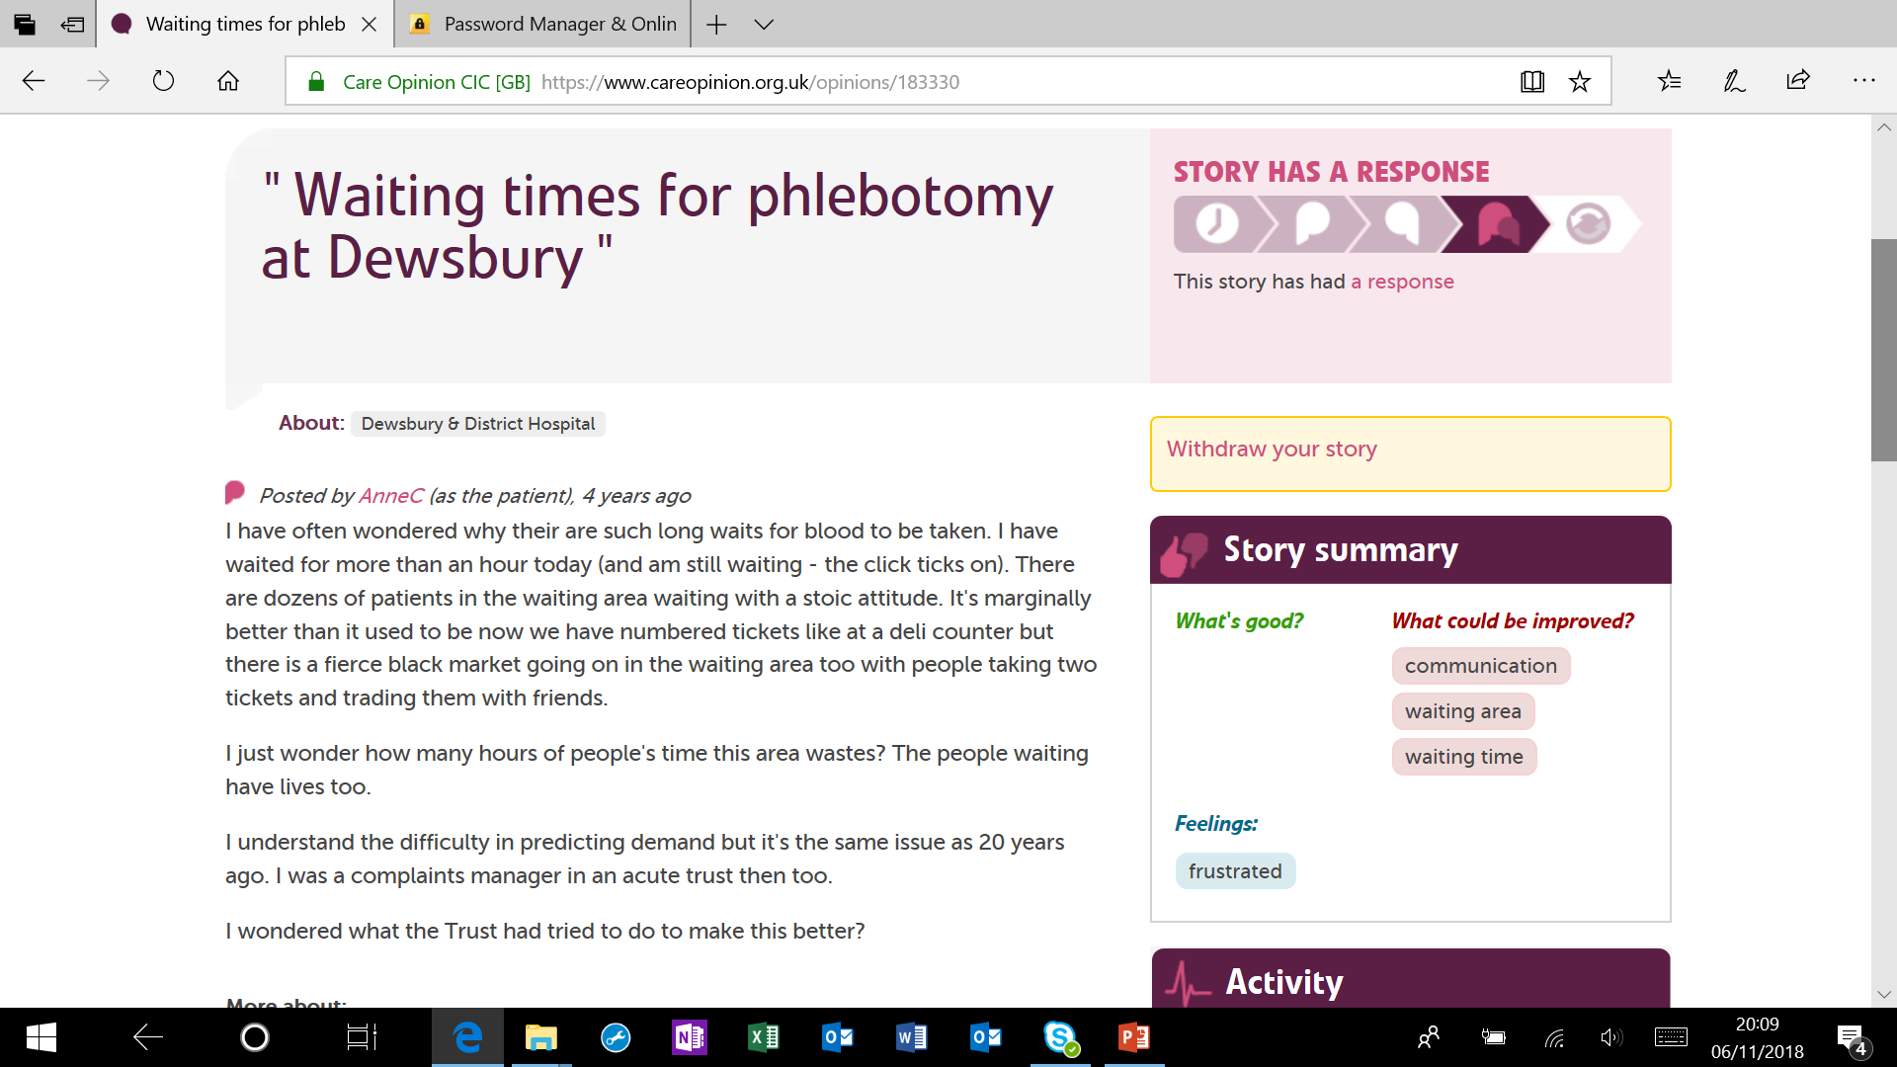

Slide 9
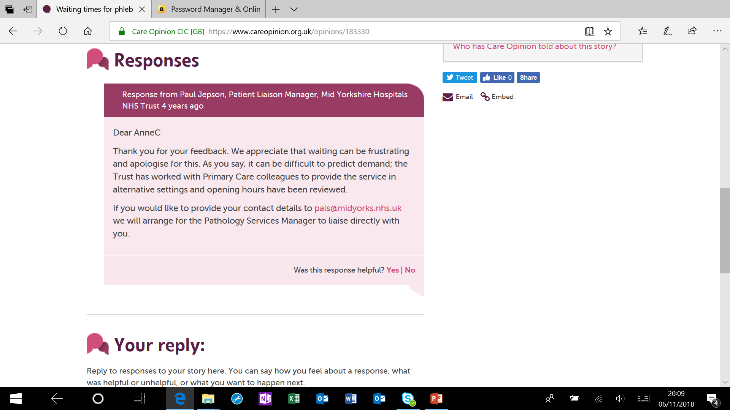

Slide 10
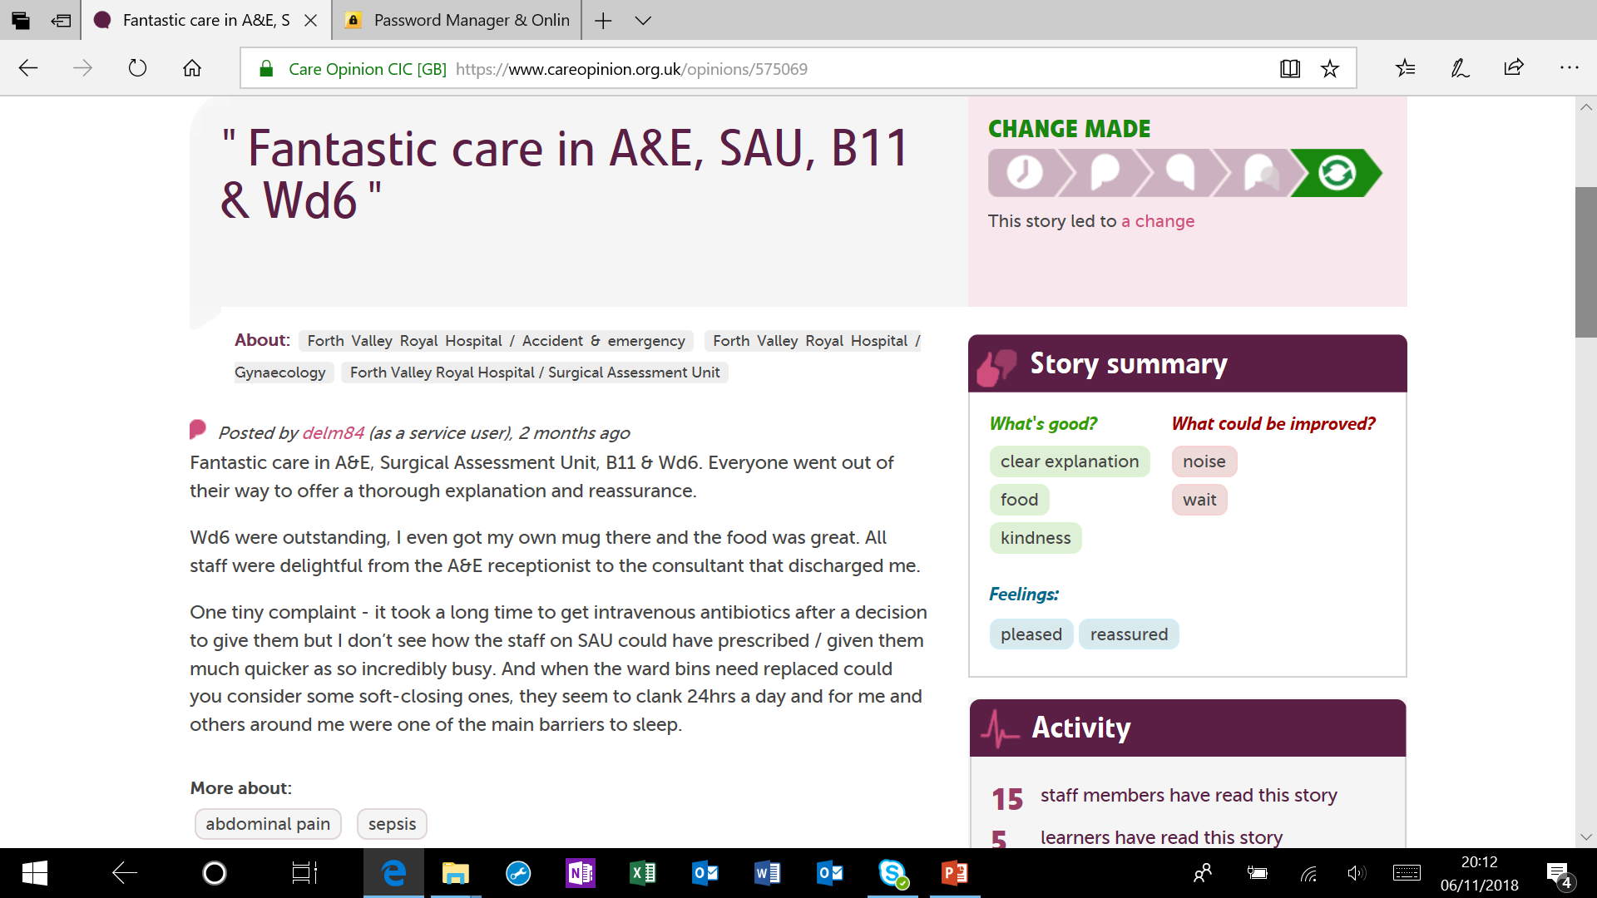

Slide 11
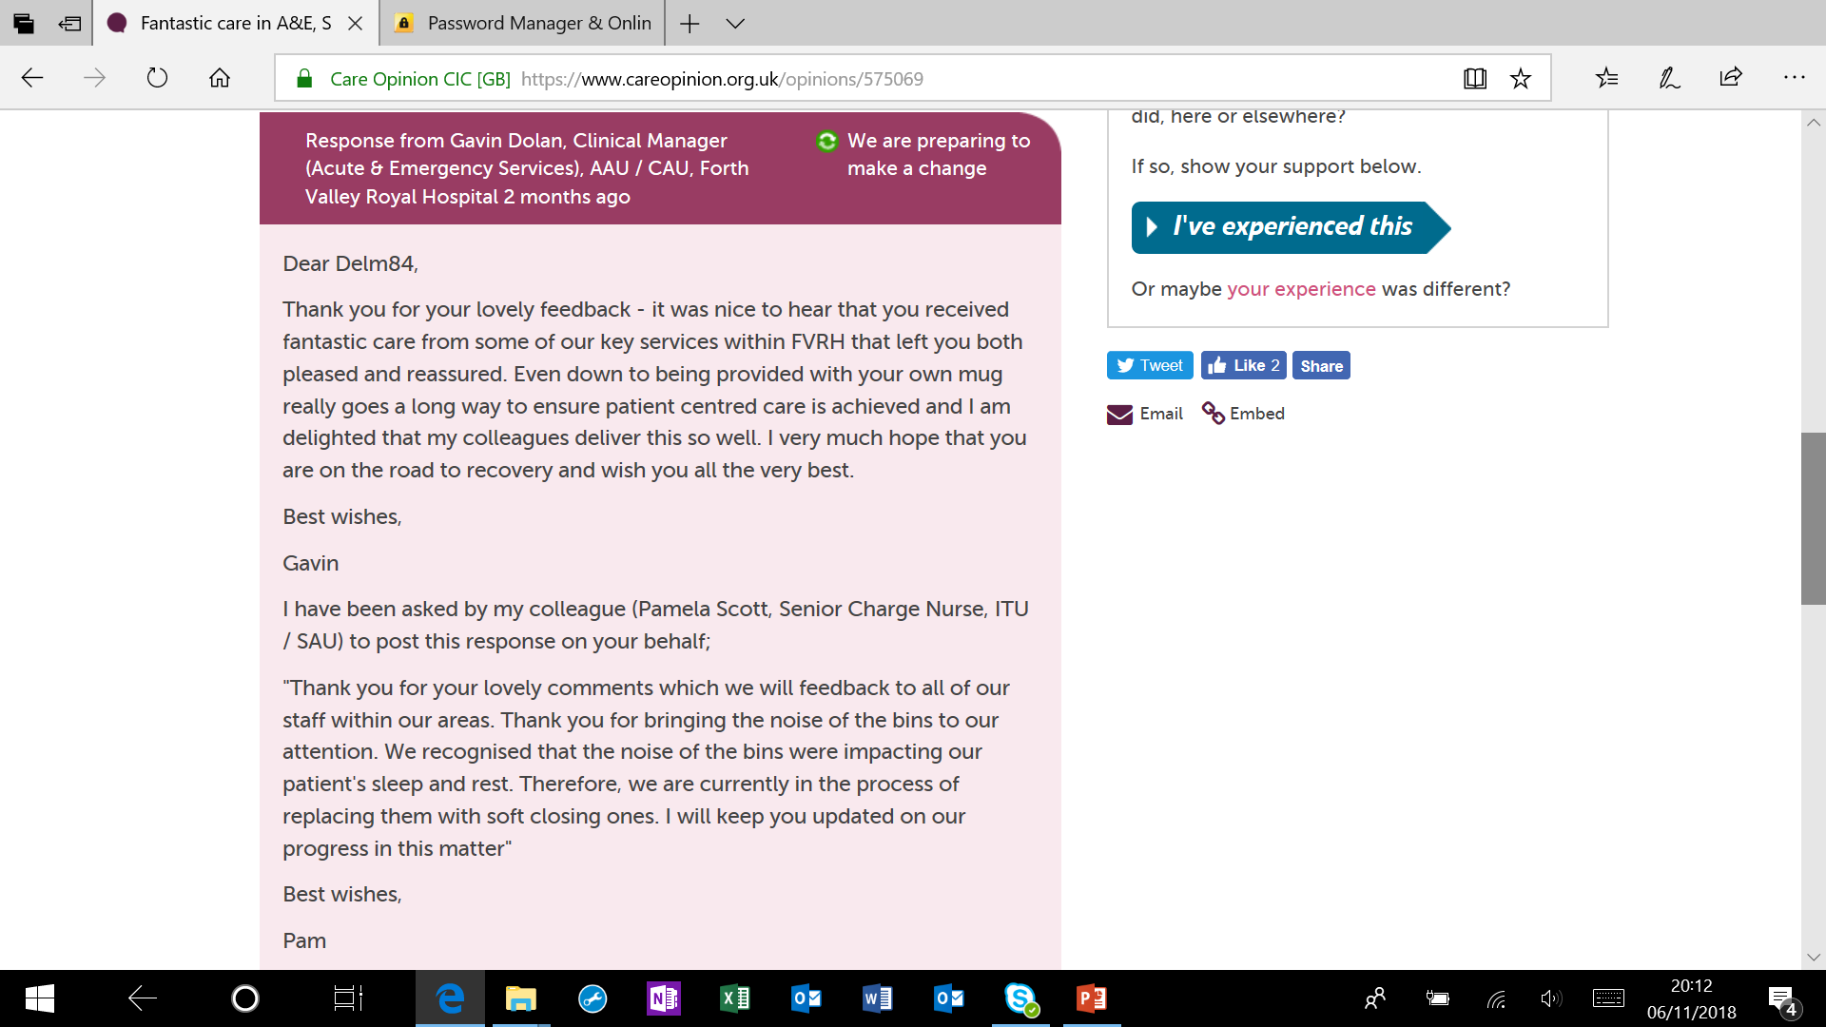

Slide 12
Thank you
@anniecoops
www.anniecoops.com
anne@ethicalhealthcare.org.uk

