Slide 1

A decade of online feedback:
Nottinghamshire Healthcare
Amy Gaskin-Williams
Deputy Head of Involvement, Experience and Volunteering
Notes:
Introduction to me
Notts Healthcare – big, MH predominantly, also physical health and a large Forensic MH division
In keeping with the spirit of CO, I’m going to take you through our ten years of working with CO as though it were a story – which it surely is!
An interesting side plot is that I worked for PO at this point in the story. I moved over from PO to Notts Healthcare in 2013 (four years into the story), having worked closely with the Trust in my role supporting mental health Trusts. I tell you that firstly because I’d feel guilty taking any credit for what the Trust achieved in those first 4yrs (!) and secondly because I arrived at the Trust with a real enthusiasm about CO, which has not waned one jot. As an outsider and then as an insider, I could see Care Opinion’s potential and have been able to contribute to the success we’ve had since.
So, once upon a time..

Slide 2
It was 2009.
Notts Healthcare were intrigued about Patient Opinion but just a little apprehensive…
Complaints, PALS and a survey
  Nothing public
  Didn’t get a response from anyone in the service
  Lord knows the impact, particularly on culture
  Very formal – rarely received a response from the service
  Designed mainly for our convenience
CEO – ‘What happens if it goes viral?’
Head of Communications – ‘How will we control it?’
Services – ‘How will we respond to everything?’
CO felt agile, technologically advanced, supportive of us and focussed on people’s stories and exciting – but it’s easy to be faddy
We wondered how patients, and their families and carers, would use Patient Opinion
Notes:
Stuff on slides
Took advantage of the NHS England funded two year subscription for all mental health Trusts.
It’s obvious to me now that the Trust would have paid for a subscription from the get-go, but the funded subscription came at the right time – there was really no excuse not to make the most of it. Don’t want to say much about cost – but we now renew our contract annually without a second thought, it is worth it, without any doubt.
Ultimately the decision taken by the Trust was based on: People are saying this stuff anyway - CO let us in on it, delivered it to our inbox, themed and packaged it for us in reports, allowed us the opportunity to respond and it was all supported by a team of skilled staff who will help you through anything difficult. It ended up a no-brainer and as I said, continues to be.

Slide 3
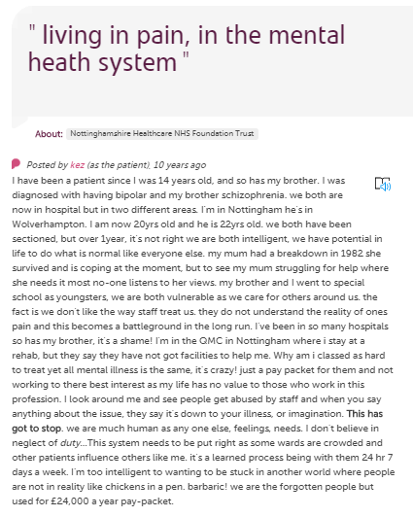
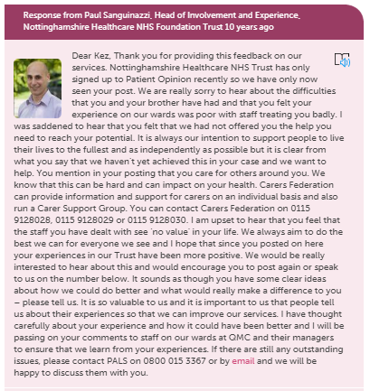
Off came the Trust’s shoes and socks, and with a palpable excitement, in the deep end they jumped!
Notes:
Where does our story start:
This was one of our first postings. We weren’t eased in with a gentle posting about an appt running 10 mins late. ‘Like chickens in a pen, barbaric!’
The Trust responded – as warmly, openly and helpfully as we knew how to do then. This would receive a very different response now but we’re not too proud to say that we’ve learned a lot about responding in 10 years.
Mike (CEO, paid and gave it some profile)
Julie (reputational protection, advice on responding)
Sandra (clinical services, to consider how to promote to patients and to set the standard for how services respond to and use feedback)
Jane/Paul (leg work, manage, promote, sell it hearts and minds to services).
Jane deserves a special mention – dynamite, never lost an ounce of her enthusiasm.
Being NHS-y about it (cautious – ‘pilot’, over-controlling, stuffy and hierarchical)
The Trust wrote protocols, had plans (communication plans, how we’ll respond plans, progress plans), added just a few people to start, advertised through posters/on letters. Some of this was helpful, some of it has gradually or fairly quickly got ditched.
Added a few people to the subscription
We got the logo on anything we could
We did the internal comms campaign to staff (intranet, reports, meetings etc) and we started to tell patients about it.
First Trust to use CO in a secure forensic setting (second to use CO in inpatient MH setting)
No time to take you through the whole story, and those who know me in the room know that brevity is not my strong suit, so to save you all from post-lunch boredom, we’ll just focus on some of the most memorable chapters from our story…

Slide 4
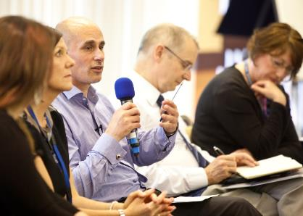
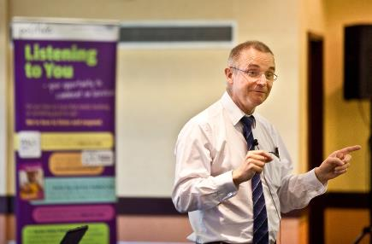
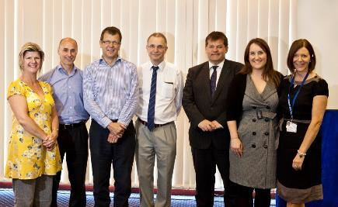
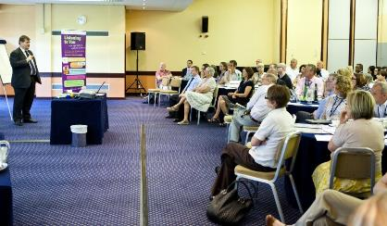
Chapter One: Early impact.
Notes:
2011. This was important because it took stock of what the Trust had achieved in the last two years, it brought together everyone who’d had anything to do with CO, it allowed people the opportunity to collectively share what they loved about CO and what help they needed to use it more effectively, it praised and recognised the people who’d had real success, it taught people about new features they’d not found yet and it introduced people to the CO (then PO) team.
Opened by our CEO, it also showed his and the Board’s commitment to CO.
CO was really gaining traction in the Trust by this point. This event galvanised staff and really demonstrated that CO was a great reflection of our organisational culture – of being open, responsive, having integrity, being accountable to patients and caring about their experiences.

Slide 5
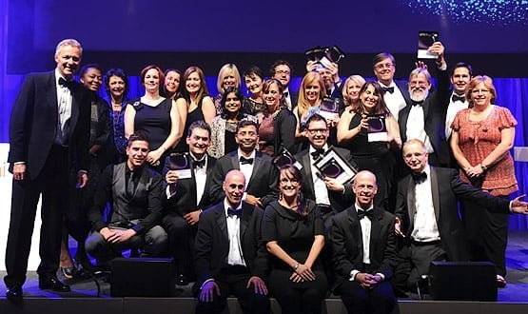
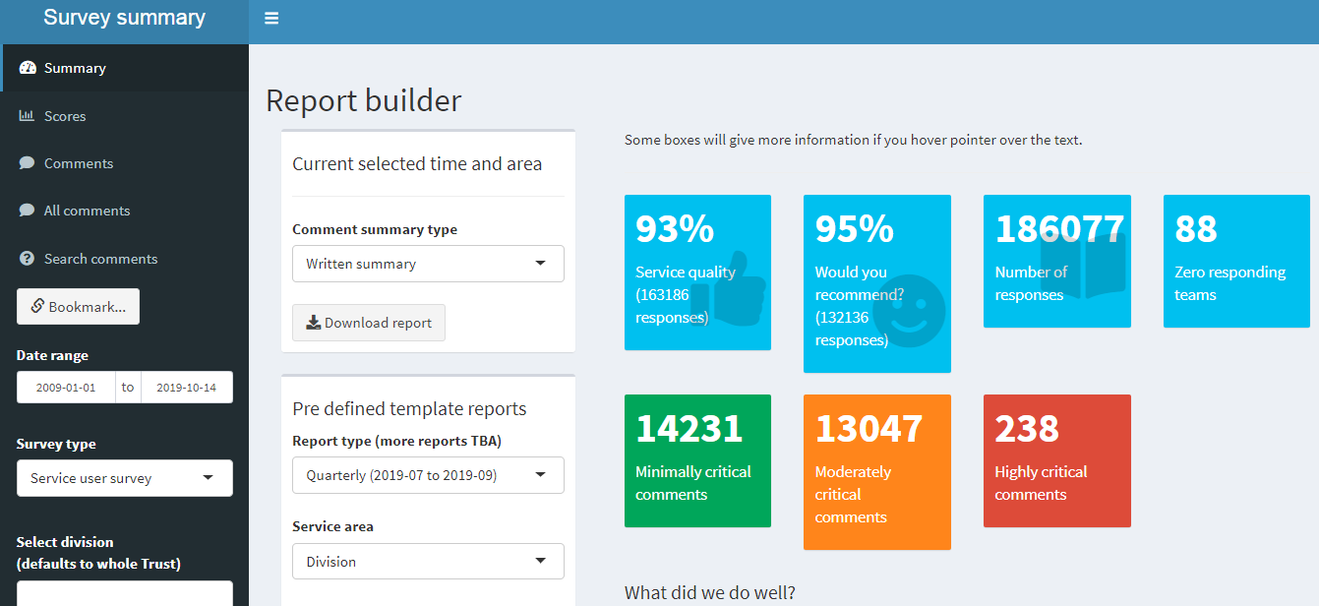
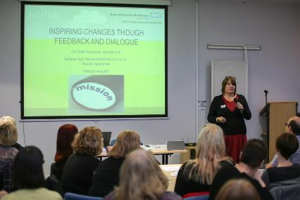
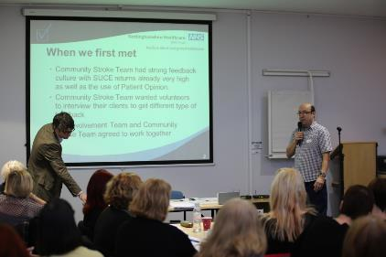
Chapter two: The Patient Feedback Challenge.
£1m fund from NHS I - 90+ organisations vied for the fund – Notts Healthcare, in partnership with CO, were one of the nine successful organisations.
Ten exemplar teams - capturing, sharing, responding/acting on, sharing what’s changed
Built Your Feedback Matters website
“It’s a real boost to our vision that patients and carers’ voices can get to the heart of healthcare more than ever before”
Also in this year, we hit our 500th posting – and at about the same time, we realised numbers are not a problem if you’ve shared the responsibility for responding
Notes:
2012. PFC: National Challenge, £1m fund from NHS I. Over 90 organisations applied with projects ranging in cost and scope, Notts Healthcare in partnership with CO and the EMLA were one of the winning 9 Trusts.
Two aspects:
Inspire and support 10 teams (varied in nature) to become exemplars in either: capturing, sharing amongst their team, responding and acting on, sharing what you’ve done as a result
Built a devoted feedback website for the Trust, on which we published every bit of feedback we had (including pulling across CO postings), within the month it was received, analysed coded and themed – the first in the NHS (we think) and possible still the only. The website was responsible for our 2013 National Patient Experience Award.
1ST wave – Feb 2012: we selected the 10 teams
Year long project, loads of great stuff, held a big celebration event
2nd wave – Feb 2013: we selected some teams (for reasons), but most asked to be part of it
3rd wave – Feb 2014: we had 17 teams come forward wanting to be part of it! It had become a movement, something teams wanted a bit of.
We then made this our way of working with teams, rather than treating it as waves.
The website was a big hit, immediately. So much development since, we’re now integrating staff experience with patient experience, we can analyse almost anything, we can build custom reports. It’s amazing! We’re very proud.
All of that, lead to:
2013 E-Health Insider Awards – Best use of Social Media in Healthcare (my first week at Notts Healthcare!)

Slide 6
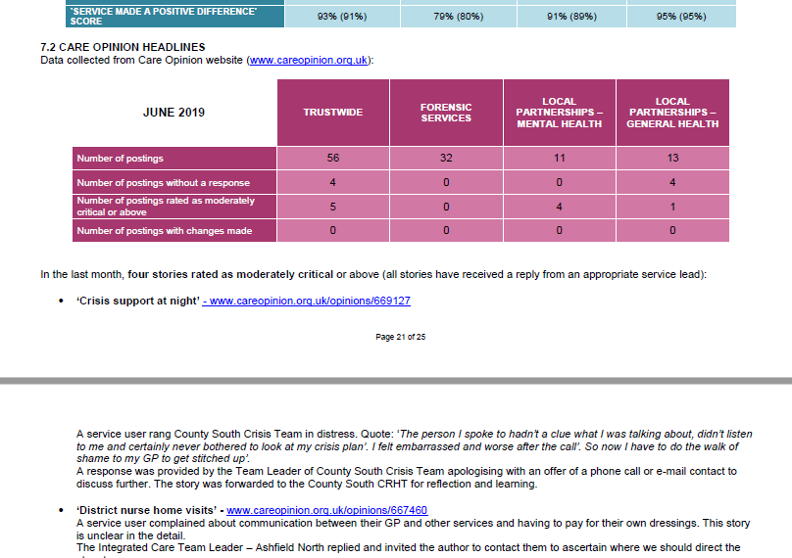
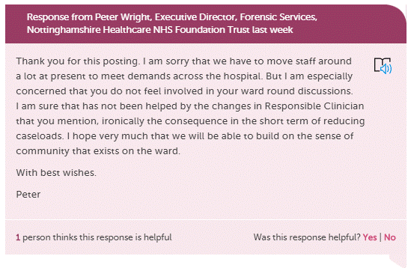
Chapter three: The Board.
Notes:
In 2015, we improved how all of the Trust’s feedback was reported to Board. We were a bit tired of how they focussed on tiny little movements from 92% on one thing to 94% on another, and on quantity not content of feedback. We weren’t helping by presenting mainly numbers.
We created the Patient Voice report – a 15-20 page report that goes to Board every time they meet, which summarises the feedback about one area of service each time and also gives headline info for the Trust in general. It includes a large section on CO – both the stories from the service we’re focussing on, and stories for the Trust (the most critical, the most noteable, those that have lead to a service change).
Standing item at every BOD meeting (screenshot of report – happy to share)
We used this development to educate the Board about CO, by running a Board Development Session on CO and other mechanisms for feedback, and now most execs, CDs and GMs have reports/digests – some respond.

Slide 7
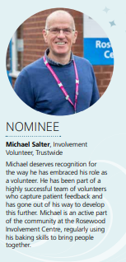
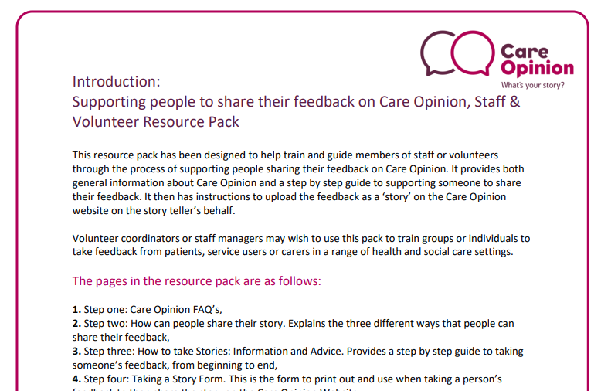
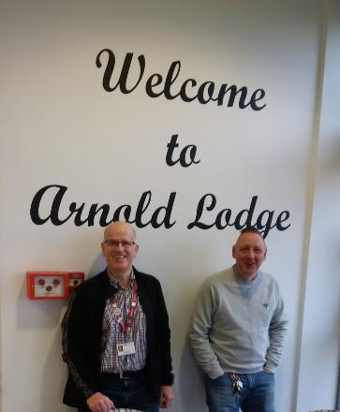
Chapter four: The value of volunteers.
Our service user and carer volunteers capture richer, more detailed and (we think) more honest feedback than via any other method.
…and it’s a win-win, because our volunteers love doing it.
Notes:
From the beginning, we involved volunteers.
Volunteers capture stories, help to get the message out to patients, take handfuls of PO forms everywhere they go, spread the message about this as an opportunity to say what you want to say, in your words, published as is, responded to by our services. They continue to be huge advocates for CO, and are now requested across almost every area of service to help capture people’s stories.
We have found that it is a skill – not all volunteers are built for the task, and it would be a mistake to think that they were. We have a role profile for a patient experience volunteer, and initial training, plus a 6-8 weekly check in point for them to talk about what they’ve heard, any difficulties, debrief etc.
CO volunteer pack.

Slide 8
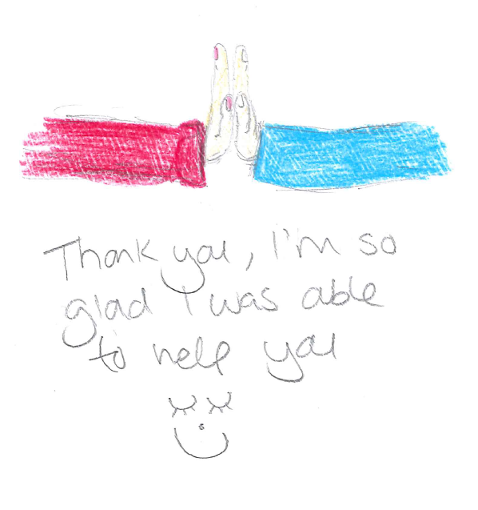
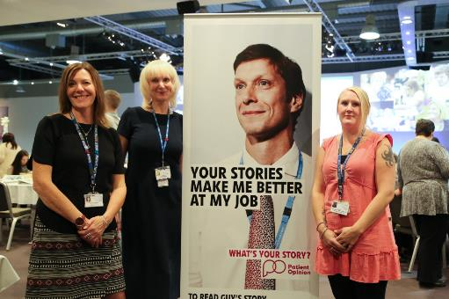
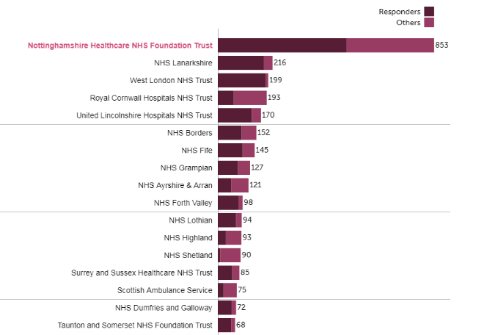
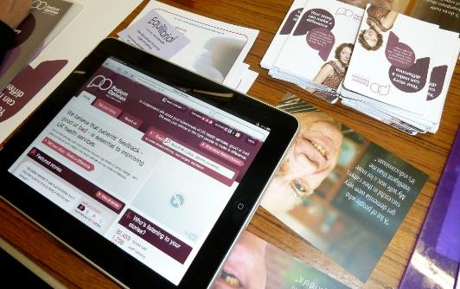
Chapter five: Supporting our staff.
Notes:
Mandatory staff induction
Bands 2-4 programme
Vision 21 middle management programme
Leadership Council (James has been keynote speaker twice)
Nurse Preceptorship Programme
Board Development Session
Governor Development Session
Bespoke training we run most months for teams
Training we provide to our involvement and experience champions
Team away days
This is not a small task. Jane has the tenacity of collie, so she gets out there as much as she can, and spreads the good word.
It is worth it. I would have been daft not to show this graph… (it’s our favourite!)
We have confidence that our staff know what we expect of them in responses, and they know they have our support. We have loosened the reins right off, and just encouraged people to be human in their responses.
Protocols were replaced by guidelines (two working days, if it will take you a while to get a full answer then first acknowledge, respond constructively and compassionately, attribute the response to a person – that’s it). It’s working for us and it’s become a lot more manageable for us as a central team.
Showing off about the graph of highest number of responders is one thing, but they could all be crap! The real win is when a member of staff uploads a drawing to a posting by a child, where they draw about how much they love their nurse. That’s when we know the training paid off.

Slide 9
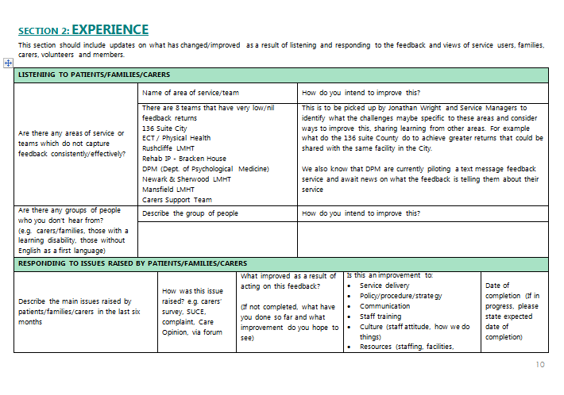
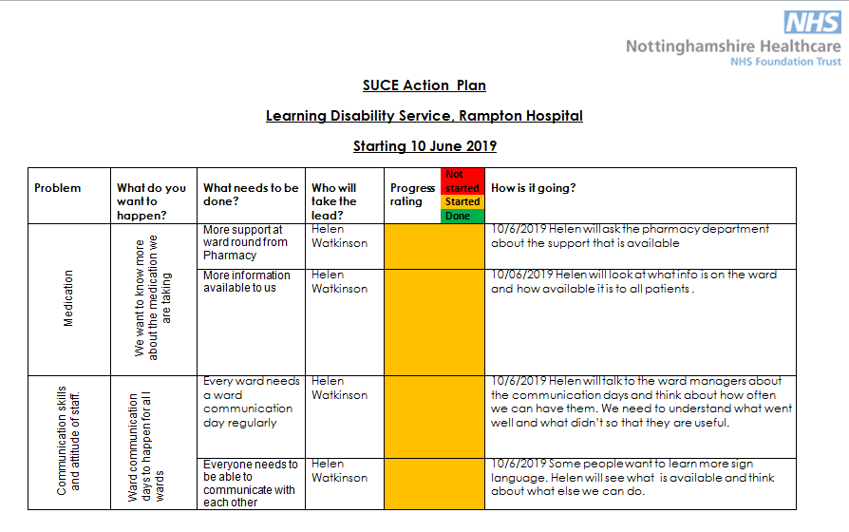
Chapter six: In search of evidence.
Notes:
If you’re collecting feedback and then leaving it in a cupboard, you’re doing it wrong.
All our services send a report to us every six months declaring what they’ve heard, how they’ve understood the feedback and what they’re doing with it. The reports are initially received by us, we give the services our feedback on the content (and also on how they’ve put the report together) and then they are scrutinised a bit further by: IEV forum to which service users/carers attend, and Quality and Risk meetings – which hold the services to account for the actions they declare they’ll take.
Some services also have a rolling SUCE (acronym) action plan which they keep up to date with what they’re hearing, what they’re planning to do, how they’re getting on with it. That makes writing the report every six months much easier but also means that nothing waits six months to be actioned.
Of course, on CO there is an expectation that services respond publicly, which is better still, and as you saw, all the figures on stories received, themes, changes is reported directly to Board.
The IEV reports going into forwarding reports to our Board and top level committees – so there is a good understanding at all levels of what patients, families and carers are saying and importantly, how our services are being influenced by their experiences.
This might all sound quite heavy handed but actually, it’s fairly low effort for large gain. If you imagine that this was information on clinical outcomes or patient safety (the other corners of the Holy Triangle of good healthcare), there would be an awful lot more governance. We think the balance is good.

Slide 10
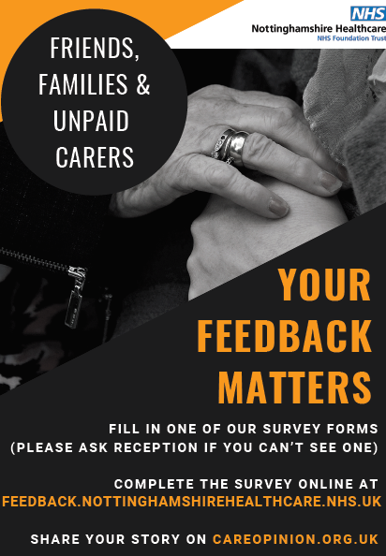
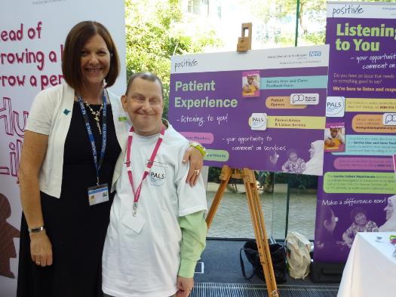
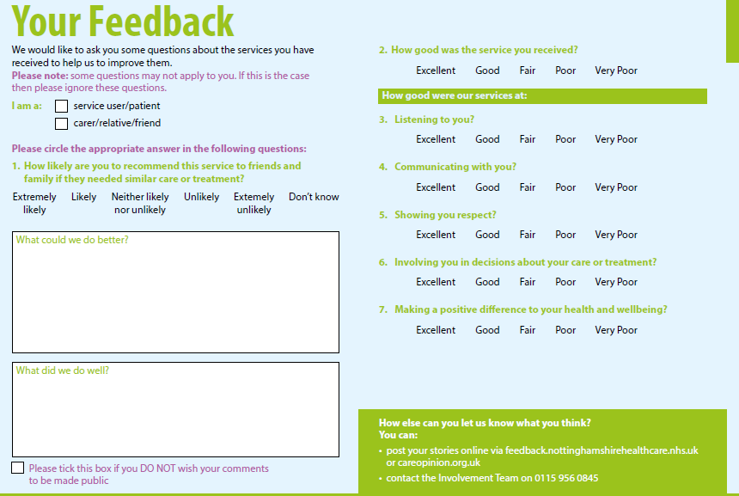
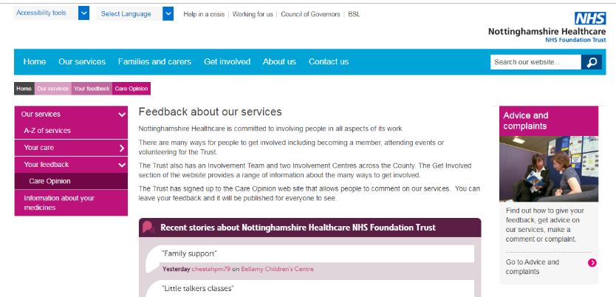
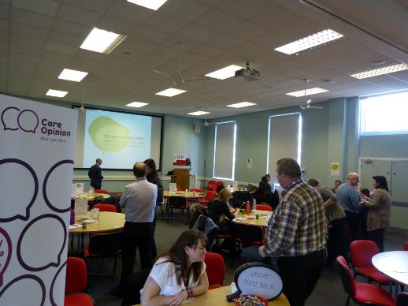
Chapter seven: Shouting it from the rooftops.
Notes:
This doesn’t need a lot of explanation: get CO on everything!
Posters, note on our surveys, all over our social media profiles, ‘Your Feedback Matters’ cards, on exit questionnaires, on appointment letters, on patient information, on the walls!

Slide 11
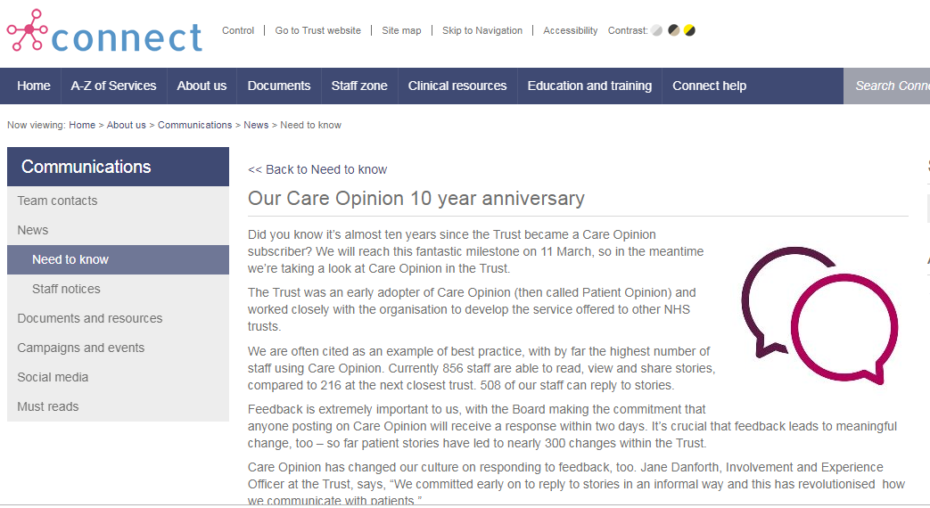

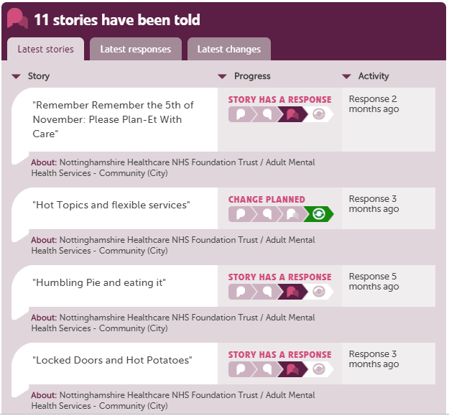
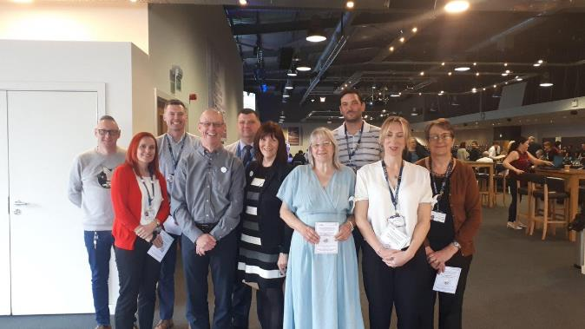
Chapter eight: The Ten Year Anniversary.
Notes:
2019. A real celebration.
Ten blogs, from people around the Trust, talking about what they’d learned in 10yrs of working with CO.
We devoted an entire Leadership Council to patient experience, at which James was keynote. We asked our 150 top leaders to make commitments to how they would do more with patient experience and we’ve seen a really fantastic spike of interest – particularly from clinical leaders, who’ve evaded us a bit over the years, toughest nut to crack.
We ran a CO masterclass the same afternoon – to upskill those people who use it most. That included people from our Quality Improvement Team who are really starting to use CO as part of how they understand patient views and issues that might need to be addressed through QI methodology.
We awarded ten CO heroes – who all received a CO pin badge and certificate, one missing from this photo but we got James in it instead!
CO dominated our Trust intranet for a week, with stories and photos of our CO heroes.
As an organisation, we took stock of what we’d achieved – which felt like a huge amount – and started to think about our next big moves with CO. It was a real celebration.

Slide 12
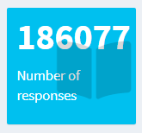
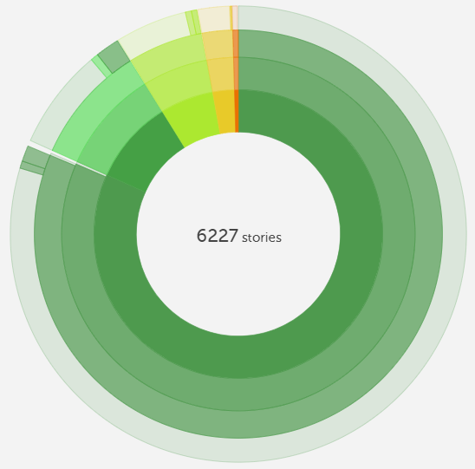
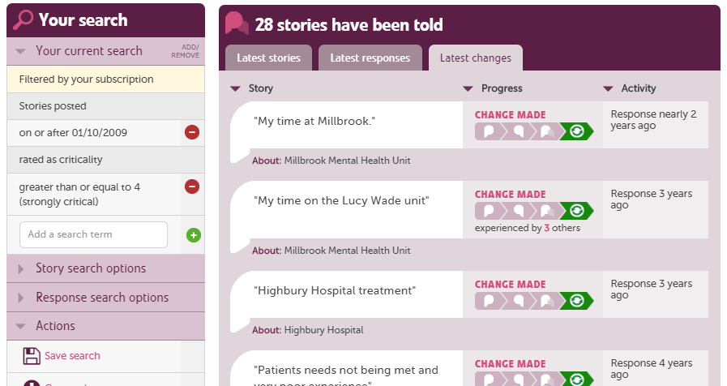
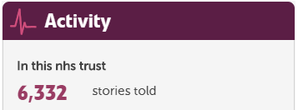
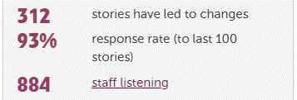
Notes:
In those 10 years
180677 surveys – and we’ve learned a lot from those
6,332 stories told – and we’ve learned more from those.
Because they’re public.
Because someone has to, rightly, take responsibility for responding to the person who shared their story.
Because they’re stories – they resonate more, people pay more attention to them, they feel more real, and people tell us the things we wouldn’t have thought to ask about.
Mostly positive, vast majority are positive. We work with very vulnerable people, some very angry people, some of whom we section and hold against their will. All of them have the opportunity to post – we’ve made sure of that. Even patients in seclusion in our high secure hospital are asked if they want to say anything and a volunteer helps to take their story. And we’re still getting this percentage of positives.
Those that are most critical all get responses, most have changes made as a result, and the sky didn’t fall in.

Slide 13
It is 2019.
Notts Healthcare are converts, enthusiasts and advocates for Care Opinion. But this is not the end of the story…
4yr Trustwide Patient and Carer Experience Review
Off-shoot QI project in IDD (LD) services
Automated language processing
Subscriber tagging
Large scale analysis of our positive feedback for learning
We want to be more courageous
Using CO as a mechanism to pre-empt CQC
Notes:
Still to come:
Trustwide Patient and Carer Experience Review – four year programme of work, CO is a major part of each of the five priority areas
Large off-shoot QI project to look at how we better involve people with IDD in decisions about their care and in providing feedback
Automated language processing – OK, so that doesn’t sound very sexy but it’s innovative
Subscriber tagging (CQC domains, for example)
Positives
More courageous sharing of critical stories (show next slide)

Slide 14
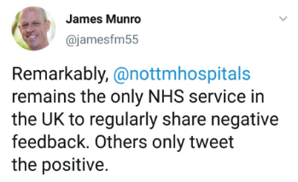
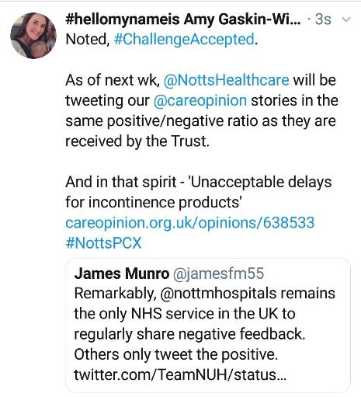
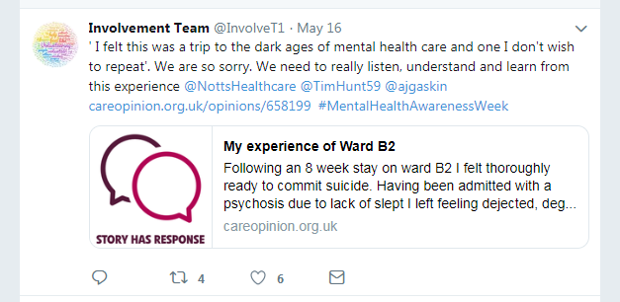

Slide 15
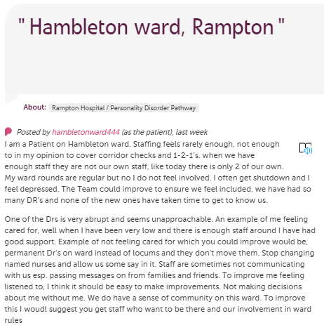
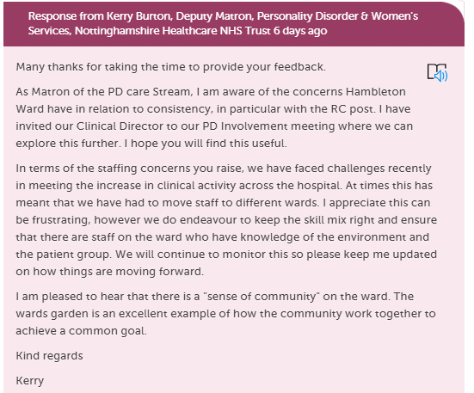

Safe | Do you feel that we have the right amount of staff on your ward to keep you feeling safe? | What things could we do to make you feel safer?
Effective | Are your ward rounds ran on a regular basis and do you feel involved in the meeting? | What could your Team do to support you to ensure you feel included ?
Caring | Can you give any examples of when you have felt the care you have received has been to a good standard? | Are there any examples of when you haven’t felt cared for and how can we improve on this?
Responsive | What makes you feel heard? | Is there anything we could do to make you feel listened to?
Community | Do you feel your ward has a sense of community? | What could be done to improve the sense of community on your ward?
What’s your story?
Notes:
Using CO to pre-empt CQC

Slide 16
Listen with the intent to understand
Don’t be too NHS-y (over-control, stuffy and hierarchical)
“I’m convinced that using Care Opinion over the last ten years has allowed us to be open and transparent in a much more progressive way than we would have been otherwise” – Head of Comms
Make the most of CO’s features – they make it easy
Carrot not stick
The freedom and speed of CO is so refreshing!
Keep talking about it – cultural change isn’t quick
Notes:
Listen with the intent to understand – NOT to respond/placate/tick a box
Don’t be too NHS-y (over-control, stuffy and hierarchical) - Head of Comms: “I’m convinced that using Care Opinion over the last ten years has allowed us to be open and transparent in a really progressive way”
Make the most of CO’s features – they make it easy
Carrot not stick – find the people who naturally arrive at this with the right attitude and aptitude, work with them, show the rest of your organisation what they’ve achieved
Freedom to CO that is so refreshing! Embrace that, it will make some of our archaic NHS systems look bad and cause us all to question them and ditch them for the greater good!
Keep talking about it – cultural change isn’t quick (quote on wall), including report to Board/Execs

Slide 17
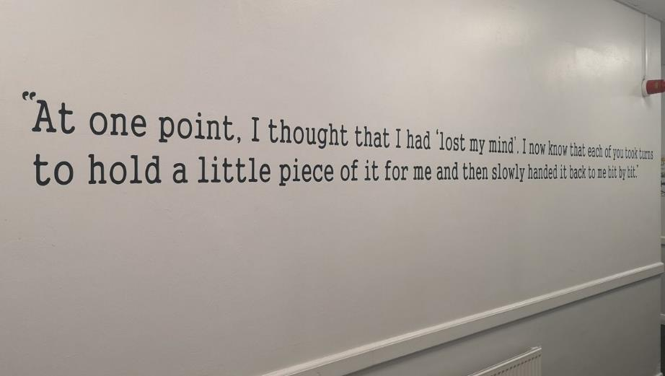
www.careopinion.org.uk/57597
Notes:
There will, in the next year, be a negative story on a wall in our Trust. Groundbreaking.

