Slide 1


Online feedback in Primary Care
Lessons from City and Hackney
Caroline Millar: Lay Board Member, C&H GP Confederation
Mercedes O’Garro: Deputy Practice Manager, Cranwich Road Surgery
Amanda Rayner: Deputy Practice Manager, The Lawson Practice

Slide 2
City and Hackney GP Confederation
A social enterprise since 2014 not NHS
All 41 practices are members
323k patients – universal coverage £1 per head
Delivering extended contracts
Service redesign/quality improvement
Supporting GP networks

Slide 3


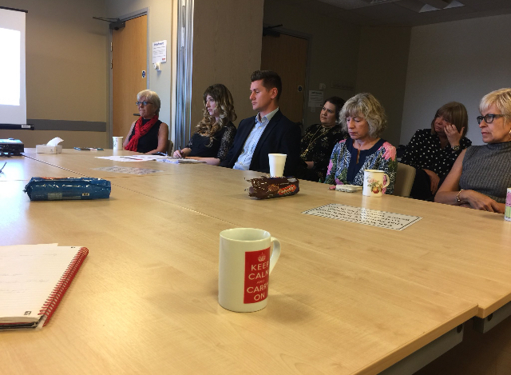
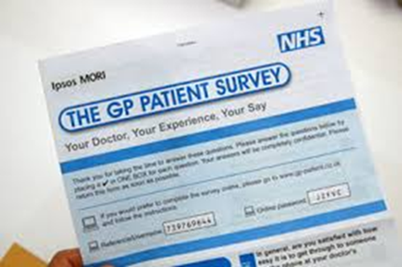
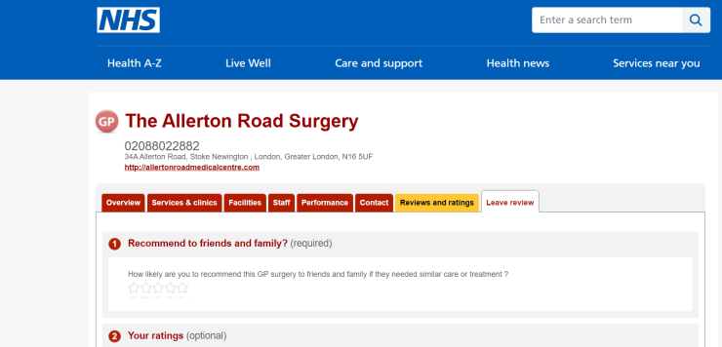
Piloting Care Opinion:
Why we wanted to try something new

Slide 4
Initial concerns in practices
No time or energy to take on something new
Anxiety about staff being identified
Perceived imbalance of power between patient and responder
Will increase complaints and damage staff morale
What’s wrong with NHS Choices?
CQC only looks at Choices star ratings

Slide 5
Care Opinion in GP practices in C&H – the pilot
Free to practices (fees paid by Confed)
Initial 6 months - extended to one year
11/42 practices volunteered for pilot
Senior leadership (Confed Board, GP leaders, Practice Managers’ Forum) on board
Significant support from Care Opinion: on call, webinars, email updates and encouragement
Care Opinion tools: widgets on the website, cards, posters, screen images etc
Regular reporting from CO to practices and Confederation

Slide 6
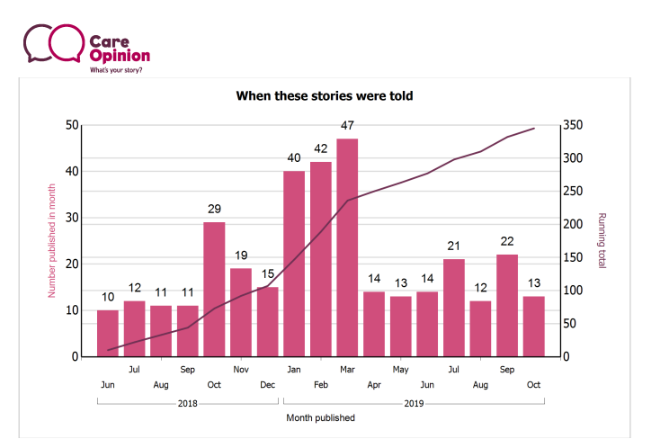
Slow but steady increase in stories
345 stories told
Viewed 6,275 times

Slide 7
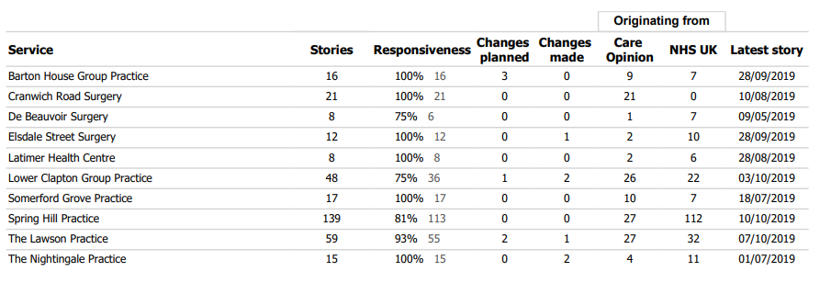

Where we are now
(June 2018 to mid-October 2019)
330 stories viewed 5649
times

Slide 8
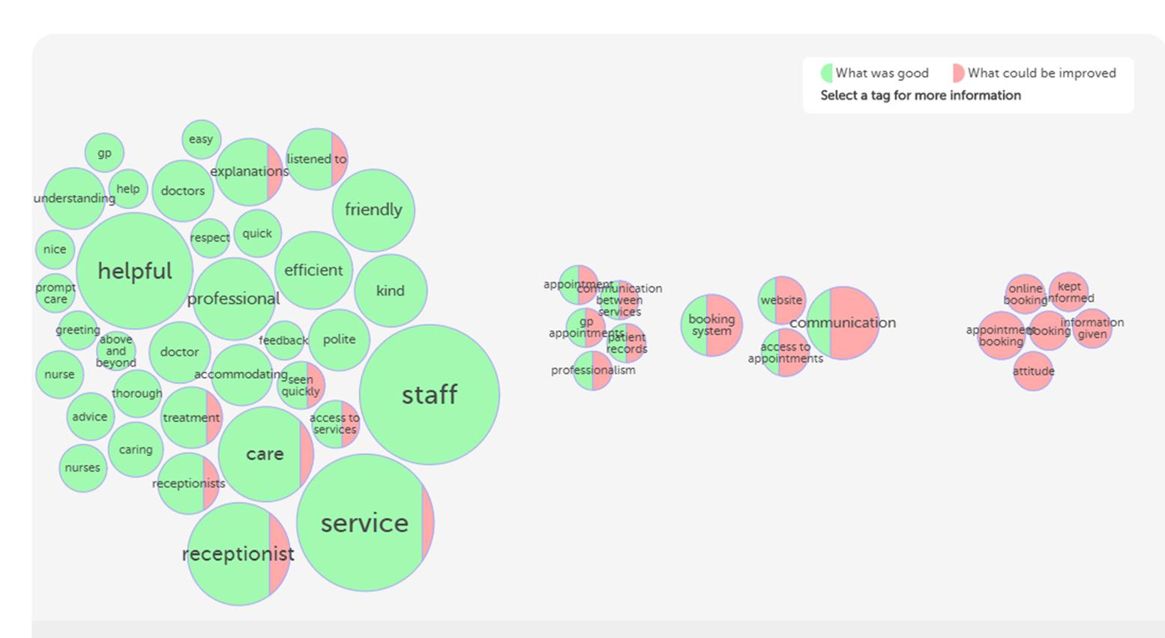
Making sense of the feedback

Slide 9
The key to making care opinion work!
Get the all staff on board and aware of the changes
  Make it an item on the practice meeting agenda
  Send email reminders to the clinician's
  Make it fun- A Practice Challenge
  Make a weekly target
Notes:
Working together promotes team work with staff. allows them to engage with patients. Allows them to welcome change

Slide 10
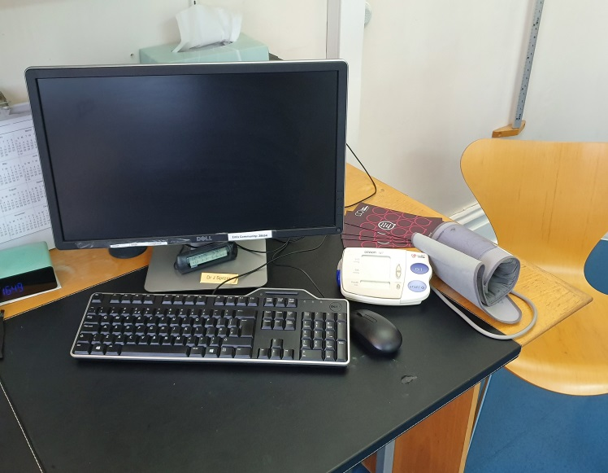
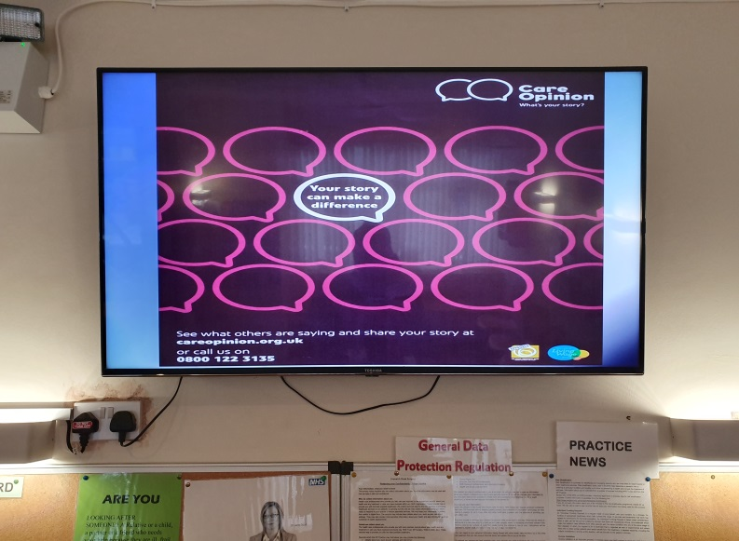
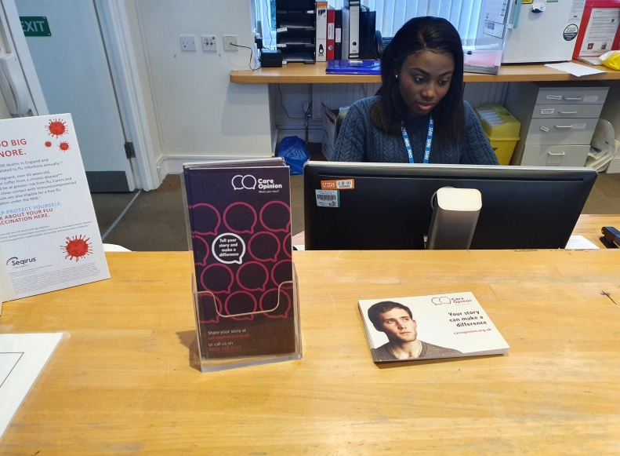
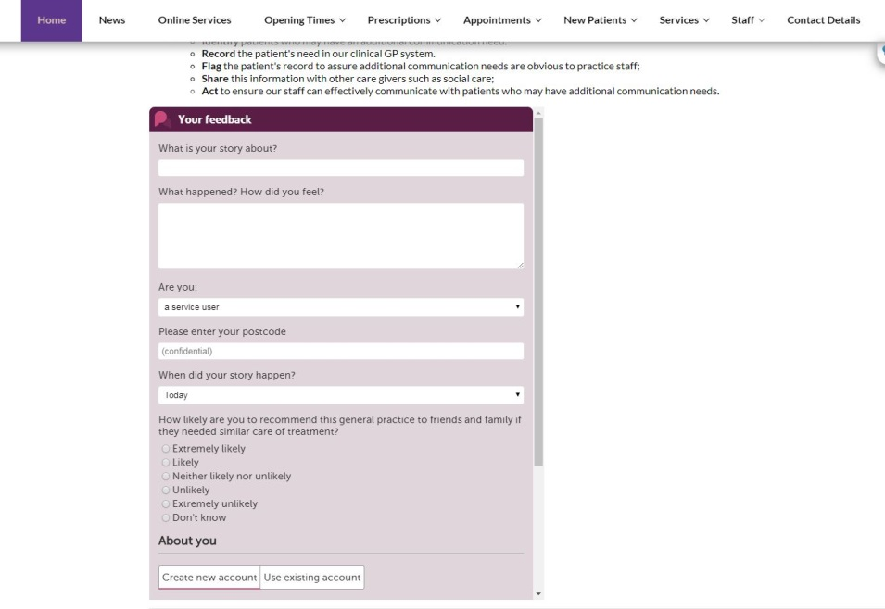
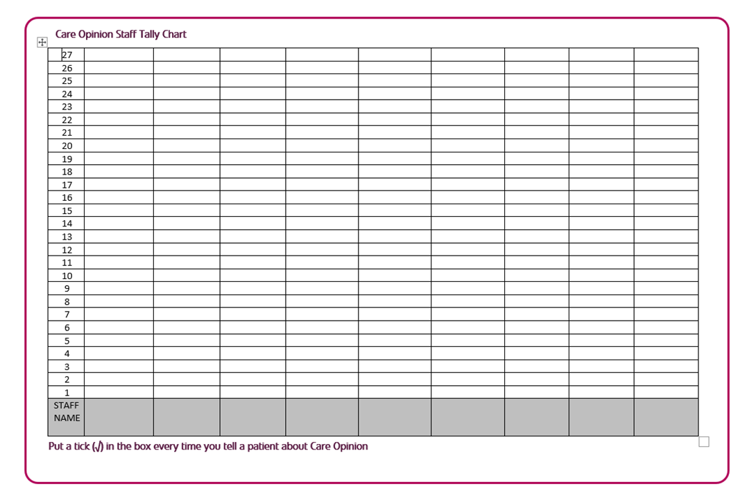
C&H GP practice initiatives

Slide 11
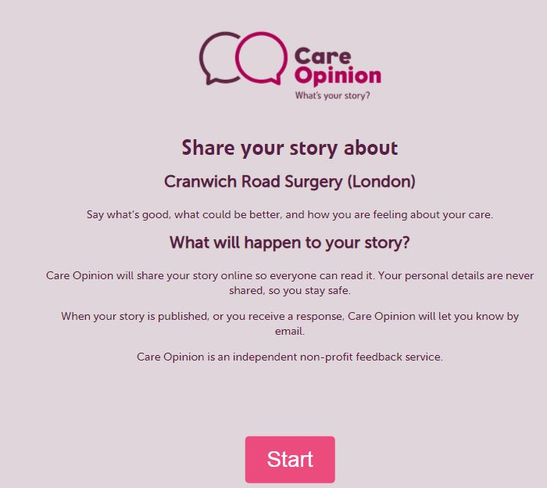
The Outcome for Cranwich Road Surgery
Hi Mercedes/Geetha
Just wanted to email to say how amazing it is that you have had 15 stories through Care Opinion in the last 2 weeks. Congratulations, it just goes to show that all your hard work with promotions has paid off!
Fantastic, so pleased for you ☺ , Tracy Tracy Molloy, Engagement and Support Officer
With all the help of the staff and the promotional material
90% positive feedback for receptions and clinicians
Changes implemented
CQC supportive and interested
New developments - Kiosk mode for Care Opinion link to use on out text service

Slide 12
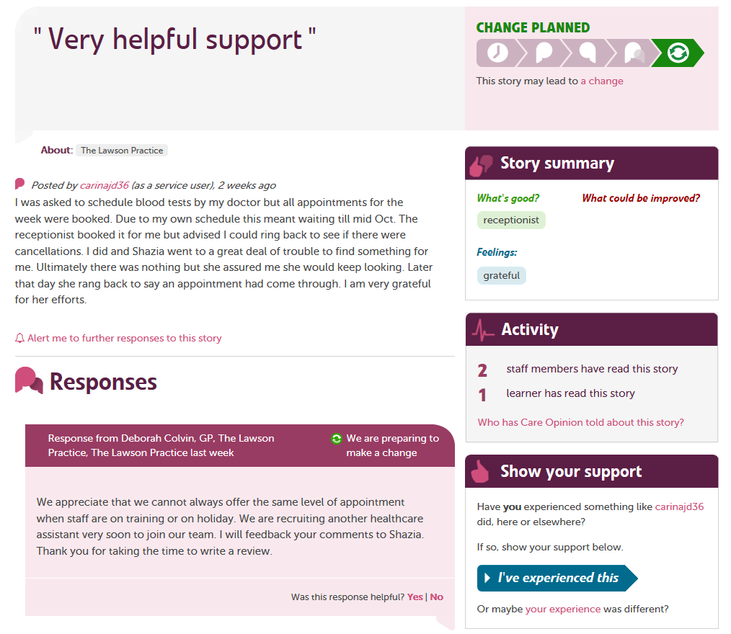
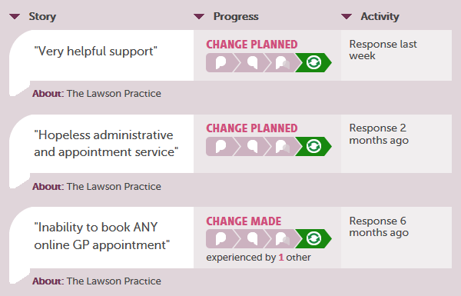
Our Experience - The Lawson Practice
The best parts of Care Opinion for us;
Transparency of the site
Responses can be posted from us
and the patients
Ability to implement and
demonstrate change
Staff personal mentions

Slide 13
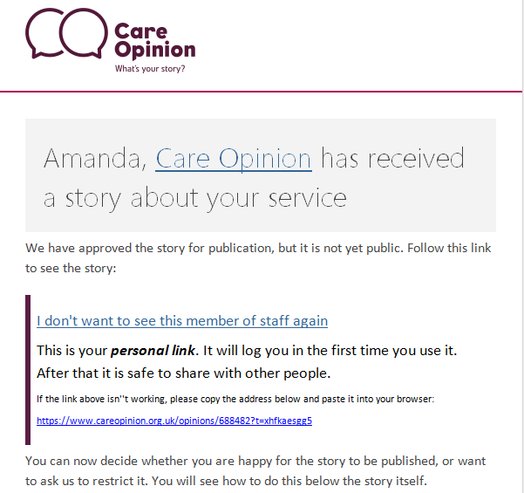
Supportive team in Care Opinion
I worked with Care Opinion on a critical posting that personally identified a member of staff.
Care Opinion shared pre-publication of the post with me and discussed the post and issue raised.
The decision was taken by Care Opinion to not publish this post and instead explain/signpost the patient to follow correct complaint procedures.
Our staff were very reassured by this process and the support received.
The ability to have this frank discussion with a supportive team allows for staff to feel confident in promoting the site as there is a level of protection.

Slide 14
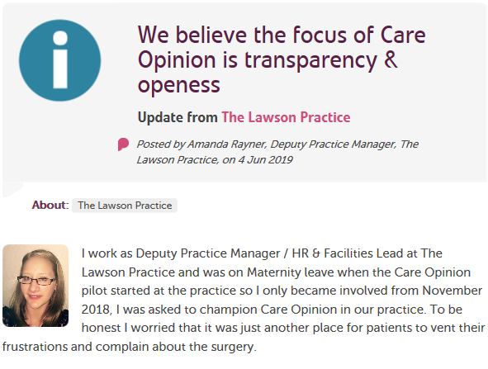
Why we use Care Opinion?
Patients have been very positive on the whole and staff have benefited from positive mentions and thanks for the work they are doing. Snippet from my blog on Care Opinion;
“From gaining feedback through Care Opinion we have learnt that there are people willing to thank staff for the service that other patients sometimes complain about. That for negative comments there are equal reflections of positive comments. The service is adapting to the growing needs of the population and there are sometimes issues when introducing change. It is a useful tool for us to see that there are people who are finding the service is of a high standard and would recommend our surgery as it is a balance to the negative comments that we receive from other review sites.”
The work required to implement this in practice is minimal, after promotion the most important part is the responses and obviously any changes.
Actual feedback levels are not too high so the workload is manageable.
“The most important part of using Care Opinion, after promotion is obviously the responses. We need to keep on top of these so that patients can see that we are listening to what they have to say. We actively promote Care Opinion to our patients via the use of a Care Opinion screen saver on our patient screens in our waiting rooms, we have posters and leaflets available here too.”
Very important to have all of your staff onside to help with promotion – you cannot do it alone.
We have noticed an increase in the positives – this spurs us on.
Care Opinion is constantly evolving to keep up with changes, this keeps it current and user friendly for both the practice and the patients.
Excellent support from Care Opinion – webinars particularly helpful

Slide 15
The Positives for practices
Care Opinion are amazing at monitoring and capturing information.
Mobile-Friendly Experience
Easy-to-Navigate Menus
Great Communication
Good Promotion Content
Helpful Team members
Good Support for issues
Patients happy to engage
Staff mentions = improved morale!

Slide 16
Next steps for the GP Confed
Pilot practices all want to continue – some need more encouragement/support to get more stories
Need to expand to other practices – persuasion needed!
Build CO into new models of patient engagement across the new networks
How can practice/network PPGs use Care Opinion?
Allow others to respond to stories – PPGs, Confed, CCG?
Share data with other providers, patient groups/ researchers (locally and more widely)
Raise awareness of CO across the area - persuade other healthcare providers to join us by signing up – a single route for all feedback on health in City and Hackney?

