Slide 1



Our Teams journey through the care opinion pilot and our hopes and aims for the future.
Royal Free Neurological Rehab Centre
Using Online Feedback to Shape and Develop Service

Slide 2

Royal Free Neurological Rehab centre
We are a team of therapists providing a community neurological rehabilitation service in North London. We applied to use Care Opinion as part of a 6 month pilot offer by UCL Partners and we’ve been using it now for just over five months.
The level of support and advice available from Care Opinion and UCL Partners through meetings and webinar's has been so vital for our learning and for continuing to develop ideas, so Care Opinion become business as usual for the team.

Slide 3
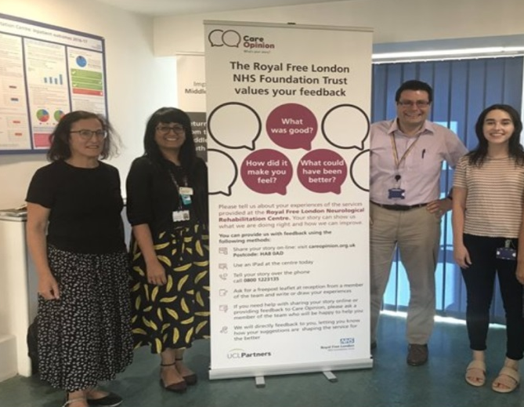
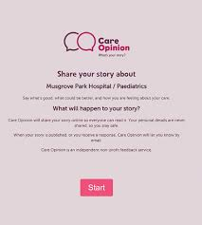
How we promoted Care opinion and achieved team buy in.
We created posters and banners
in our department
All team members were provided
with their own folder of resources
1:1 sessions during supervision and meetings to continue to promote Care Opinion and share stories
Using kiosk mode on the teams iPad for immediate feedback after sessions.

Slide 4
How we are progressing on our journey
We have received such positive feedback from the team, people have loved to receive instant feedback
Reduced overall workload in regard to feedback, we are no longer posting out surveys or waiting until discharge to gain feedback
We are learning more, hearing the service users voice more clearly and seeing how people value what the team offer

Slide 5
What we are learning as a team
The team has received such positive feedback through the pilot, at times we have been hoping for constructive responses, so we can create that change.
It has reinforced the value of new initiatives within the team including the MS Coffee Morning, which has proven to be a life line for so many.
Staff wellbeing and pride in our roles as AHP’s, to hear such powerful stories from our service users.

Slide 6
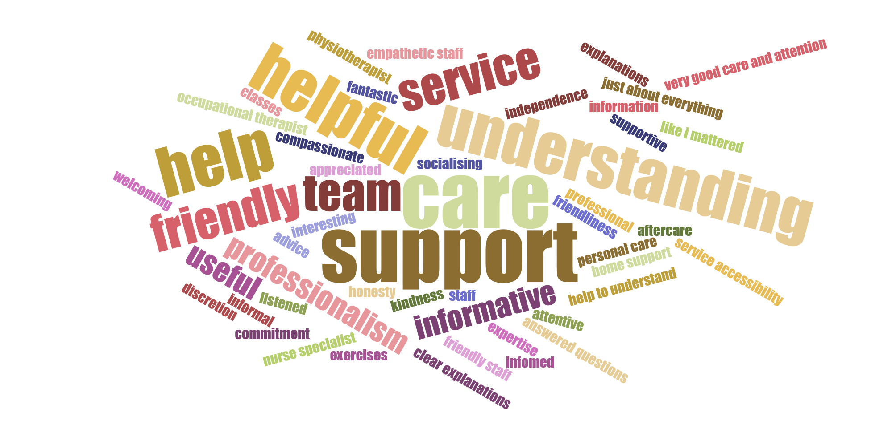
Visualisations

Slide 7

How we are feeling now as a team
We continue to remain positive about the impact using care opinion can have on the development of the service.
We continue to promote care opinion, we are so keen to have an open dialogue with our service users so that they can shape the development of the service.
Optimistic and hopeful that we will continue to use Care Opinion as part of our business as usual.

Slide 8


Our Next steps
Business case, so that we can use Care Opinion in the long term and across our in-patients team.
Continued promotion of the service at trust level.
Use of social media to share stories and experiences.
Maintain team buy in and the level of positivity around Care Opinion, broaden our responding team even further.

Slide 9
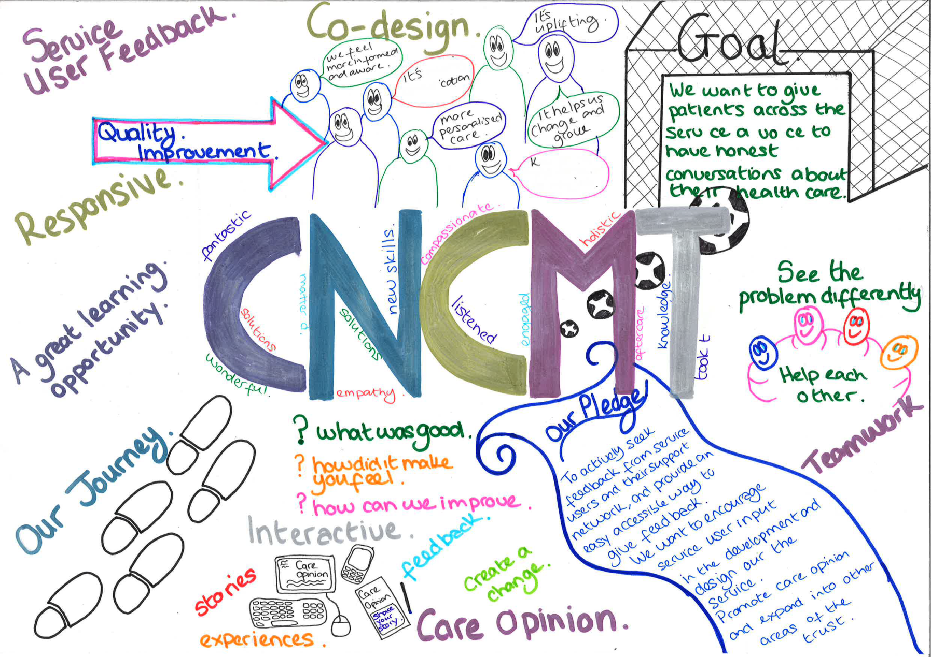
Our Journey

