Slide 1
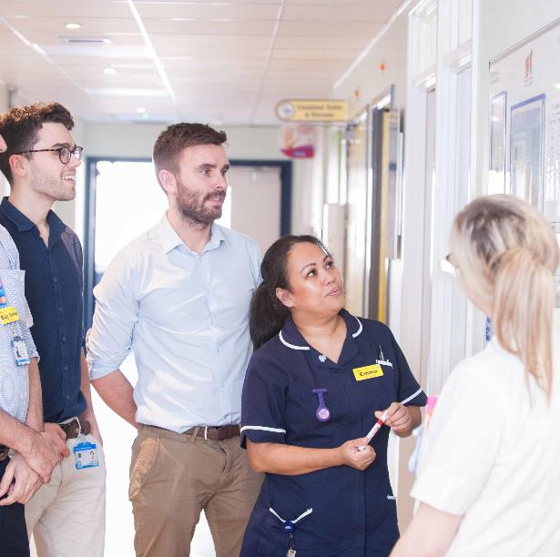
UCLPartners Care Opinion pilot
Emma Mordaunt, Improvement Projects Manager, UCLPartners
Erin Walker, Patient Insight and Involvement Lead, UCLPartners
17 October 2019

Slide 2

Tweet us!
@UCLPartners
#UCLPQI
Notes:
Encourage participants to tweet throughout the day using the handle @UCLPartners and hashtag #UCLPQI.
Explain how to log onto the wifi “UCLGuest”.

Slide 3







UCLPartners – a partnership organisation
Who we are
UCLPartners brings people and organisations together to transform the health and wellbeing of our population
Parts of London, Bedfordshire, Hertfordshire and Essex
6 million
population
46
Healthcare organisations and clinical commissioners
11
Higher education partners
844
primary care practices
100s
industry partnerships
6
Sustainability and Transformation
Partnerships
Notes:
UCLP’s commitment
To give patients access to the most effective medical discoveries and innovation
To transform the health of the local population
To support a sustainable health and care system in England

Slide 4
UCLPartners Care Opinion pilot
What does online feedback offer to clinical teams?

Slide 5
Purpose of the pilot
To enable partner organisations to better understand patient experience with the view to improving patient care
To increase understanding of patient experience
To increase awareness of the need to seek feedback about patient experience
To provide an opportunity to capture what really matters to patients and identify themes for improvement
To provide a mechanism to identify and celebrate what works well
To provide opportunities to share learning and create an open dialogue

Slide 6
The offer
Open to all secondary care departments in our region
Fully-funded CO subscription for 6 months
Hands-on support from Care Opinion and UCLPartners
Notes:
Speak about the application process

Slide 7
Hands-on support throughout the pilot
Individual team support
Initial introductory meeting & site visit
Four bespoke one-hour webinars:
  Introduction and training
  Engagement and promotion
  Reporting and visualisations
  Demonstrating impact
Team coaching on quality improvement, stakeholder engagement and patient involvement.
Impact report
Group support for participating teams
Bimonthly group webinars
A full-day bespoke Introduction to Quality Improvement training day
Opportunity to present and share learnings at the Care Opinion London event

Slide 8
Pilot timeline
Phase | Date |  | Action
Phase 1: Preparation | wk 1 | w/c 03 Jun | Introductory onboarding call
 | wk 2 | w/c 10 Jun | Group webinar
 | wk 3 | w/c 17 Jun | Bespoke webinar 1: Introduction and training
 | wk 4 | w/c 24 Jun | Group webinar
 | wk 5 | w/c 01 Jul | Site visit
 | wk 6 | w/c 08 Jul | Group webinar
Phase 2: Implementation | wk 7 | w/c 15 Jul | Bespoke webinar 2: Engagement and promotion
 | wk 8 | w/c 22 Jul | Group webinar
 | wk 9 | w/c 29 Jul | Full-day bespoke Introduction to Quality Improvement training for your team on 31 July
 | wk 10 | w/c 05 Aug | Group webinar
 | wk 11 | w/c 12 Aug | Bespoke webinar 3: Reporting and visualisations
 | wk 12 | w/c 19 Aug | Group webinar
 | wk 13 | w/c 26 Aug | Site visit
 | wk 14 | w/c 02 Sep | Group webinar
 | wk 15 | w/c 09 Sep | -
 | wk 16 | w/c 16 Sep | Group webinar
 | wk 17 | w/c 23 Sep | -
 | wk 18 | w/c 30 Sep | Group webinar
 | wk 19 | w/c 07 Oct | -
 | wk 20 | w/c 14 Oct | Group webinar Care Opinion London event on 17 October
Phase 3: Evaluation | wk 21 | w/c 21 Oct | Bespoke webinar 4: Demonstrating impact
 | wk 22 | w/c 28 Oct | Group webinar
 | wk 23 | w/c 04 Nov
 | wk 24 | w/c 11 Nov | Group webinar
6 months
3 phases
  Phase 1 – Preparation √
  Phase 2 – Implementation √
  Phase 3 – Evaluation

Slide 9
Departments taking part in the pilot are:
Neuro Rehabilitation Centre – Royal Free NHS Foundation Trust
Maternity Department – Barking, Havering and Redbridge University Hospitals NHS Trust
Maternity Department – University College London Hospitals NHS Foundation Trust
Emergency Department – North Middlesex University Hospital NHS Trust

Slide 10
QI@uclpartners.com
020 7679 6633

