Slide 1


The right end of the telescope – building services around user need
Care Opinion training day, 17 October 2019
Dr Charlotte Augst
Chief Executive, National Voices
Charlotte.augst@nationalvoices.org.uk
@CharlotteAugst
Notes:
I gave this presentation at the launch of the London group of Darzi fellows (cohort 2019 – which is the 10th cohort).

Slide 2

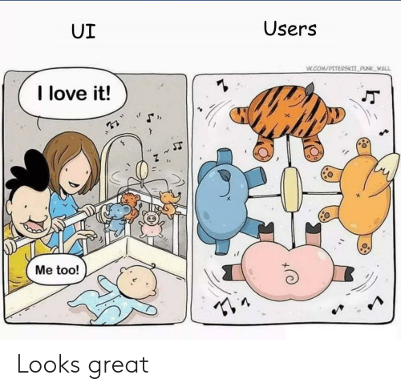

Why we need to take the user perspective much more seriously
Who cares?
Who is on the team?
What adds value?
Notes:
My ‘brief’ was to explain to this group of bushy tailed and talented clinicians why clinical knowledge is only part of the ‘expertise’ that is needed to support people well, particularly those living with ongoing health problems.
I always talk about this picture, which I think captures the ‘health policy dilemma’ quite nicely. Parents looking down on a beautiful mobile over the child’s bed – child only sees bums.
So without understanding the user perspective, we don’t know
Who does most of the caring? How? How well?
Who is actually on the team supporting this person?
What care you can provide would actually add value?

Slide 3
A statistic everyone knows…
0.1% of waking hours a person living with diabetes spends with a health care professional (5 hours)
99.9% of waking hours a person living with diabetes spends on their own, self managing (5000 hours)
Where is health being created and managed? Where should we focus our efforts to improve health(care)? What gets in the way of good health/ care?
Notes:
So first question: who does the caring?
Which resources have we got?
What does effective use of this resource look like?
If we maximise the effectiveness of the 0.1% by cutting the appointment time from 15 to 10 minutes – what impact does this have on the effectiveness of care?
Should we use the appointment to improve the 99.9% of time the patient spends on their own?
Does the HCP even know what happens during these 5000 hours? What the patient does that is effective, or less so? Are they interested?
Does the patient know how to describe their life with diabetes? What works well for them? What they struggle with?
Importance of self management support.
Holistic needs assessment – focus on skills, knowledge, confidence
If you don’t hear from the patient about their experience of living with a condition, you will not deliver effective care.

Slide 4
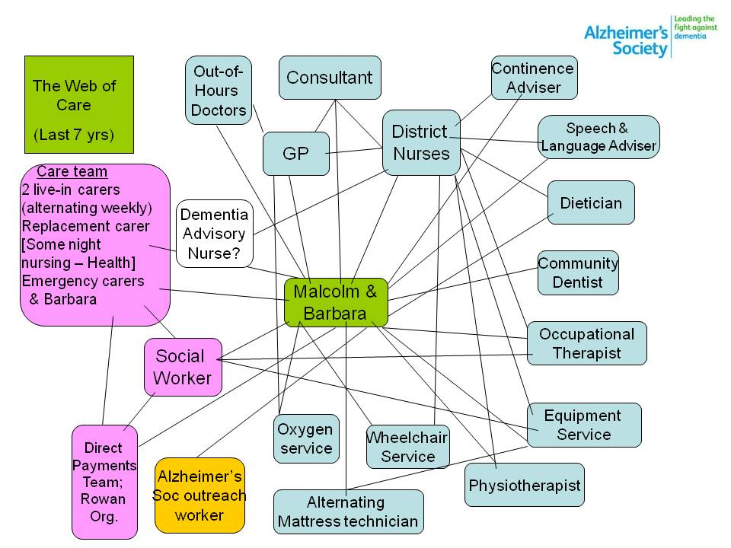
I diagram everyone knows…
Notes:
Second question: Who is on the team?
This slide has the Alzheimers Web of Care. It has been very widely used including by the WHO.
This web was drawn by a lady called Barbara Pointon. For 17 years she was the carer for her husband Malcolm who had Alzheimers. The lines represent their touch points with various services. The blue shapes are health services and the pink ones are the adult social car services that Malcolm needed in the last seven years of his life.
When she presented this picture to an Alzheimer’s and National Voices workshop, Barbara said:
‘Care is care is care. You are the ones who divide it into primary, secondary, social care and so on.’
She also made a plea for what people really need in these circumstances – one point of contact who knows both you and your life and preferences, and knows about the condition(s) and needs that you have. She talked about how, in the middle of this web, you are trying to find ‘the person with the backpack of knowledge who will walk beside you.’
Patient/carer often the only person who knows who is on the team. Pharmacist, mattress technician – also : informal carers – who needs to know what?
If you don’t hear from the patient/ carer, you won’t know who needs to know what and whose work needs to be coordinated.
The next few pages show similar maps drawn by other patients and our members for similar conditions and situations. Increasingly, people don’t just have one condition, they have a number of them. SO it is entirely possible that a person or their carer juggles all these webs on top of each other. Which is pretty daunting.

Slide 5
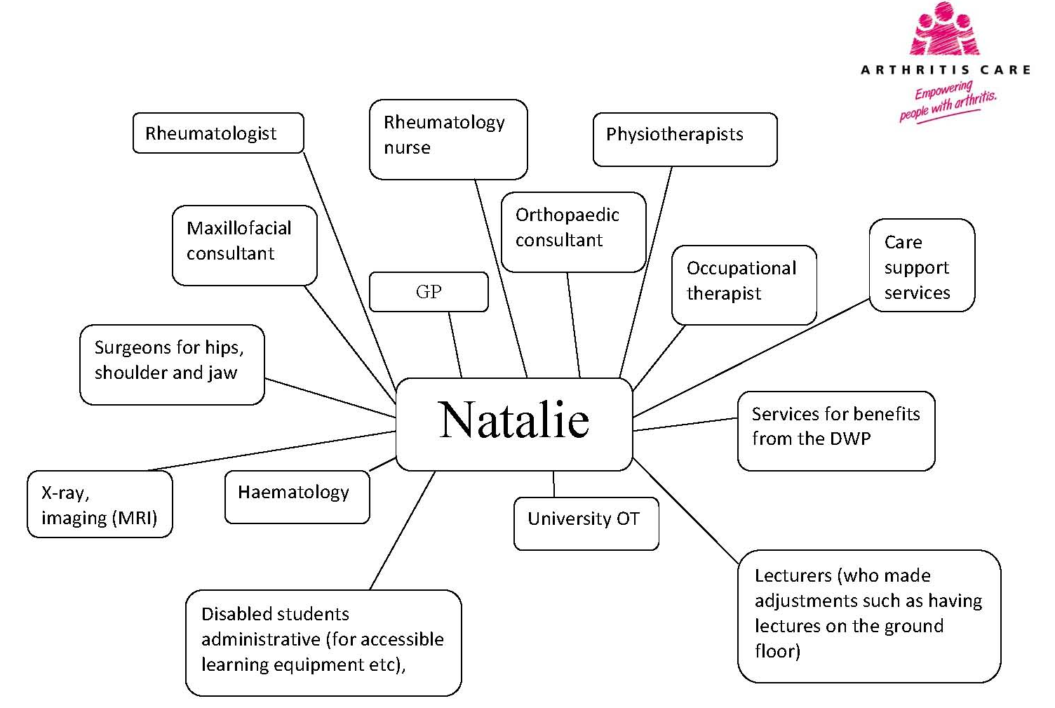

Slide 6
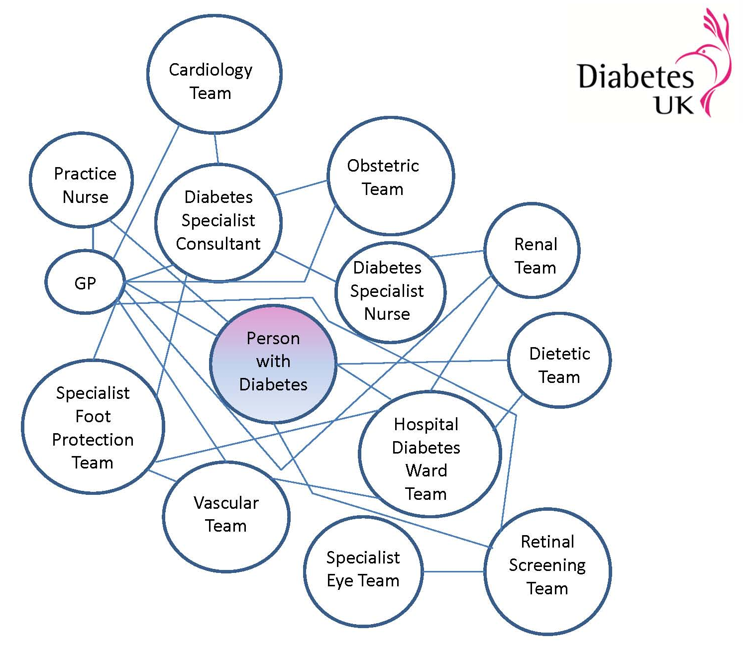

Slide 7
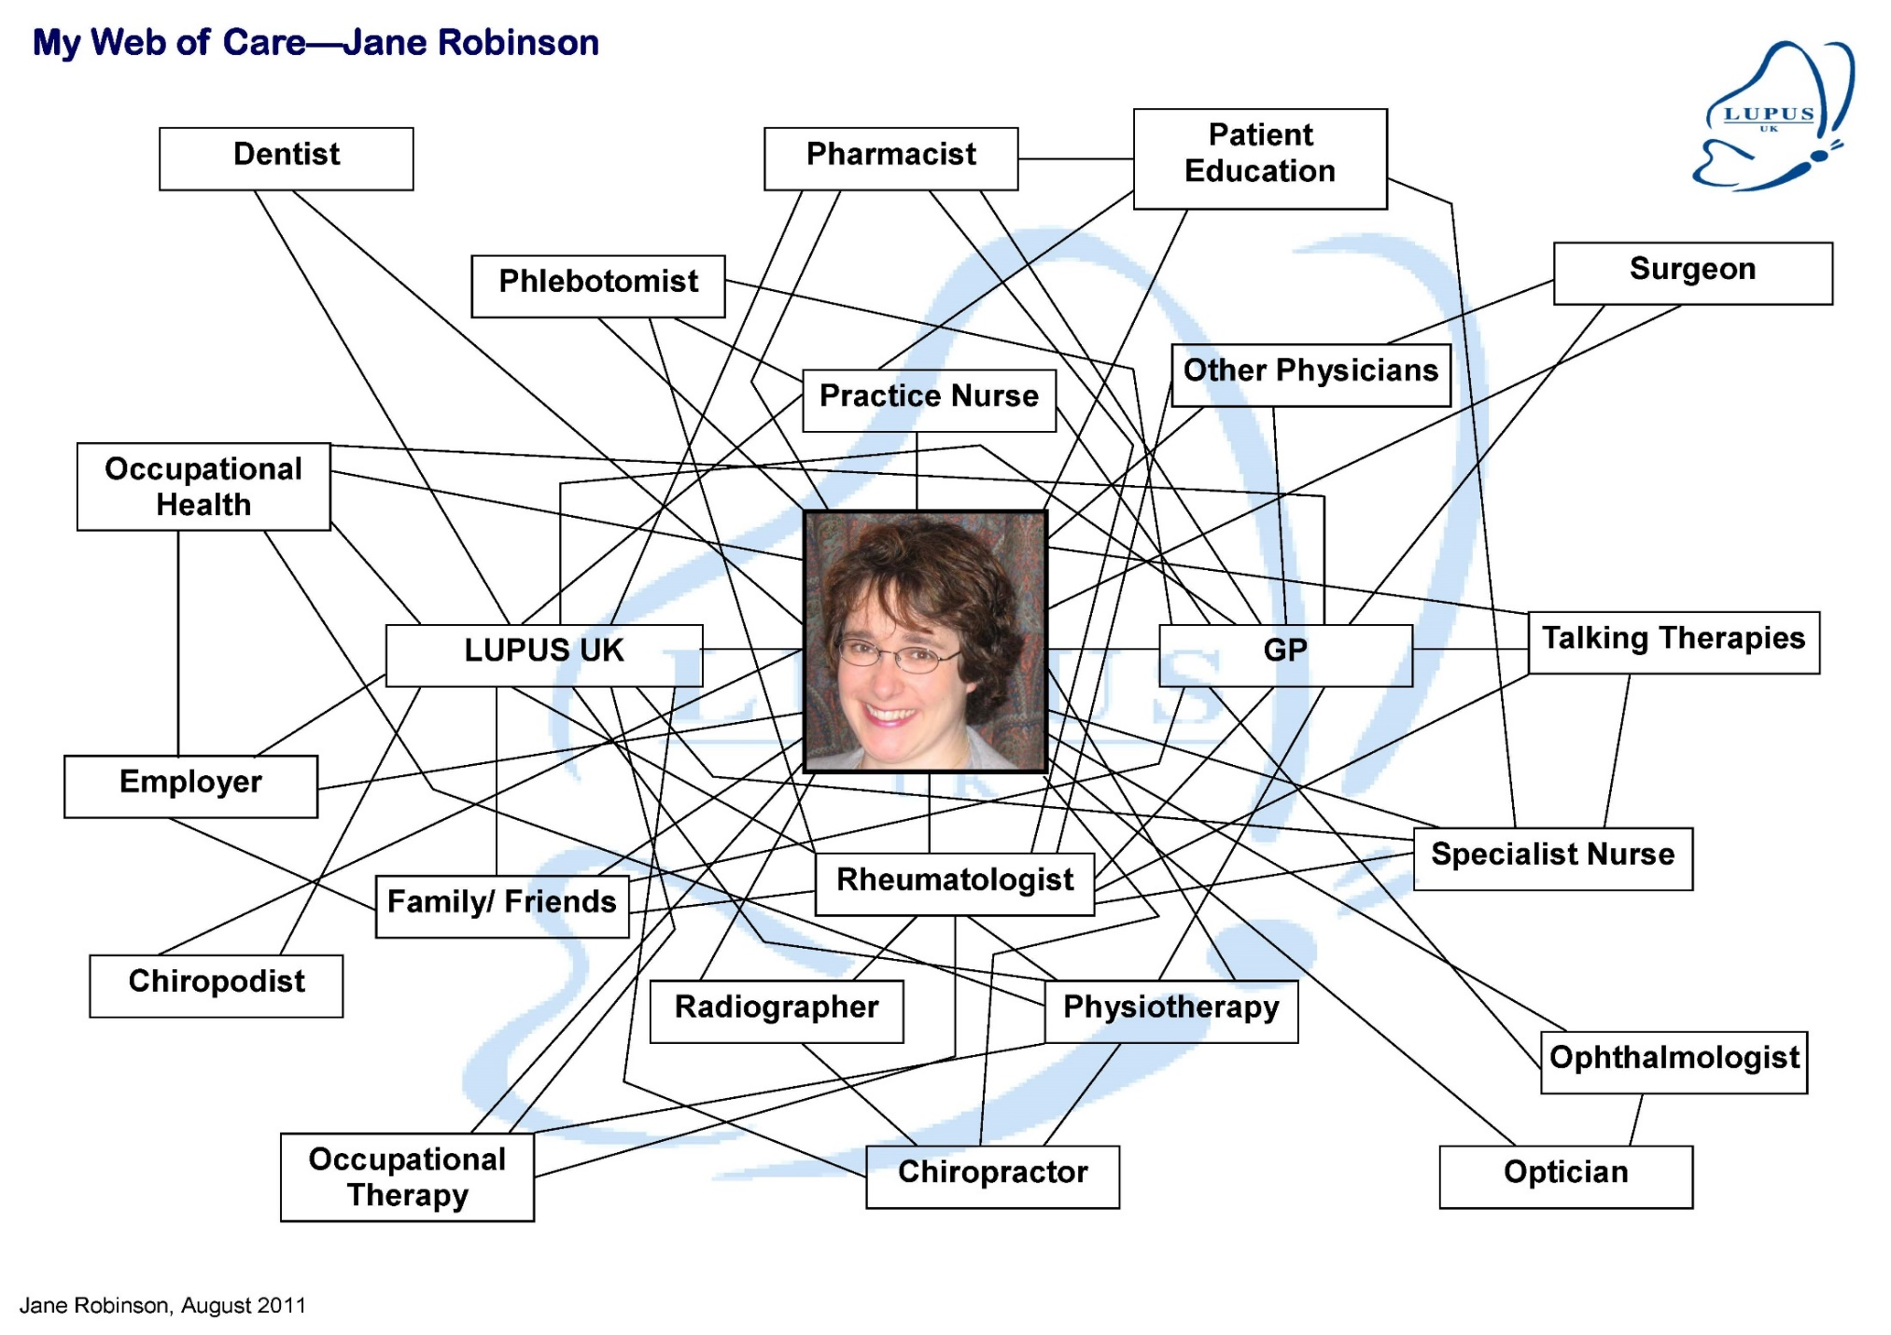

Slide 8




“Just one thing after another”: rethinking how we support people with multiple long-term conditions
Eve Riley, Programme Manager
The Taskforce on Multiple Conditions
Notes:
So this is a piece of work I did in a previous role, when I led the work of the Richmond Group of Charities. You can find plenty of information about this programme of work on their website. Eve manages this programme now, and is always happy to engage too.

Slide 9
The extent and impact of MLTCs is significant:
It is estimated that between 15%-30% of the population in England live with two or more long term conditions;
People with multiple conditions have poorer health outcomes, and poorer experiences of care and are more likely to report care coordination problems;
The impact is deeply unequal. Multimorbidity occurs 10-15 years earlier in people living in the most deprived areas than it does in those living in the most affluent areas;
Multimorbidity is not just a problem of old age - for example, in Lambeth, over a third of people estimated to be living with multiple long-term conditions are under the age of 65.
Notes:
I just flick through these slides – saying ‘there is lots of hard data, why this is important, all the stuff you are used to looking it. So literally just paused for a few seconds on each of those slides.
This is the main user of health services. But this is not how, in the main, our services are organised. Is this because we don’t hear the user perspective?

Slide 10
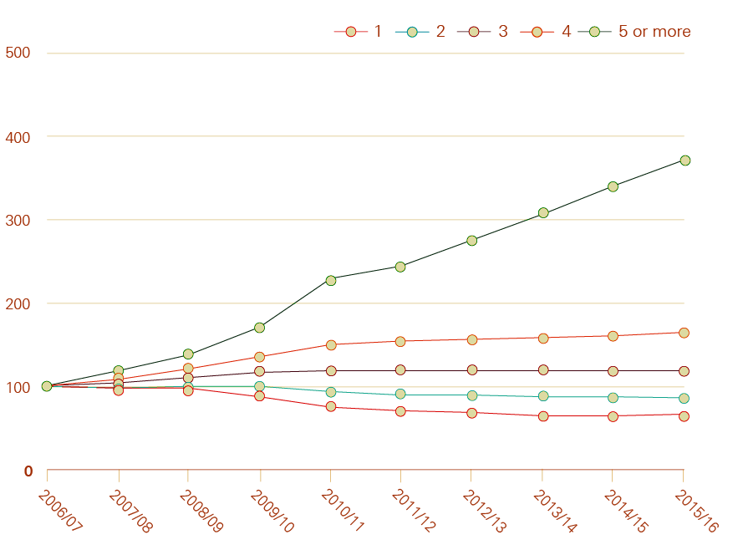
The number of people living with Multiple Conditions
Emergency admissions by number of health conditions over time
In 2006/07, one in 10 patients admitted to hospital as an emergency had 5+ conditions. In 2015/16, the figure was one in three.
Half of all primary and secondary care consultations and admissions are for people with multiple conditions.
People in disadvantaged areas are at greater risk of having multiple conditions, and are likely to have multiple conditions at younger ages.
Health Foundation (2018)
Notes:
Data published this year from the Health Foundation gives a good picture of the rising prevalence of MLTCs.

Slide 11

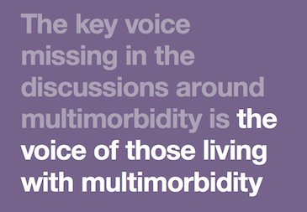
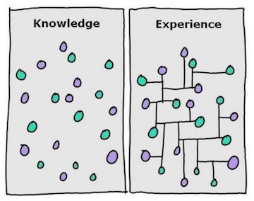
But knowing the numbers is not enough.
Image taken from Imago Training Ltd
Notes:
So we concluded that we needed to make this voice heard through our work.

Slide 12
“In other sectors of the economy, there are severe consequences for knowing so little about what people you serve want. It’s called bankruptcy.
In healthcare it’s called unsustainability.”
Dr Al Mulley, MD for Global Health Care Delivery Science - the Dartmouth Institute – working with 6 of the MCPs in England under the vanguard programme.
“It’s more important to know
what sort of person has a disease than to know
what sort of disease a person has”
Hippocrates (460-370BC)
Notes:
This is really important insight. It is our lack of understanding of the people who we are here to serve that is at the heart of unsustainability.

Slide 13
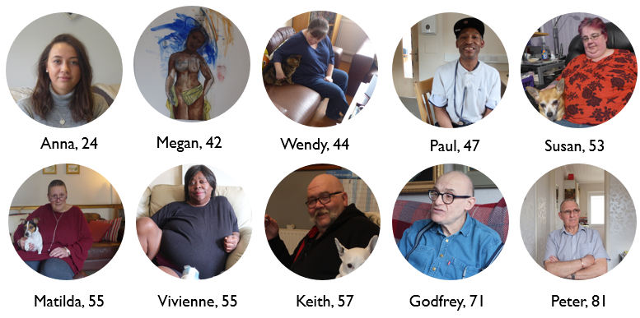

“Just one thing after another”: Living with Multiple Conditions
We carried out half day ethnographic style in-home interviews with 10 individuals…
Notes:
As the ethnographic research reveals, it’s striking that people didn’t speak in terms of their individual diagnoses – they instead spoke movingly about the compound impact to their lives. Loss of mobility contributes to diminished social connections which in turn can contribute to a loss of mental wellbeing. Cross cutting impacts such as chronic pain and fatigue can be more of a daily battle than individual diagnoses and have a significant impact on quality of life. These challenges are coupled with the treatment burden of a fragmented system. Multiple conditions often mean multiple appointments, multiple tests across multiple sites, trusts and multiple medications – all of which can come to have a dominating effect. Further, much of the unmet need described was not biomedical, but social – including support with work, family and relationships, finance, housing and transportation. We also see examples of people’s extraordinary adaptiveness in the face of challenge, finding unique and inventive ways to manage their conditions.

Slide 14
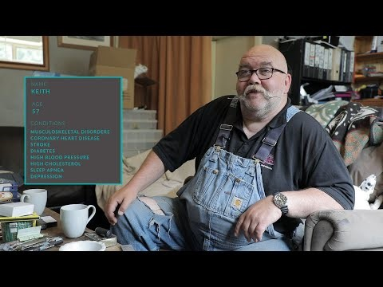
Introducing Keith, Anna, Megan and Vivienne:
To accompany the ethnographic research report, we have commissioned a series of short videos which are available to download from our website. In these, study participants are interviewed in their own homes:
Notes:
I showed them this film, but there are a a few others (They are all on u tube, focussing on different aspects of what matters to people living with multiple long term conditions).

Slide 15
What is National Voices going to do to help?
Understand better what our members know about user experience and needs
Commission our own insight work and research
Collaboration with the Health Foundation to bring together patient partners/ advocates into a community of practice
FOREGROUND EXPERIENCE

Slide 16
Questions
Does listening to people complicate matters or simplify them?
What are the obstacles to listening and to acting on what we hear?
Where will the energy for change come from?
What would healthcare looked like that helped Keith, Anna and Vivienne?
Notes:
Of course it feels hard to make time and change practice to truly listen to people. But in my view, for eample for the people living iwht multiple long term conditions, it also simplifies matters. Because you realise that rather than caring about the treatment pathways and prescribing guidelines for 5 different conditions, you can focus on a smaller number of overall impacts:
Fatigue, pain, mobility, social connectedness.
What would care look like htat focussed on those impacts? What if every appointment for a LTC raise the question: how easy do you find it to get out and about? How can we help you with this? In my view, having engaged with this data in detail, this would almost be the most value adding intervention of them all. Helping people to stay mobile.
It is hard to make these changes – it is counter cultural. SO we are only going to continue working against these obstacles (professional, managerial, resource constraints) if we tap into plenty of energy. And who will have the most energy to keep at it: the people to whom it matters the most – the people living with LTCs. If you work with patients and carers on this, it’s like you take an extra battery pack into your struggles.

Slide 17




Get in touch
info@nationalvoices.org.uk
020 3176 0738
www.nationalvoices.org.uk
@NVtweeting

