Slide 1

Involving volunteers and patient/user groups in online feedback with Care Opinion.

Slide 2
Agenda
Care Opinion and Online Feedback
Benefits and value of Volunteer Involvement
Resources and Support

Slide 3
What’s in it for Volunteers and Services
Care Opinion-Mission and Values
Helping to generate postings-a volunteer role
Hearing from a wider range of patients, users and carers
Helping Inclusion
Empowering Volunteers, Patient Representatives and Service User Mentors.

Slide 4
Volunteers can
Let people know about Care Opinion as a way to give feedback;
Show people the website and how it works;
Let people see stories already shared about the service;
Explain why the service would like to hear feedback and what they will do with it;
Help people to login;
Support people to share their story on the website;
Help people to write their story and put this on the website;
Make sure responses get back to people who don’t have internet access.

Slide 5



Collecting Feedback
Some ideas for volunteers collecting feedback. Use an I Pad and our new Feedback (Invitation Links) to quickly collect feedback from users of services.
Place Volunteers in waiting rooms or find a meeting room to chat to users. Top tip is to have a tin of chocolates to entice people to a conversation.
Use the telephone to reach out to people, have a chat and agree feedback to enter onto the Care Opinion Site.

Slide 6
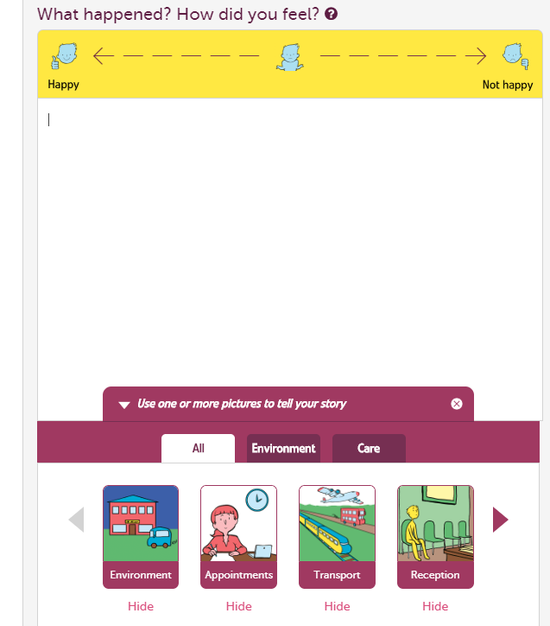
Picture Tiles
Learning Disability
Dementia
Cognitive Impairment
Low Literacy
English not 1st Language
People with Imagination

Slide 7
Resources for Volunteers
Volunteer Start up pack
https://www.careopinion.org.uk/info/staff-and-volunteer-overview
Concise but Complete!!!!

Slide 8
Other Resources
Volunteer FAQ page
Assisting people with sharing their stories
Submitting stories to Care Opinion
Step by step conversation guide
Volunteer Guidance for how to manage volunteers

Slide 9
Volunteer Guidance
How to keep Volunteers safe and properly supervised in this task
Advice about difference between feedback and an issue with care
Advice for organisation about managing volunteers who might be talking to vulnerable patients/users carers

Slide 10

CARE OPINION: Volunteer-generated postings
Signpost Patient to Pals
Advocacy, Keyworker
STORY
Discuss with agreed
contact
Content of story
is a concern
Contact relevant staff
/clinical team
Agreed contact to
advise, liaising with
CO if necessary re.
edit/moderation policy
Content of story is
not a concern
Debrief/Support Volunteer
If agreement is to publish:
If agreement is to not publish:
Care Opinion
moderation
Publish story
Response on site
Share with patient?

Slide 11

Facilitating Stories
Enable as far as possible
Stories not data
Themes but not survey
Qualitative not quantitative

Slide 12
Value to Volunteers
Brings you closer to patients, service users and carers
Include on Subscription
More independent than staff
Helps with professional development
Develops Interpersonal skills

Slide 13

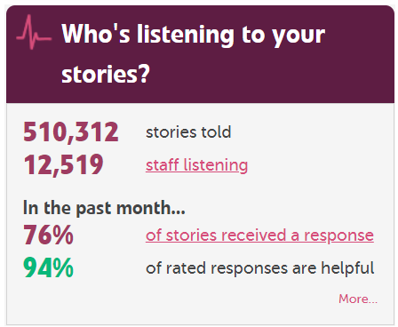
Power of Stories and Being Heard

