Slide 1

Involving volunteers and staff

Slide 2
Aims of today's webinar
Get volunteers (or named staff members) involved in generating and learning from feedback
Help you establish a volunteer role and training programme in relation to Care Opinion
Discuss different options depending on setting
Share resources available on Care Opinion

Slide 3
Volunteers in your organisation can…
Let people know about Care Opinion as a way to give feedback
Show people the website and how it works
Let people see stories already shared about the service
Explain why the service would like to hear feedback and what they will do with it
Help people to login
Support people to share their story on the website
Help people to write their story and put this on the website
Make sure responses get back to people who don’t have internet access

Slide 4
Benefits to volunteers…
Brings them closer to patients, service users and carers
Can take the feedback they hear from service users and help it be a force for change
Helps with professional development
Helps people grow and demonstrate interpersonal skills
Can increase confidence in basic digital skills

Slide 5
Setting up your volunteers
Add them to your Care Opinion subscription so they can access all the stories and Care Opinion features
Run an introduction to Care Opinion session so the are happy talking about Care Opinion (see our FAQS)
Brief volunteers on what to do if the person discloses something they need to report to the ward manager etc. Not everything is suitable for Care Opinion
Think about the environment and the potential abilities and internet access of the service users or families
Available resources:
volunteer-tool-kit-may22.docx
taking-a-story-form.pdf
Volunteer FAQ page
Assisting people with sharing their stories
Submitting stories to Care Opinion
Step by step conversation guide
Volunteer Guidance for how to manage volunteers

Slide 6
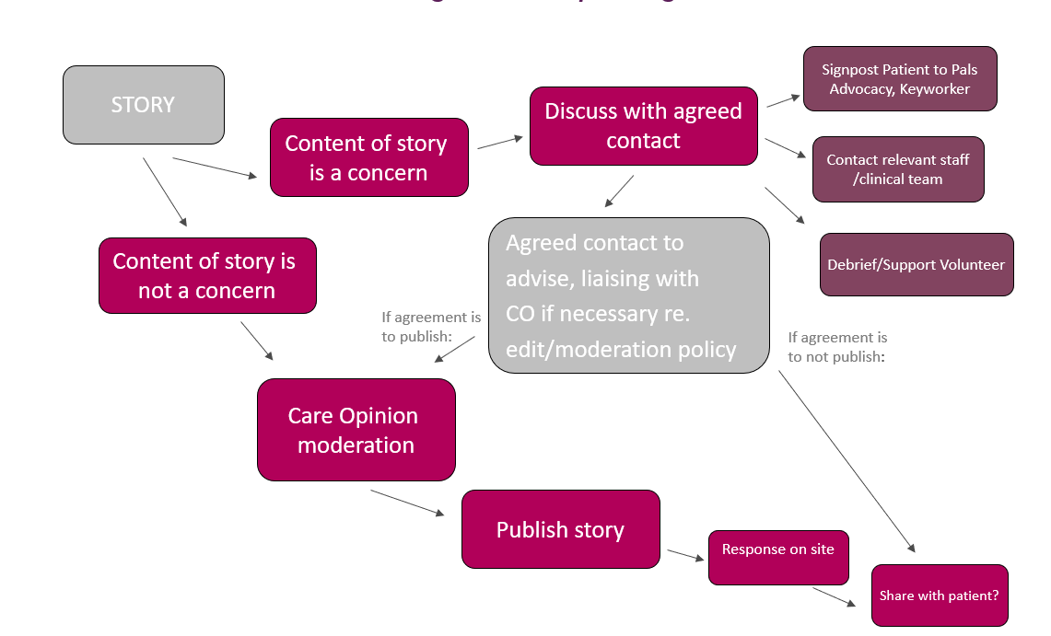
Volunteers collecting a story with an immediate concern for the person
This could still be published on Care Opinion eventually, but you should have a process in place to support the volunteer to raise with appropriate staff first

Slide 7
Supporting someone to share their story
This is one of the main ways volunteers can support the organisation to hear from their users. Volunteers can discus Care Opinion with users and encourage them to submit feedback. This can be in several ways:
Discussion and signposting to careopinion.or.uk or to the team’s invitation link/QR code for Care Opinion
Sitting with someone and helping them share a story on a laptop or tablet. Kiosk mode is ideal for this.
Taking the story down on paper to type up later. This is only recommended within secure settings and where internet access is not permitted*
*you will also need to consider your data retention policies – how you are keeping date safe, how long do you keep it etc.

Slide 8


Signposting to Care Opinion
Many people in services have access to the internet at home of via their phones.
Volunteers can discuss Care Opinion and why the service is looking for feedback and give the person a card or flyer.
Make sure volunteers understand and can explain :
who Care Opinion is. i.e independent, not complaints
That feedback is published anonymously online
The patient will get a reply

Slide 9

Supporting someone to share their story
Volunteers can sit with people and help them share their story. This works best on an ipad or laptop where the volunteer facilitates the person to share their feedback. Depending on the person’s ability, the volunteer might:
Give the person the kiosk on the iPad with a brief explanation and allow the person to add their own feedback in private
Sit with the person whilst they dictate their story/help them move the picture tiles
Using their own account to add the story on the person’s behalf if they do not have an email address/access to the internet

Slide 10
Does the person have an email address?
Does the author have a postcode and email address they can use?
Yes
No
Make sure you are not logged in
Enter the story in the author’s words then select the role that best describes the author in the ‘About you’ section.
Log into careopinion.org.uk and enter the story in the author’s words BUT then in the “About you section” the role of “a staff member posting on behalf of a patient/service user”
Currently the ONLY way for a person to find their story is though the story ID
Follow the tell your story process and put in the author’s postcode and email address when prompted.
Then ask the author to create a username that is not their real name or use the username generator
Follow the tell your story process and put in the author’s postcode or the post code of the service
Check the author is happy for you to share the story on their behalf and submit.
This means the story needs to be entered on the website with the patient present and then they are given the number when it is submitted, or you need to go back to the ward to give the person the number
The story will now be added under the author’s account to they will be directly emailed if they get a reply from services
The story will be shared under your staff/volunteer account. If the story receives a reply you will need to share this with the author

Slide 11

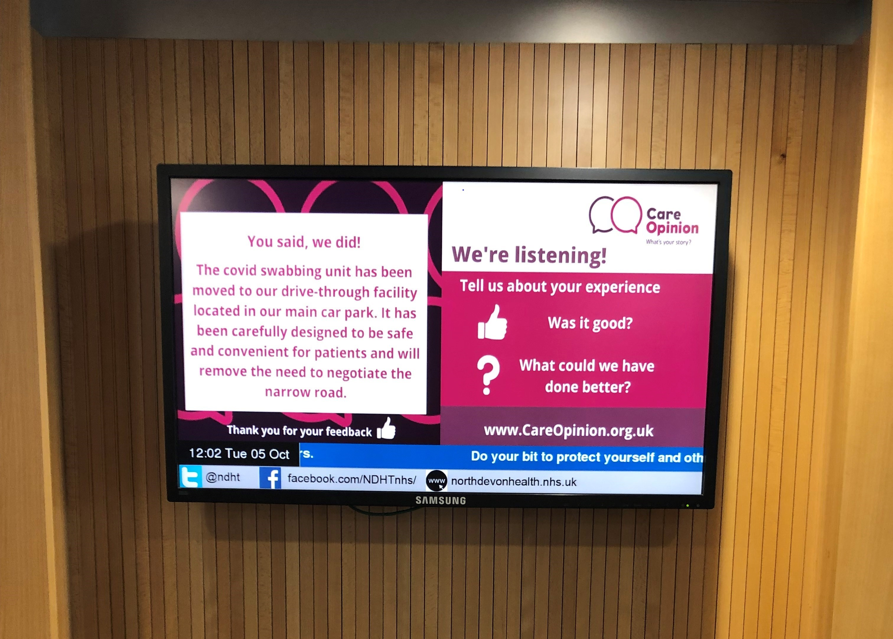
Closing the loop
Consider how volunteers will make sure the person can have access to their story and any responses. If they have an email address this will happen automatically. If they don’t you may need to get creative:
Flyers with link to story using the story id (see appendix on the presentation on how to find this
Revisiting the ward to share feedback directly with the person
Book of feedback and Reponses for all to read or on service notice board
Screens with feedback and responses

Slide 12
Questions?

Slide 13

Contact me:
sarah.ashurst@careopinion.org.uk

Slide 14
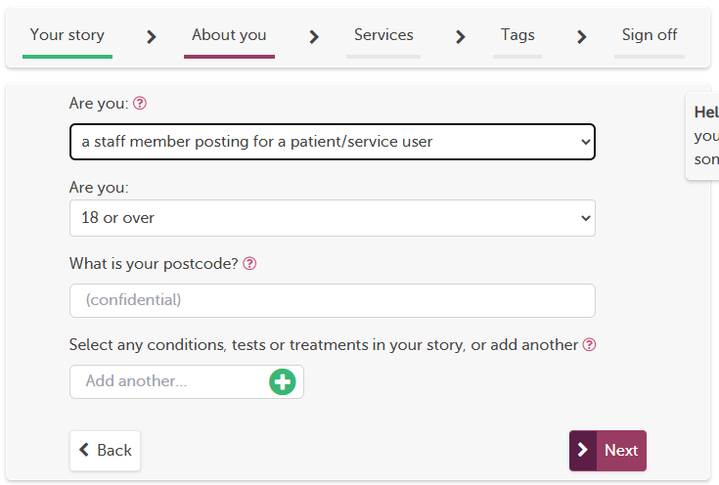
Appendix: Adding a story for someone and finding the posting ID
If the person doesn’t have an email a volunteer can add it on their behalf
They must be logged in with their organisation email
Add the story in the persons own words
On step two identify as a “staff
member posting on behalf of a patient
or service user”

Slide 15
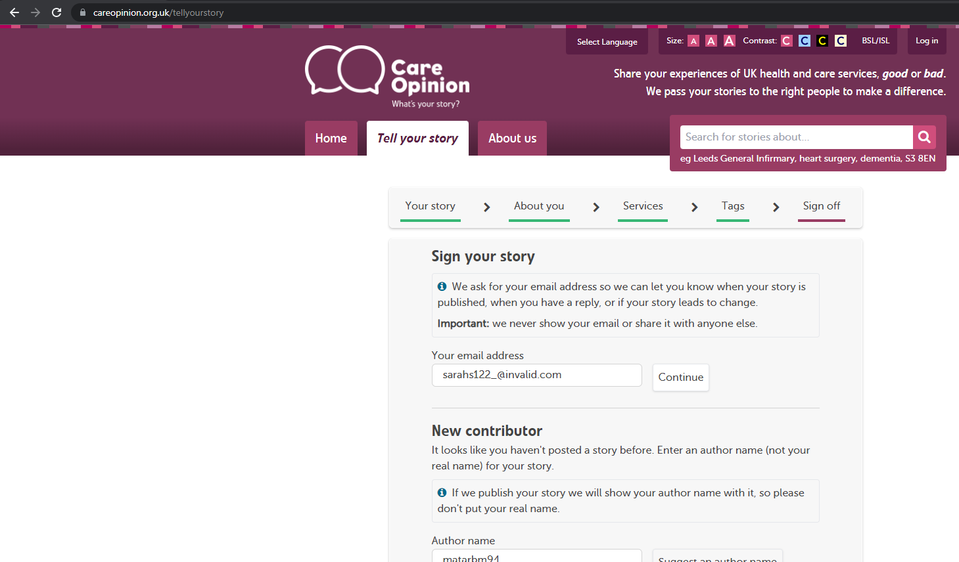
4. Follow the process through until or signing off as a feedback assistant
5. Click SUBMIT

Slide 16
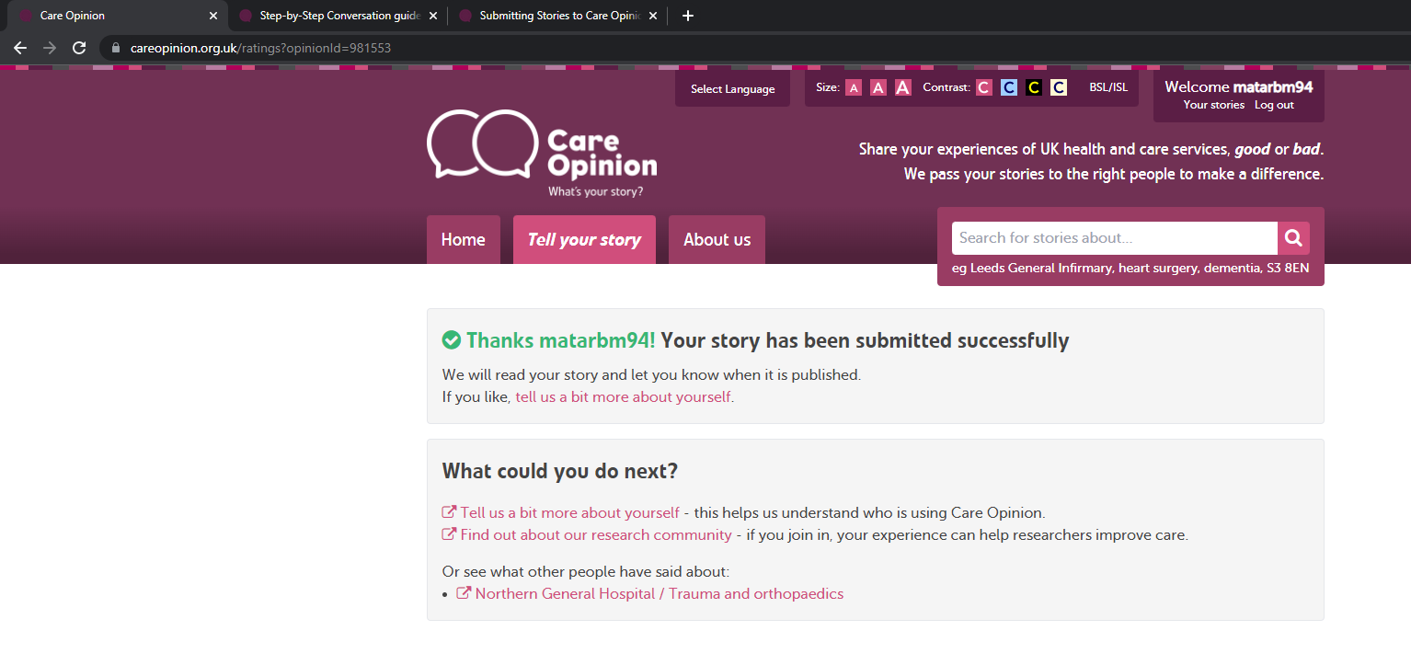
This is the posting ID

Slide 17
The link to share is https://www.careopinion.org.uk/981553
Where the number in red is the story id shown in the URL after the story is submitted.
Currently authors cannot search by username or title to find a story. There is a risk these will also be changed in moderation. ID number is the one thing that does not change on any story

