Slide 1
Using Care Opinion in revalidation

Slide 2
The position of the GMC
At least once in each revalidation cycle you must reflect on feedback from patients that has been collected using a formal feedback exercise
You should consider which mechanism or tool would be most appropriate for your patients, and what would give you meaningful information about your practice*
The purpose of reflecting on feedback from your patients is to help you to understand their experience of your practice.
Patients have a unique perspective and their feedback can help identify areas of strength or opportunities for improvement. It can help develop greater insight and self-awareness and challenge assumptions.
Source; https://www.gmc-uk.org/registration-and-licensing/managing-your-registration/revalidation/guidance-on-supporting-information-for-appraisal-and-revalidation/your-supporting-information---feedback-from-patients-or-those-to-whom-you-provide-medical-services
Notes:
. A structured questionnaire (e.g. friends and family test), may be suitable, however you may take another approach if it better suits the context of your work and/or your patients’ needs. Other approaches could include: structured interviews, focus groups, formal comment cards or a remote feedback tool like an app.

Slide 3
The GMC’s requirements
GMC requirements | How Care Opinion can meet these
At least once in each revalidation cycle you must reflect on feedback from patients, collected using a formal feedback exercise | Care Opinion is an Independent feedback website already in use by your organisation with well developed and safe moderation principles
Feedback you reflect on should be collected in a way that is appropriate for your patients and the context in which you work. | You can direct people to your unique Care Opinion link via email, sms, a QR code, in a chat after a remote consultation, from a paper flyer
At each appraisal you should reflect on any other sources of patient feedback you can access, that give you helpful information about your practice (such as unsolicited feedback). | Additional feedback my come in about you and your department independent of your link. You can include this in your reporting
You should reflect on patient feedback that covers your whole scope of practice across each revalidation cycle. | Stories on Care Opinion are in the patients' own words and often include feedback across the whole care pathway
You must reflect on feedback and if appropriate, act on it in a timely manner and discuss how it has informed your practice at your appraisal. | Feedback is published right away, meaning you can respond directly to patients and say how it has changed your practice. You can they also turn all the feedback into a summary report to reflect on as a whole
Source; https://www.gmc-uk.org/registration-and-licensing/managing-your-registration/revalidation/guidance-on-supporting-information-for-appraisal-and-revalidation/your-supporting-information---feedback-from-patients-or-those-to-whom-you-provide-medical-services
Notes:
Source; https://www.gmc-uk.org/registration-and-licensing/managing-your-registration/revalidation/guidance-on-supporting-information-for-appraisal-and-revalidation/your-supporting-information---feedback-from-patients-or-those-to-whom-you-provide-medical-services

Slide 4
But please note, The GMC also askes you replect on other sources of feedback:
At each appraisal you should reflect on any other sources of patient feedback you can access, that give you helpful information about your practice (such as unsolicited feedback).*
*We’re encouraging doctors to reflect on existing sources of patient feedback, such as letters, cards or team feedback at each appraisal to support their professional development, but this isn’t mandatory. We recognise that what doctors can reflect on will depend on their role and what they can access.
Source; https://www.gmc-uk.org/registration-and-licensing/managing-your-registration/revalidation/guidance-on-supporting-information-for-appraisal-and-revalidation/your-supporting-information---feedback-from-patients-or-those-to-whom-you-provide-medical-services

Slide 5
Asking for feedback about your practice using a personalised invitation link
You may already be using invitation links in other areas
These are a way to make sure feedback is linked to a specific service or project
Stories are tracked via the link you give people
For revalidation this is a private to you link – meaning others cannot track the story
Stories will be moderated in the usual way. If you are criticised your name will be removed but you will know it arrived through your link
You and other teams can then respond to the feedback
You can collate the feedback into Care Opinion reports and visualisations

Slide 6
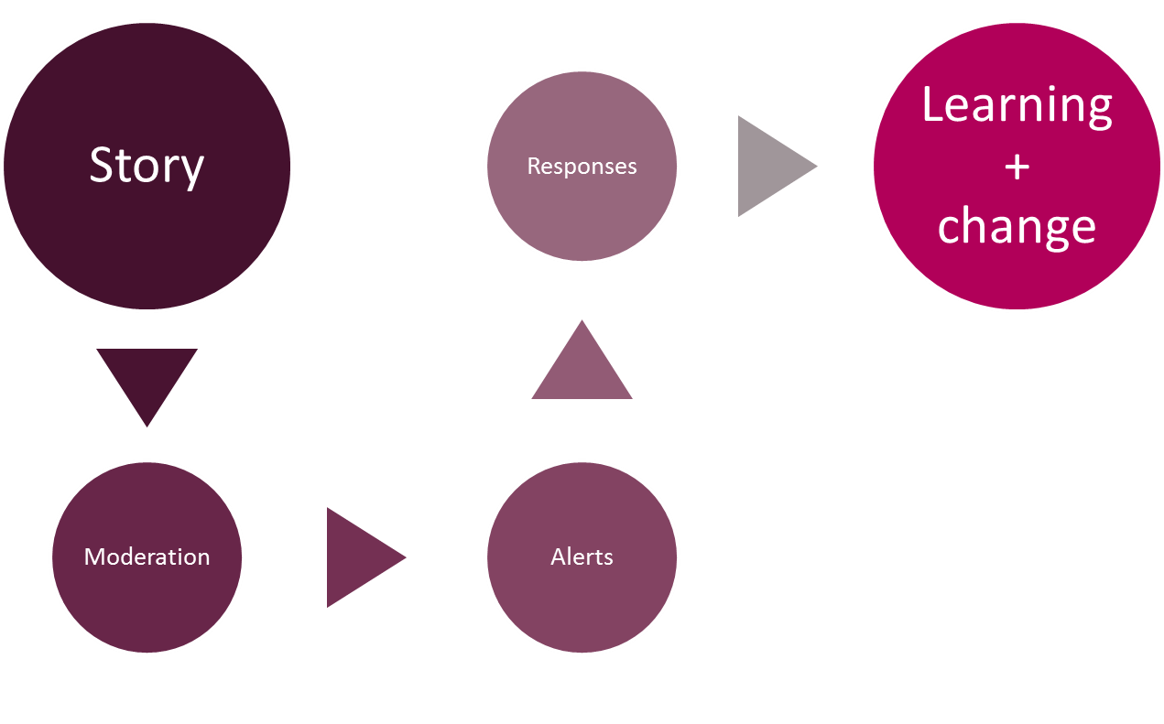
Stories collected via your link will be treated like all other stories submitted to Care Opinion

Slide 7
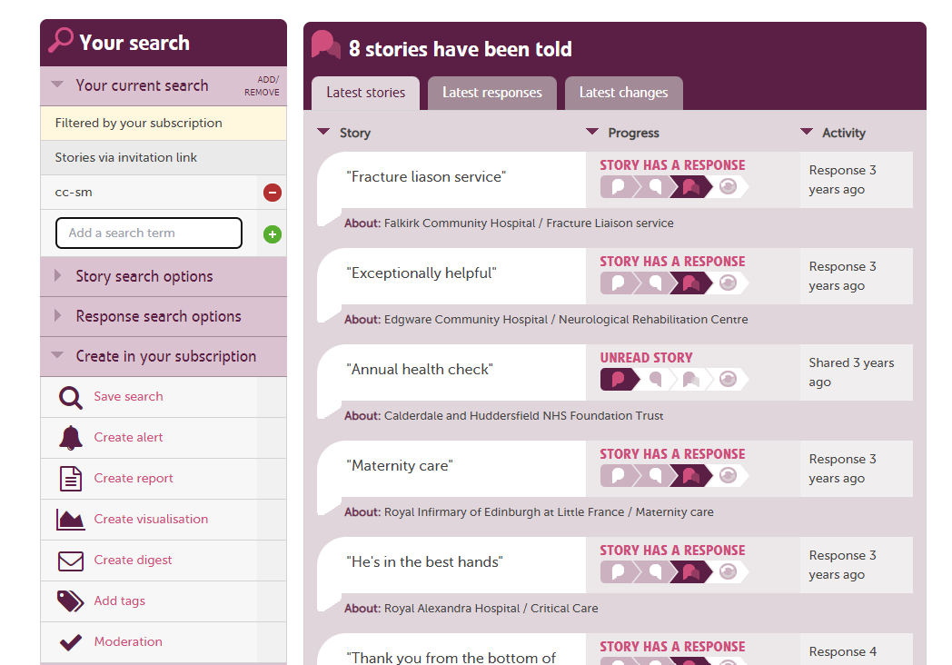
Use your link to track and report on feedback

Slide 8
Benefits to patients
Feedback is public and they can comment on all aspects of care
They will receive a reply
They only need to give feedback once and it can be used in multiple contexts
They can tell you what is important to them in their own words
Easy to use and accessibility options

Slide 9
Benefits to you
Safe and simple for you and you patients to use
Robust moderation policy
If feedback includes other areas, they will be linked, and they can respond as well
Near real time feedback that you can reply to
Suite of reporting and visualisations

Slide 10
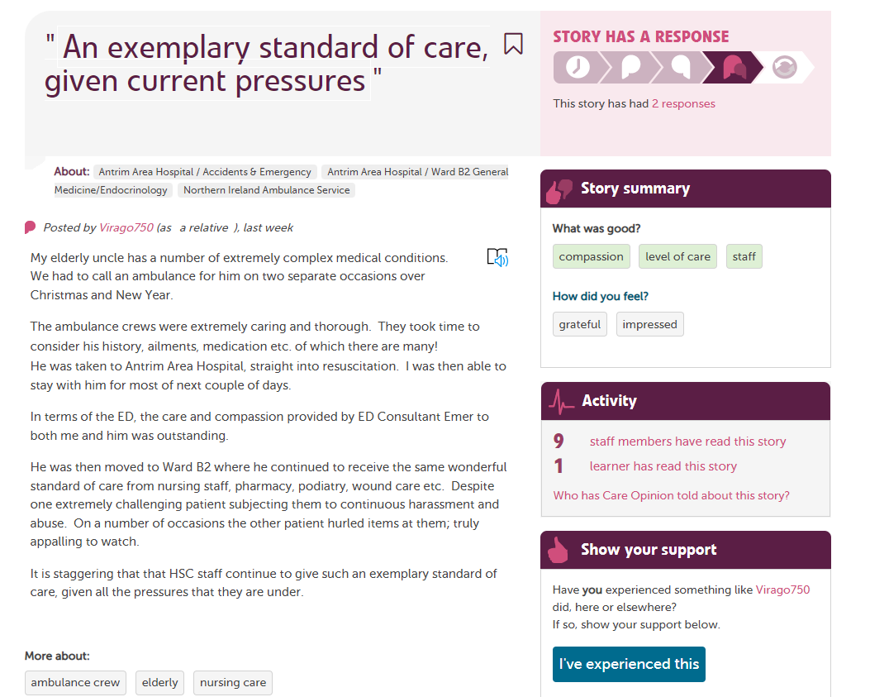

Slide 11
Live site: creating your link
See help pages: https://www.careopinion.org.uk/info/invitation-links

Slide 12
Now you are ready to share your link with the world 🌎

Slide 13
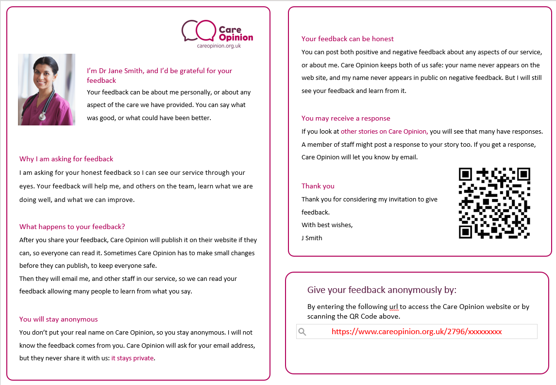

Slide 14
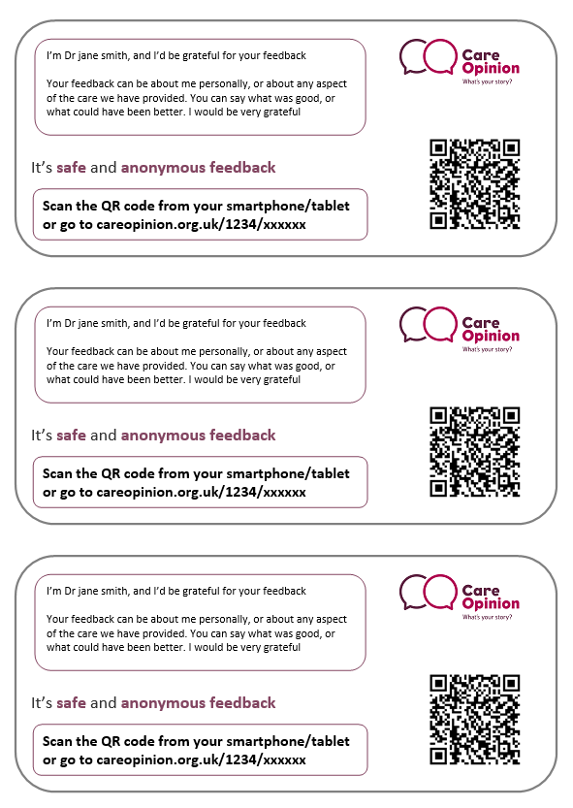
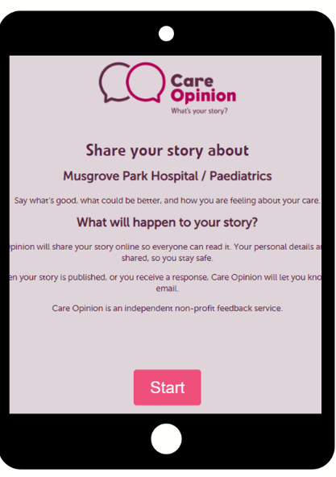
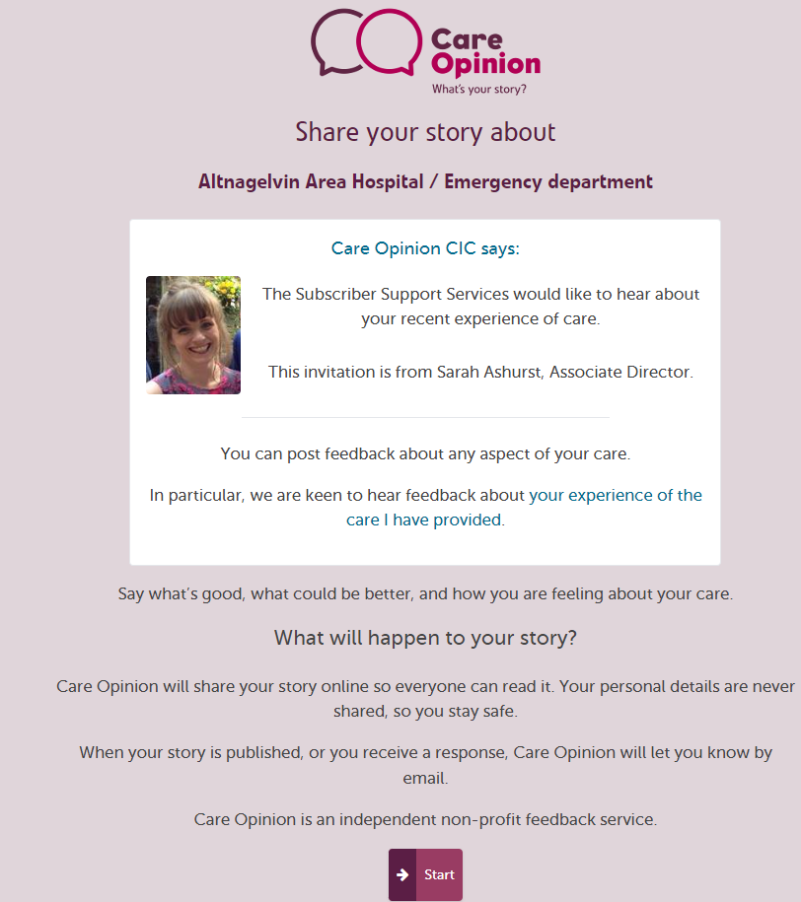

Slide 15
Some things to note
You should not change the name of an invitation link after you have created it
Be careful deleting active links. You will lose the connection between the stories
You can use all the CO reports and visualisations on stories submitted on the link
We run additional webinars on responding well to feedback and how to create reports and visualisations
https://www.careopinion.org.uk/info/support-webinars
Notes:
https://www.careopinion.org.uk/info/invitation-links

Slide 16
Questions?

Slide 17
Contact me:
sarah.ashurst@careopinion.org.uk

