Slide 1
Your feedback can be honest
You can post both positive and negative feedback about any aspects of our service, or about me. Care Opinion keeps both of us safe: your name never appears on the web site, and my name never appears in public on negative feedback. But I will still see your feedback and learn from it.
You may receive a response
If you look at other stories on Care Opinion, you will see that many have responses. A member of staff might post a response to your story too. If you get a response, Care Opinion will let you know by email.
I’m Dr Jane Smith, and I’d be grateful for your feedback
Your feedback can be about me personally, or about any aspect of the care we have provided. You can say what was good, or what could have been better.
Why I am asking for feedback
I am asking for your honest feedback so I can see our service through your eyes. Your feedback will help me, and others on the team, learn what we are doing well, and what we can improve.
What happens to your feedback?
After you share your feedback, Care Opinion will publish it on their website if they can, so everyone can read it. Sometimes Care Opinion has to make small changes before they can publish, to keep everyone safe.
Then they will email me, and other staff in our service, so we can read your feedback allowing many people to learn from what you say.
You will stay anonymous
You don’t put your real name on Care Opinion, so you stay anonymous. I will not know the feedback comes from you. Care Opinion will ask for your email address, but they never share it with us: it stays private.
Thank you
Thank you for considering my invitation to give
feedback.
With best wishes,
J Smith
https://
Give your feedback anonymously by:
By entering the following url to access the Care Opinion website or by scanning the QR Code above.
https://www.careopinion.org.uk/2796/xxxxxxxxx

Slide 2
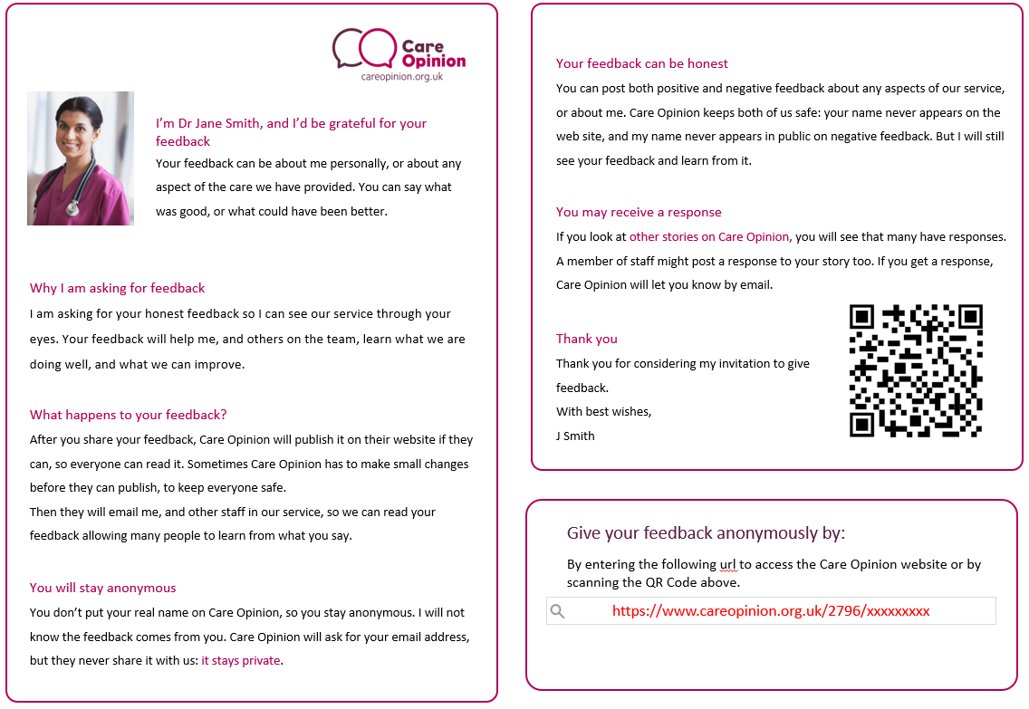
Instructions to personalize
1: Replace picture and name
2: Replace QR code with the one generated from your private invitation link
3: Relace link in red with your private invitation link

