Slide 1


How to Respond Well
Notes:
Tracy

Slide 2

Notes:
cally

Slide 3
In this session, we’ll help you...
Learn how to respond using the Care Opinion site
Understand what makes a good response
Think about what the author might want from a response
Think strategically about responding and how it can create change in services
Notes:
General Housekeeping:
We are using PP live which means you can move through the slides at you own pace (if you wish)
You can access the transcript of the webinar by clicking the 3 … in the top menu bar
We will be recording the webinar today and it will be uploaded to vimeo and shared online and with those registered for today’s webinar, so feel free to turn off your camera now if you don’t want to feature in the video
We will have time for questions at the end, but feel free to pop them in the chat as we go along and we’ll visit them at the end

Slide 4



Slide 5
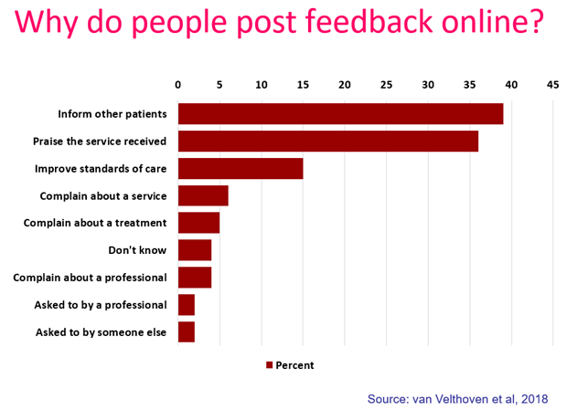
“It was therapeutic in healing my soul.”
“It was a difficult time for me to go through and Care Opinion allowed me to control the speed
and words rather than be rushed through Q&As or tick box scenario where things don't quite fit.”
“The fact I did not have to give my name made it a lot easier to provide feedback. I find it hard to do it in person.
I would like it to make changes.”

Slide 6
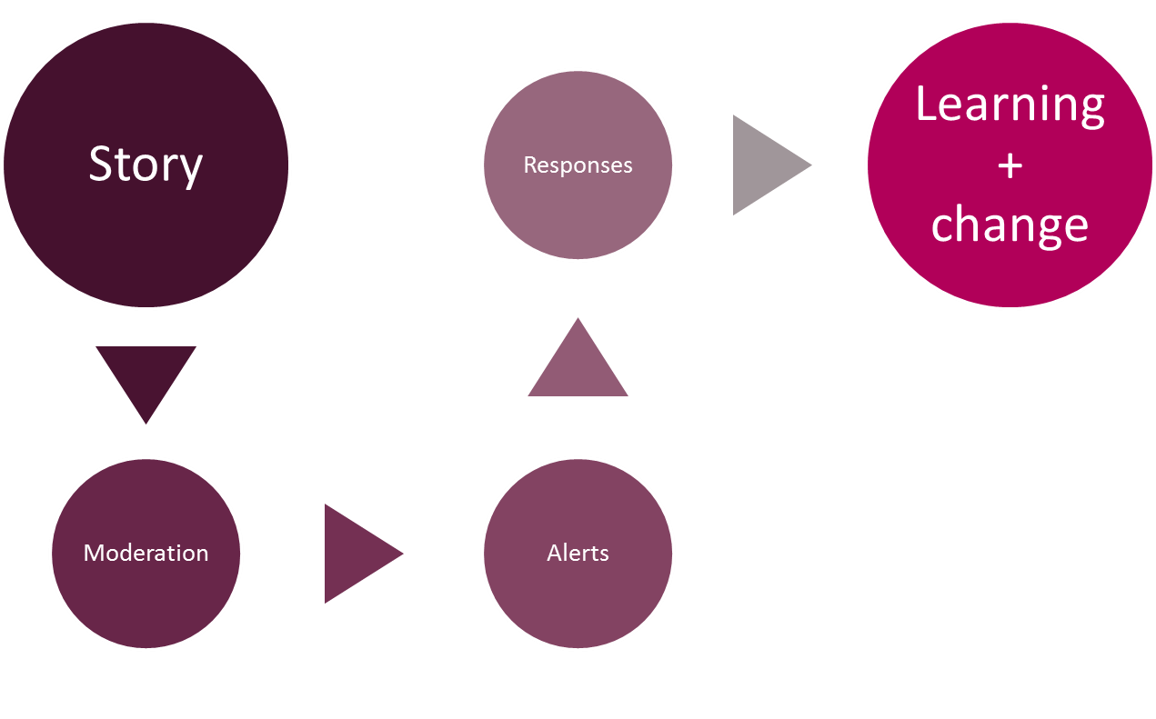
Stories – it’s about the conversation
Notes:
Tracy

Slide 7



Points before we start!
You, other responders and the author can respond to each other as many times as you wish
Never ask an author to disclose their personal information publicly – All responses are public once published on the website
By having a transparent, honest and safe conversation on Care Opinion, you can demonstrate to the public, how your service listens to feedback, resolves problems and works towards positive change
Notes:
Lisa

Slide 8
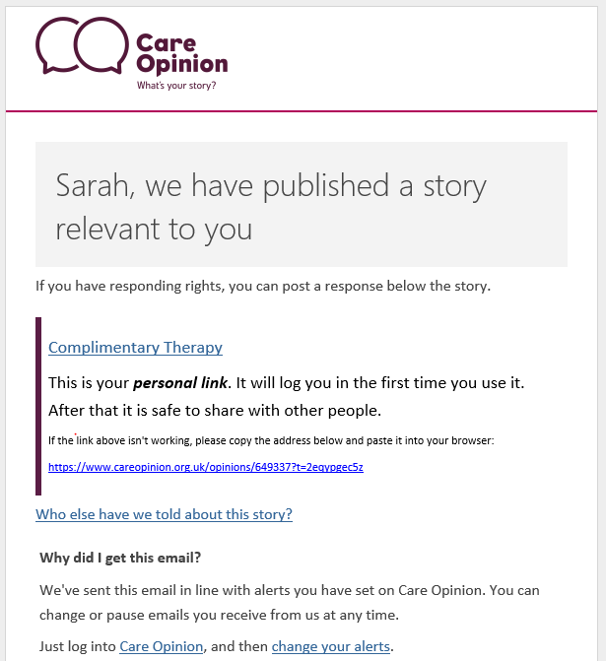

Practical Tip!
The link only log’s you into the site the 1st time
Notes:
Lisa

Slide 9
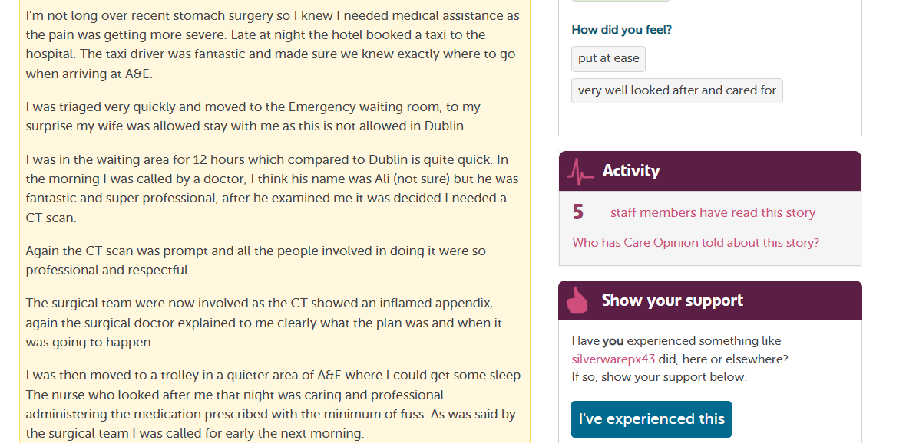
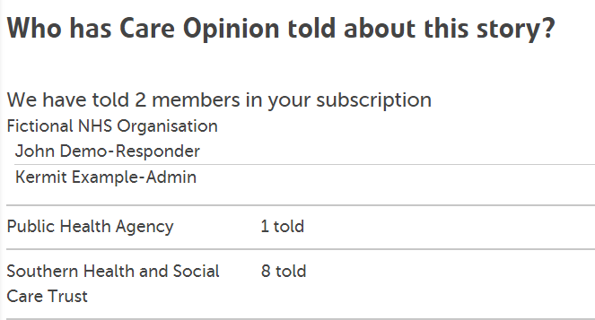

Who else received an email alert?

Slide 10
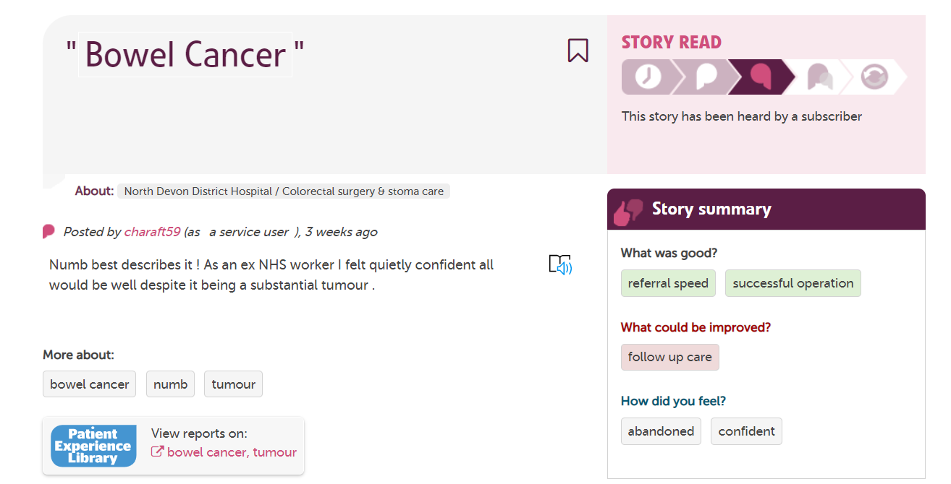
Pay attention to the ‘How did you feel?’ tags
The link only log’s you into the site the ^{st} time

Slide 11
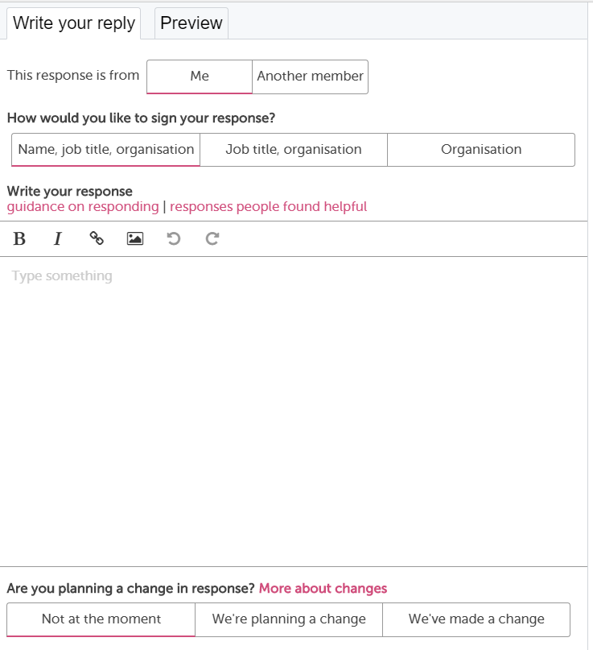
Notes:
Lisa

Slide 12

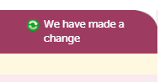
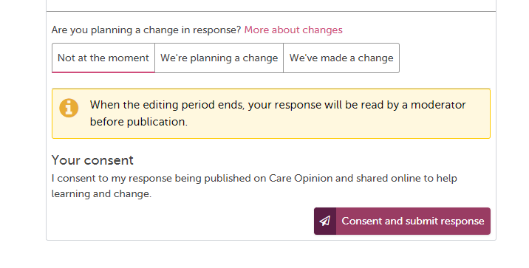
Demonstrating you’ve made a change!
30 minutes editing time once submitted
Notes:
Lisa

Slide 13
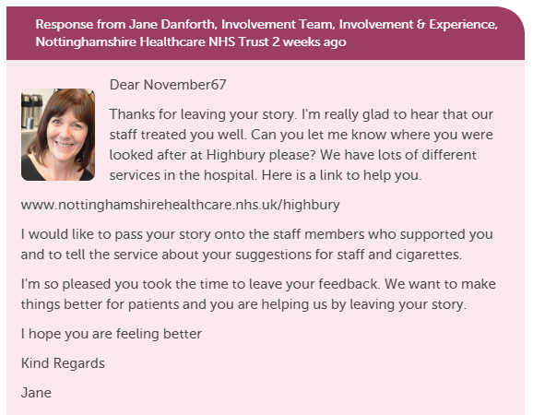
What does a Response look like on Care Opinion?
Include a profile picture
Add links and images
Invite the author to reply to
you or offer a method of contacting you/service
Notes:
Lisa

Slide 14

Preparing yourself for feedback…
Take a deep breath
Take your professional hat off
Imagine it’s you, what response would you expect?
Try to understand and connect with the motivation
Control any inclination to defensiveness
Walk away, reflect, get someone else’s viewpoint
Examine your own motivation –to learn, to improve, to protect, to defend

Slide 15
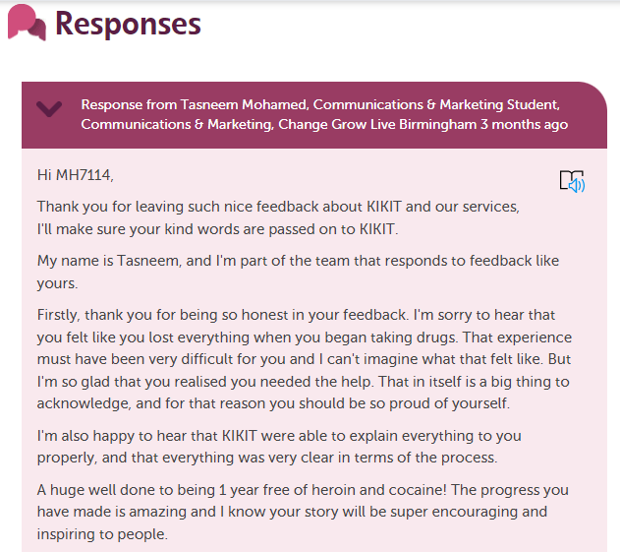
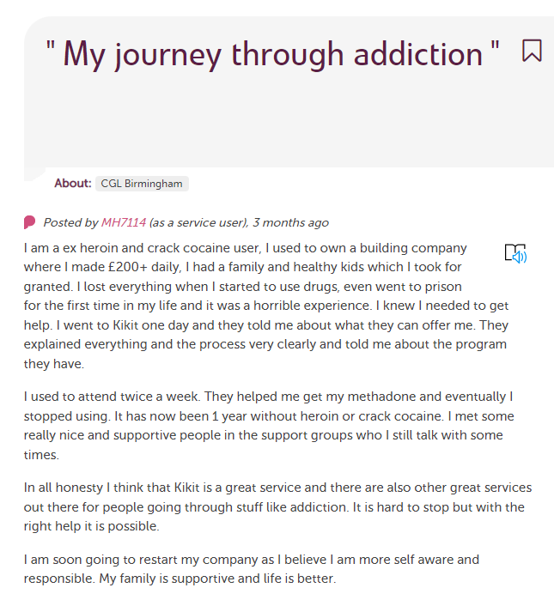
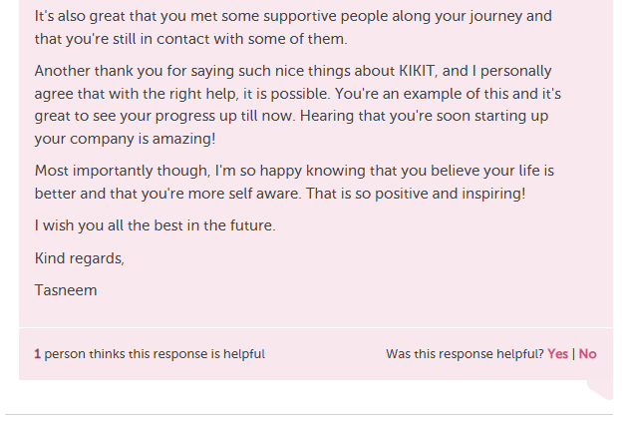
What does a really great Response look like on Care Opinion?
Click here to read full story
Notes:
Tracy

Slide 16
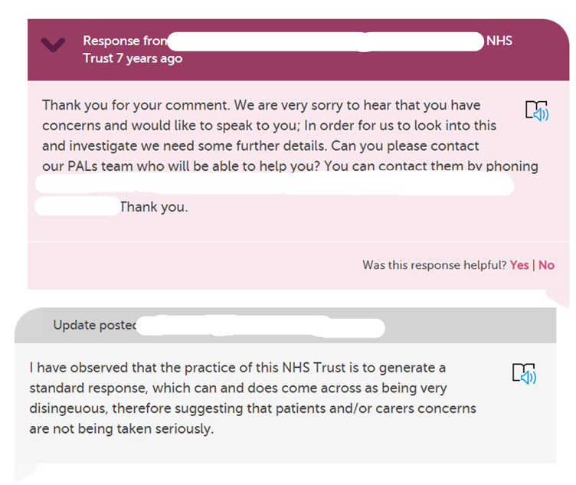
How would you feel if you got this response?
Research chat 17: organisational culture and online patient feedback | Care Opinion
Notes:
Tracy

Slide 17
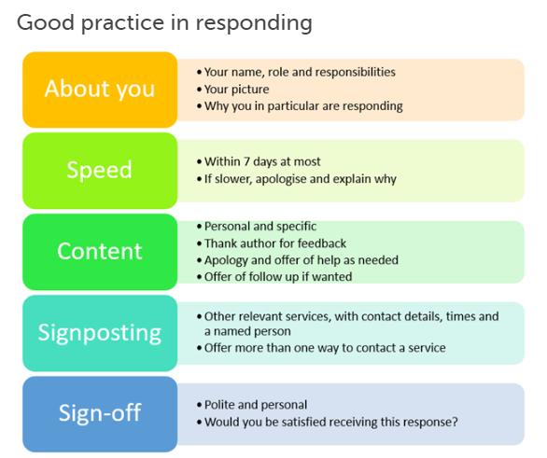
Blog post : Link to ‘What makes a good response’
Notes:
Tracy: People valued a response within 3 days and found it acceptable within 7 days. If the response has been delayed for any longer apologise if appropriate and explain why or add a holding response.
Be Personal & polite – The web is an informal place your responses don’t have to be corporate, they can be personal ☺

Slide 18
Examples of good responses
Empathy and understanding
Apologising
Explaining what normally happens or why things happen
Saying what you will do with the feedback
Saying what you will do to make an improvement
Notes:
Lisa

Slide 19
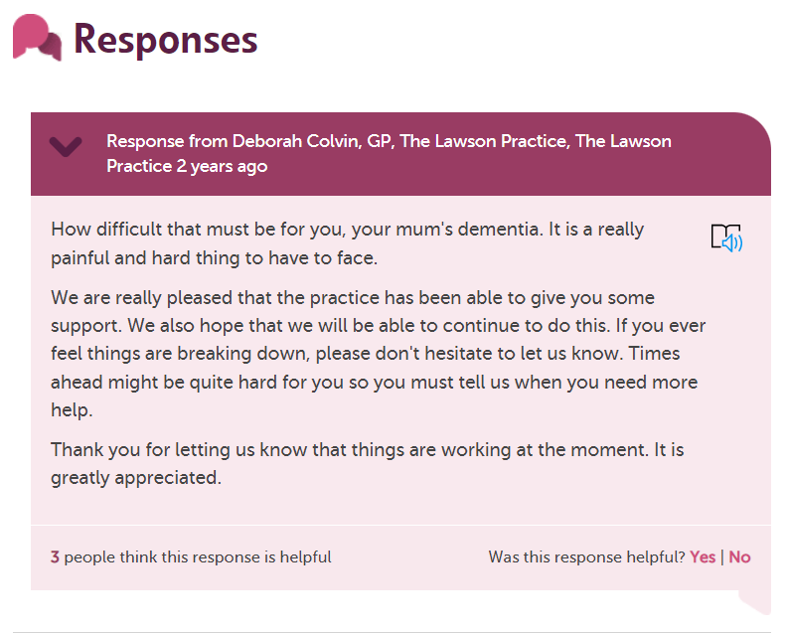
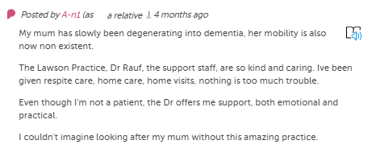
Empathy and understanding
Click here to read full story
Notes:
Lisa

Slide 20
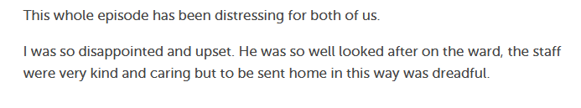
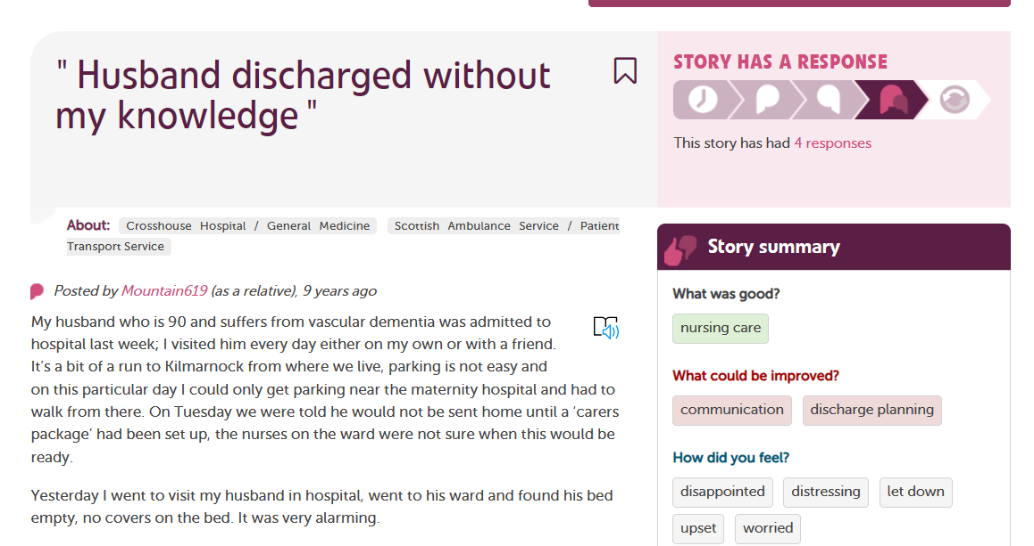
Apologising
Click here to read full story
Notes:
Tracy: There was no explanation why I had not been told he was being discharged.
I’m not sure how the driver got my husband into the house – I believe the driver was on his own, there are steps to the door so my husband could not be wheeled in.
My husband was sent home with a some equipment; I’m not sure what I’m supposed to do with this. A physiotherapist has been arranged; they will come sometime today or next Monday or Tuesday. I will need to wait until then to find out.

Slide 21
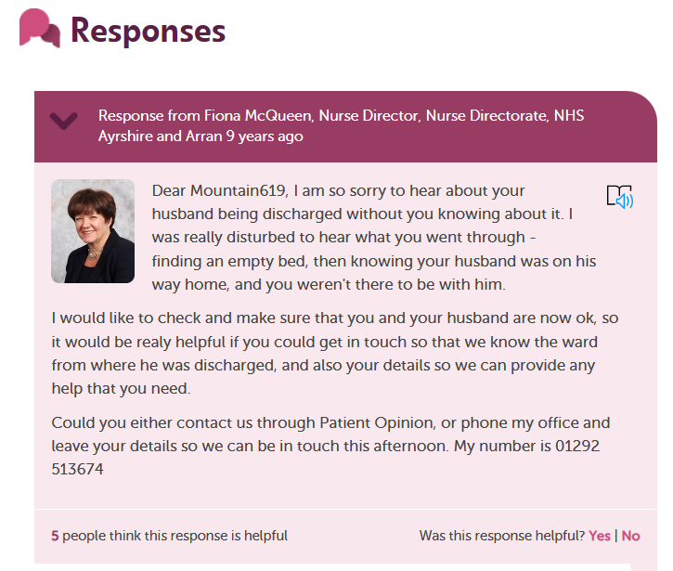
Apologising
“I am so sorry to hear about your husband being discharged without you knowing about it.”
Click here to read full story
Notes:
Tracy

Slide 22
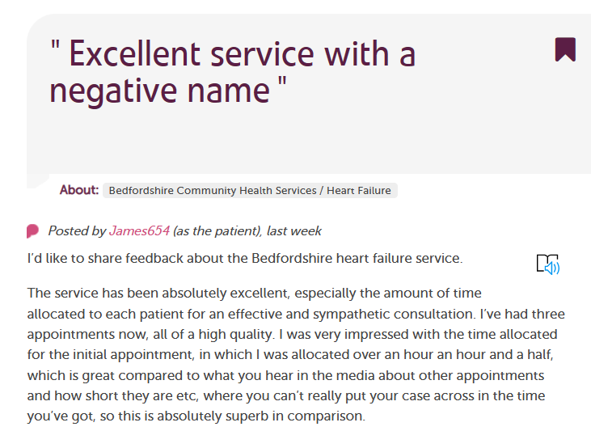
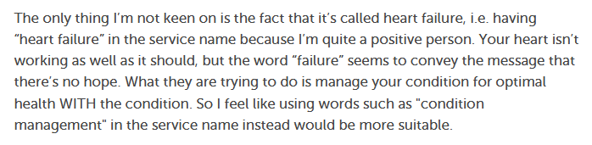
Explaining what normally happens or why things happen
Click here to read full story
Notes:
Tracy: It might help to explain what normally happens in a similar situation or what has happened previously, or in deed why things happen in a certain way.
It’s a good way to inform the people using your service why things are they way they are, it may be due to an organisational process in place for example.
It’s really about being transparent – When people understand a process it can be more easily accepted.

Slide 23
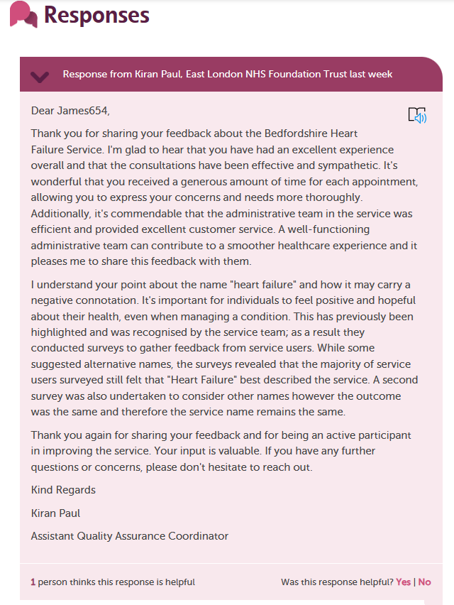
“This has previously been highlighted and was recognised by the service team; as a result, they conducted surveys to gather feedback from service users”.
Click here to read full story
Notes:
While some suggested alternative names, the surveys revealed that the majority of service users surveyed still felt that "Heart Failure" best described the service. A second survey was also undertaken to consider other names however the outcome was the same and therefore the service name remains the same.
Thank you again for sharing your feedback and for being an active participant in improving the service. Your input is valuable. If you have any further questions or concerns, please don't hesitate to reach out.

Slide 24
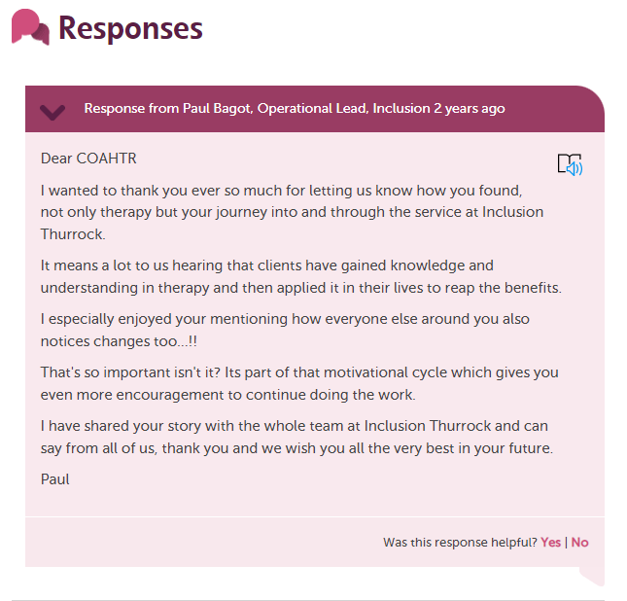
Saying what
you will do
with the
feedback
Click here to read full story
Notes:
Tracy: If you share the feedback with staff, tell the author that is what you have done.
Say “I have shared your feedback with staff” rather than “ I will”
Or likewise if you are able to make a change or are preparing to make a change this is your chance to let everyone know, the stories & responses on Care Opinion are public not just seen by the author.
Tell the author that their feedback is important and contributes to learning & service improvement. Telling the author that their story has made an impact can be a powerful thing!
A great response shows that you have really heard what the author is saying. Simply writing ‘thank you for your feedback’ can seem robotic and suggests the story hasn’t been fully read.
We always recommend responding directly to the point the author has made in the story, it lets the author know they have been heard.

Slide 25
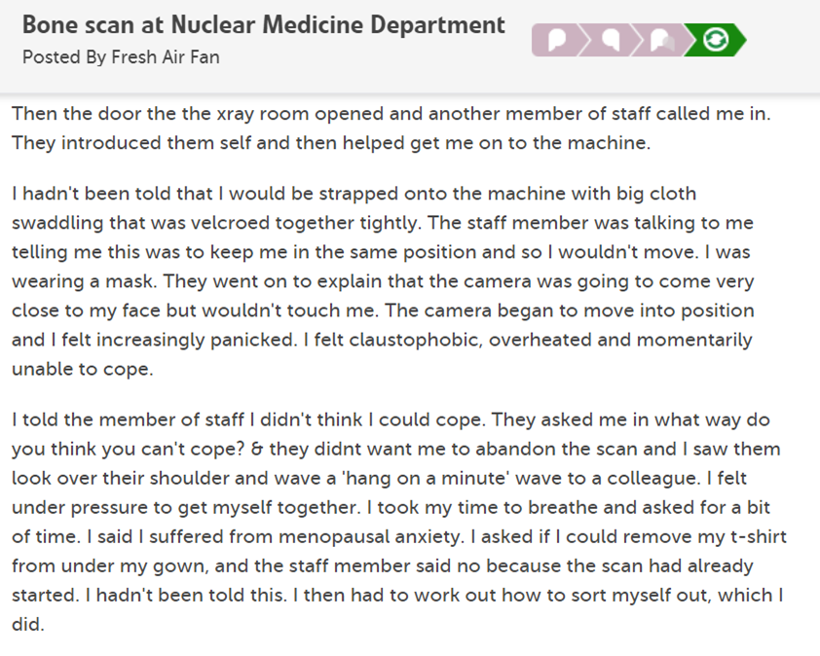
Saying what you will do to make an improvement
Notes:
Tracy: A nurse / technician did my injection. They were very friendly and jokey, but missed a few opportunities to explain things to me. The leaflet said: if you are claustrophobic to tell a member of staff when you arrive. I told the technician I was mildly claustrophobic but thought I'd be OK.
I was proud of myself for getting through it but I felt I could have had more support from the team to help me get through a stressful experience. There seemed to be no idea how to help someone cope who was anxious and claustrophobic - no reassuring continual speaking to me as the patient, I felt like I had to do all the problem solving. No help with visualisation, or breathing.
The camera began to move into position and I felt increasingly panicked. I felt claustophobic, overheated and momentarily unable to cope.

Slide 26
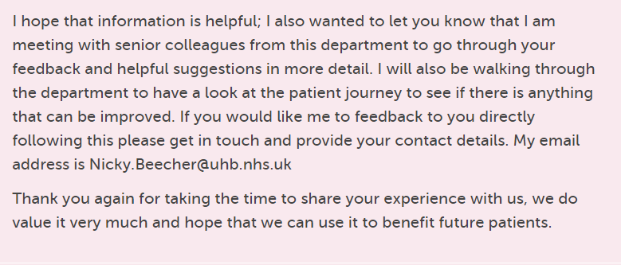
Initial responses from people in the department about what should have happened and offering follow up, ending with….
Making that ‘Planned Change’
into a
‘Change made’
Click here to read full story
Notes:
Tracy

Slide 27
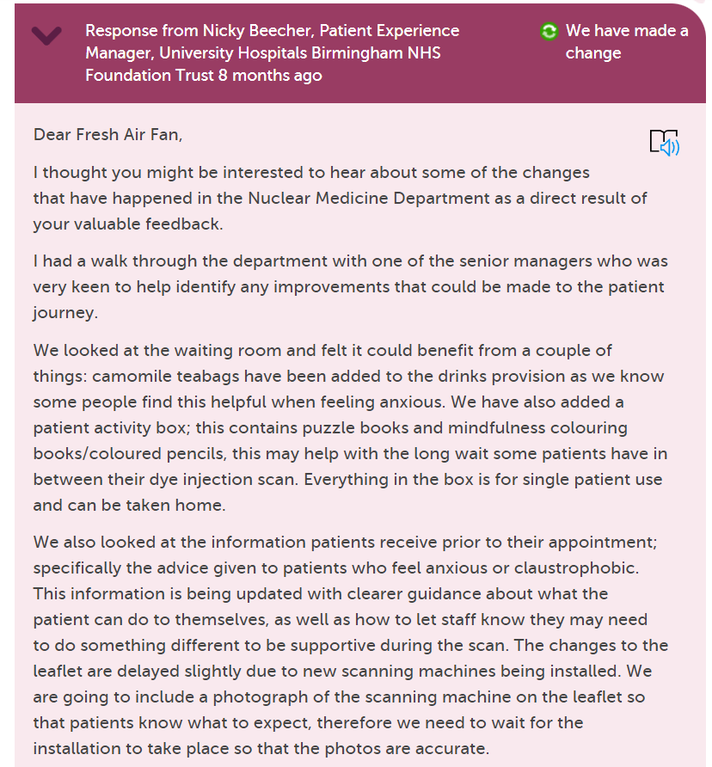
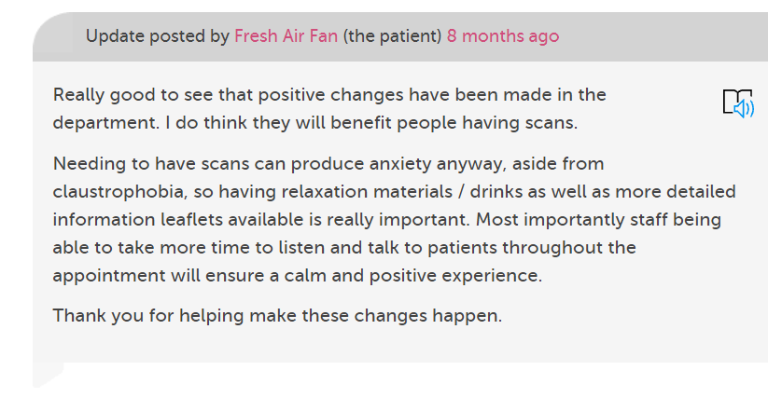
Several changes made from a walk through
Blog: Being a critical friend
Notes:
Tracy

Slide 28
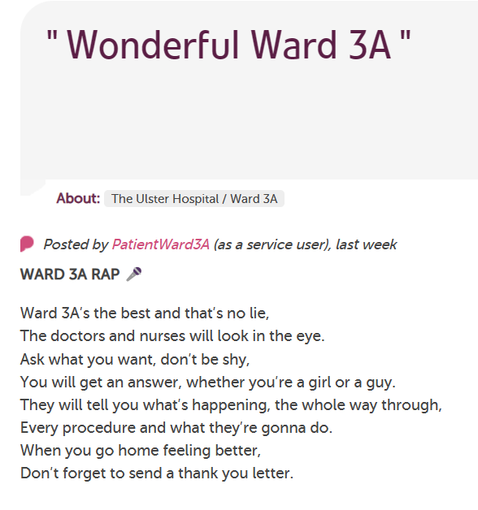
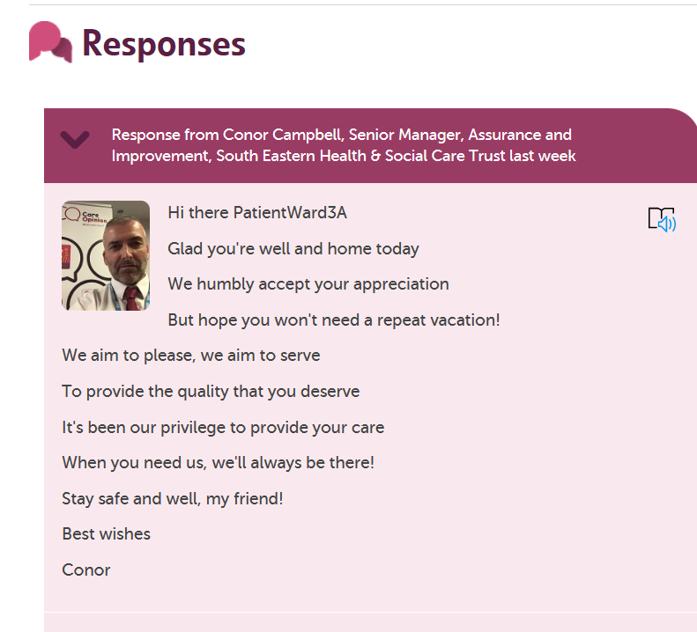
And a little something different

Slide 29
Responding Re-cap
Prepare yourself for the feedback, don’t rush, ask for support from other staff if you need a 2nd opinion
Take your professional hat off, put yourself in the authors shoes, what response would I be happy with?
Try not to be defensive & apologise sincerely
Use the ‘Change’ logos in your responses
Sign off with full signature as often if you can
Be personal but polite, no cut & paste generic responses
Notes:
Tracy

Slide 31
Questions/Comments?
info@careopinion.org.uk

Slide 32
Thank
you

