Slide 1


How to Respond Well
Notes:
Tracy

Slide 2

Notes:
Lisa

Slide 3
In this session, you will learn...
How to respond to stories on Care Opinion
What makes a good response
What authors might want in a response
How to show you’re planning or have made a change to your service, as a result of feedback
Notes:
General Housekeeping:
We are using PP live which means you can move through the slides at you own pace (if you wish)
You can access the transcript of the webinar by clicking the 3 … in the top menu bar
We will be recording the webinar today and it will be uploaded to vimeo and shared online and with those registered for today’s webinar, so feel free to turn off your camera now if you don’t want to feature in the video
We will have time for questions at the end, but feel free to pop them in the chat as we go along and we’ll visit them at the end

Slide 4
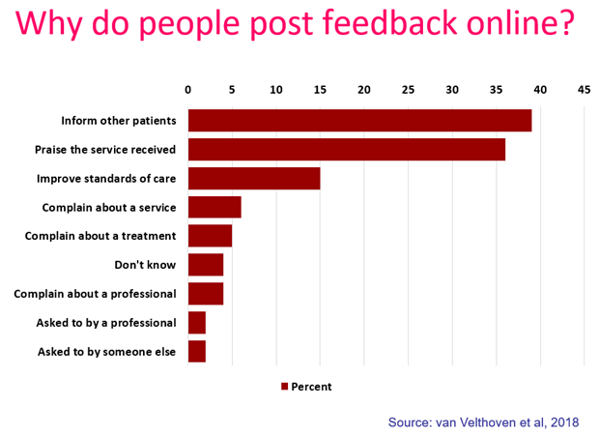
“It was therapeutic in healing my soul.”
“It was a difficult time for me to go through and Care Opinion allowed me to control the speed
and words rather than be rushed through Q&As or tick box scenario where things don't quite fit.”
“The fact I did not have to give my name made it a lot easier to provide feedback. I find it hard to do it in person.
I would like it to make changes.”

Slide 5
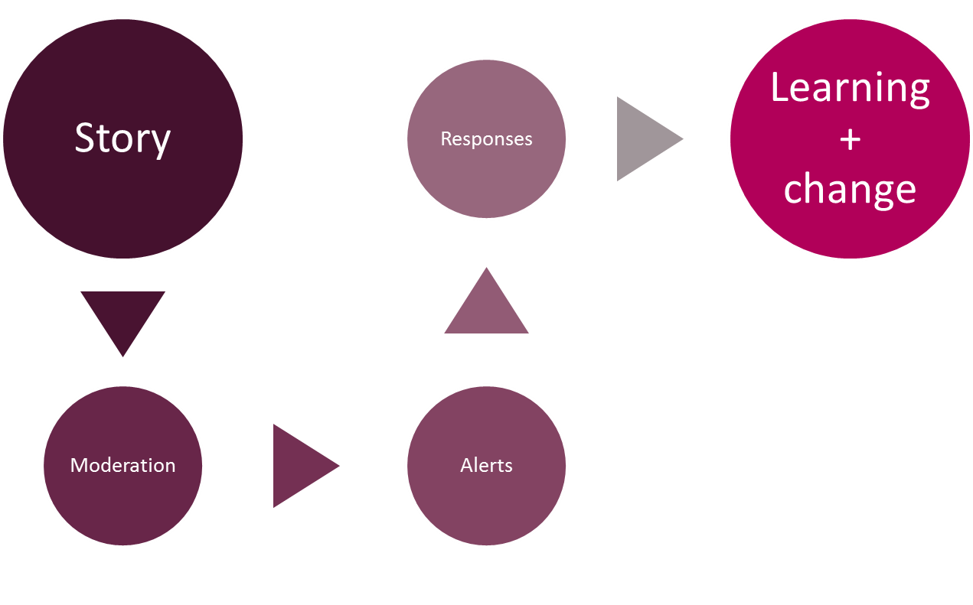
Stories – it’s about the conversation
Notes:
Tracy

Slide 6



Points before we start!
You can respond as many times as you wish
Never ask an author to disclose their personal information on the website.
A transparent, honest and safe conversation on Care Opinion demonstrates that your service listens to feedback, resolves problems and works towards positive change.
Notes:
Lisa

Slide 7
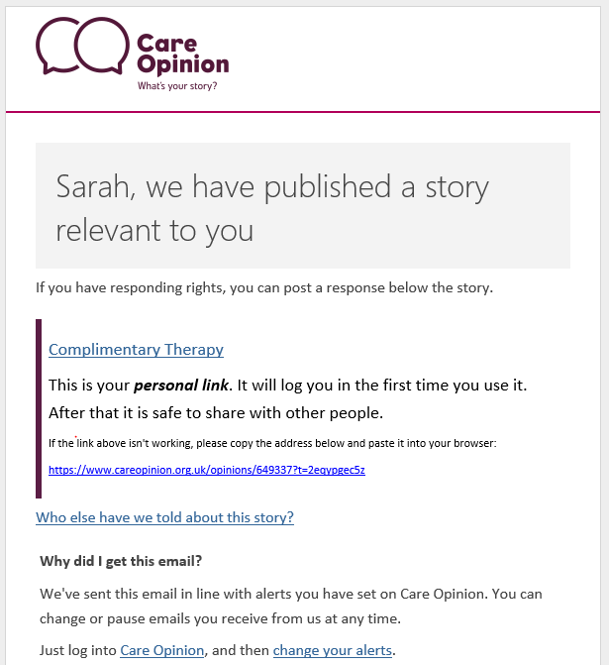

Practical Tip!
The link only logs you into the site the 1st time
Notes:
Lisa

Slide 8
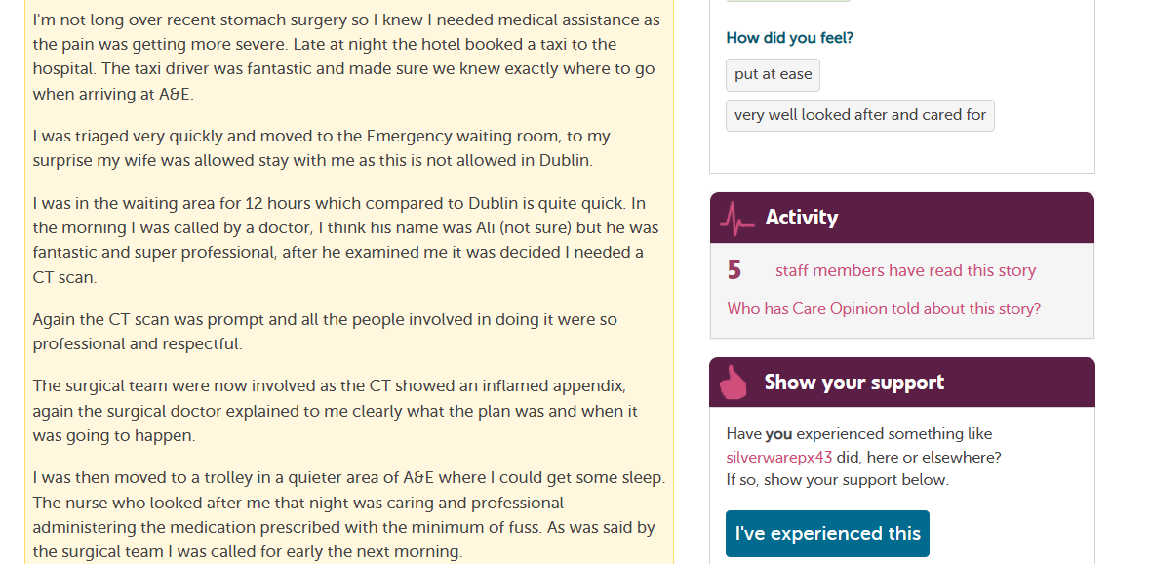
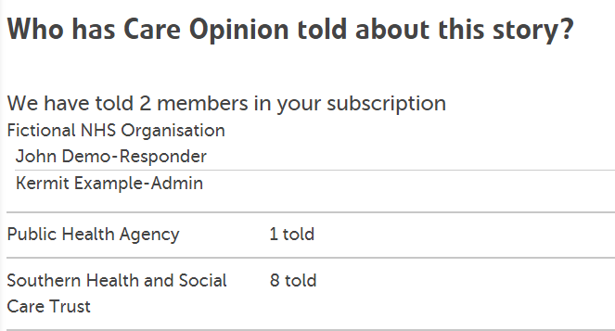

Who else received an email alert?

Slide 9
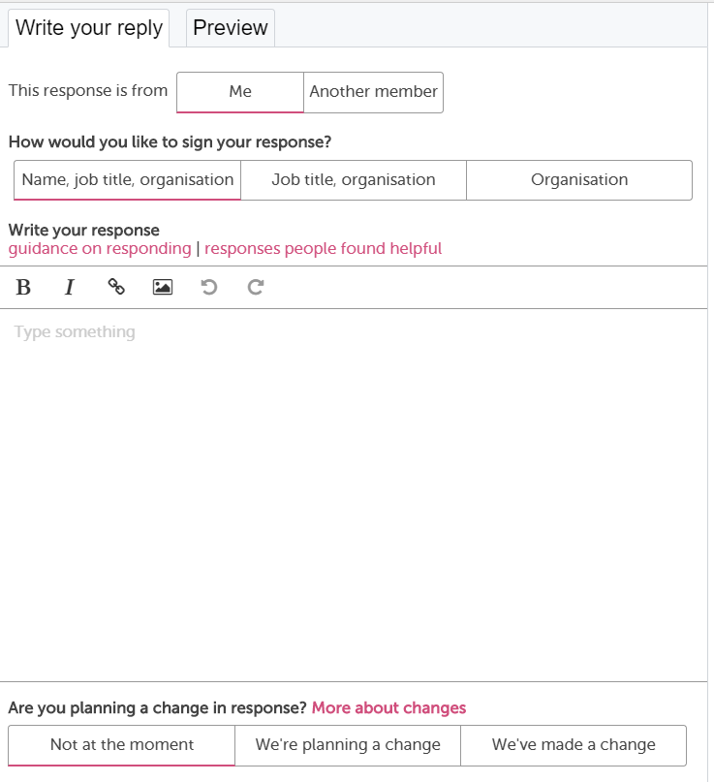
Notes:
Lisa

Slide 10

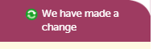
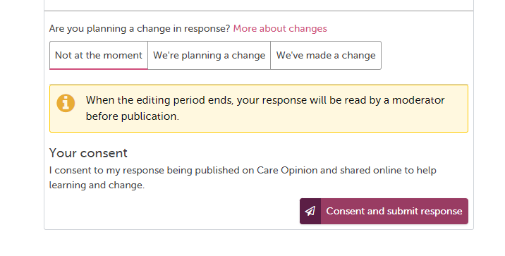
Demonstrating you’ve made a change!
30 minutes editing time once submitted
Notes:
Lisa

Slide 11


Demonstrating a change!
Must affect the service and patients/service-users directly.
Can be big or small.
Can be planned for the future or made immediately – update with a new response once the change has progressed or been made!
Can be planning actions in staff meetings or updating staff training or maybe seeking funding to make the change.
Can be made on positive and critical stories e.g. good practice can be replicated or enhanced in other parts of a service/organisation.
Notes:
Lisa

Slide 12
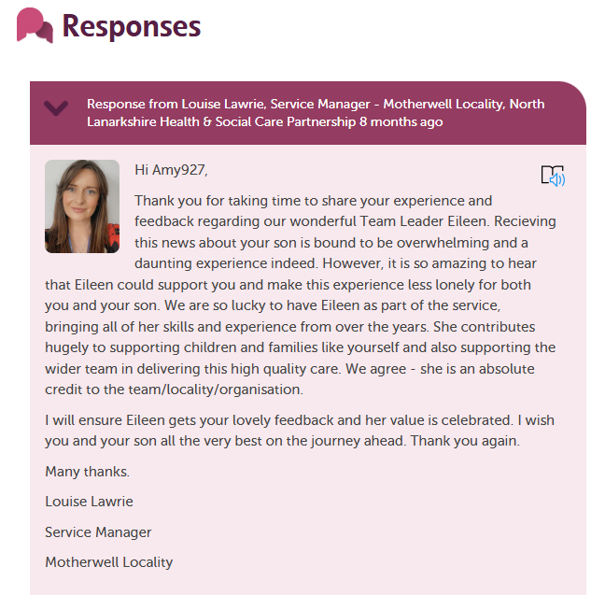

What does a great Response look like on Care Opinion?
Profile picture
Personal touch
Saying what you will do with the feedback
Sign off
Has went over and above for me and my son | Care Opinion
Notes:
Tracy

Slide 13

Preparing yourself for feedback…
Take a deep breath
Take your professional hat off
Imagine it’s you, what response would you expect?
Try to understand and connect with the motivation
Control any inclination to defensiveness
Walk away, reflect, get someone else’s viewpoint
Examine your own motivation –to learn, to improve, to protect, to defend

Slide 14
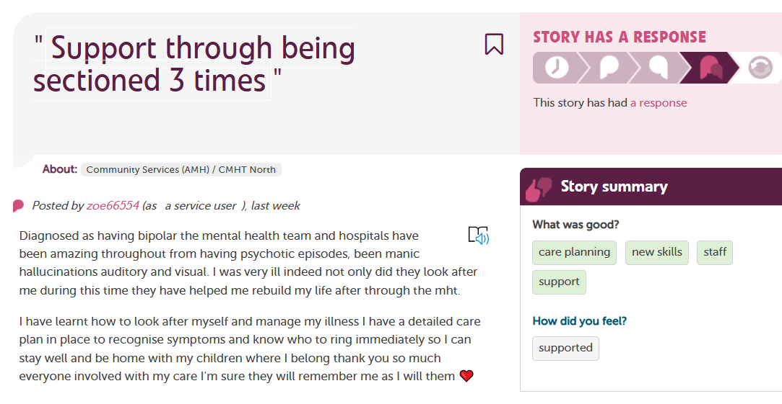
Pay attention to the ‘How did you feel?’ tags

Slide 15
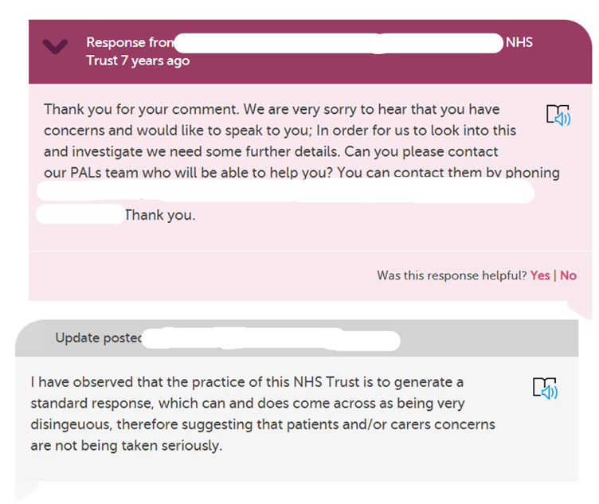
How would you feel if you got this response?
Notes:
Tracy

Slide 16
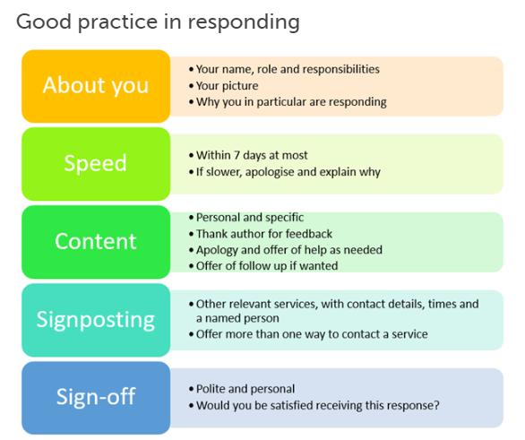
Blog post : Link to ‘What makes a good response’
Notes:
Tracy: People valued a response within 3 days and found it acceptable within 7 days. If the response has been delayed for any longer apologise if appropriate and explain why or add a holding response.
Be Personal & polite – The web is an informal place your responses don’t have to be corporate, they can be personal ☺

Slide 17
5 elements of good responses:
Empathy and understanding
Apologising
Explaining what normally happens or why things happen
Saying what you will do with the feedback
Saying what you will do to make an improvement
Notes:
Lisa

Slide 18
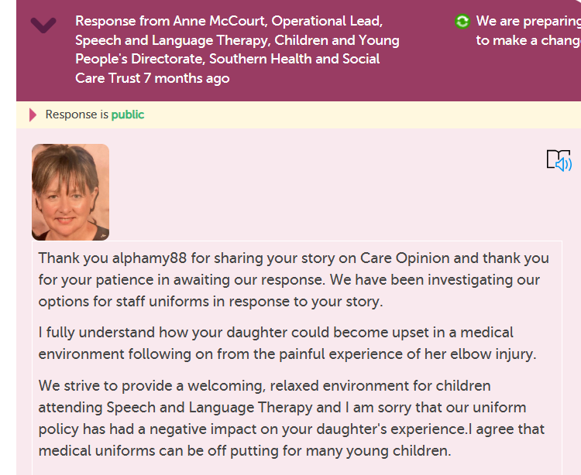
Say what you’ve done with the feedback
Empathy
Explaining what normally happens
Apologising

Slide 19
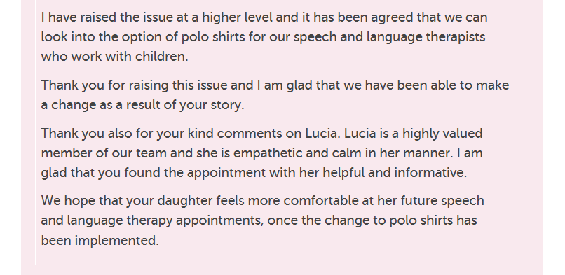
Say how you’ll make an improvement

Slide 20

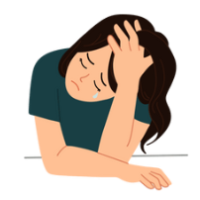

Responding to critical feedback
Remember, it’s entirely normal to feel…
Angry
Upset
Frustrated
But your goal is to improve the relationship, not to prove who is right.
Show the author that you have listened to them.
And show that you genuinely care about the experience they’ve had.
Notes:
Tracy

Slide 21

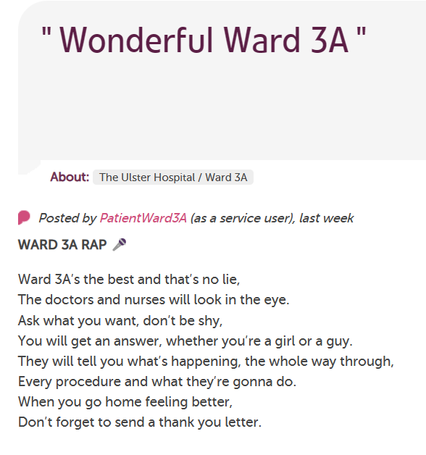
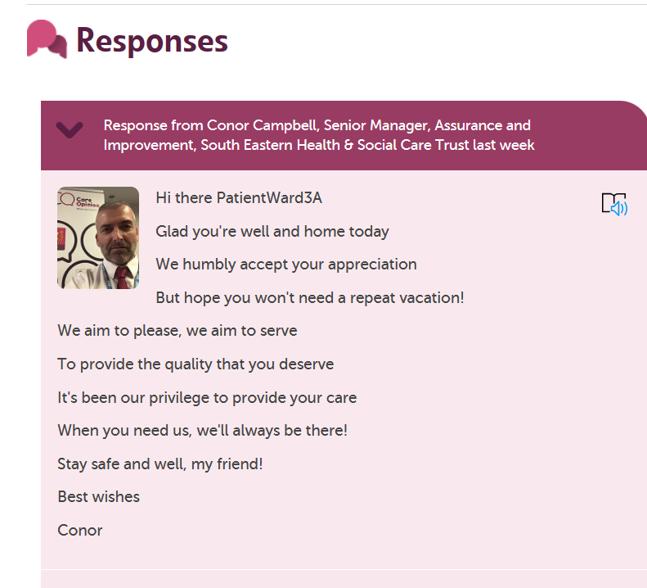
And something different

Slide 22



Nominate a Star Responder…
Star Responder | Care Opinion

Slide 23
Questions/Comments?
Email us: info@careopinion.org.uk

Slide 24
Thank
you

