Slide 1
Responding well and demonstrating impact
Guidance for Mental Health Services

Slide 2
Aim of today’s training
We’ll help you to:
Consider why people share their feedback online
Understand the journey of a story
Navigate how to respond on Care Opinion
Think about what people might want from a response
Understand what makes a good response
Consider the importance of how the author is feeling when drafting a response
Get impact from your feedback - and show it!
Think strategically about responding and change

Slide 4
What the research says…
“Patients were wary of giving feedback before discharge for fear of persecution; this anxiety was shared by carers, who often felt excluded by staff”
“The research found that “few trusts had robust or extensive processes for analysing data in any detail and we found little evidence that patient feedback led to service change.”
“Positive feedback was seen by both patients and staff as having equal value to negative feedback in maintaining or improving the quality of inpatient mental health care.”
Weich S, Fenton S-J, Staniszewska S, Canaway A, Crepaz-Keay D, Larkin M, et al. Using patient experience data to support improvements in inpatient mental health care: the EURIPIDES multimethod study. Health Serv Deliv Res 2020;8(21)

Slide 5
Why do people share their feedback online?
Source: Van Velthoven et al, 2018

Slide 7
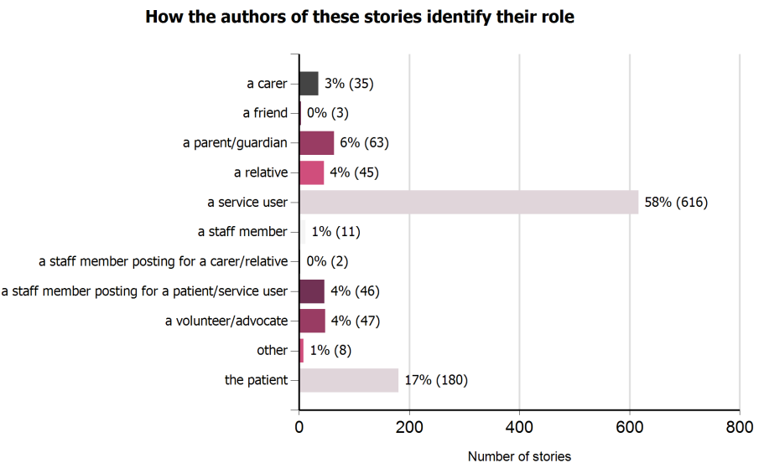
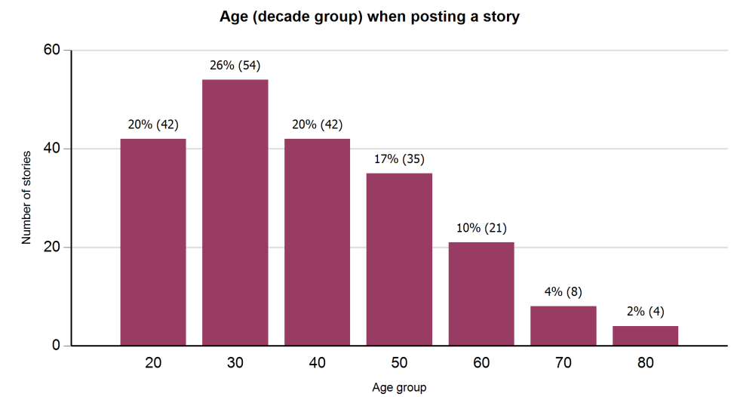
Mental Health stories at a glance… Since 1st April 2021

Slide 8
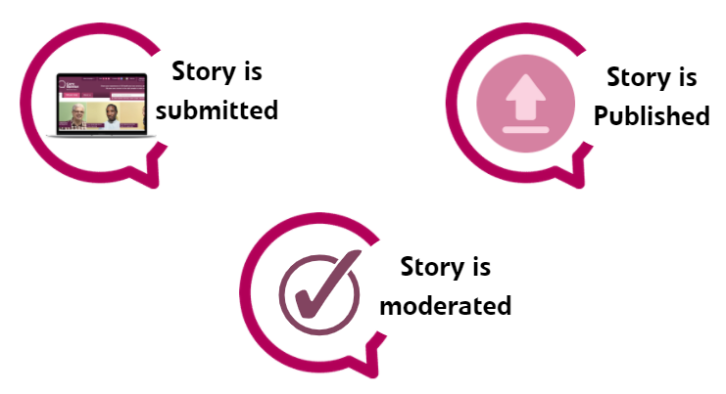
A story’s journey – what you see…

Slide 9
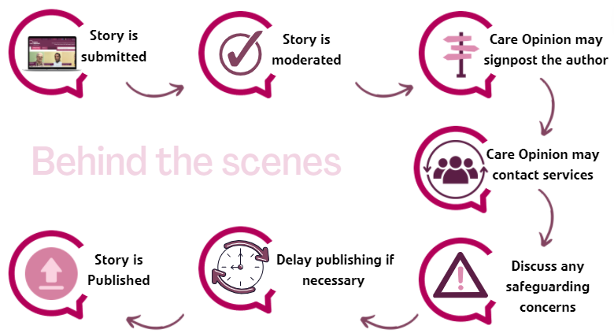
A story’s journey - What really happens…

Slide 10
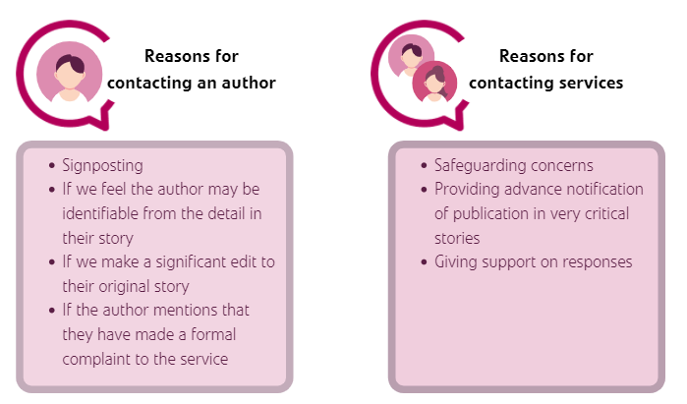
The moderation process

Slide 11
Support from the Care Opinion team
First line moderators
Second line moderators
Safeguarding Lead
Moderate stories using our moderation guidelines
Have access to signposting and safeguarding information & resources
Receive internal training on safeguarding
Refer stories of concern to 2nd line moderators
Staff with more experience/senior members of the team
Will review and discuss any stories of concern or very critical stories (criticality 4 or above)
Provides support and advice to 1st and 2nd line moderators
Delivers safeguarding training to moderators
Develops safeguarding resources and guidelines for moderators to use
Care Opinion itself has no powers to investigate concerns about abuse or neglect, but we can help to make sure such concerns are reported to the proper authorities.
Read more about how we moderate stories here.

Slide 12
Support from the Care Opinion team (Continued)
Story Locking
Although at Care Opinion we actively encourage open and honest conversations, we do recognise that sometimes this cannot be achieved. To support responders, we now have the ability to ‘lock’ a story, which prevents any further comments from being made.
If we feel that it is not in anyone’s best interests to continue a conversation on the Care Opinion site, then we may decide to use this feature and lock the story to further responses.

Slide 13
How to respond to stories
Email to your inbox
Scroll to the bottom of the story and click ‘post your response’
Click on the story title
Bitesized - How to respond on Care Opinion on Vimeo

Slide 14
Good practice in responding
Before you can respond to feedback, people must share their story on Care Opinion! Here are some quick pointers, based on the evidence discussed, about encouraging people to give their feedback about Mental Health Services…
Explain who Care Opinion is – Independent from NHS, social enterprise /CIC, encourages social value
Explaining its safe! Always inform your patients/service users that feedback is anonymous
That you will get a response - This is a key motivational factor for many people to share their feedback, so it is always worth mentioning
Show you are a listening organisation and that you use the feedback in a constructive way to learn from & improve services for others – explain why feedback is so important​

Slide 15
Good practice in responding
Your name, role & responsibilities
Your picture
Why you in particular are responding
Within 7 days at the most
If slower, apologise and explain why
Personal and specific
Thank author for feedback
Apologise and offer help as needed
Offer follow up if wanted
Other relevant services, with contact details
and a named person if possible
Offer multiple ways of contacting if possible
Polite and personal
Would you be satisfied receiving this response?

Slide 16
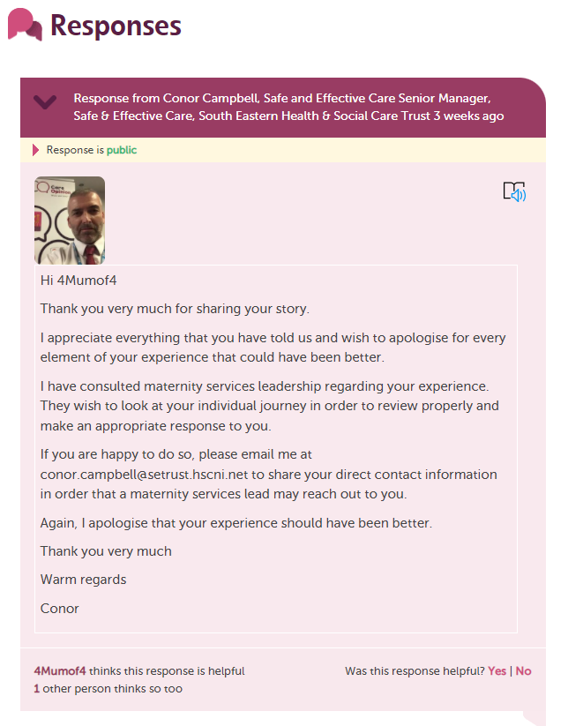
Good practice in responding

Slide 17
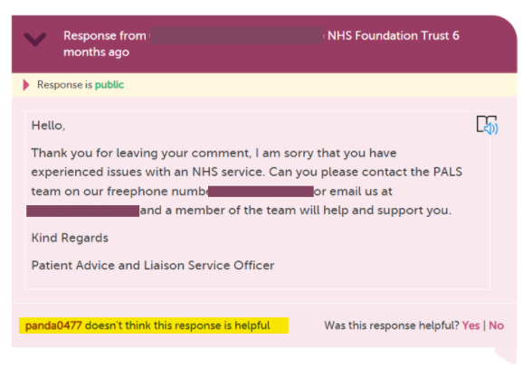
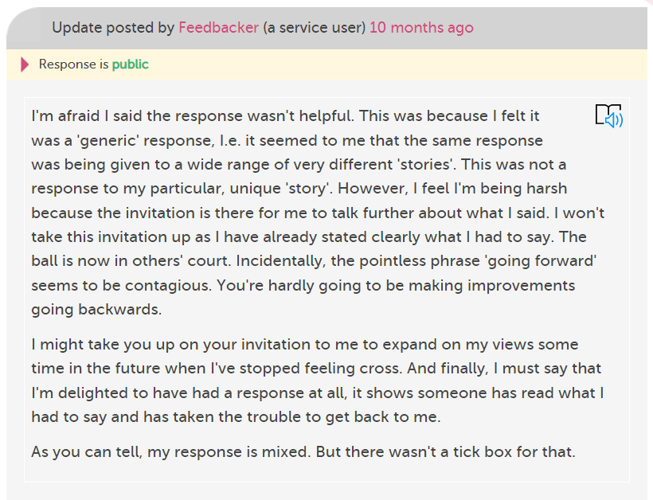
Good practice in responding
Avoid using standard or ‘copy & paste’ responses…

Slide 18
Understanding and engaging with the Author Feelings, situation and Care
Author
Provider
Care giver
Dr

Slide 19
Issues around care that need signposting
Unhappy with Care - Why e.g lack of care, disagreement about treatment
Is author posting for first time?
Who is involved with care?
What can I offer?
Holding response
Other providers involved
What does the author want?

Slide 20
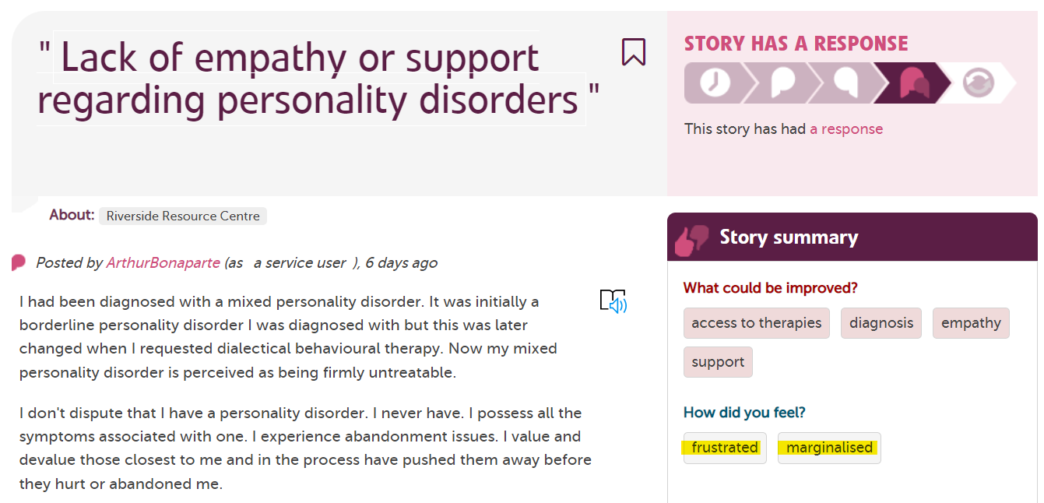
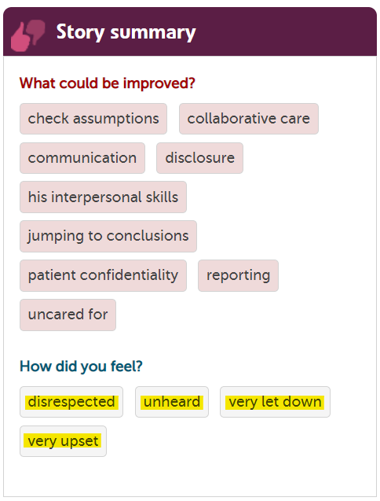
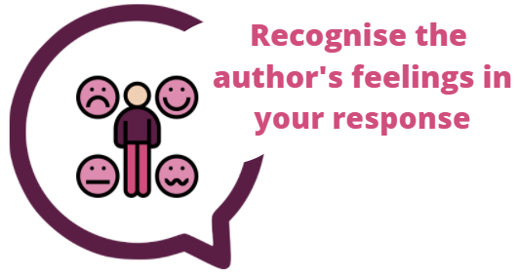
Feelings, Situation and Care
Understanding and engaging with the Author

Slide 21
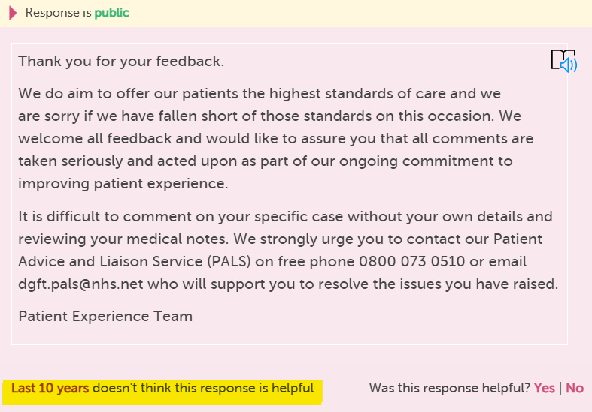
Asking the author to contact you
Asks the person to break anonymity
Takes the conversation offline
Less transparency
Communication barrier
Desire to fix the situation

Slide 22
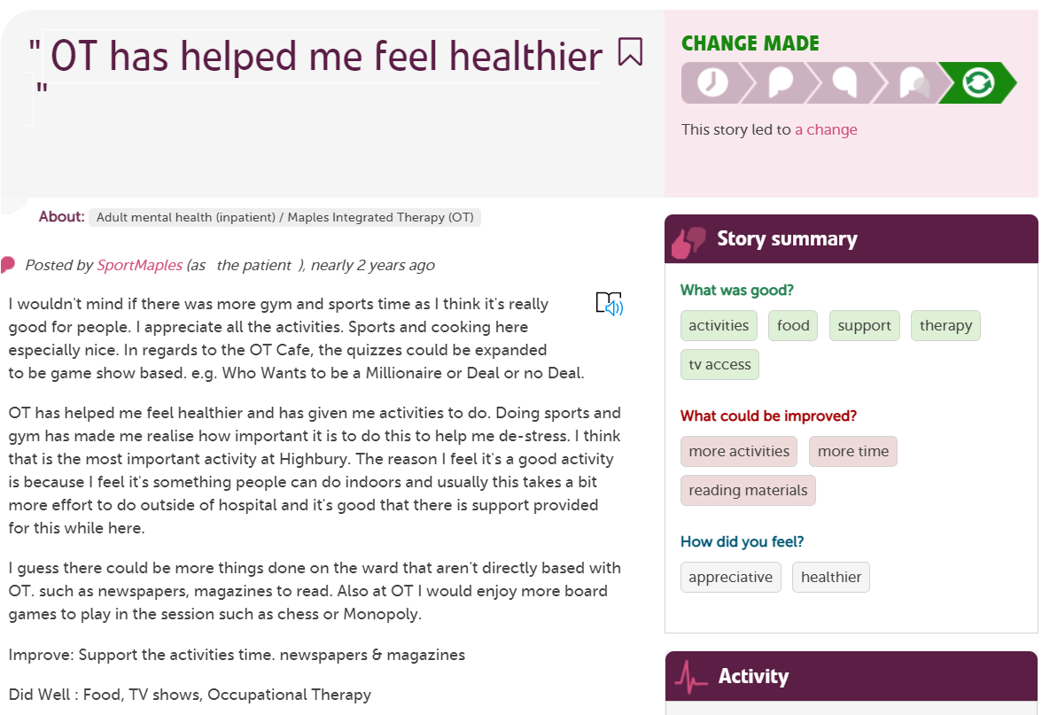
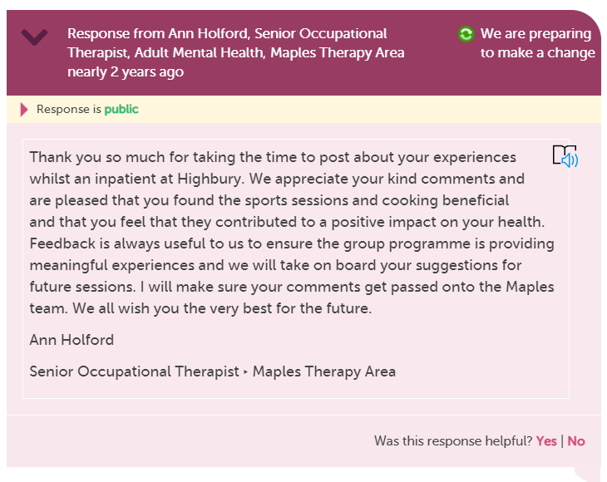
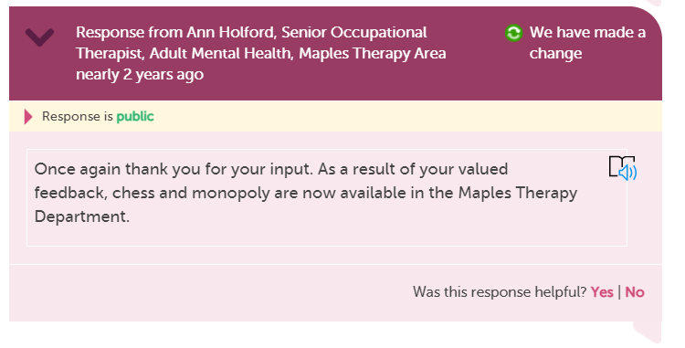
OT has helped me feel healthier | Care Opinion

Slide 23
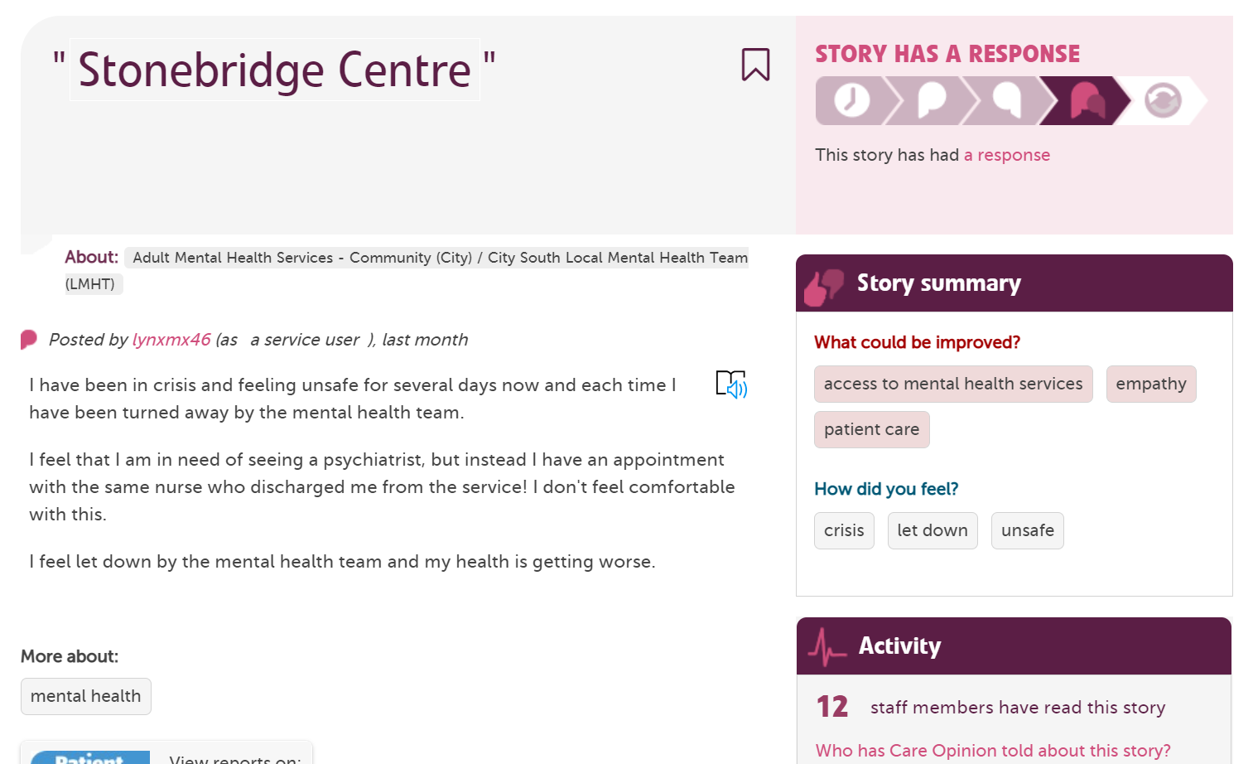
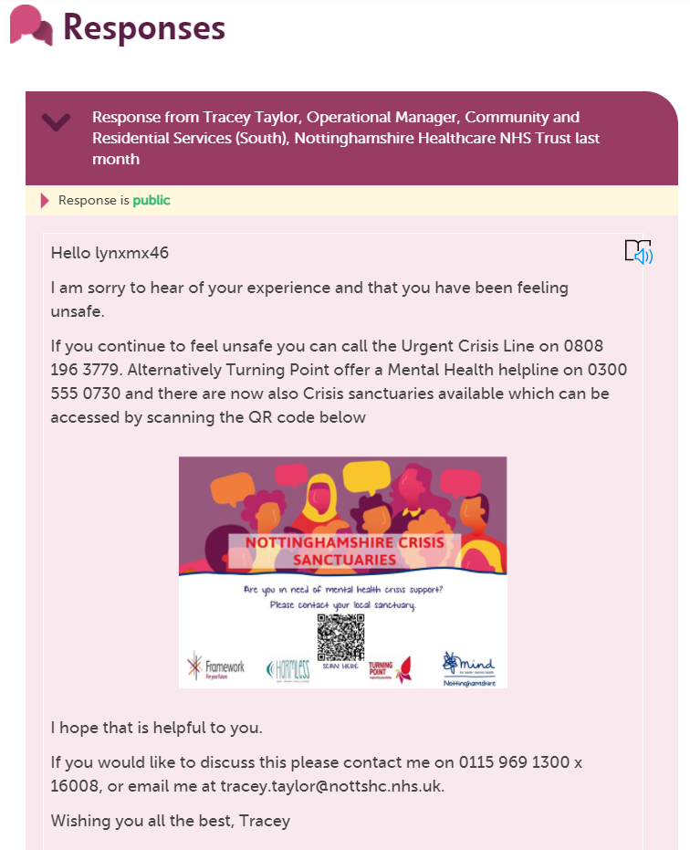
Stonebridge Centre | Care Opinion

Slide 24
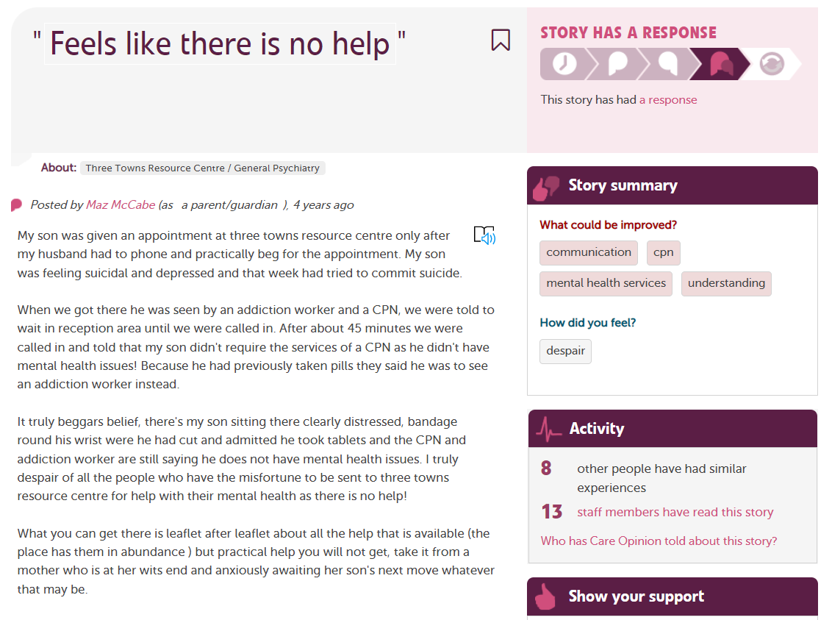
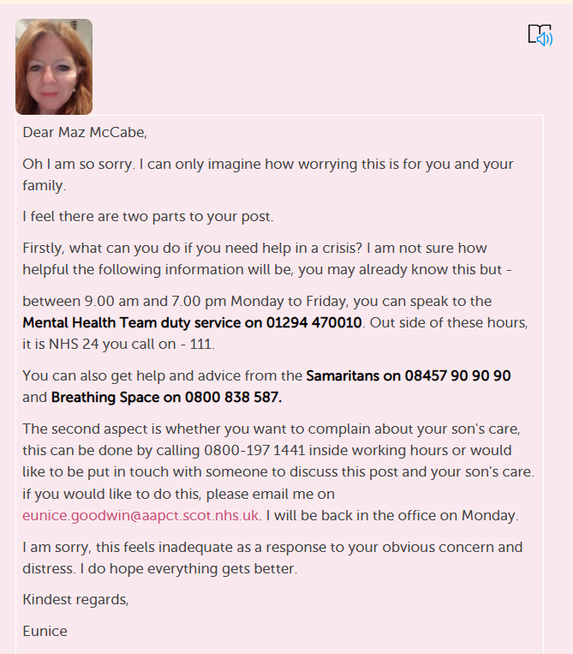

Slide 26
More response examples
Empathetic, kind and proactive | Care Opinion
Always sympathetic | Care Opinion
autism | Care Opinion
Mental Health Matters | Care Opinion
Borderline personality disorder | Care Opinion
I did not feel safe | Care Opinion
I would rather just stay quiet | Care Opinion

Slide 27
Further reading on Mental Health Services and feedback
User feedback in acute mental health care: making it better | Care Opinion
Research chat 5: Principles for effective feedback in adult mental health | Care Opinion
User feedback in acute mental health care: why isn't it working? | Care Opinion
Why do I post on Care Opinion? | Care Opinion
Feedback via Care Opinion: a dainty dish to set before the Trust | Care Opinion
Care Opinion Chat #2: Mental Health, why it's important to give people a voice | Care Opinion
How we deal with concerns about vulnerable people | Care Opinion

