Slide 1
Introducing Care Opinion in a Large Multi Site Health Trust – challenges and opportunities
Belfast Health and Social Care Trust

Slide 2
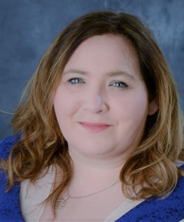
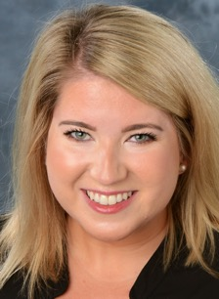
About us
Máire Alexander
Patient and Client Experience Manager
Caitlin Cosgrove
Patient and Client Experience Facilitator

Slide 3
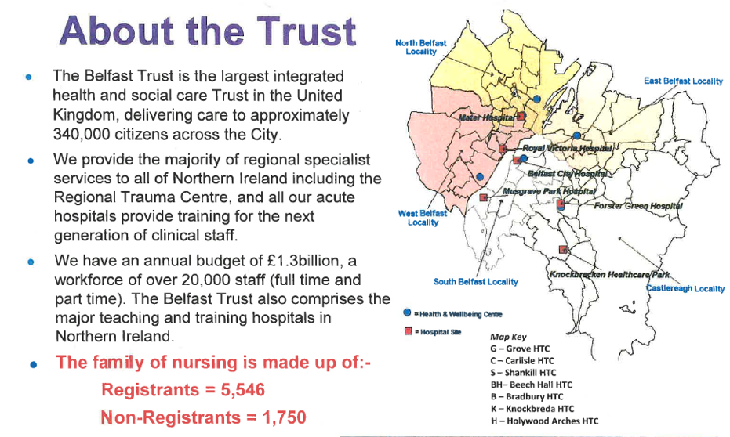

Slide 4
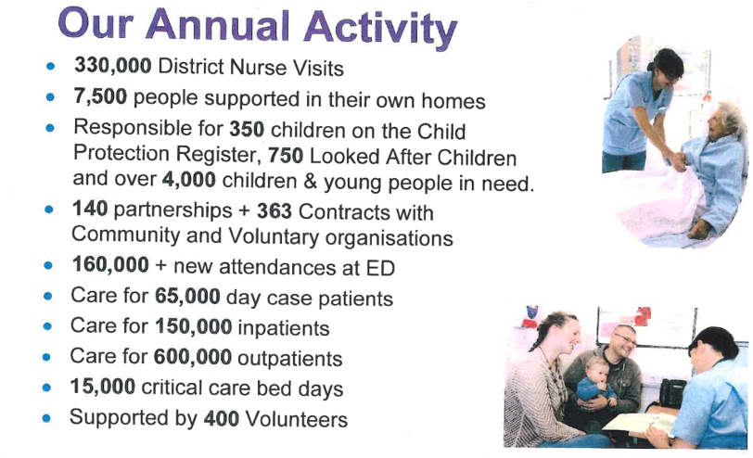

Slide 5

Big Organisations change slowly

Slide 6

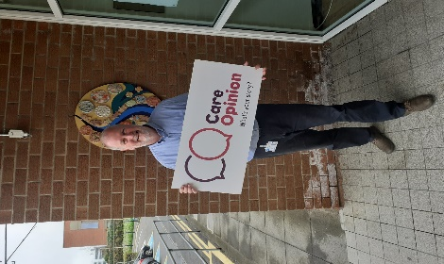
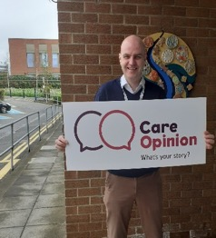
Care Opinion
The story so far
Year 1 20/21 - Average of 8 stories per month
83 trained responders
Promotion activities limited due to Covid-19

Slide 7
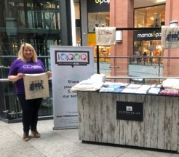
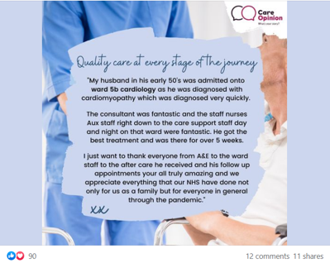
Current Picture
Average of 39 stories per month
484 trained responders
Weekly social media posts

Slide 8
Opportunities

Slide 9
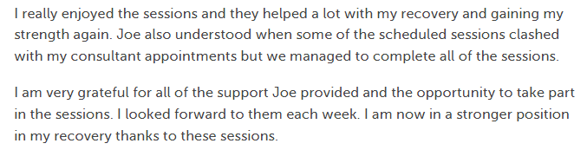
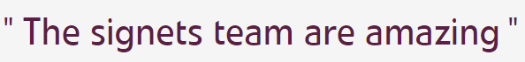
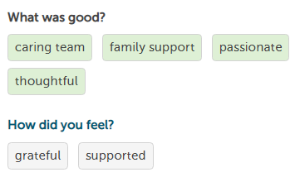
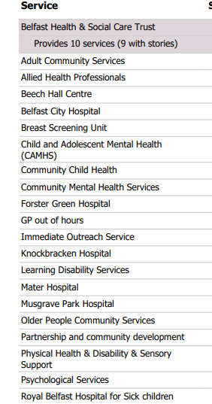
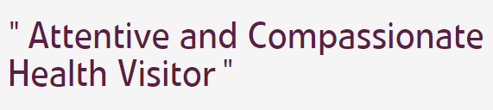
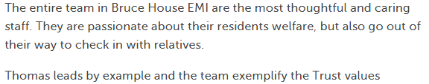
What we have achieved
Feedback for new areas

Slide 10
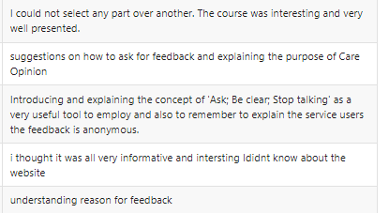

What we have achieved
Training expanded to include how to ask for feedback and the importance of feedback to the Trust

Slide 11
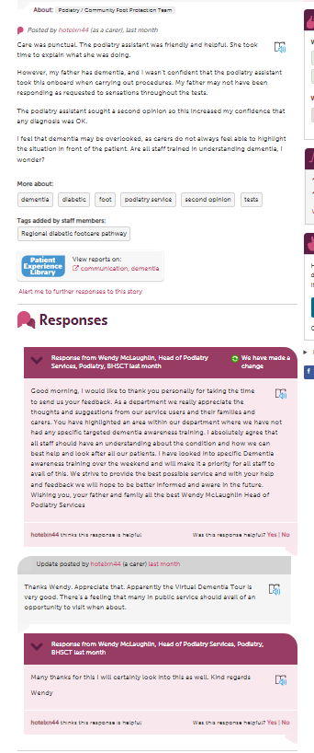
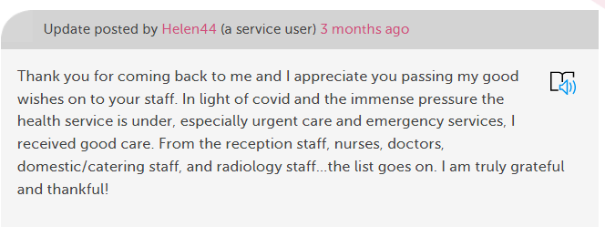
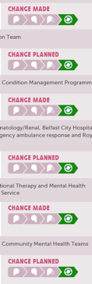
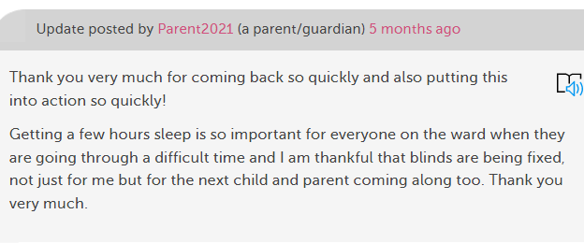
What we have achieved
Build conversations and changes through communicating with stories

Slide 12
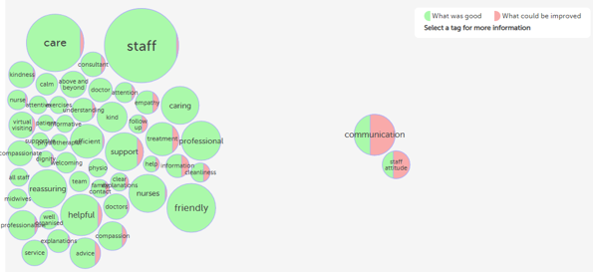
What we have achieved
Boosting staff morale through recognition
She was an absolute angel! Rushed off her feet and she still managed to provide the best care to myself and two other patients awaiting beds.”
“All of the doctors and nurses involved were really nice and empathetic and throughout the whole process, I was treated with respect.”
“Cared for with so much compassion and empathy, even with the department being so
busy, I could look round me and see each person was being cared for by the lovely staff
going to highest for each patient.”

Slide 13

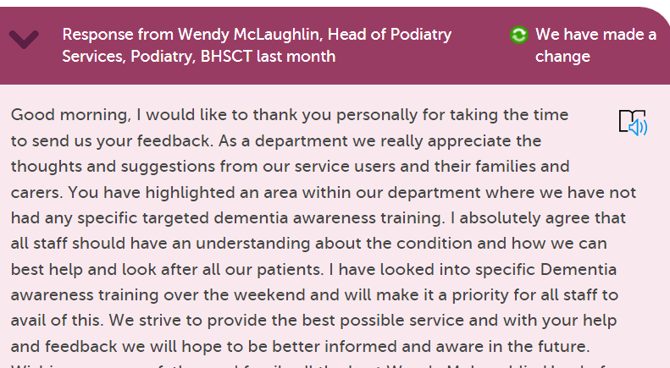
Feedback is influencing our work…..

Slide 14
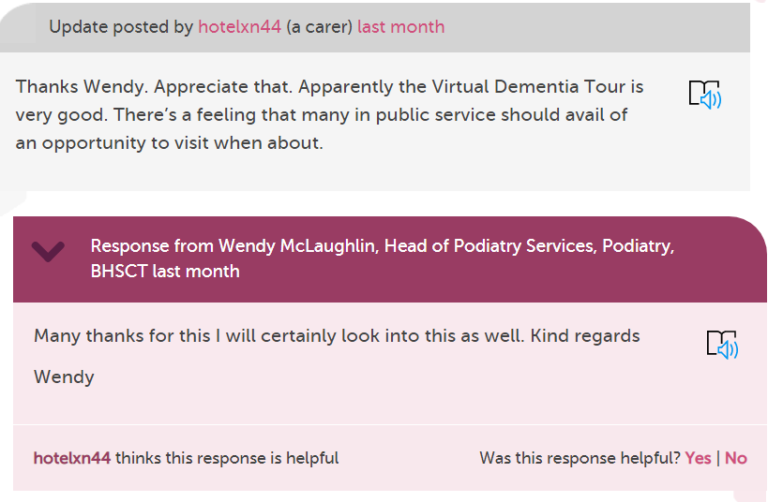
Which leads to more involvement in our services

Slide 15
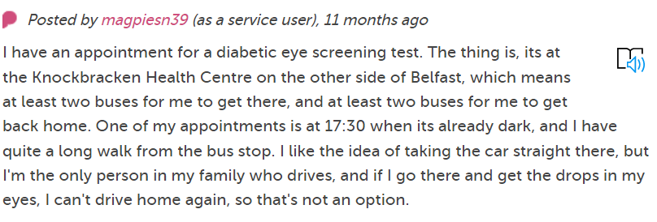
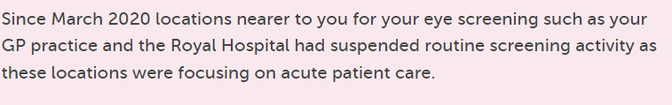
We answered concerns and explained why things happen…

Slide 16
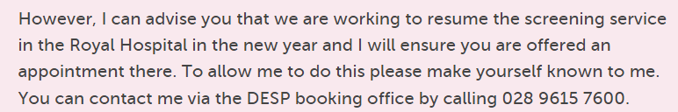
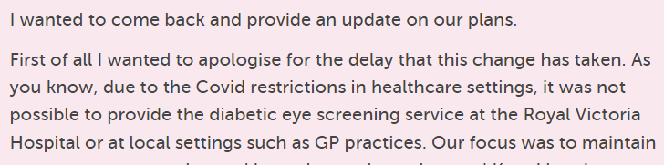
And increased communication

Slide 17
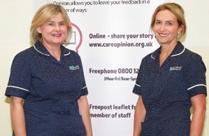
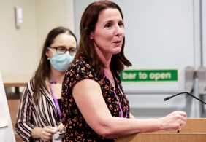
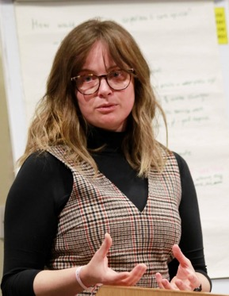
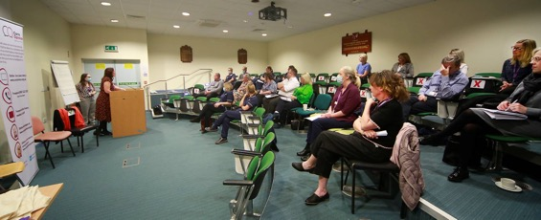
Care Opinion Forum

Slide 18
Challenges

Slide 19
What have we learned?
Small steps make big journeys
  - concentrating on one service or area at a time is better than trying to do it all at once
Local voices not just a central team
  -Having champions who are engaged and promoting within their areas lightens the load

Slide 20
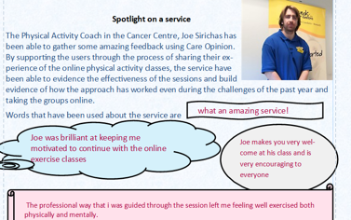
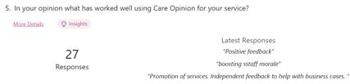
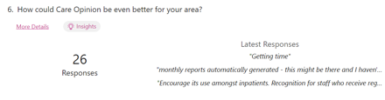
What have we learned?
Praise areas who are engaging with Care Opinion
Listen to feedback from the staff – what works in one area may not in another!

Slide 21
What have we learned?
Understanding Care Opinion should be throughout the levels of staff
  We held awareness sessions for frontline staff not just responders
Timing is everything!
Don’t be shy!

Slide 22
OVER TO YOU…

Slide 23
What can you learn from us?
Embed Care Opinion in Governance Structures –
    use it as Quality Assurance and have reporting mechanisms based on Care Opinion
Think about responses
    Training for responders makes our feedback more valuable for staff and for patients
Increase visibility of Care Opinion internally and externally
    attending public events, using online channels, newsletters etc

Slide 24
Next steps
Oversight mechanisms within Divisional and Directorate Structures
Recognising ‘soft’ changes – where feedback leads to change, but not in a direct or immediate way
Continued engagement from all levels of staff within BHSCT

Slide 25
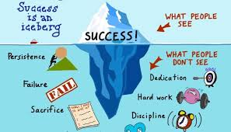
Which will lead us to…

Slide 26

And maybe?

Slide 27

Thank you!

