Slide 1



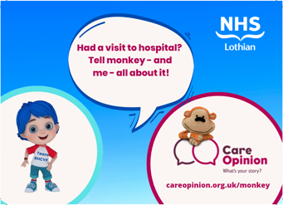
Care Opinion Collaboration within Royal Hospital for Children and Young People in Edinburgh

Slide 2
Session Objectives:
  Example of understanding your problem with using or not using feedback, with a particular emphasis on what your data tells you.
  - Example of understanding the processes and systems within your organisation, how this can be linked in with other assurance processes.
  Benefits of feedback and how this can be used to drive improvement.
  - Choosing the right tools to make change, including leadership and clinical engagement, skills development, and staff and patient participation.

Slide 3

Background To LACAS:
- Framework to give Organisational and Service User Assurance that Quality Person Centred Care is being delivered consistently.
- Developed to promote Quality Assurance activity in line with the board’s Objectives, Quality Strategy and Quality Management Approach
- Levels of assurance are designed to set out Point of Care (Bedside) to Board Governance for the organisation and the public.
Lothian Accreditation & Care Assurance Standards (scot.nhs.uk)

Slide 4





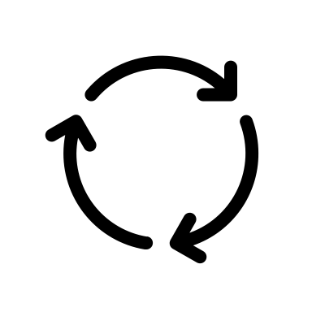
Data:
Benefits of feedback
Provides us with qualitative data that should be used to improve the quality and safety of care we deliver
Instilling a culture of person-centred care and listening
Patients and Families concerns can be raised and responded to appropriately
Gives praise
Allows us to determine themes
Evidence of learning from complaints and adverse events and actions completed
Evidence displayed is out of date and incomplete – Cards etc
Incidents and feedback are viewed positively as an opportunity to improve the quality of care

Slide 5

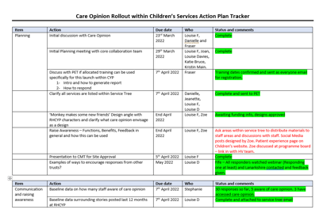
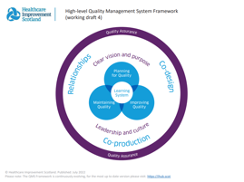

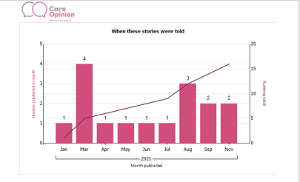

What did we do:
Collaboration team has been created
Quality Planning approach used prior to implementation based on a quality management system
Linked closely with Care Opinion and PET
All staff will have raised awareness of Care Opinion and its use
Staff training was provided by Care Opinion Team ‘Bespoke’
‘Monkey makes some new friends’ Design angle with RHCYP Characters

Slide 6
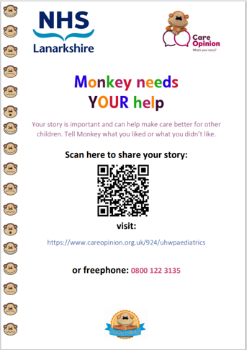
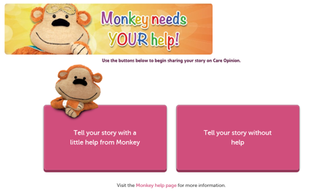
Planning for Quality:

Slide 7


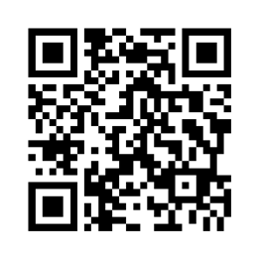
Co-Design:

Slide 8
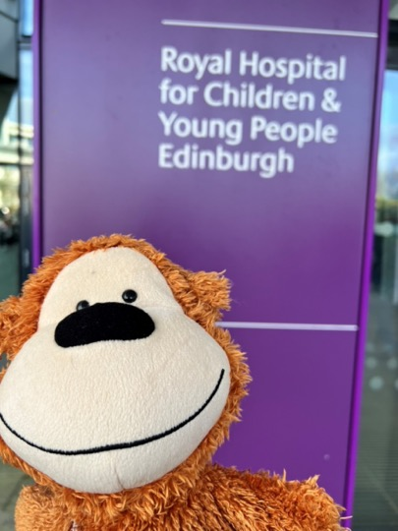
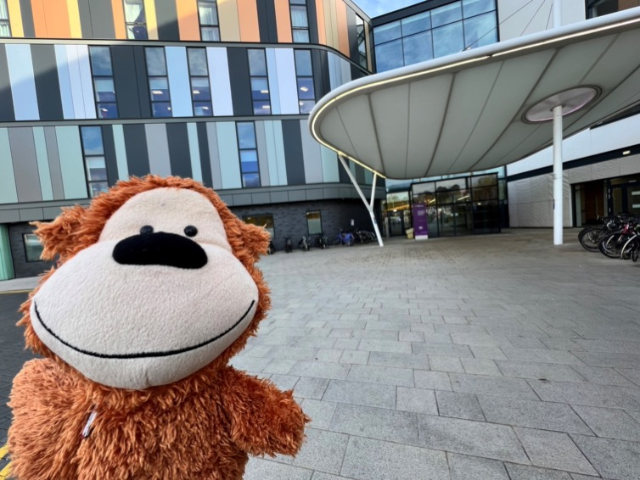
Launch Day at RHCYP:

Slide 9
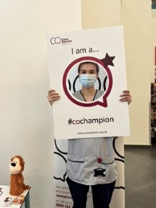
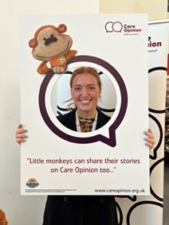
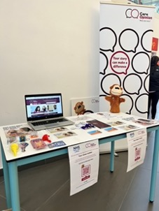
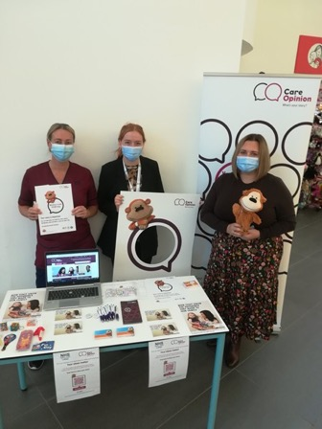
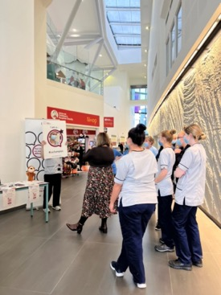
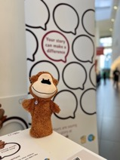
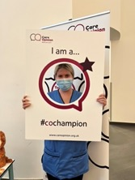
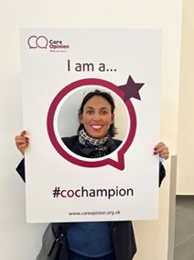
Launch Day at RHCYP:

Slide 10


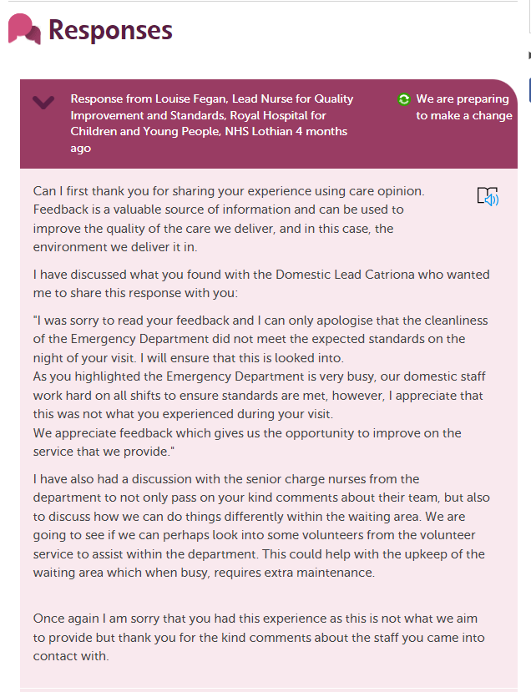
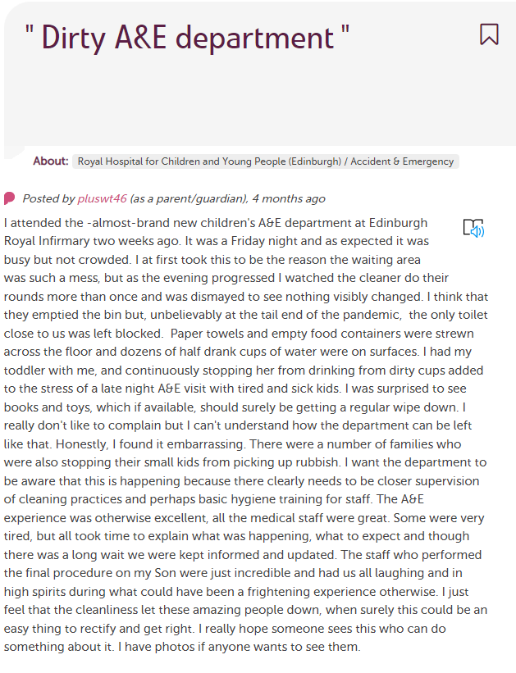
Examples of stories already shared…

Slide 11

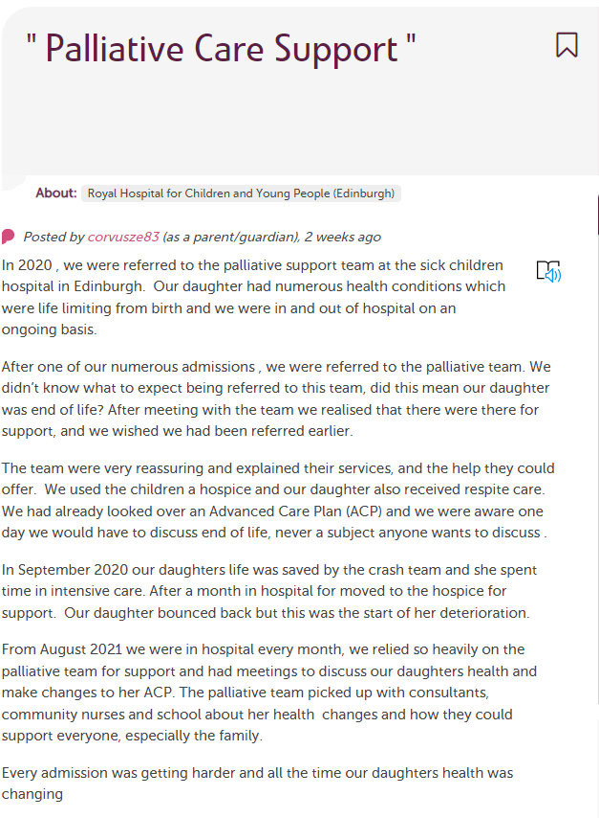
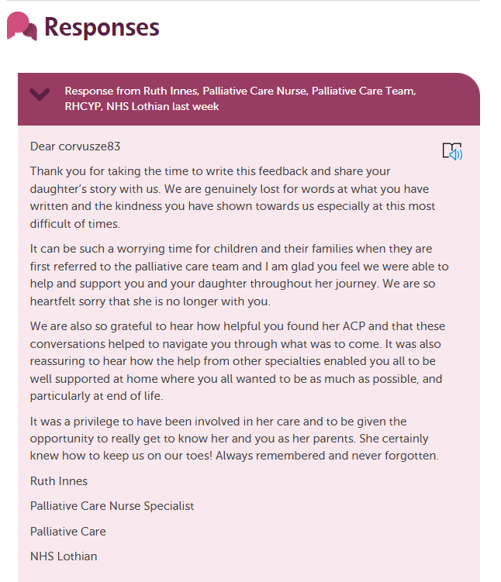

Slide 12
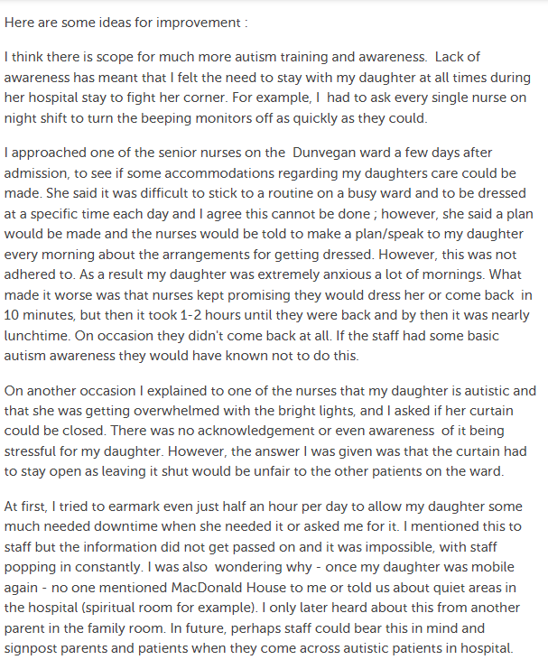
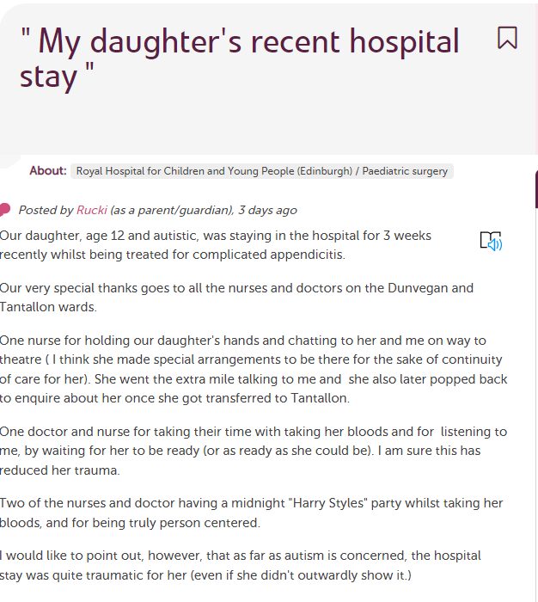

Slide 13
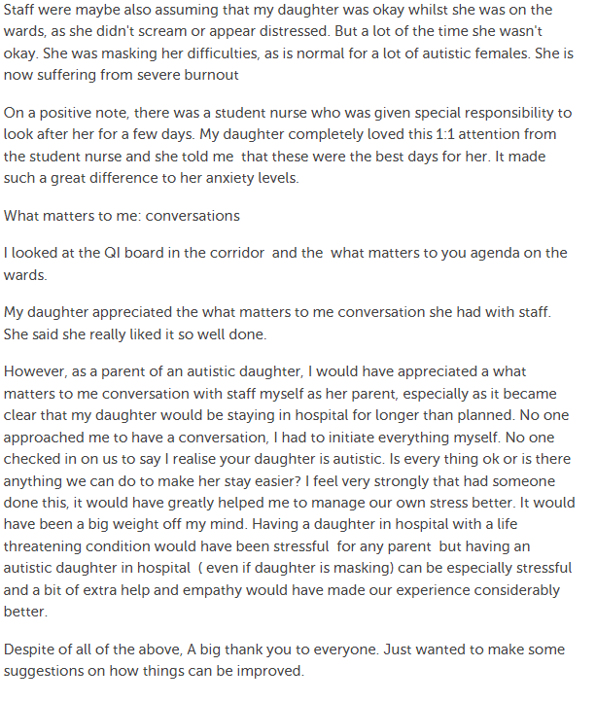
This patient story gives us a great platform to drive improvement within our service:
Recognition to staff
Ideas for improvement
Examples
Recognises areas of focus for our current improvement work e.g LACAS improvement boards
Ideal opportunity to respond further when changes have been made

Slide 14

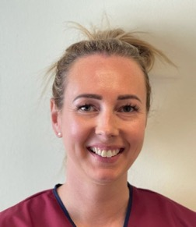
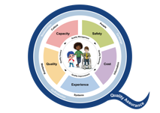

Thank You!!!
Louise Fegan
Lead Nurse Quality Improvement & Standards
Clinical Management Offices, 4th Floor
Royal Hospital for Children and Young People
50 Little France Crescent
Edinburgh
EH16 4TJ
Mobile 07773745238 or Tel 0131 312 0742
louise.fegan@nhslothian.scot.nhs.uk

