Slide 1

Exploring the online feedback evidence-base what we know and what we don’t
James Munro, CEO, Care Opinion CIC
@jamesfm55
@careopinion

Slide 2
What is Care Opinion?
A resource of data: stories and responses
  Qualitative studies
  Quantitative studies
A resource of people: authors and staff
  Research participants
  PPI participants
An intervention
  An object for study in its own right

Slide 3









Research collaborations

Slide 4
Stories as qual data

Slide 5
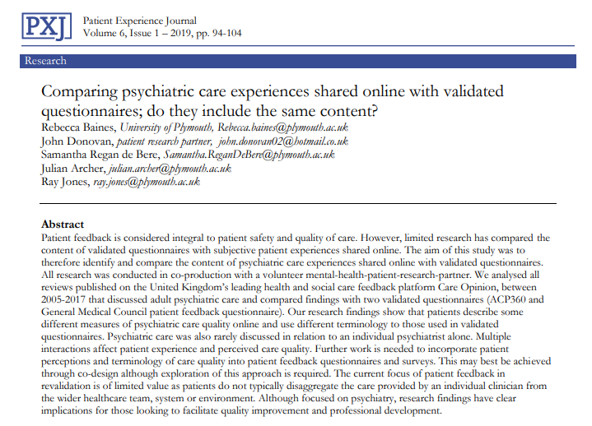
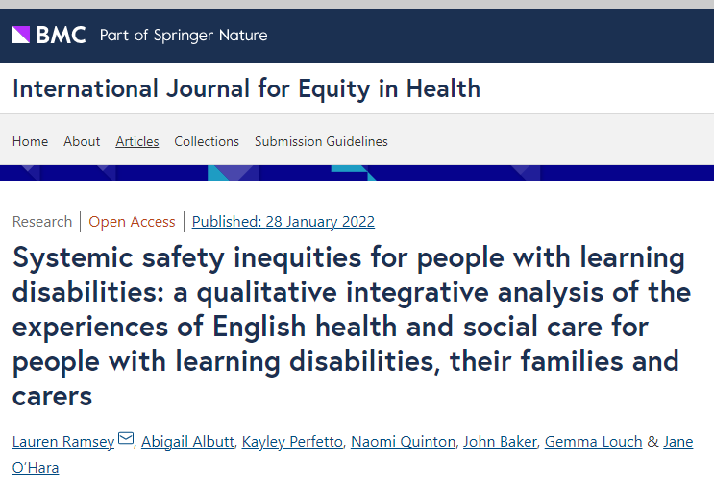
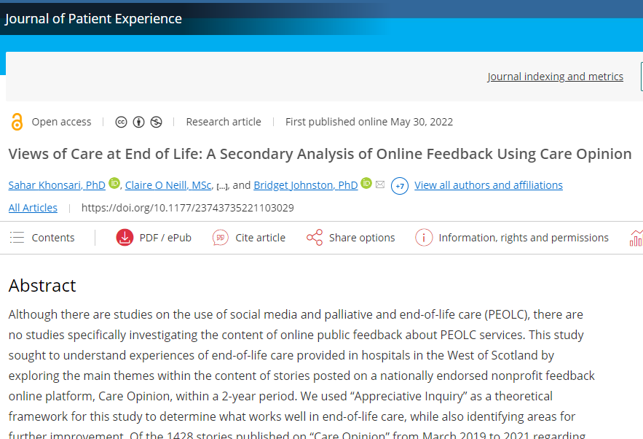
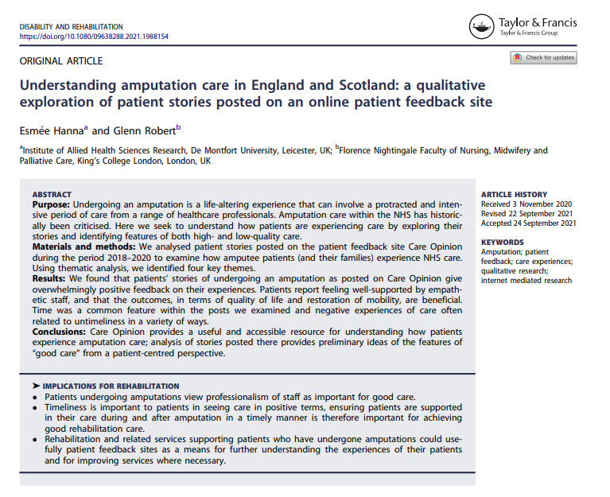
https://www.careopinion.org.uk/info/research-outputs
Notes:
Many studies have used Care Opinion as a qualitative data source. We learn about care, but less about the value and impact of CO itself.

Slide 6
Stories as quant data

Slide 7
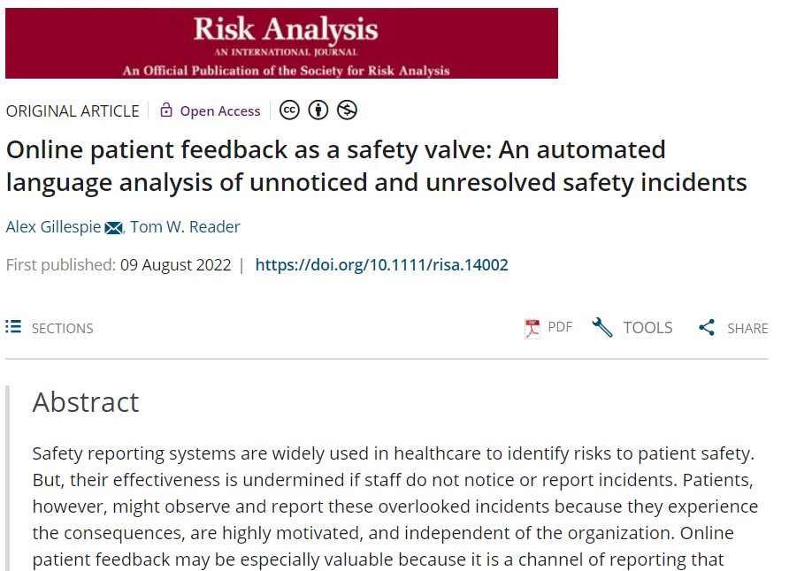
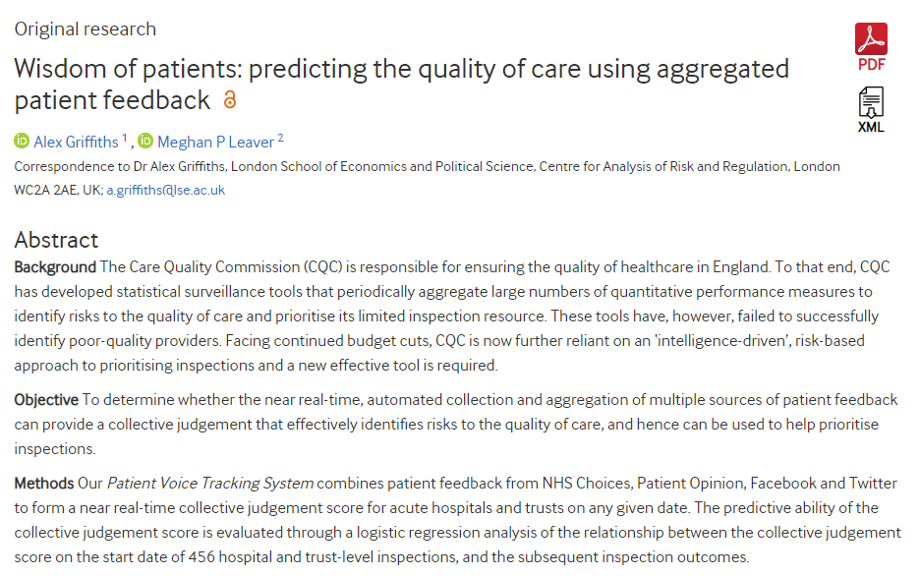
Notes:
At least 2 studies have taken a “big data” approach to CO, using machine learning (ML) to analyse very large numbers of stories for specific purposes. These studies are interesting in their own right and also point the way to possible future applications of ML:
Real time detection of safety issues or improvement opportunities
Summarisation of issues within a service or a set of services
Real time improvement of response quality (defensiveness, generic responses, etc)

Slide 8
Authors as research subjects

Slide 9
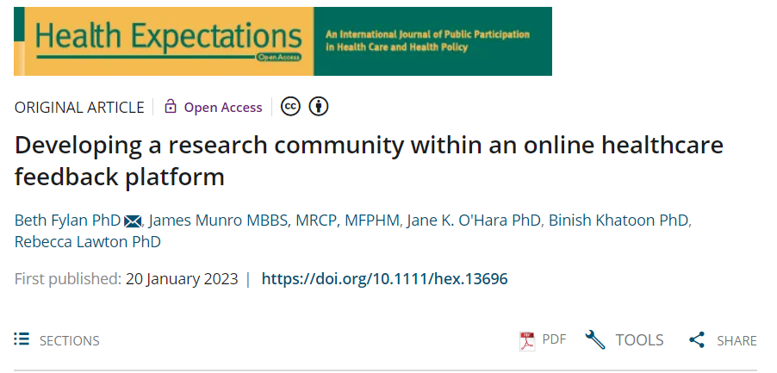
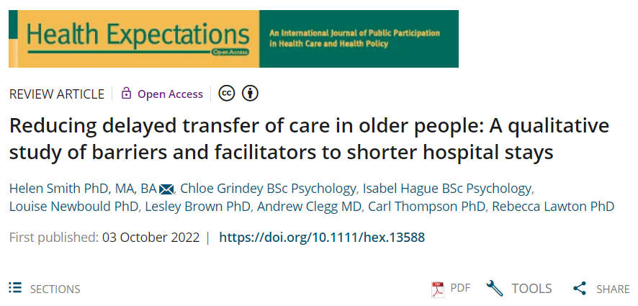
Notes:
Just in passing, for info only

Slide 10
Care opinion as an intervention

Slide 11
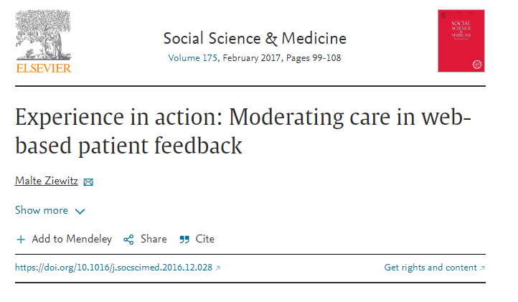
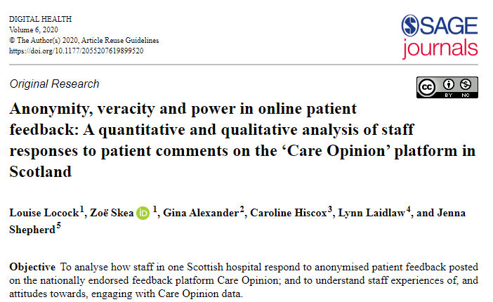
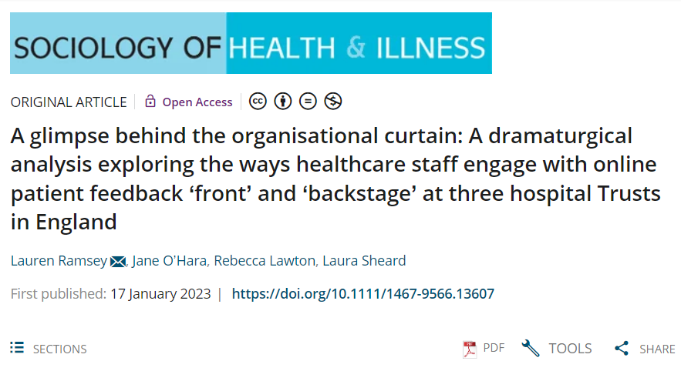
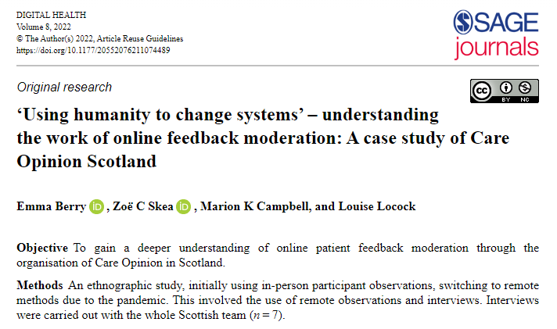
Notes:
There have been a number of studies of how staff and organisations react to online feedback and work with it – or don’t.
Often these studies indicate a defensiveness on the part of staff, confusion over roles, lack of clarity over the purposes of feedback or what it might achieve within the organisation.

Slide 12
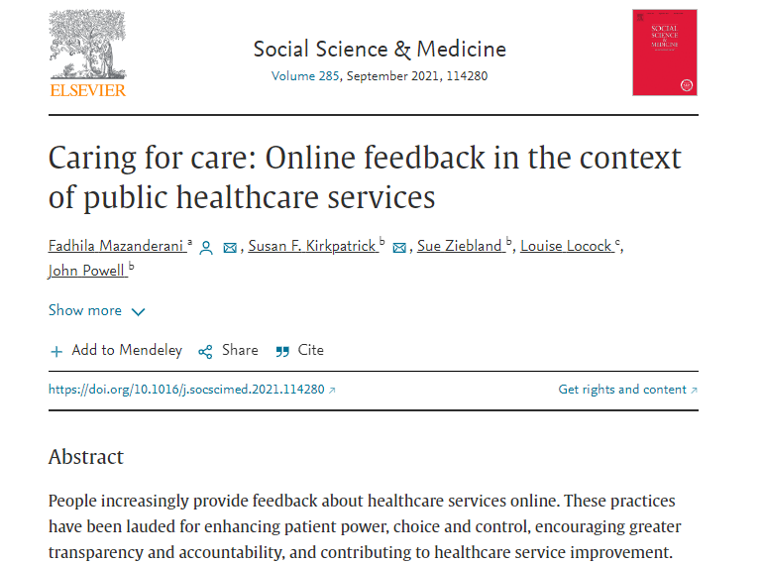
Notes:
Studies of how patients feel about online feedback indicates that they think in terms of helping, improving or making an intervention in the health system – not just providing data to it.

Slide 13
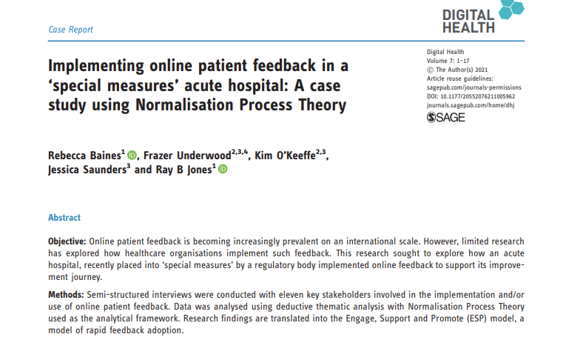
Notes:
The impact of online feedback can go far beyond just providing information.
This study showed how using Care Opinion created a wide range of benefits for staff, including positive effects on morale, confidence and pride at work.

Slide 14
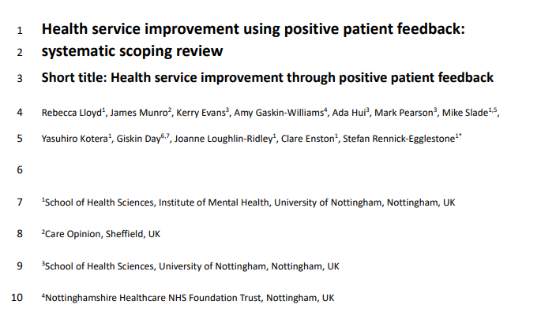
Notes:
This new study, to be published this month, reviewed 68 studies of the impact of positive patient feedback on staff and showed a wide range of positive effects.

Slide 15
Online feedback, hospital defensiveness and the possibilities for organizational learning
Alex Gillespie
a.t.gillespie@lse.ac.uk
Department of Psychological & Behavioural Science
London School of Economics
Notes:
To return to ML analysis of large numbers of stories… this as yet unpublished work looking at large scale analysis of defensiveness in responses.

Slide 16
Conclusion
Defense tactics
  Are observable
  Not the property of ‘defensive individuals’
  Structural sources (e.g., organisation closed to change)
  Story ←→ Response ←→ Organisation
  Are detected by patients & public
Avoiding defense tactics:
  More helpful to people posting stories
  Much more likely to lead to changes
  Weakly indicative of a safer culture
Constructively engaging with online feedback can help the organisation create a good safety culture
Notes:
This study found that defensiveness was observable in responses and could be detected by machine.
Some suggestion here also that:
Defensiveness in responding was indicative of poorer safety culture
Perhaps even that responding to/using online feedback might improve safety culture (interesting research topic!)

Slide 17
Some things we know little about
Impact over time on
  Patients and staff
  Teams and organisations
Relationship to complaints
  How do people choose (if they do)?
  Value to patient and service
Explicit CO interventions
  Gratitude stream
  Safety issue detection
Notes:
These are some areas where we know little (apart from our own experience). Some of these issues are already being explored in developing research proposals.

Slide 18
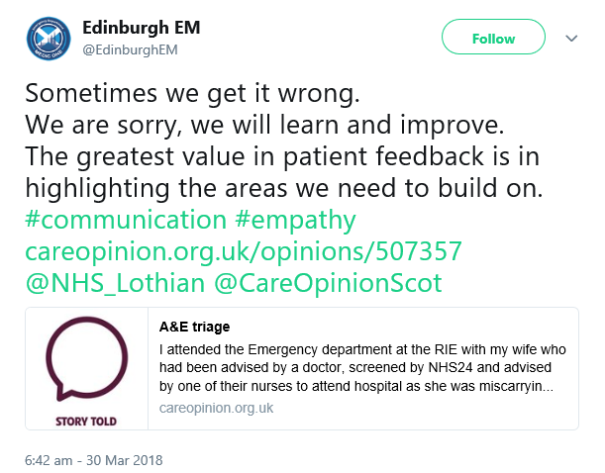
Notes:
To finish: a tweet which illustrates some of aspects of a cultural shift we think is achievable with CO:
Acknowledgement and apology as normal forms of communication
Reducing defensiveness to critical feedback
Being open to patient experience as a source of learning and improvement opportunities

