Slide 1


Invitation links

Slide 2
Aims of today's webinar
Explain what an invitation link is
Explain what an invitation link can do
Talk about ways that you can use an invitation link to invite feedback
The pros and cons of using an invitation link
Live website demonstration
Examples of invitation links currently being used
Important things to remember
Questions

Slide 3
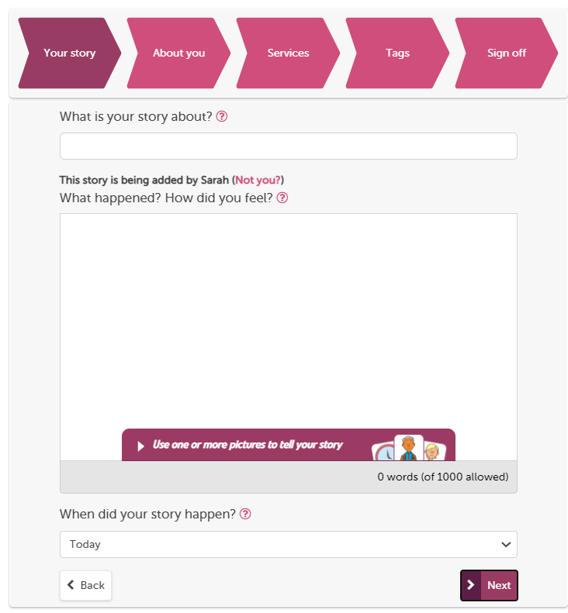
The “tell your story” workflow is our full process on the website
You can use pictures
Give what was good/could be improved tags
Provide optional demographic information, FFT and ratings.
Tag story to multiple providers
Formatted to work on mobile devices

Slide 4
Inviting online feedback
The simplest way to invite people to share their experiences on Care Opinion is just to provide a link to the site.
Another way is to make an "invitation link“ and provide that instead.
What does an invitation link do?
An invitation link allows you to:
customise various aspects of our story-telling workflow
easily access widget codes, kiosk links or QR codes to share with people using services
keep track of which stories came via which invitation links, and run reports and visualisations easily

Slide 5
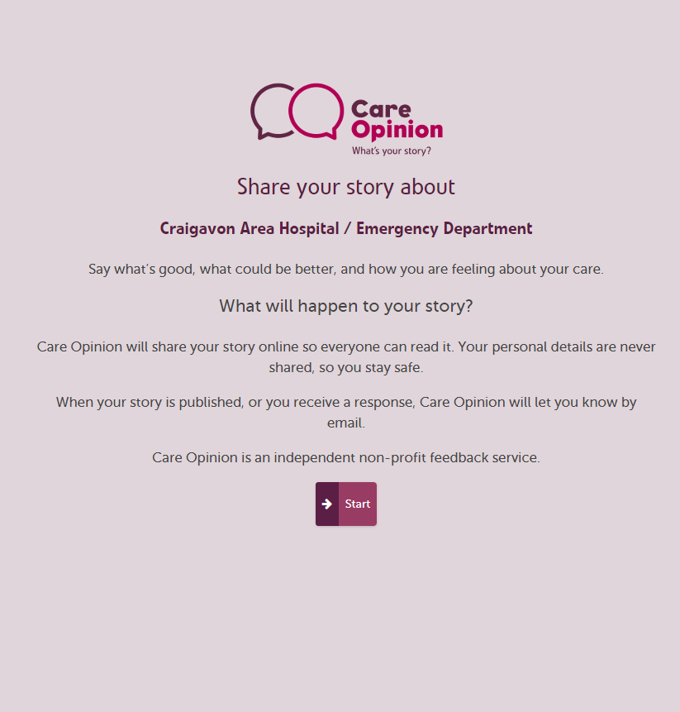
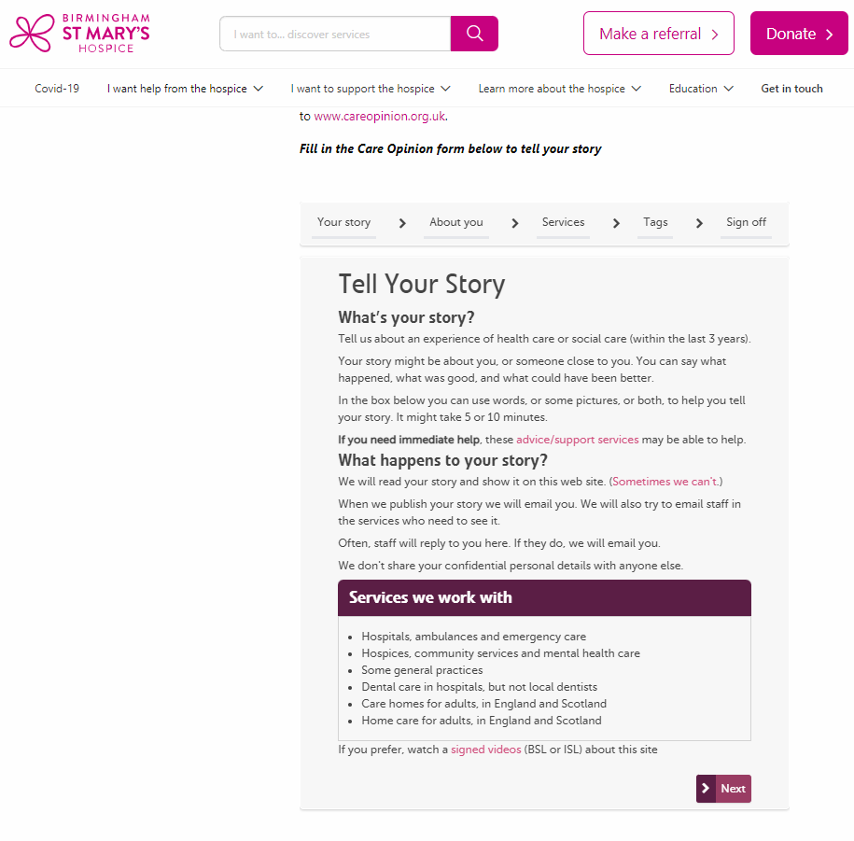
What does an invitation link look like?
A link to share feedback using the tell your story work flow:
https://www.careopinion.org.uk/49/Paediatrics-Major-Trauma-Team
The link can also be hyperlinked, for example: We’d love to hear your feedback
A kiosk link to share feedback : https://www.careopinion.org.uk/49/Paediatrics-Major-Trauma-Team/kiosk (This can be a QR code)
A widget code: <iframe src="https://www.careopinion.org.uk/49/Paediatrics-Major-Trauma-Team/widget" width="400" height="600" allowTransparency="true" frameborder="0"></iframe> (This embeds the story telling process on your website)

Slide 6
The “kiosk workflow” turns mobiles and tablets into a handheld kiosk
Linked to one service
Author cannot add what was good and what could be improved tags
No option to add demographic information and ratings
Author is not logged in. Safe to pass to another user.
Tablet can be locked to this page
Still needs to be on the internet
FFT rating can be added in

Slide 7
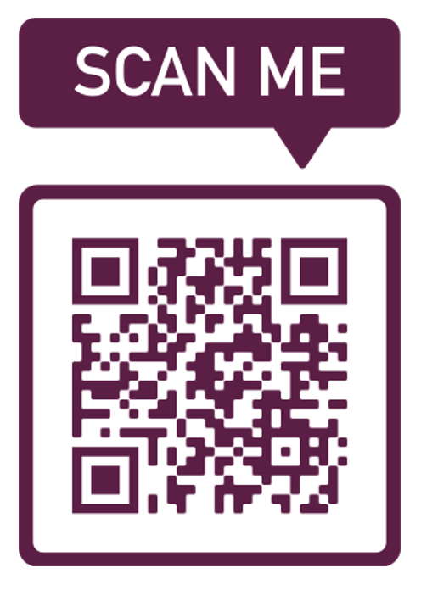

How can I use an invitation link?
Invitation links can be added to most correspondence
that you have with patients and/or service users.
Here are some ideas:
Emails
Texts – appointment reminders etc
Letters
On staff email footers
As a QR code on posters & leaflets
Social Media
On a tablet or Ipad

Slide 8
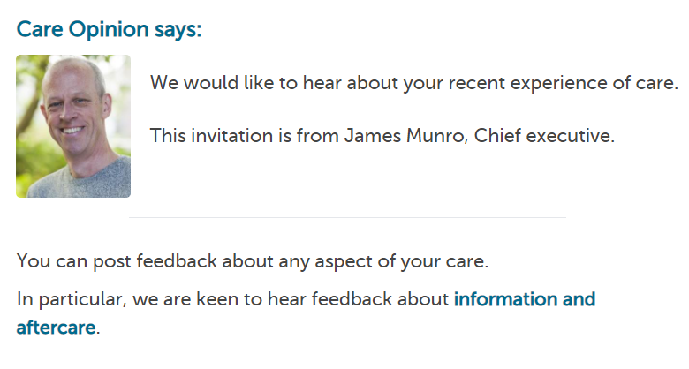
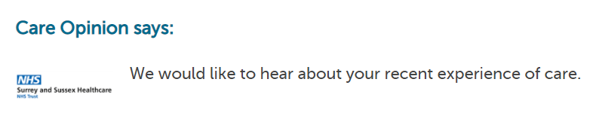
Customising your invitation link
Invitation links can be customised in a number of ways:
Add a personalised message from your service or yourself personally

Slide 9
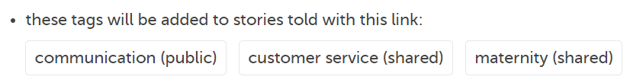
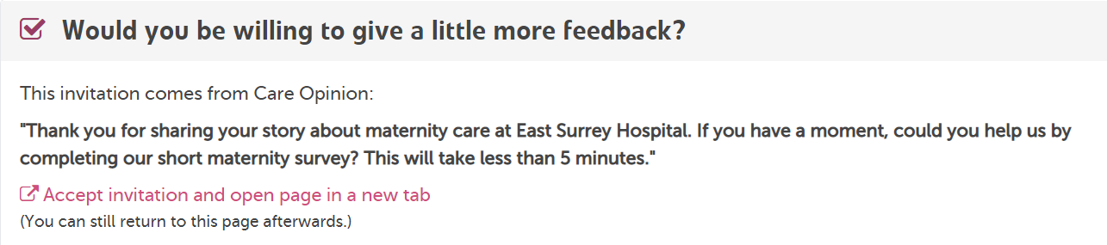
Customising your invitation link
Invitation links can be customised in a number of ways:
Add pre-selected tags to stories
Link an external survey

Slide 10
What are the pros of using an invitation link ?
With an invitation link you can customise the “tell your story” workflow, or direct people to the "kiosk workflow".
Your invitation link can:
make sure a specific health/care service is pre-selected
add specific tags to new stories
after a story is told, invite the author to visit your own survey or consultation too
For English services you can add the FFT question to the kiosk work flow
Track stories relating to a specific topic by using subscriber tagging
Feedback focus

Slide 11
What are the cons of using an invitation link?
You need to share a specific link with people, be that via email, a message on paper or a QR code
Stories that are not submitted via this link are not tracked, ie if the patient chooses to call or fill in a leaflet
Invitation links can only be tagged to one service. E.g. The emergency department at the Northern General, to use the kiosk mode
It may be more complicated than you need if you just want feedback for a single department/location and don’t want to track the link.

Slide 12
Live site here

Slide 13
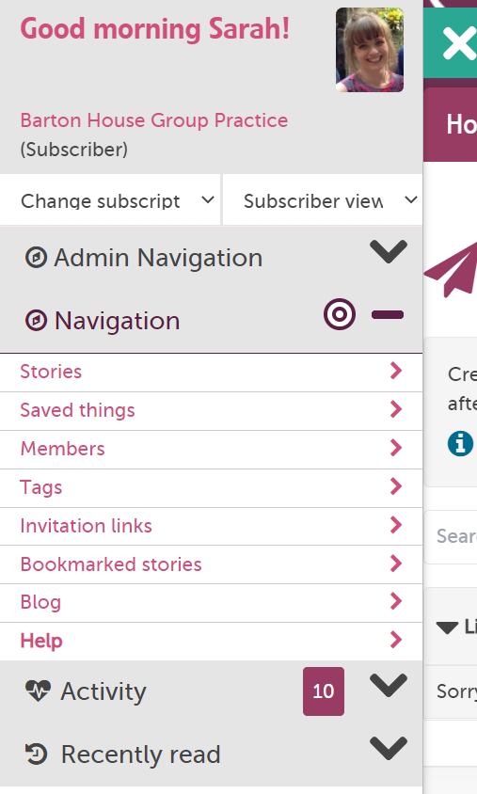
How to create an invitation Link
Example: I am a GP practice manager and I want to get feedback on our nursing services. I plan to text patients after their appointment and/or ask them to scan a QR code on the way out.
1: I need to be logged in and go to “invitation links” in the drawer

Slide 14
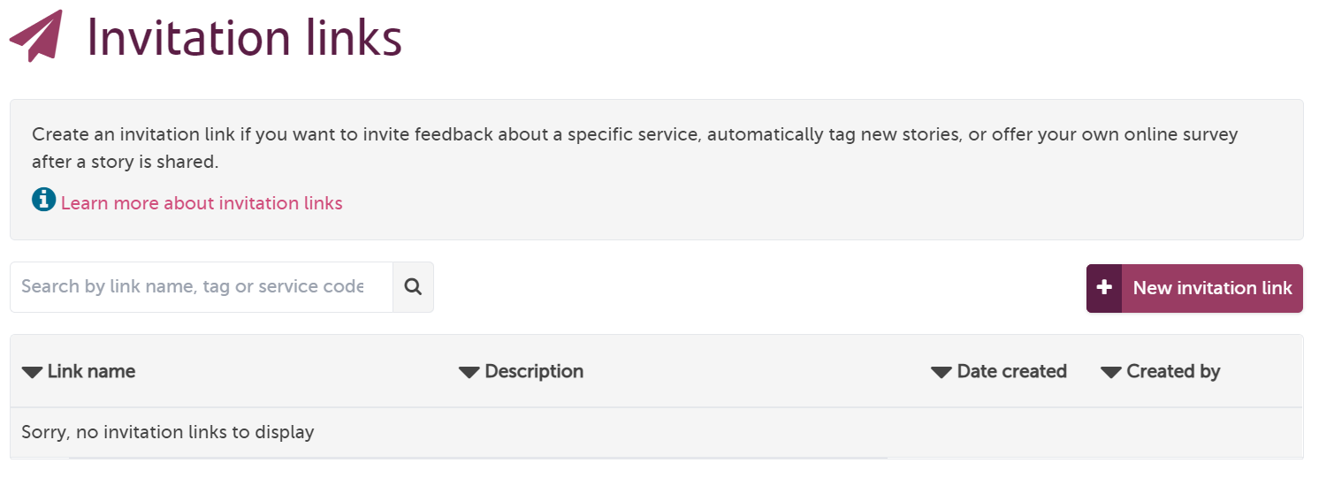
This takes me to the invite link page for my subscription. I can see if any of my colleagues have created links previously (no links in this case)
2: I need to click “new invitation link”

Slide 15
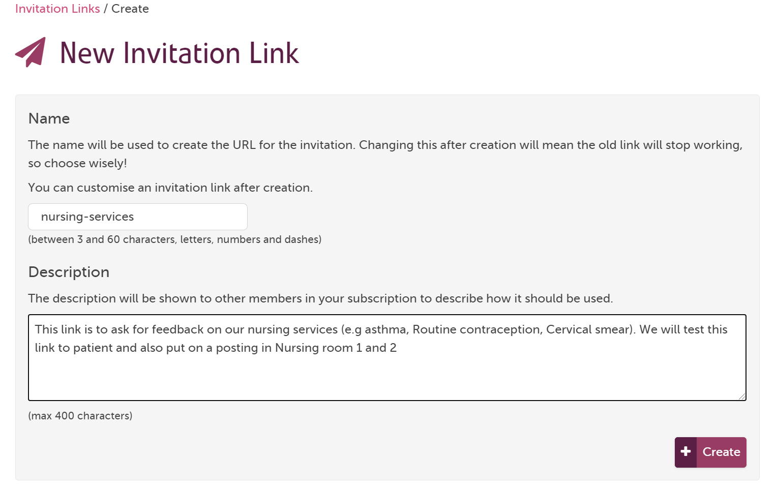
3: I give my link a name – this will show on the end of the URL.
Note: It does not have any effect on where the stories are tagged to – this is on the next slide. The name cannot be edited after it has been shared
4: I give the link a description so me and my colleagues know what it is to be used for.
Notes:
Name should be short and contain no spaces or capital letters

Slide 16
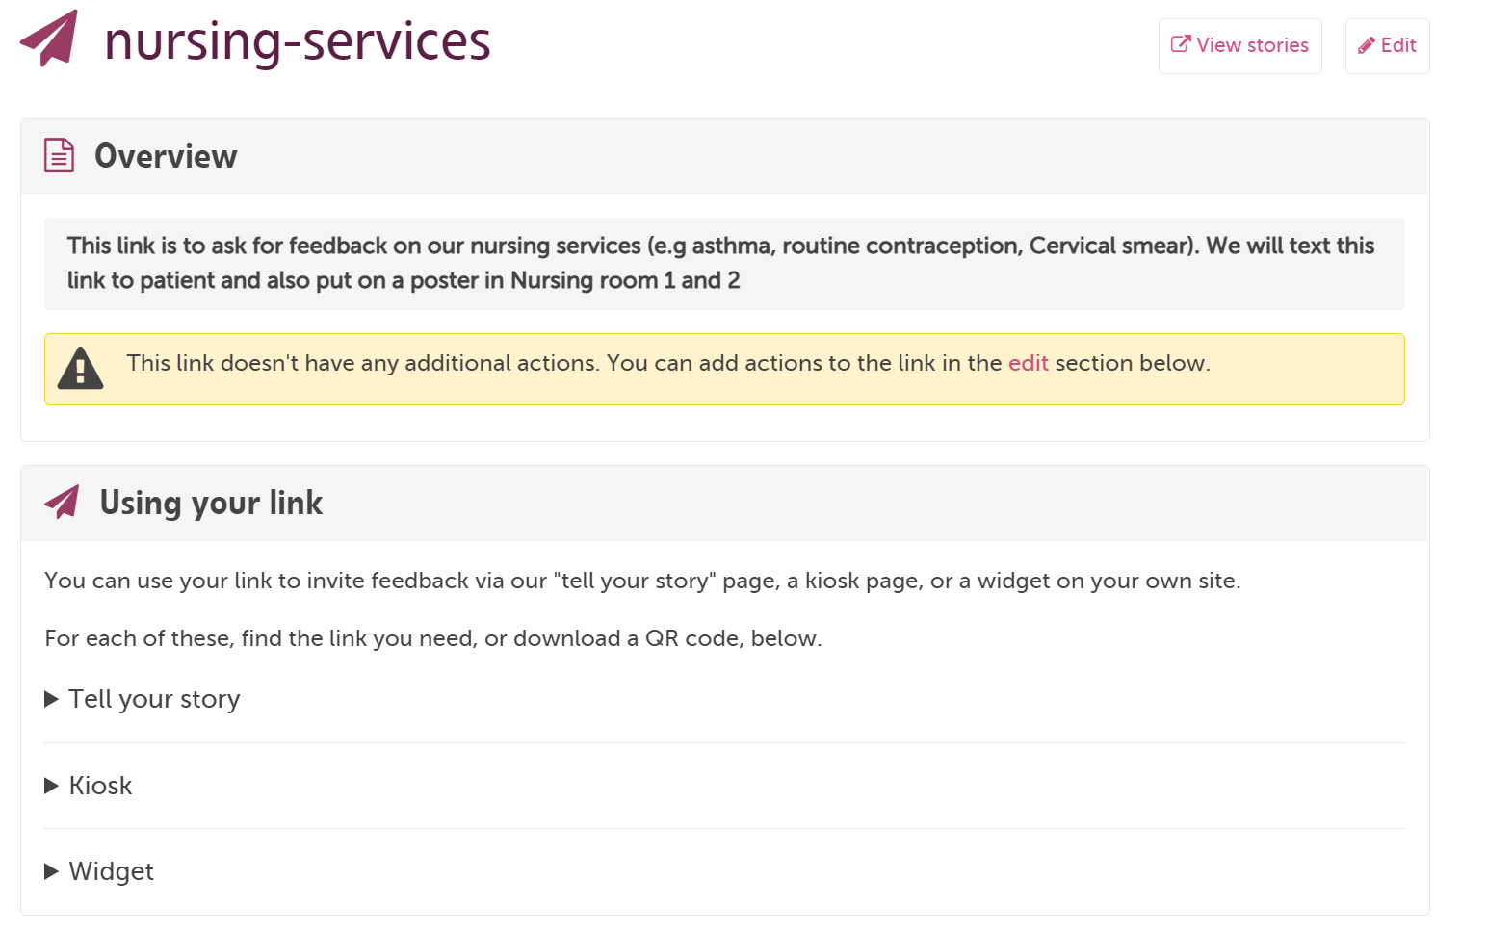

Slide 17
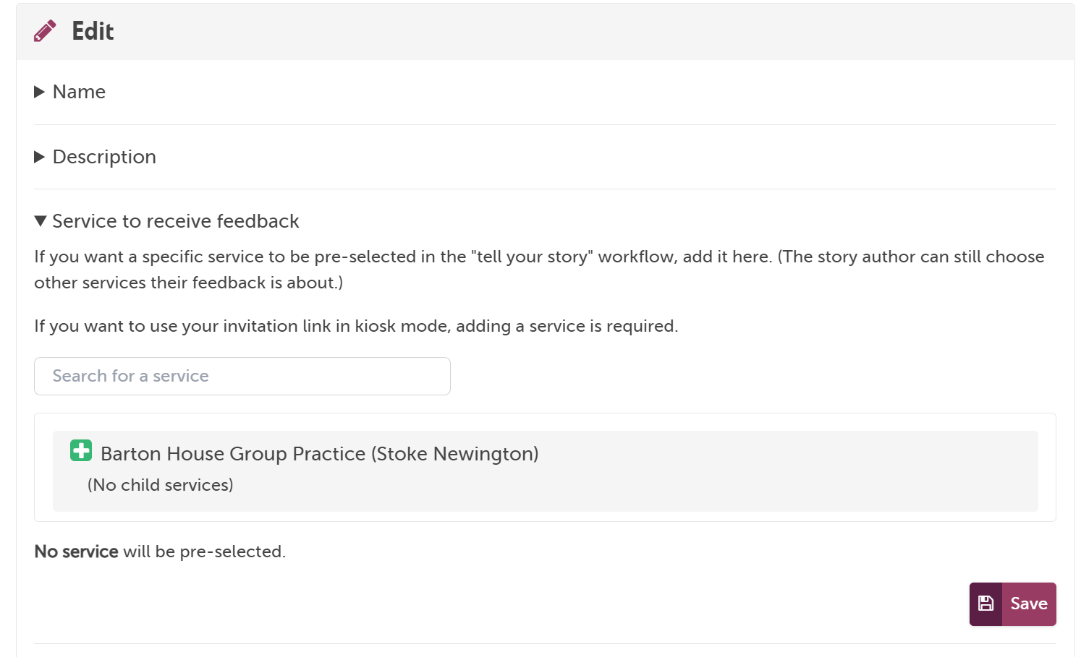
5: Important! If you want the feedback to be linked to a service, In this case my GP practice, you need scroll done the page and add it in the “edit” section
6: click the green plus then save.

Slide 18
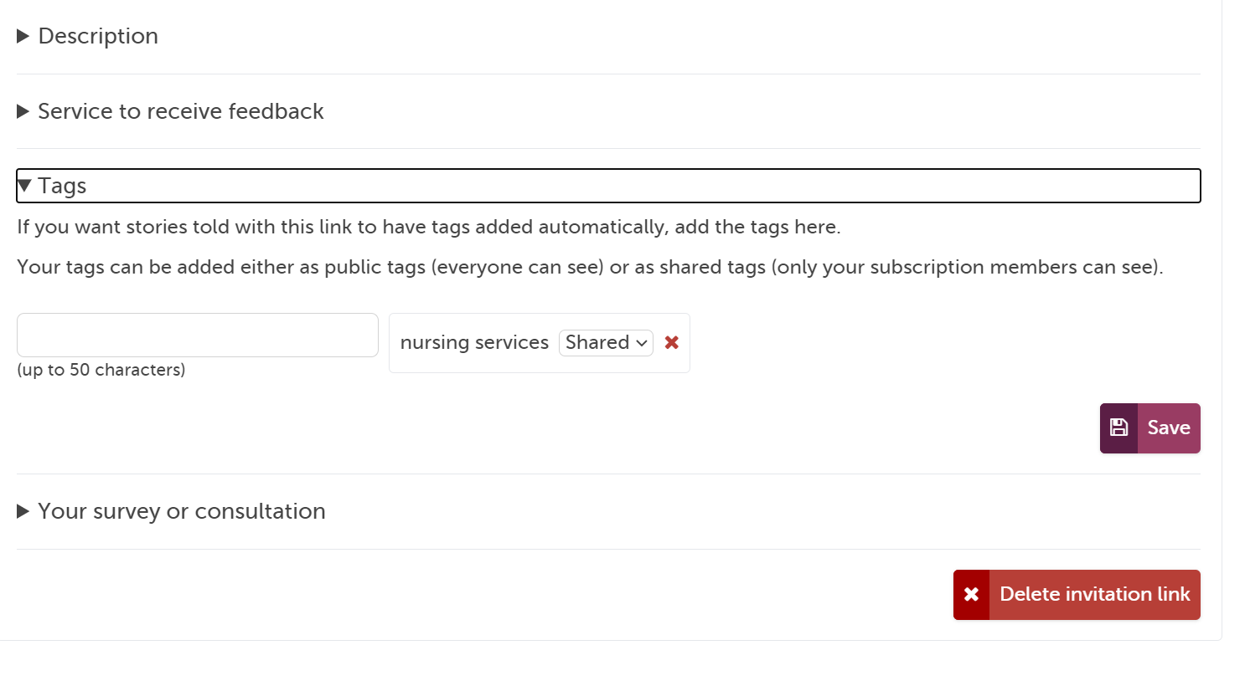
7: Still in the Edit section: I also add a subscriber tag of “nursing services” so I know the feedback is about this specially and I can also use this tag to link in feedback that has not come in via the invite link.

Slide 19
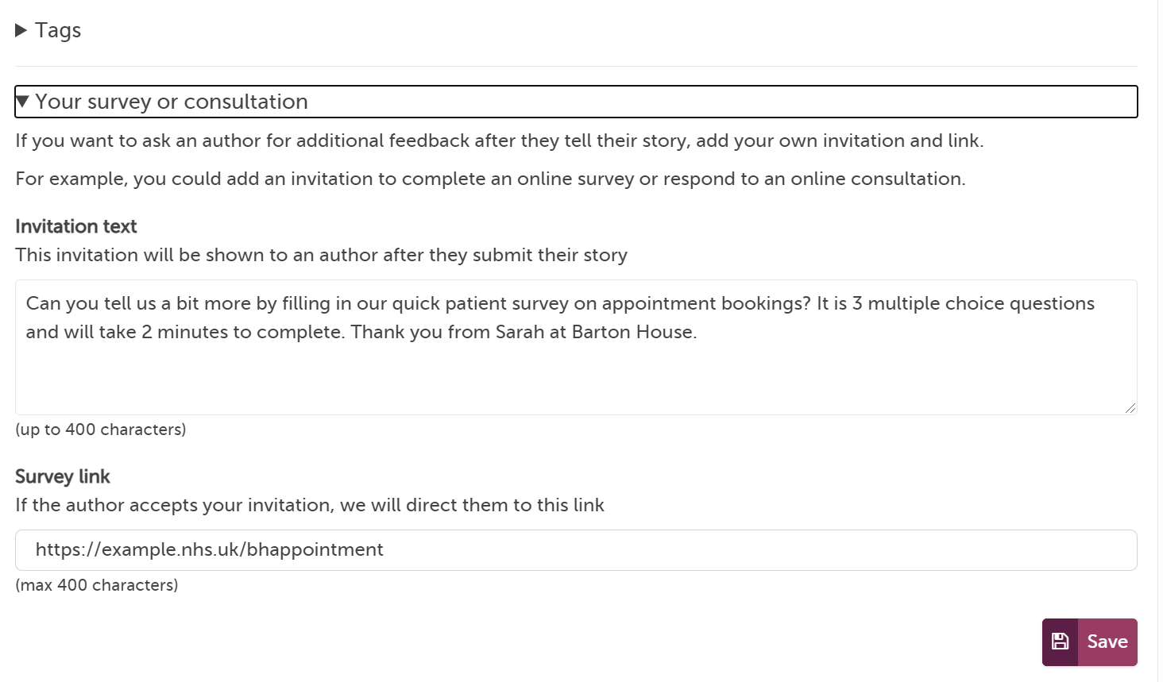
8: Finally, if I want to add a link to my own in-house survey at the end of the Tell your story workflow (not the kiosk workflow) I can add this here too, with a short patient facing description.

Slide 20
Now you are ready to share your link with the 🌎

Slide 21
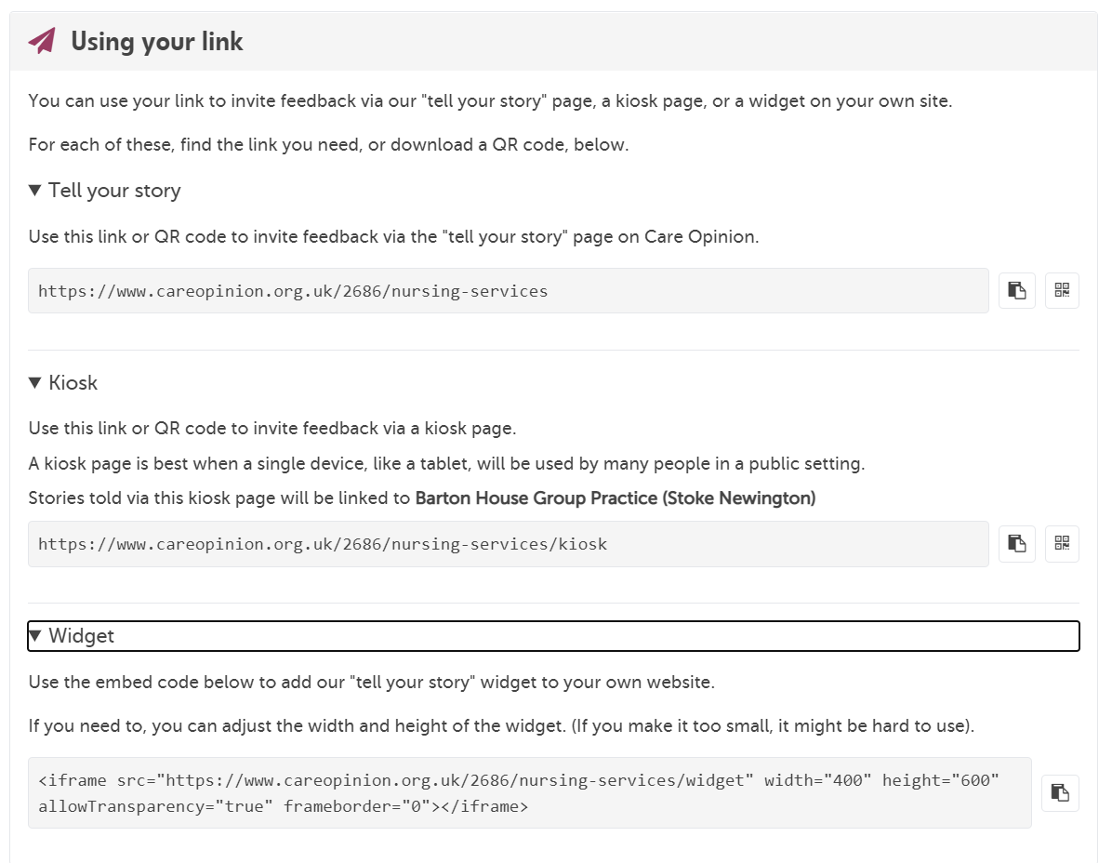
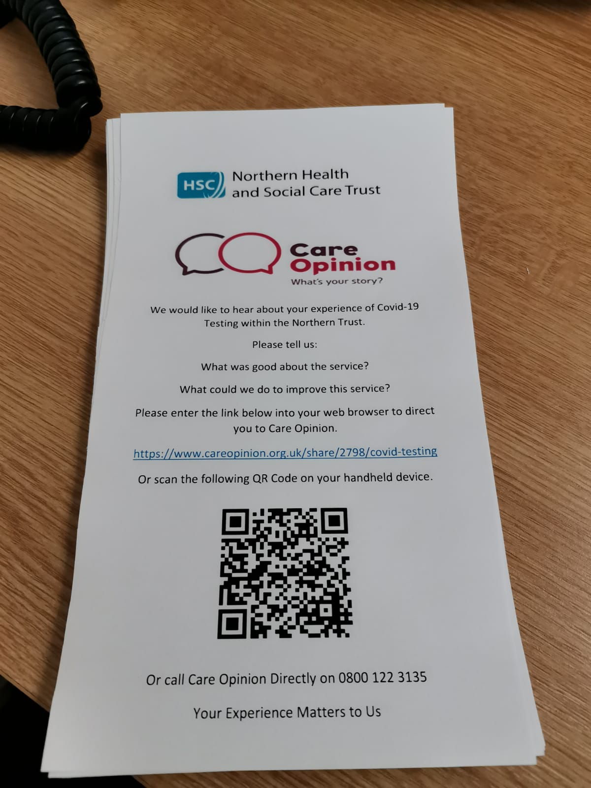

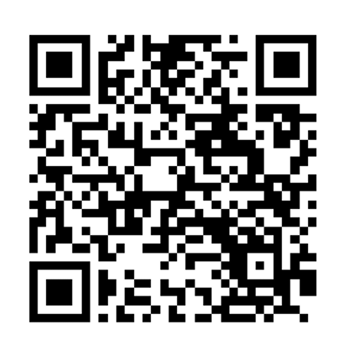

Create QR code
Copy link

Slide 22
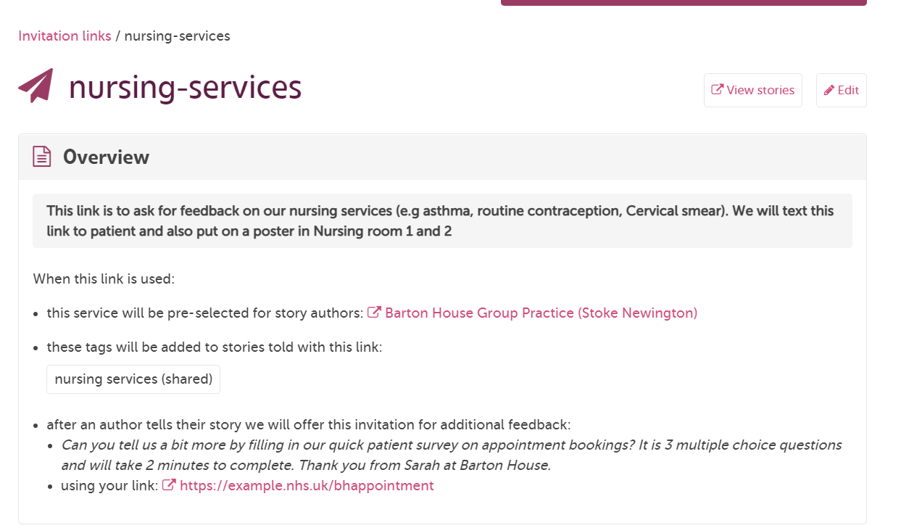
See stories submitted on this link here

Slide 23
Some things to note
You should not change the name of an invitation link after you have created it
Be careful deleting active links. You will lose the connection between the stories
You can use all the CO reports and visualisations on stories submitted on the link
Notes:
https://www.careopinion.org.uk/info/invitation-links

Slide 24
❔❔❔

Slide 25
Thank
you

