Slide 1


Introduction to Care Opinion – The Basics

Slide 2
Aims
Who is Care Opinion?
The ‘Story Telling Process’
Managing your log in – Updating your profile
Finding the service you work in and your ‘Saved things’
How to find help?
Q&A

Slide 3



Who are we?
Care Opinion is a non-profit social enterprise, based in Sheffield and Stirling.
We have been sharing people’s experiences of health and care services online since 2005, and we have built a national and international reputation for our innovative and value-led approach to online feedback.
At Care Opinion we make it safe and simple to share your story online and see other people's stories too. You can see how stories are leading to change.
How is Care Opinion funded? | Care Opinion
Meet the Care Opinion team | Care Opinion
Notes:
Care Opinion has been around for just over 15 years now (10 years in Scotland). We are a non profit organisation and have a small team, split geographically between Sheffield and Stirling.
We have also recently welcomed Northern Ireland health and care services onboard, and have a well established partner organisation in Australia called Care Opinion Australia.

Slide 4
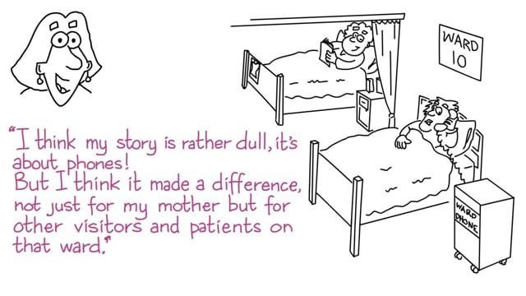
Care Opinion in 2 minute
Watch this short video to find out more about Care Opinion.

Slide 5

Mission, Vision & Values
Our vision
What do we want to see?
We want people to be able to share their experiences of health and care in ways which are safe, simple, and lead to learning and change.
Our mission
What do we do?
Our mission is to provide an online platform so that:
people can share honest feedback easily and without fear
Our values
How will we pursue our mission?
Innovation Transparency Inclusivity Positivity Humanity
Notes:
Mission: stories are directed to wherever they can help make a difference, and
everyone can see how and where services are listening and changing in response
Innovation: We will innovate in the public interest. We will keep listening, learning and improving, so that we find simpler, safer and more effective ways for people to share their experiences of care.
Transparency: When things can be seen and shared, they can be improved. We encourage transparency in health/care services, and we will be open, honest and clear in all our activities.
Inclusivity: Everyone’s story matters. We will treat everyone as equals, and will nurture trust and respect in all our relationships. We will work to make our service accessible and helpful to the widest range of people we can.
Positivity: We believe that people are most open to learning and change when they feel valued and heard. We will make our activities, conversations and connections encouraging, constructive and supportive.
Humanity: We believe effective health and care services have at their heart the humanity of those who rely on them, and those who provide them. We will keep people (story authors, customers and our own team) and their stories at the heart of everything we do.

Slide 6


Slide 7
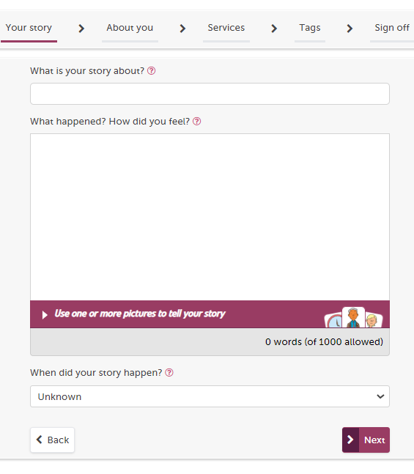
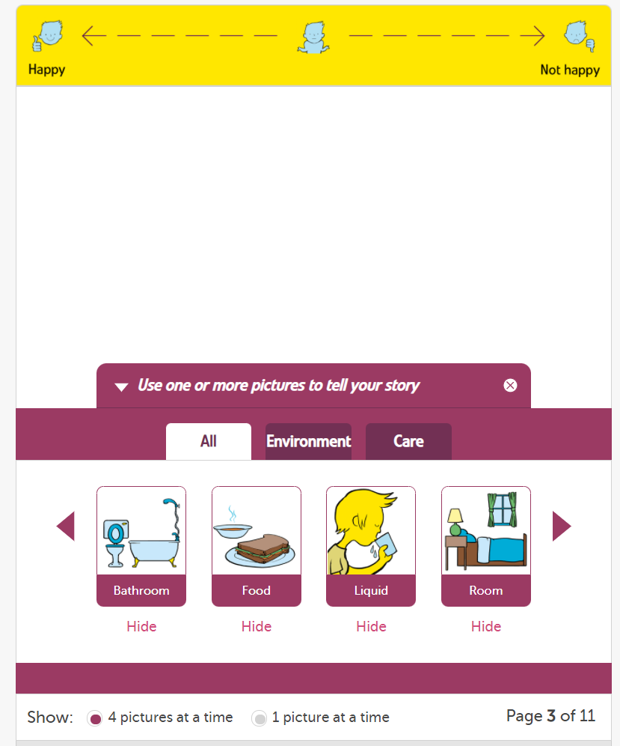

Slide 8
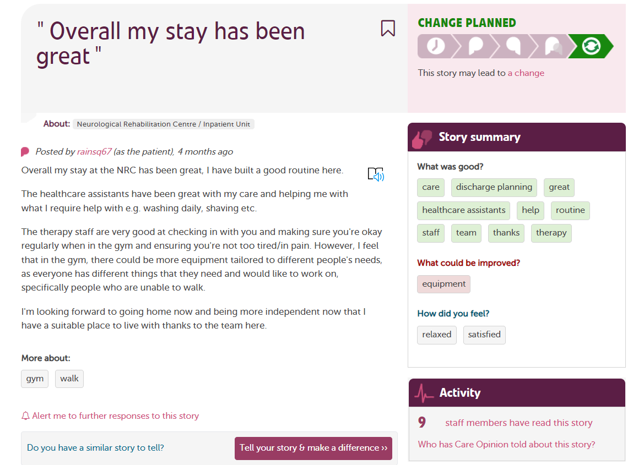
Tags are added by the author to show key themes
Stories by the same person are linked by a username
See which organisations are reading feedback

Slide 9
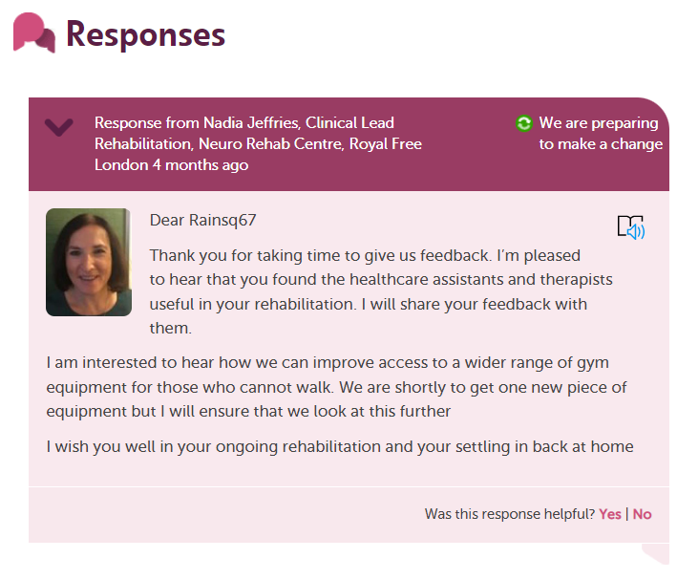

Slide 10

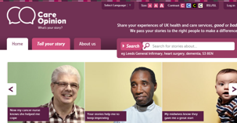
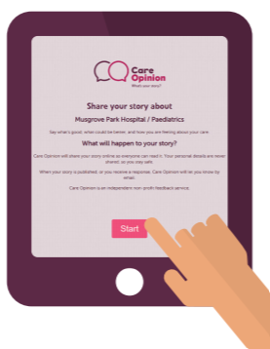
Ways to share a story with Care Opinion
Online careopinion.org.uk or careopinion.ie
Freephone 0800 122 3135 (UK only)
Freepost leaflets
From an invitation link
With support from Volunteers
Using picture tiles
All stories are subject to moderation and are uploaded to the website

Slide 11
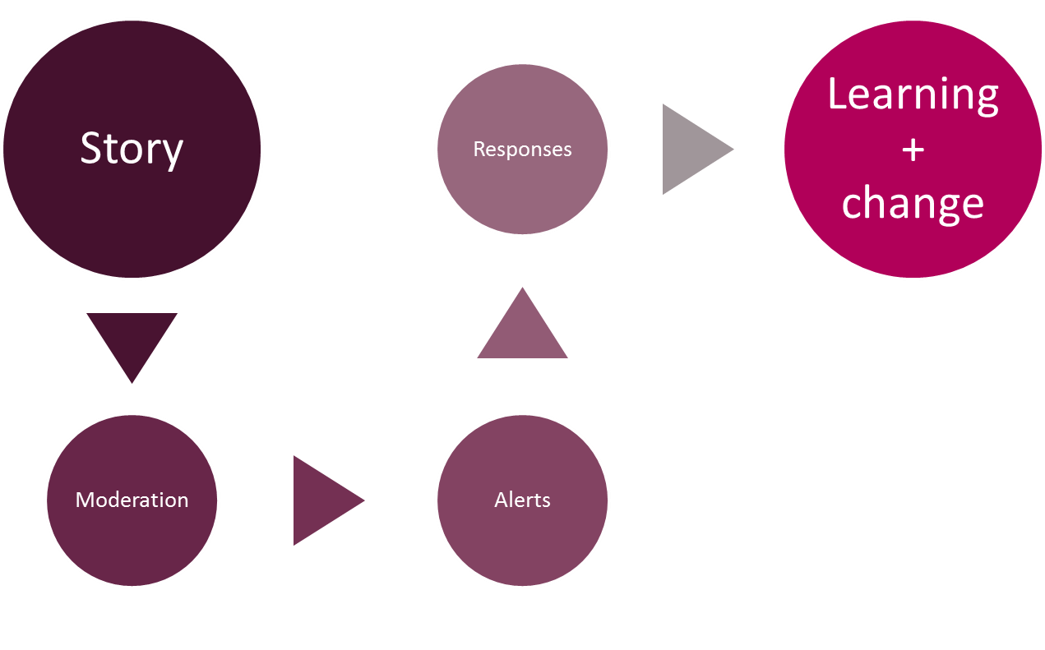
Stories – it’s about the conversation

Slide 12
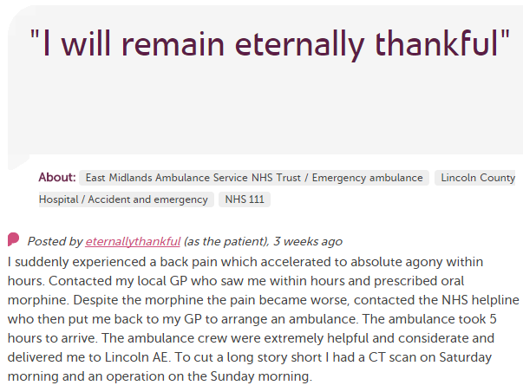










In each provider
Moderation
Service staff
Different Staff Teams
User exp, comms, complaints…
Alerting
CEO
Commissioners
Nursing, AHP students
Healthwatch
Researchers
Other Stakeholders
CQC
Notes:
Stories come in and all are moderated. Alerts can go out then to a range of stakeholders and interested parties. Stories are also tweeted out and shared on social media by CO and provider organisations.

Slide 13
Accessibility

Slide 14
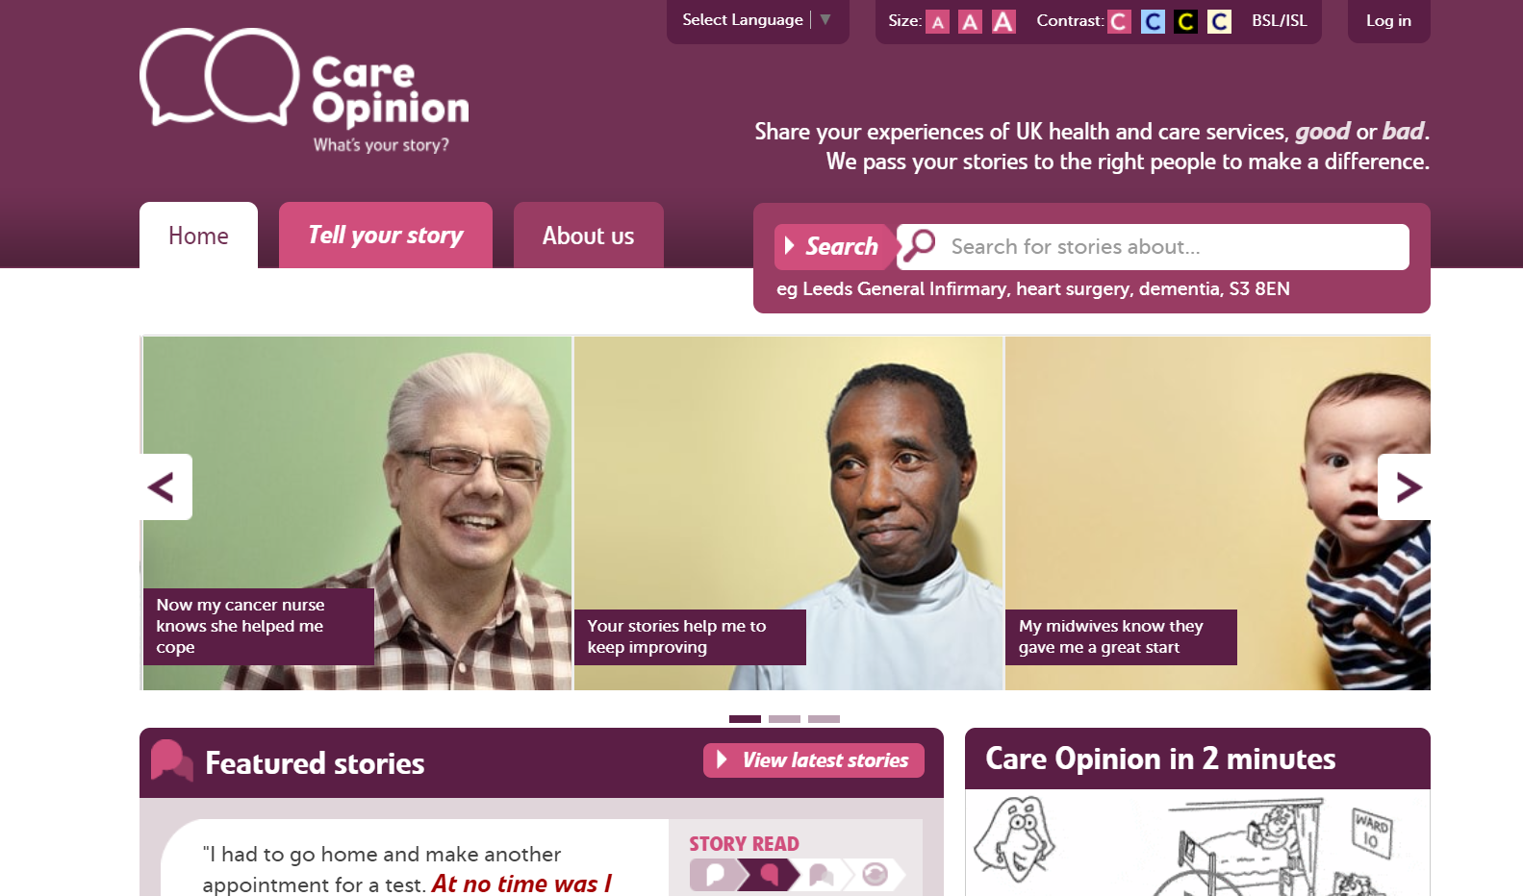

Slide 15
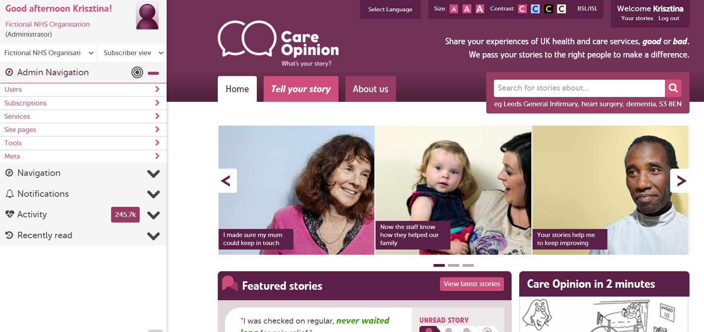

Slide 16
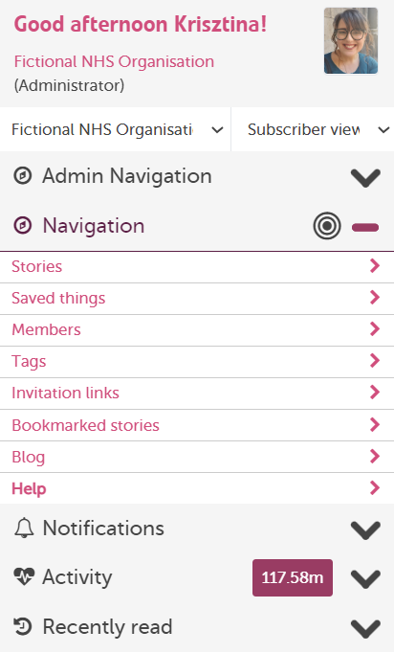
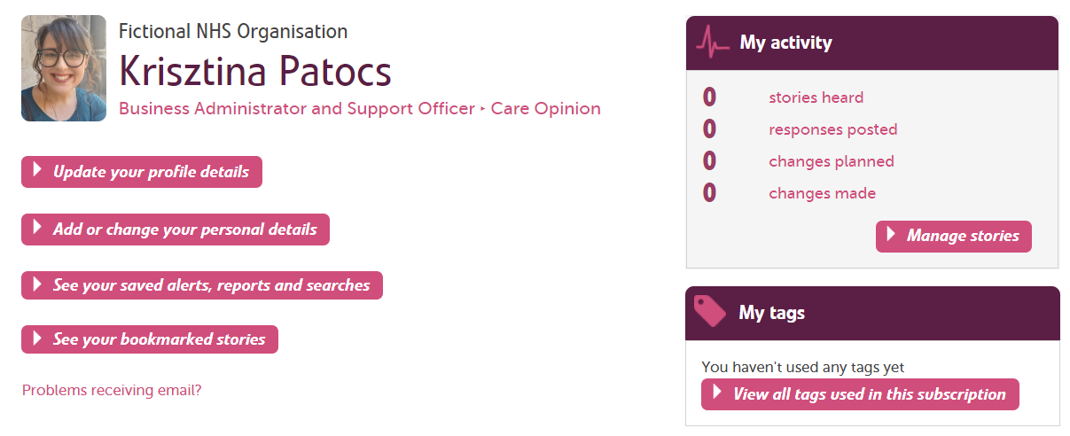

Slide 17
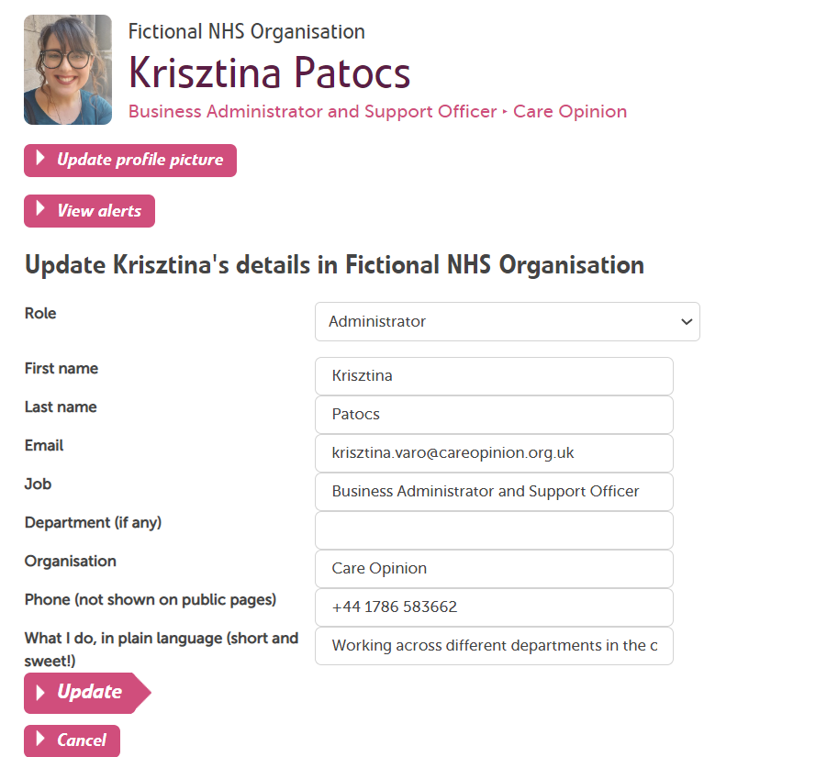

Slide 18
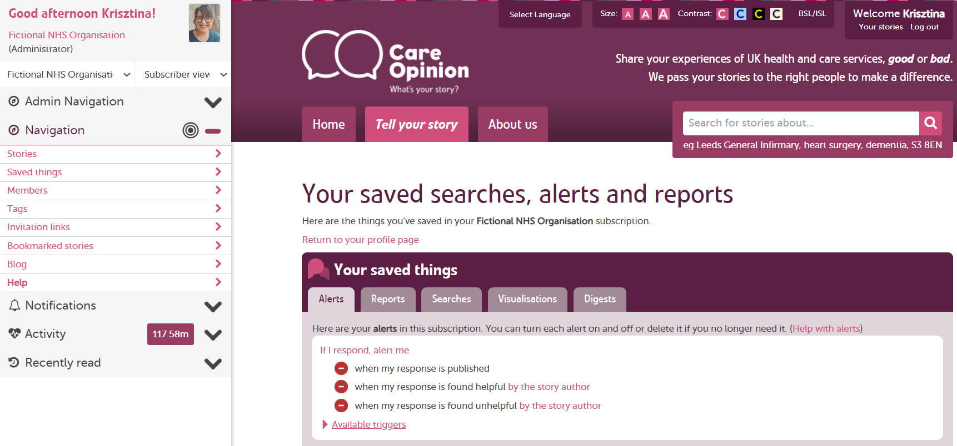
Saved things

Slide 19
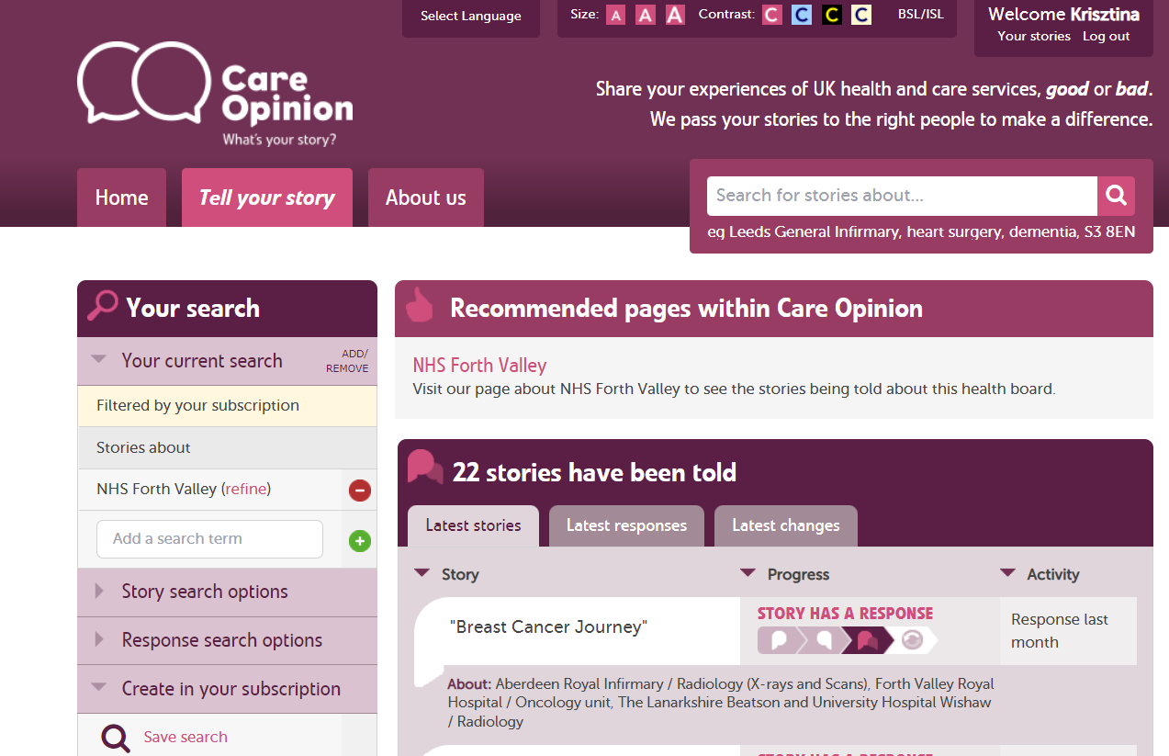

Slide 20
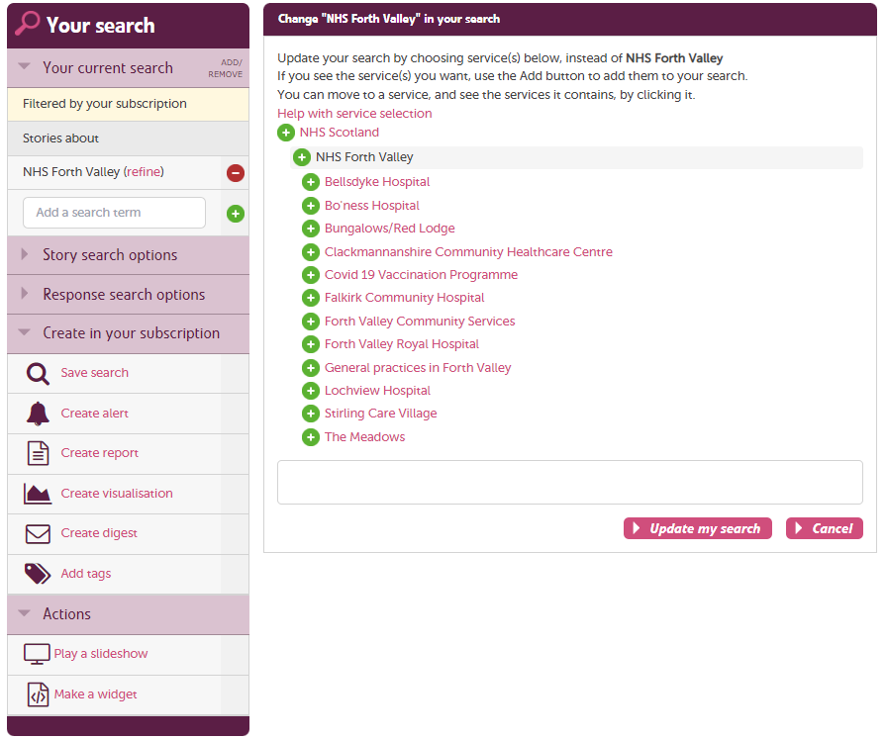

Slide 21
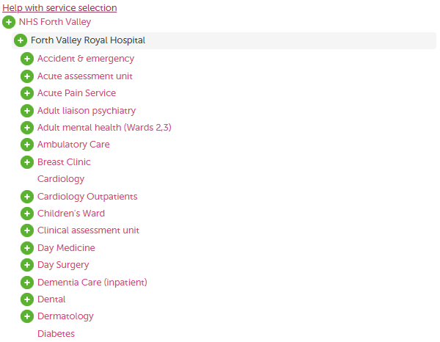
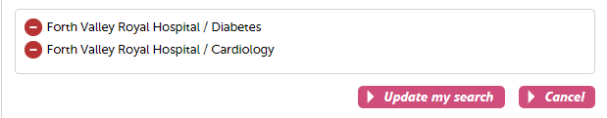

Slide 22
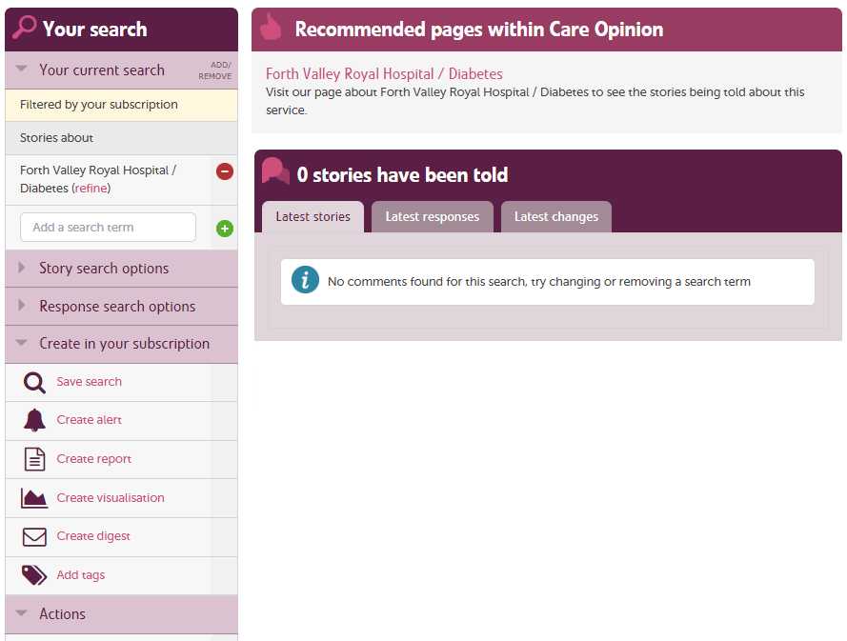

Slide 23
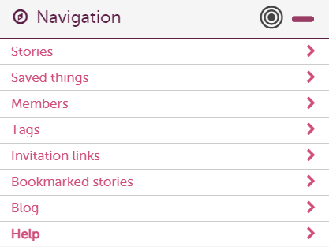

How to find help?
Help button
Support page
Contacting your support lead
Emailing info@careopinion.org.uk

Slide 24
Follow up task
After this training you will be able to do the following:
Log in to the Care Opinion site
Update your profile details – upload a profile picture and a brief summary of your role in plain language
Search for your service/ward
Save your service/ward
Create an alert for stories about your service/ward
Check these in your ‘Saved things’
& Be able to add a response!
https://www.careopinion.org.uk/info/subscriber-know-how
The above link is to the Subscriber ‘Know how’ page, helpful support pages on things you might need to know-how to do on the site.

Slide 25
Upcoming How to… Sessions – The recordings
1. How to respond and demonstrate impact – Monday 26th September 2022 @ 3pm
How to respond well to on line feedback on Care Opinion. What makes a good response?
2. Invitation links and Subscriber Tagging – Tuesday 4th October 2022 @ 2pm
Learn how to set up and use invitation links across all your services.
3. Involving volunteers in encouraging feedback – Tuesday 11th October 2022 @ 11am
This session is the one for you if you are a volunteer, a volunteer manager/coordinator or a staff member working with individuals or groups to generate stories.
4. Encouraging feedback – Thursday 20th October 2022 @ 10am
This session will explain the online, postal and phone options as well and highlighting the accessibility features of the site and story telling process.
5. Alerts, Reporting & Visualisations Webinar – Wednesday 26th of October 2022 @ 2pm
Learn how to create and manage your alerts, how to run reports and visualisations from the stories about your service.
6. Framing the ask to patients and service users – Tuesday 1st November 2022 @ 10am
It will help you understand what motivates people to share feedback, explore why we find it difficult to ask for feedback and look at various ways of 'framing the ask' to patients and service users.
https://www.careopinion.org.uk/info/how-to-sessions

Slide 26
Any questions?

Slide 27
Thank
you

