Slide 1

From feedback to learning and change
Vi Gray
Patient & Client Experience lead for 10,000More Voices & Care Opinion

Slide 2
What will be covered
What does learning and change look like in practice
sharing / reflection; change in practice to enhance users experience 2 examples
What if author doesn’t wish to engage
Sharing with staff

Slide 3
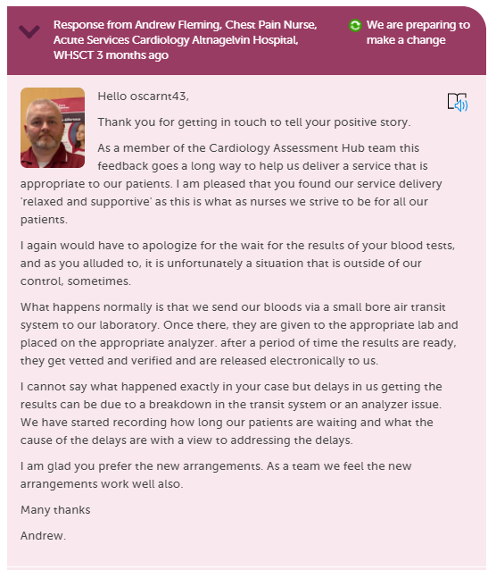
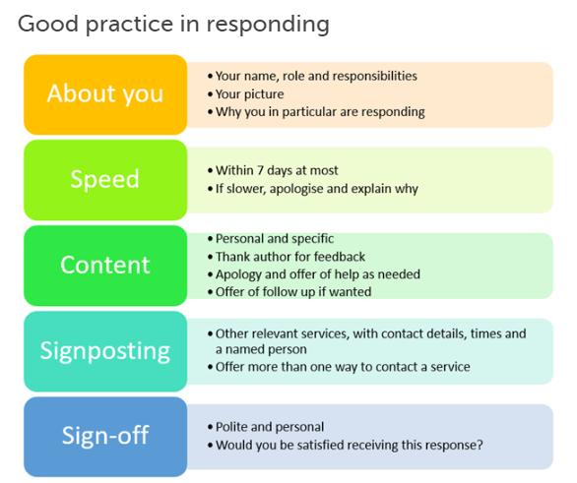

Slide 4
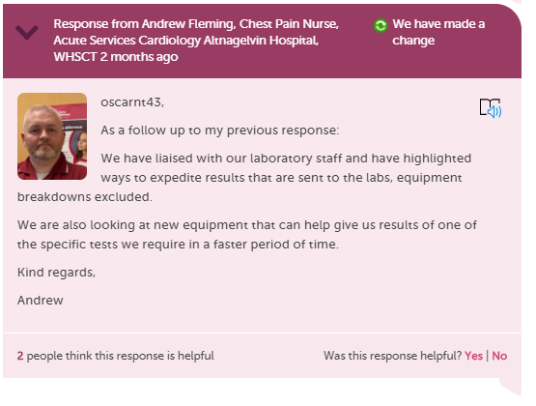

Slide 5
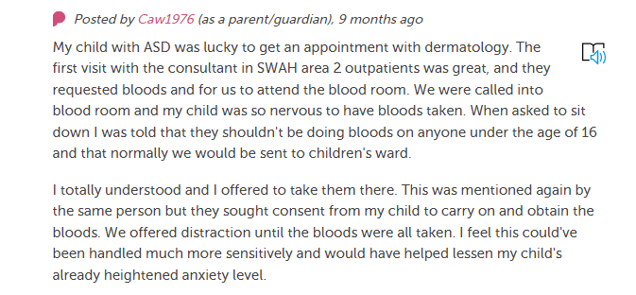
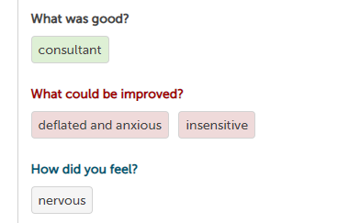
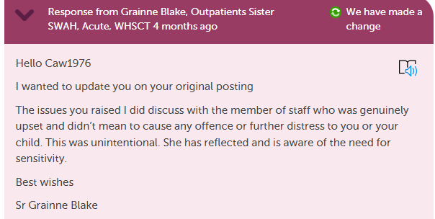

Learning and change. Sister shared with staff
Author contacted Sister - opportunity for staff reflection –avoided formal complaint
Positive outcome for parent and improved practice

Slide 6
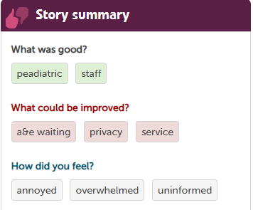
I was first seen by my own general practitioner in the afternoon, admitted to the
SWAH an hour and a half later and my baby with severe croup got seen by a doctor in
the SWAH 7 hours later and then admitted to children ward. That is nearly 12 hours later
The waiting area was busy. Myself and baby were surrounded by patients with all ailments. There is no area with any privacy provided for babies
I had no baby milk with me. Only the receptionist I had asked provided me with 2 small ready made bottles. My sister had to come up to hospital with items that I needed nappies more milk for baby. I wasn't aware at this point if my baby was going to be kept overnight.

Slide 7
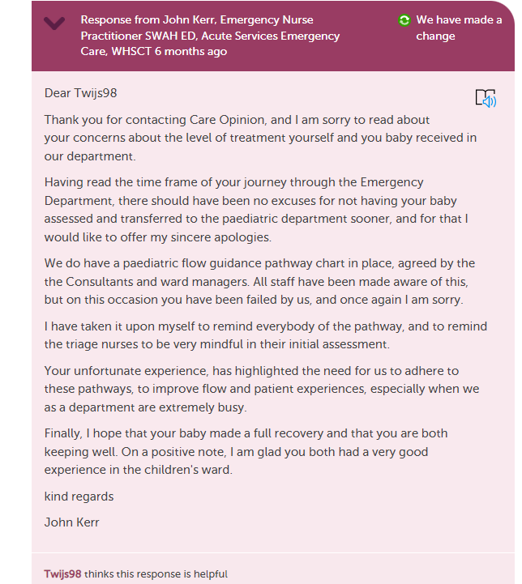

Openness , transparency and honesty is very important in a response

Slide 8
Following critical posting what if author doesn’t engage despite invitation
Unfinished business or testing the ground ?
Responders encouraged to “close the loop “ explain what action has been taken/ planned
Signpost to formal complaints

Slide 9
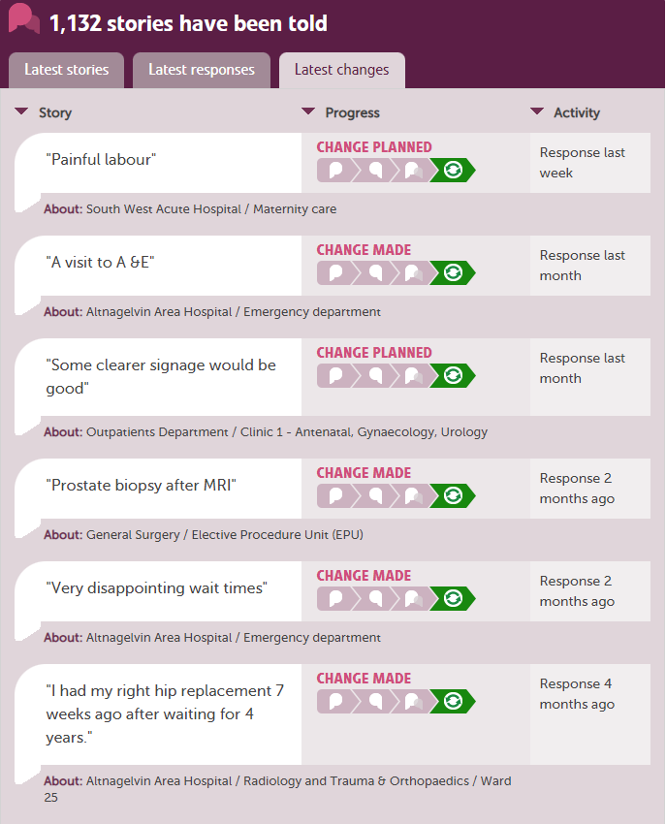
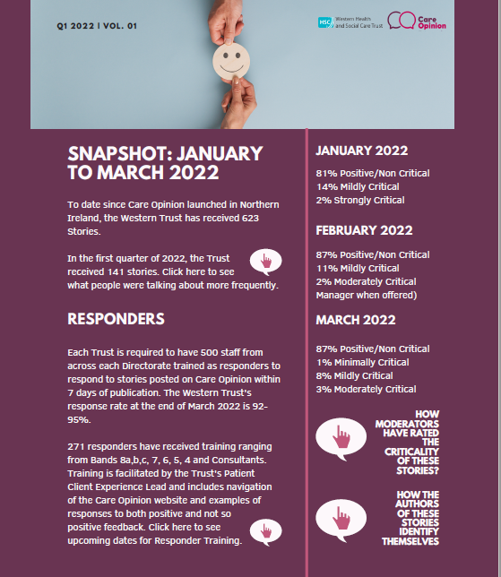
Sharing with staff
March 2023 Staff Recognition Awards there will be a new Patient / Service User Feedback Award facilitated by 'Care Opinion' feedback and compliments
Monthly updates and quarterly interactive Care Opinion Newsletter

Slide 10

Summary
Changes don’t have to be big
Encourage openness honesty, transparency ; acknowledge that we don’t get always get it right
Important to close the loop
Be creative when sharing with staff the key messages

