Slide 1
‘Monkey needs your help’: How a Paediatric unit helped Monkey in his quest for Patient & Family Feedback.
Sharing our story on the steps taken and its impact
Dr Holly Mincher & Dr Gita Modgil

Slide 2
Overview
Promoting CO in the department
Staff perceptions and experience
Promotional Activities
Results
The Impact
Sharing learning and positivity
Going forward
Learning

Slide 3
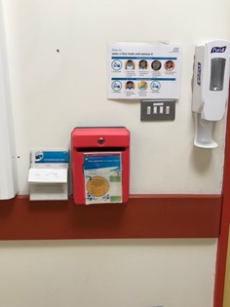
Patient and Family Feedback before Care Opinion…..
Patients and families provided with a ‘letterbox’
The Trust would collect the feedback
Feedback was returned to the department months later
Notes:
Not timely
No opportunity to respond or improve on negative feedback

Slide 4
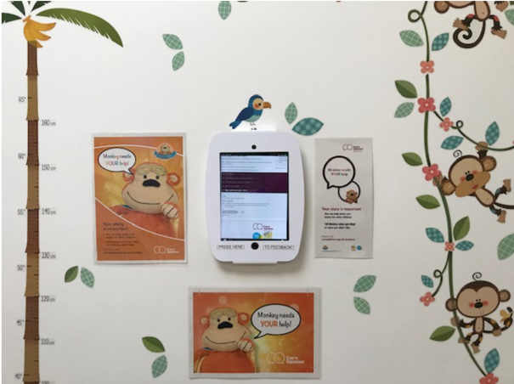
Promoting Care Opinion in our Department
Our Kiosk in situ outside Acorn ward
Notes:
Pre covid: used to promote parents attending hospital during the pandemic but use declined – patients and families and promotion from the staff
Decline in its use over time
Post COVID wanted to relaunch
Need to establish what were factors hat led o the decline and also the merits of CO as perceptived by our staff

Slide 5
The Relaunch
Promoting Care Opinion within our Department
Step 1: Understanding staff members experiences and
perspectives of patient and family feedback
– Staff questionnaire
Notes:
I created a survey – questionnaire with closed and open questions

Slide 6
Experiences and
perceptions of
patient
feedback
in an
acute
Paediatric setting
40% responded
Mix of Doctors and Nursing staff of all grades and bands
All work within the acute paediatric setting

Slide 7
Experiences and perceptions of patient feedback in an acute Paediatric setting
What benefits have you encountered when using Care opinion experiences have you encountered?
“personal, positive feedback”
“everyone thrives on praise!”
”increased trust and honest open feedback”
“Ideas for ways to improve patient/family experience Written evidence of compliments”
“Finding out ways to improve care”. “Areas of improvement”
“Happy staff”
“Increased feedback from a wider range of service users to highlight good practice points but also things we can change. This could be simple things about the environment through to more fundamental changes to our practice”
“the positive impact of families feedback on individual colleagues; change with paediatric services (environment, catering, teamwork); sharing patient stories across directorate and with the Trust exec teams; raising the platform of paediatrics within our Trust.”
“Generally very good feedback from the people who have taken time to use CO- boost to personal/team morale. I think if people had a significant complaint to make they wouldn't use CO.”
“Positive feedback can be very motivating”.
Notes:
Overall themes
Boosting staff morale - happy and motivating
Creating change for improved care

Slide 8
Experiences and perceptions of patient feedback in an acute Paediatric setting
What challenges have you encountered when using Care opinion experiences have you encountered?
” Parents don't fill the forms in”
“access to device, time to do it”
“awkward to ask!”
"access to the form. timely completion. pressure from clinician to complete versus receiving good care”
“families can be scared of technology, refuse to take part or just not bother”
“time, technical problems?”
“It can be difficult to persuade patients/parents to partake”
“Time taken- often want to go home quickly once discharged (especially if following a long wait)”
“actually getting people fill in this was the problem before”
Notes:
Themes
Technology – the lack of ease to provide feedback
Limited time opportunities to provide feedback
Staff not feeling able to ask for feedback

Slide 9
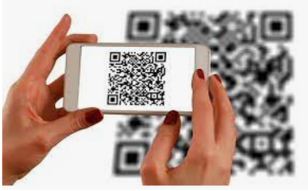
Promotion
Promoting Care Opinion within our Department
Step 2: Promotional Activities - Increasing accessibility
Notes:
A strategy to encompass:
Care Opinion has been implemented across several areas of the Paediatric department, specifically focusing upon the acute Paediatric services.
It has been introduced into the Paediatric Admissions Unit (PAU). Here, Care Opinion captures the feedback from patients and families at the point of care delivery from the community and the Emergency department.
We have also established Care Opinion within the High dependency unit (HDU) and the Paediatric wards, Acorn and Oak.
Increase accessibilities – time and place and point of reference / focus to explain or highlight a feedback request - removing the akward perception
Focus upon QR codes:
Increase accessibility – able to use anytime including at home
Access for all in all circulstances
User friendly – manly come out of COVID
Reduced time consuming
CO themselves are a wealth of resoures and provide the QR codes for us and link them to each ward

Slide 10
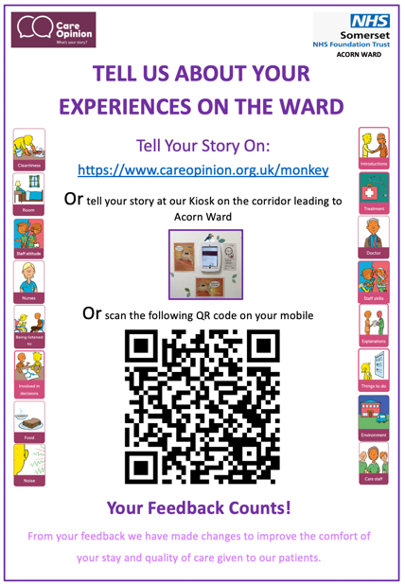
Posters
Notes:
QR codes = accessibility and familiarity in use has increased during the PANDEMIC
PAU, HDU, Ward Cubicles, wash basins, entrances, exits, Shower rooms, play room
Have taken these to Medical photography for patient leaflets – graphic designer – and redesigned the posters

Slide 11
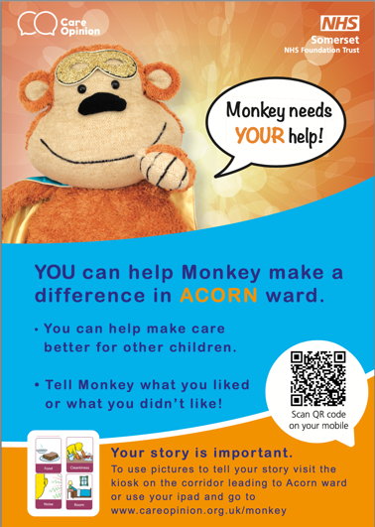
Patient Leaflets
By Donna Berridge, Medical Photography
Notes:
Handed out at point of care & on discharge – able to provide feedback in own time
Point of reference for staff to talk around the posters removing the arkward feelings
One is for children and the other for Adults and young people
Increases flexibility

Slide 12
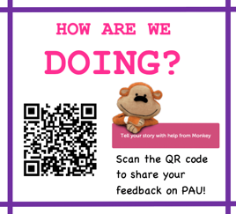
Patient Leaflets
Notes:
Handed out at point of care & on discharge – able to provide feedback in own time
Point of reference for staff to talk around the posters removing the arkward feelings
One is for children and the other for Adults and young people
Increases flexibility
No cost, timely

Slide 13
Discharge
Summary
Footnotes
Notes:
Environmentally friendly – QR attached
Able to provide feedback at home

Slide 14
Care Opinion within our Department - Feedback
Step 3: Sharing Excellence, positivity and learning
Notes:
Increase accessibilities – time and place
Specif examples then lead onto more summary of feedback

Slide 15
Feedback responses
Uplift:
1-2 weekly
from
1 every 3 months!

Slide 16
Care Opinion in our Department - Feedback
Sharing Excellence, Positivity and Learning
Paediatric Team
Dr Sam, Caroline, Paula and all our Nursing
and HCA team
“Our son was admitted with suspected sepsis via A&E. We were promptly moved to the PAU awaiting assessment. Although we felt this time was being managed slowly; when we raised our concerns that our son wasn’t improving & time was lapsing the doctors were quick to act.
Evening doctors arrived & we were immediately reassured by Dr Sam. His approach, his duty of the he implemented felt really reassuring in response to our concerns. During these initial assessments Dr Sam made some very quick decisions to treat his worsening condition promptly. We were then cared for so attentively by staff nurse Caroline in the HDU. She went above and beyond to comfort us & take the best care of our son. Both her & Dr Sam have made a lasting impact on us & we will be forever
grateful. We were cared for by several fantastic nurses & met several consultants; each with their own opinion & plan. Ultimately we were impressed with how well listened to we were as parents & how this was instrumental in our sons treatment. On our last day Paula took great care of us & checked we were happy with everything in the lead up to our discharge. Nothing felt too much trouble for any nurse or HCA. The supportive conversations, endless cups of tea & biscuits & the genuine concern & care for our son has made this very scary experience much more bearable & we are thankful to each & every one.
From L22 (Parent/Guardian)
Inclusive for all staff members
Notes:
Feedback for all members and across paediatric sites
Personal feedback for all

Slide 17
Care Opinion in our Department – Feedback
Sharing Excellence, Positivity and Learning
The ENT & Paediatric Teams
“My son has suffered with large tonsils and due to this developed sleep apnoea. We where very nervous going through with the op with him being only 3 years old but all members of staff was very reassuring and considerate, after op my son started spiking a temperature and again all staff on oak ward was extremely thorough and talked us through why this may have been happening and helped us understand more x all staff was very child friendly an knew how to make him feel calm an comfortable..’’
From Funnyny35 (Parent/Guardian)
Cross-specialty communication
The Emergency & Paediatric Teams
“ The A&E staff was very lovely and the staff at the children’s ward was brilliant very friendly and caring.”
From Avocetqqk38 (Parent/Guardian)
Notes:
Feedback across specialties
As paediatrics we reliy of cross-speciality care
Improves our own working relationships with each other

Slide 18
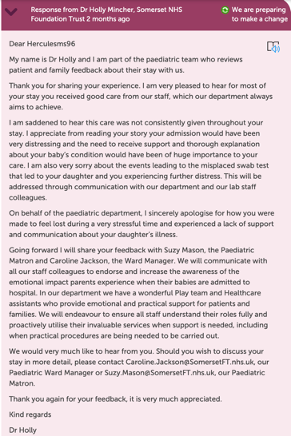
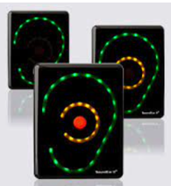
Care Opinion in our Department – Feedback
Sharing Excellence, Positivity and Learning
Let’s make a difference!
Increase awareness of our team members
Play team & Healthcare assistants
They provide emotional and practical support for patients and families”
Let’s make a difference!
Notes:
Learning – talk about ‘Reponses’ and ‘changes to be made responses’
Respond and planning a change – they can respond – because we plan to make a change we then reply explain what changes made - they reply again
Communication ongoing
Real time
emphasise that families keen to see and learn about what change is planned/has been achieved -repost demonstrates commitment

Slide 19
Care Opinion in our Department - Feedback
Sharing Excellence, Positivity and Learning
Paediatric Admissions Unit
“I have got a sore hip and everyone has been very kind to me and my mum. They made us a cup of tea”
Baby Slothy (Patient)
Provide patients with an ‘autonomous’ voice
Notes:
Patient feedback – mostly been with parents

Slide 20
Summary of Data
Notes:
CO has bought a wealth of positivity
And positive changes
What is important to Paediatrics…..

Slide 21
Care Opinion within our Department
Step 4: Sharing Feedback and Learning
Notes:
Increase accessibilities – time and place

Slide 22
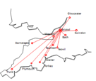
‘Shout outs’
Local meetings
Regional meetings
Email distribution; departmentally and personally
Directorate Governance
meetings
‘P.I.G’ meeting
Notes:
Raising and maintaining awareness within the department is hugely improtament
Feedback responsed emailed across department
add that we have included a specific section in dept and directorate governance under ‘patient feedback’ to include Care Opinion (used to only include friends and family) - sharing patient stories across directorate and with the Trust exec teams

Slide 23
Showcasing Care Opinion in our Department
Excellence board in PAU
Notes:
Pre covid: used to promote parents attending hospital during the pandemic but use declined – patients and families and promotion from the staff
Decline in its use over time
Post COVID wanted to relaunch
Need to establish what were factors hat led o the decline and also the merits of CO as perceptived by our staff

Slide 24
Care Opinion within our Department
Step 4: Going Forward
Notes:
Gaps so far

Slide 25
Capturing the Voice of Young People on our Ward
Patient Survey
Liaison with Consultant lead in Adolescent care
Hospital volunteers in spreading awareness and hearing stories
Discussion with the CAMHS participation lead
Spreading across the Directorate
Gaining a better understanding into perceptions of what patient feedback means to young people including:
it’s accessibility
its’ role it can play in their care
Notes:
Volunteers – CO provide resources for training

Slide 26
My Learning
Promotional strategies need to be simple & accessible
Understand staff perspectives and experiences of feedback
Does require active engagement for its longevity
Care Opinion brings a wealth of positivity to the work place
Leads to positive change for patient care in real time
Notes:
Promotional strategies – removing the effort – keeping things simple simple
Establish and maintain a culture of obtaining patient feedback. Need continual active engagement (leads etc)
Postive care – real time, able to respond maintain relationships or repair
How to establish and maintain a culture of obtaining patient feedback.
The need to gain an insight into the perceptions and experiences of staff to understand the barriers needed to overcome prior to introducing any interventions
Named leads and volunteers to persistently drive interventions and awareness
Examples of promotional strategies used to increase patient feedback within a paediatric department, focusing upon feedback acquisition from children and young people
What is important to patients and their families when admitted to a paediatric unit and how this is shared to make changes to improve patient care

Slide 27
Thank you
Any questions?
Holly.Mincher@SomersetFT.nhs.uk
Gita.Modgil@SomersetFT.nhs.uk

