Slide 1


Completing the puzzle
– from feedback to learning and change
Caroline Millar
Confederation Chair
and
Jill White
GP Practice Manager and Care Opinion Champion

Slide 2

City and Hackney GP Confederation
A social enterprise that supports its 39 member GP practices (population 339,000) to improve quality, resilience and stability in primary care and to develop innovative, cost-effective services that respond to the needs of local people.

Slide 3

Care Opinion in GP practices in C&H
June 2018 offered free to 11/42 practices
October 2022, now 20/39
Support from senior leadership (Confed Board, GP leaders, Practice Managers’ Forum)
Significant support from Care Opinion: on call, webinars, email updates and encouragement
CO tools: widgets on the website, cards, posters, kiosk mode, screen images etc
Training and webinars provided by CO
Regular reporting from CO to practices and Confederation

Slide 4
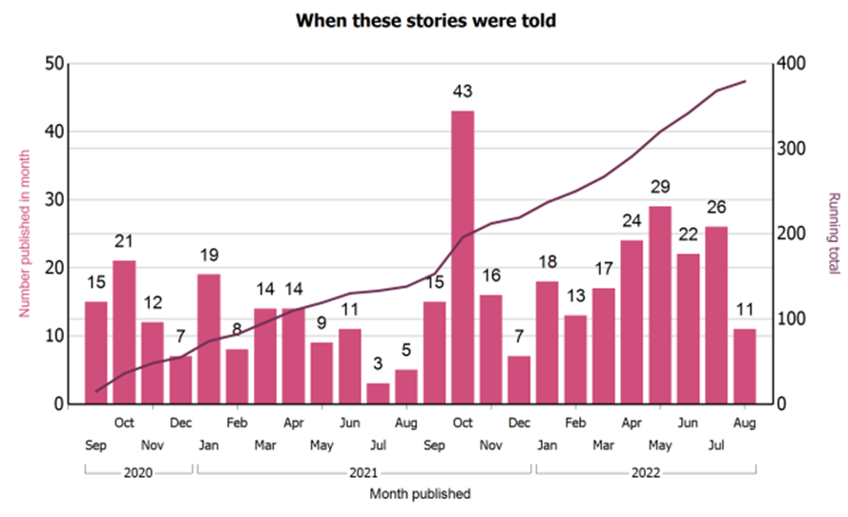
Stories told since September 2020
654 stories, read 39,247 times

Slide 5
Six principles of good complaint handling
Getting it right
Being customer focused
Being open and accountable
Acting fairly and proportionately
Putting things right
Seeking continuous improvement

Slide 6
Engaging with our patients
Patient Participation Group
Together Better
Practice newsletters
Care Opinion – Tell Us Your Story

Slide 7
How to use Care Opinion and communicate with patients
Ask clinicians and receptionists to seek feedback via Care Opinion
Take both positive and negative feedback to practice meetings
Encourage everyone to think like a patient
Discuss alternative ways to do things
Thank patients for negative feedback that leads to positive change
If a patient wants to make a complaint, suggest CO instead and explain why
Invite potential complainants to join the surgery friends’ group
Make yourself available to talk face to face

Slide 8
Change can be good – in response to feedback we have..
Reduced the amount of paper used when sending out paper invitations
Opened doors early for vaccine sessions
Changed the header on the home page of our website
Changed the length of the message on the answering machine

