Slide 1
Working together with
Sharon Kidd
Patient Experience Manager

Slide 2
Aim of the webinar
Welcome and introductions
What have we learned at ULHT
From a Surgical Unit experience of using Care Opinion
The Care Opinion Team James Munro and Emma Noonan
Q&A Session

Slide 3
Human experience matters most!! “You can argue with figures and statistics, but you can’t argue with personal experience”.
Stephen Elsmere
Patient, Carer & Experience of Care Partner with the NHS Leadership Academy

Slide 4
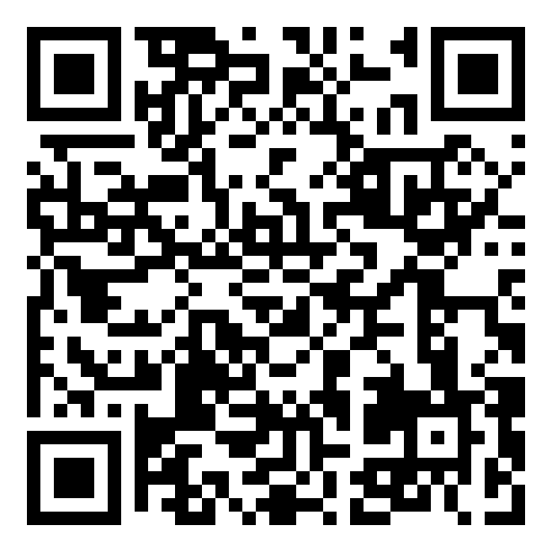
Who is Care Opinion?
Care Opinion is a different way for the Trust to seek feedback from patients, visitors, relatives and carers. It was founded in 2005 and is a national independent feedback platform for health services.
It is non-profit making and is about sharing experiences and opinions regarding health services within the UK.
Care Opinion is a conversation online between the patients, carers and the professionals of the health service bodies. Everyone requires healthcare at various points in their lives and this is the ideal way to share stories and experiences.
NHS Trip Advisor!!

Slide 5
The benefits
Share their story so that others can learn from their experience.
Real time feedback and the ability to have an ongoing narrative with patients and their loved ones. It enables the clinician to know how the patients and loved ones felt the care delivered from their team.
Changing culture. As feedback builds the team celebrates. It generates a vibe of wanting to see more and do more. Instant Ambassadors
Care Opinion also allows for clinicians to understand what didn’t go so well and how this can be solved in real time.
Trends can be discovered and visible.
Care Opinion can help providers meet regulatory requirements, such as those related to patient experience and feedback, early warning indicator, recruitment.
Ability to track changes made in practice in an open and candid way.
Don’t be afraid of negative comments

Slide 6
Our journey
6,000
Our journey with Care Opinion started way back in 2012!
We have received
just over stories
people have read our stories
response rate (to last 100 stories)
416 staff listening and responding to our stories
We have the ability to take the stories offline
We can tag stories with ‘change planned’ or ‘change made’
2.1 million
84%

Slide 7
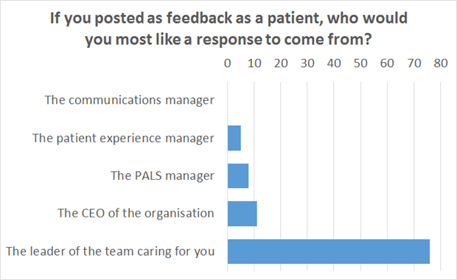
Storytellers have been asked who they would like a response from

Slide 8
How we manage our stories
Patient experience team act as gatekeepers for all stories.
Process in place to seek responses
Story is sent to relevant service/Fab Champion seeking a response
Expectation is 7 days to send a reply.
Patient Experience team post the reply back under the name of the staff member responding.
Following a reply, we have the ability to take a story ‘offline’.

Slide 9
Change can happen from stories
Thank you for taking the time to provide feedback following your experience at Louth hospital and enabling us to make a change to help rectify this situation.
Usually if we know a Doctor has requested blood tests my staff are aware after 4pm that these cannot be undertaken so they usually advise the patient to contact the hospital the next day and ask for the path lab. It appears this message may not have been given to the patient and we sincerely apologise for this.
As a result of this feedback we will be introducing some cards which will be given to patients after 4pm advising them of the number to contact to arrange for their bloods to be taken. Doctors will be made aware they need to give these to patients after 4pm or If they cannot attend for their test on the day. Hopefully this will make it clearer for patients of who to contact.
NEED CLARIFICATION
About: County Hospital Louth
Today I attended for a eye test which concluded with a request to make an appointment with the phlebotomy dept. for a blood test for the following day, as requested by the optician. After 5 phone calls I eventually got through to the appointment dept. and was told that dept. does not make appointments. I am a loss

Slide 12
Our journey on the Surgical Unit, Grantham Hospital using
Matron Julie Record
Surgical Unit, Grantham Hospital

Slide 13
What is the Surgical Unit?

Slide 14
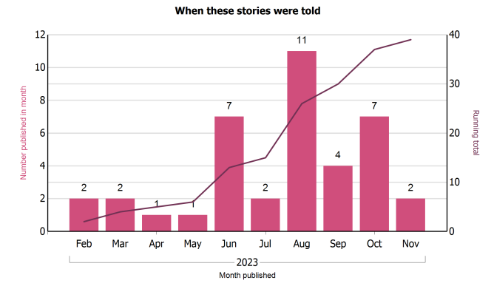
Our journey during 2023

Slide 15
What was good?

Slide 16
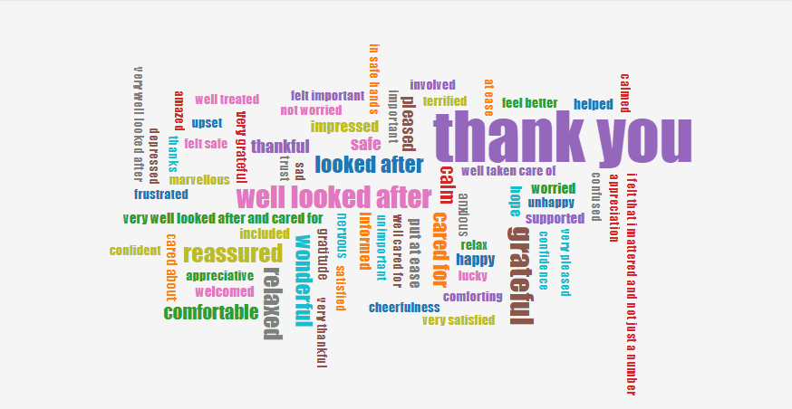
How did you feel?

Slide 17
