Slide 1
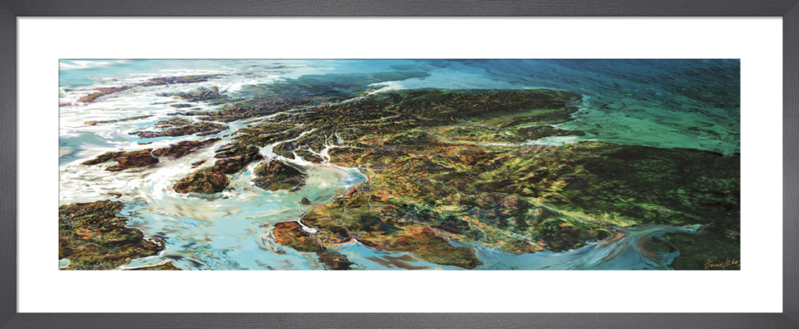
Care Opinion in Scotland
Learning & improving from the big picture

Slide 2
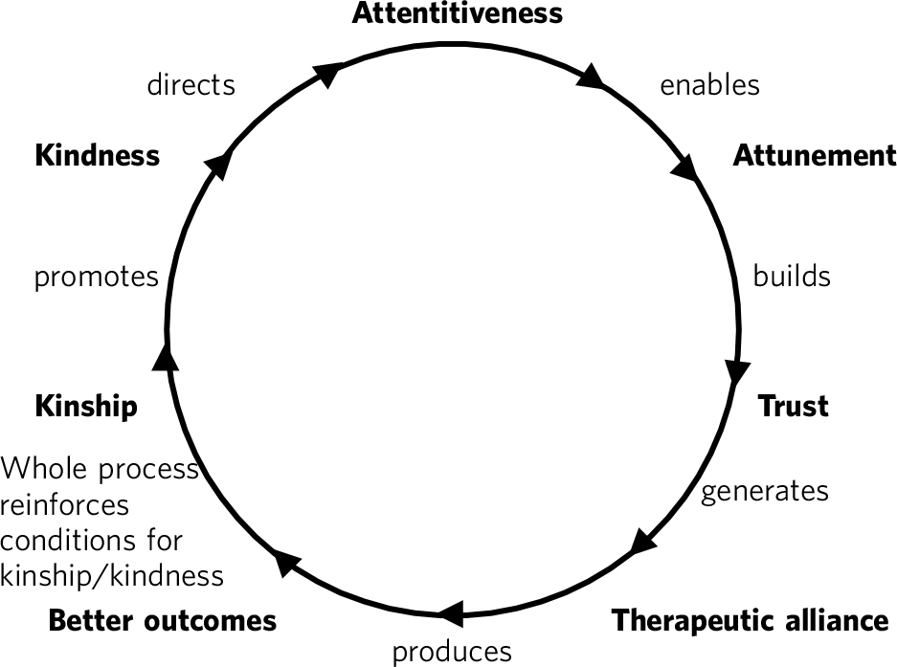
The circle of person-centredness
Intelligent kindness: reforming the culture of healthcare
Ballat & Campling 2011

Slide 3
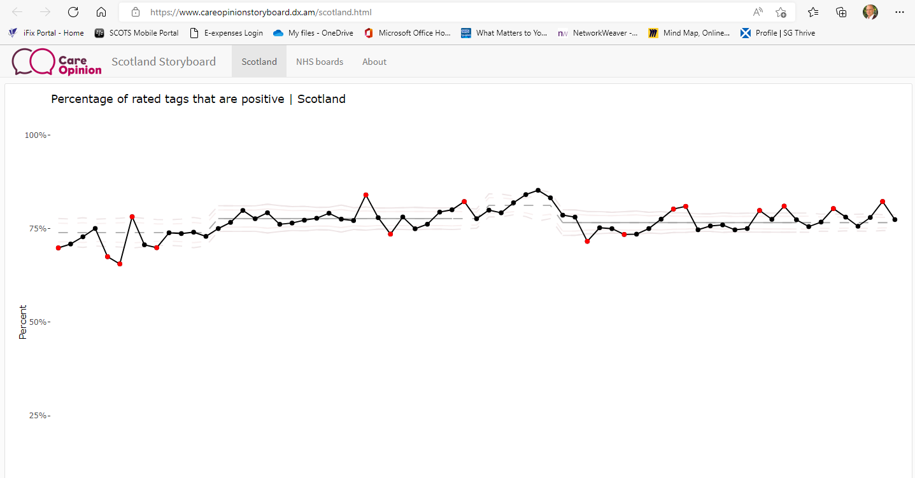

Slide 4
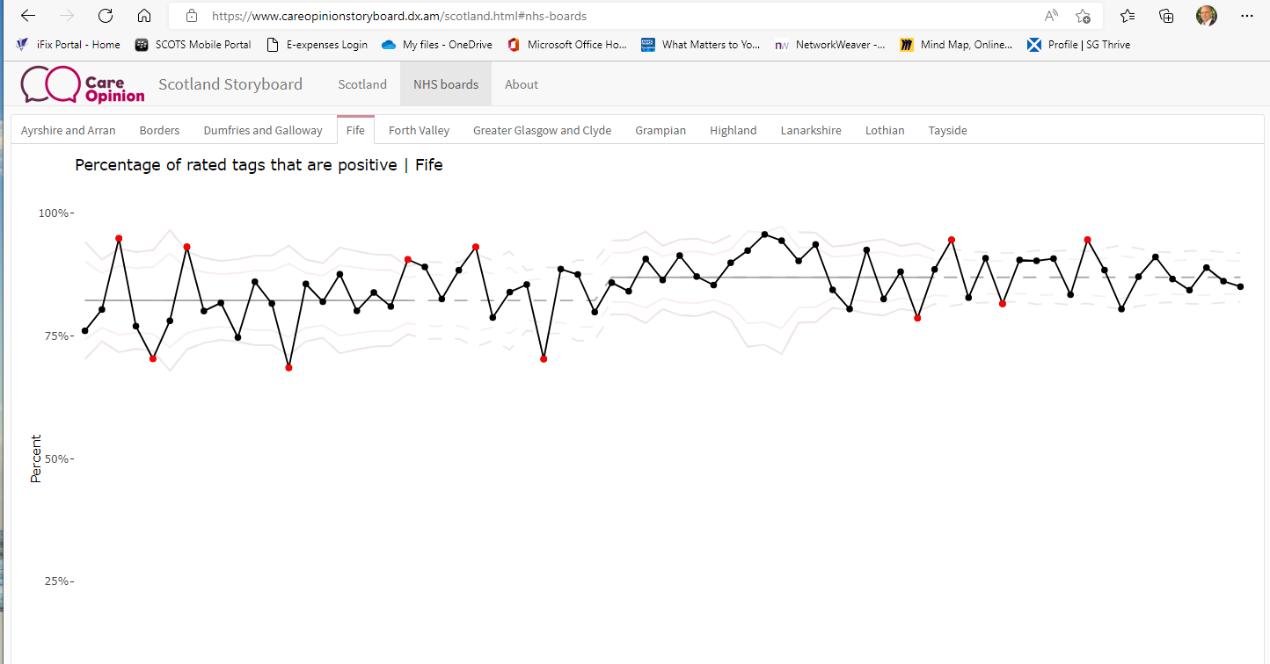

Slide 5
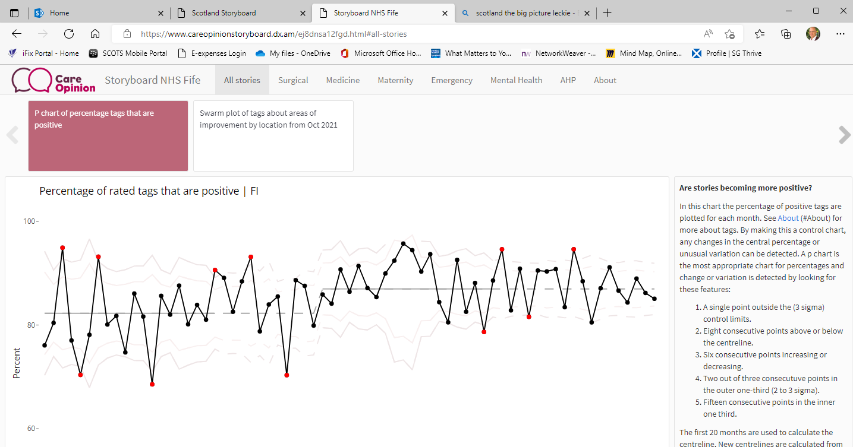

Slide 6
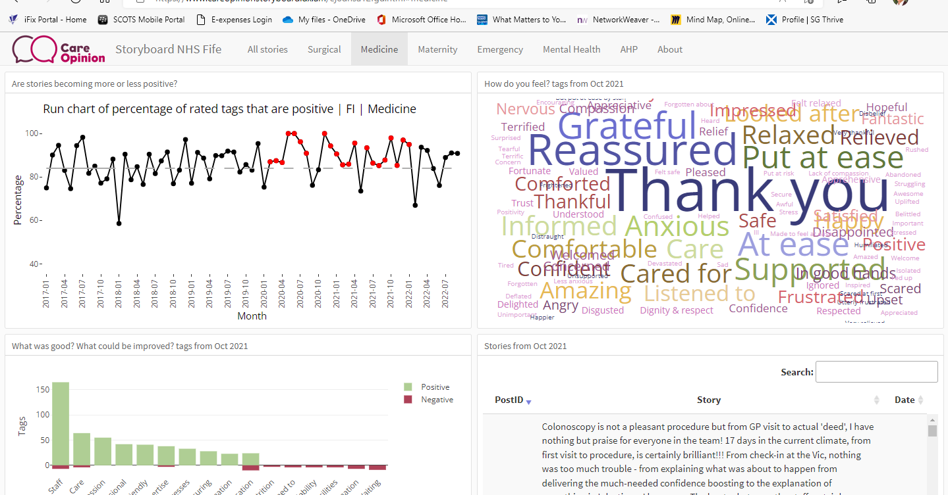

Slide 7
