Slide 1

Involving volunteers and staff with Assisted Story Telling

Slide 2

Aims of today's webinar
Explore ways to share feedback via Care Opinion and the role of the volunteer
Get volunteers/staff members involved in generating and learning from feedback (benefits to volunteers and potential disadvantaged)
How to establish a volunteer role and training plan
Discuss different options depending on setting
Share resources available on Care Opinion

Slide 3







Ways to share a story with Care Opinion
Online careopinion.org.uk or careopinion.ie
Freephone 0800 122 3135 (UK only)
Freepost leaflets
From an invitation link
Via a Kiosk link
With support from Volunteers
All stories are subject to moderation and are uploaded to the website
Freephone, freepost, invitation links, volunteer support are subscriber only features

Slide 4

Volunteers in your organisation can…
Let people know about Care Opinion as a way of giving feedback
Show people the website and how it works
Let people see stories already shared about the service
Explain why the service would like to hear feedback and
what they will do with it
Help people to login
Support people to share their story on the website
Help people to write their story and put this on the website
Make sure responses get back to people who don’t have internet access

Slide 5

Benefits to volunteers…
Brings them closer to patients, service users and carers
Can take the feedback they hear from service users and help it be a force for change
Helps with professional development
Helps people grow and demonstrate interpersonal skills
Can increase confidence in basic digital skills

Slide 6

Exception not ‘the norm’
What proportion of stories shared by staff would we expect to see?
In keeping with experience over the past decade, we would expect less than 10% of stories told about an organisation to have been submitted by staff.
There is likely to be variation within a large
organisation: in some specific services the proportion
may be far higher than this, but conversely in most
parts of the organisation we would expect the
proportion to be far lower (i.e. less than 5%).
https://www.careopinion.org.uk/info/stories-shared-by-staff
Notes:
Most stories on CO are posted by authors, however, we also recognise that in some settings that might not be possible: High secure mental health services/Prisons healthcare, where internet is blocked and they may use postal.
In some services people may lack email or digital skills, or have cognitive, physical or sensory disabilities, which make it difficult for them to post feedback on line themselves. In such services staff will often help people to get their feedback online by posting it on their behalf.
CO encourages staff doing this to flag the story as submitted on behalf of a patient/carer so that we are transparent about how stories come online.
In decade of 2011 to 2020 7 % of stories were submitted by staff on behalf of, as we expand this has grown to 19% in 22 and 24% in 2023.

Slide 7
Disadvantaged of adding stories by Staff/Volunteers
Disadvantages for authors
Too soon to reflect on their care
May not feel able to give critical feedback
Questions shaped by staff
May not expand
If staff email is used, lack of receiving the response, closing the loop
Disadvantages for Staff
Stories may feel repetitive
Stories are less likely to raise new or surprising issues
Stories may feel less personal/authentic
Staff may feel less connected to story authors
Responders may feel their response matters less
No opportunity to seek further Info
Disadvantages for Services
Independence
May be viewed as less transparent
Fewer authors to join CO participation community
Missed opportunity to grow a community of supporters or become repeat users

Slide 8
Setting up your volunteers
Add volunteer to your Care Opinion subscription
Available resources:
volunteer-tool-kit-may22.docx
taking-a-story-form.pdf
Volunteer FAQ page
Assisting people with sharing their stories
Submitting stories to Care Opinion
Step by step conversation guide
Volunteer Guidance for how to manage volunteers
Think about environment and internet access
Run Intro to Care Opinion training
Brief them on what to do if something is not suitable for CO

Slide 9
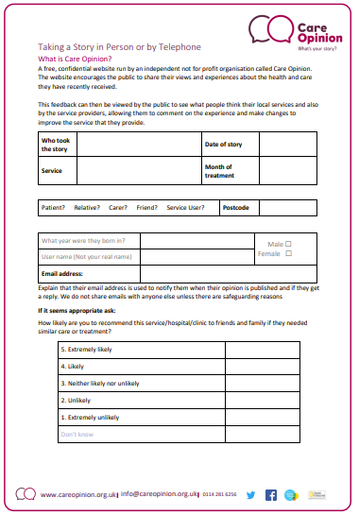


Slide 10
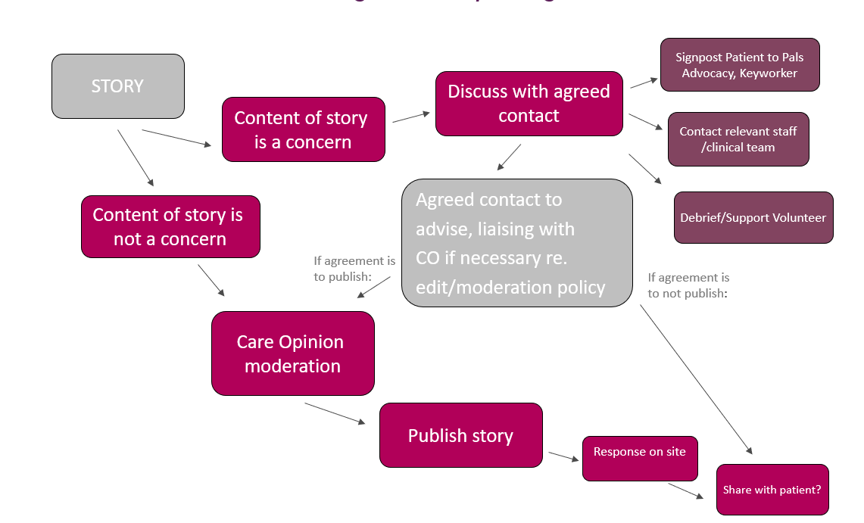
Volunteers collecting a story with an immediate concern for the person
This could still be published on Care Opinion eventually, but you should have a process in place to support the volunteer to raise with appropriate staff first

Slide 11

Supporting someone to share their story
Discussion and signposting to careopinion.or.uk or to the team’s invitation link/QR code for Care Opinion
Sitting with someone and helping them share a story on a laptop or tablet. Kiosk mode is ideal for this.
Taking the story down on paper to type up later. This is only recommended within secure settings and where internet access is not permitted*
*you will also need to consider your data retention policies – how you are keeping date safe, how long do you keep it etc.
Notes:
This is one of the main ways volunteers can support the organisation to hear from their users. Volunteers can discus Care Opinion with users and encourage them to submit feedback. This can be in several ways:

Slide 12

Signposting to Care Opinion
Many people in services have access to the internet at home of via their phones.
Volunteers can discuss Care Opinion and why the service is looking for feedback and give the person a card or flyer.
Make sure volunteers understand and can explain :
who Care Opinion is. i.e independent, not complaints
That feedback is published anonymously online
The patient will get a reply

Slide 13

Supporting someone to share their story
Volunteers can sit with people and help them share their story. This works best on an ipad or laptop where the volunteer facilitates the person to share their feedback. Depending on the person’s ability, the volunteer might:
Give the person the kiosk on the iPad with a brief explanation and allow the person to add their own feedback in private
Sit with the person whilst they dictate their story/help them move the picture tiles
Using their own account to add the story on the person’s behalf if they do not have an email address/access to the internet

Slide 14
Does the person have an email address?
Does the author have a postcode and email address they can use?
Yes
No
Make sure you are not logged in
Enter the story in the author’s words then select the role that best describes the author in the ‘About you’ section.
Log into careopinion.org.uk and enter the story in the author’s words BUT then in the “About you section” the role of “a staff member posting on behalf of a patient/service user”
Currently the ONLY way for a person to find their story is though the story ID
Follow the tell your story process and put in the author’s postcode and email address when prompted.
Then ask the author to create a username that is not their real name or use the username generator
Follow the tell your story process and put in the author’s postcode or the post code of the service
Check the author is happy for you to share the story on their behalf and submit.
This means the story needs to be entered on the website with the patient present and then they are given the number when it is submitted, or you need to go back to the ward to give the person the number
The story will now be added under the author’s account to they will be directly emailed if they get a reply from services
The story will be shared under your staff/volunteer account. If the story receives a reply you will need to share this with the author

Slide 15

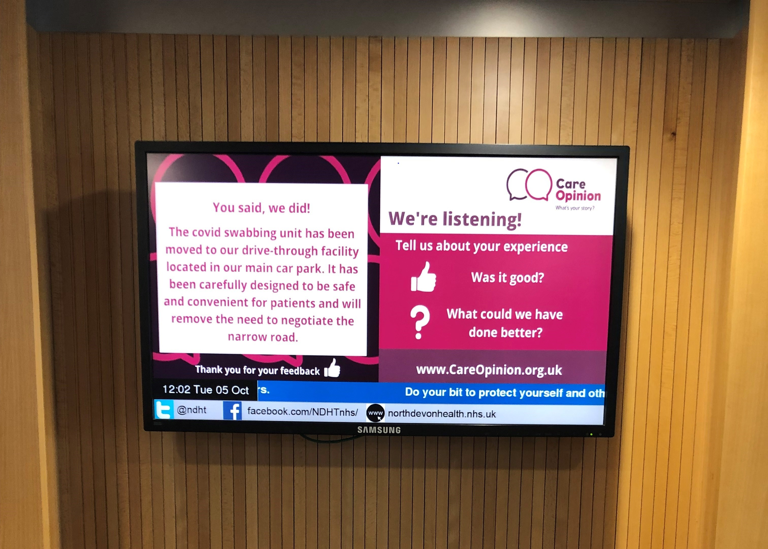
Closing the loop
Consider how volunteers will make sure the person can have access to their story and any responses. If they have an email address this will happen automatically. If they don’t you may need to get creative:
Flyers with link to story using the story id (see appendix on the presentation on how to find this
Revisiting the ward to share feedback directly with the person
Book of feedback and Reponses for all to read or on service notice board
Screens with feedback and responses

Slide 16
Questions?

Slide 17
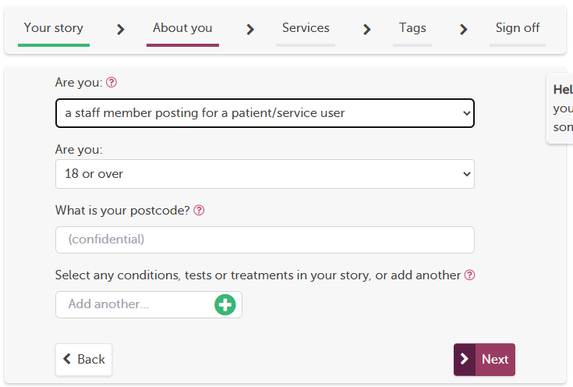
Appendix: Adding a story for someone and finding the posting ID
If the person doesn’t have an email a volunteer can add it on their behalf
They must be logged in with their organisation email
Add the story in the persons own words
On step two identify as a “staff
member posting on behalf of a patient
or service user”

Slide 18
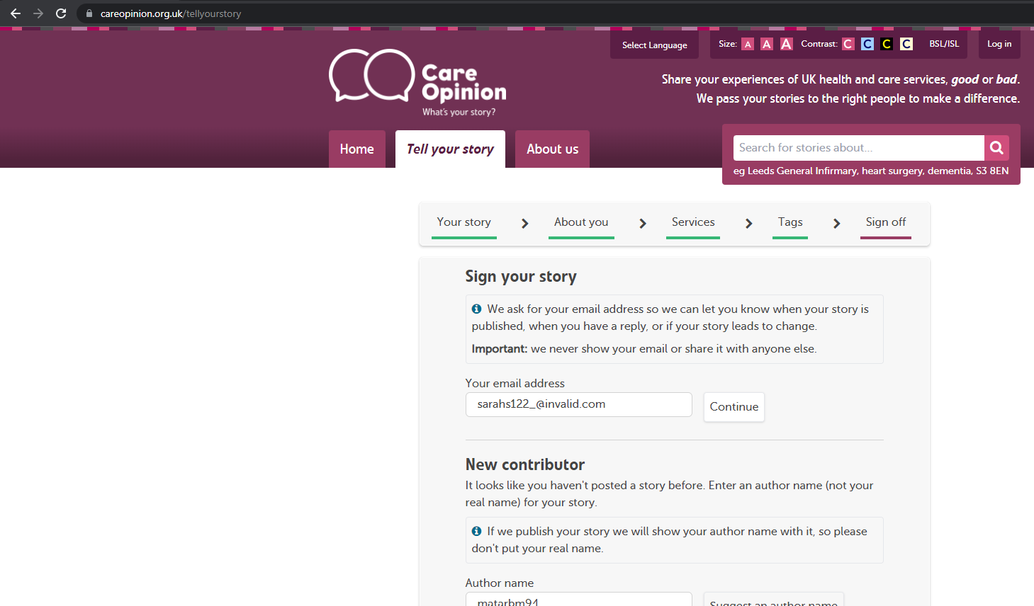
4. Follow the process through until or signing off as a feedback assistant
5. Click SUBMIT

Slide 19
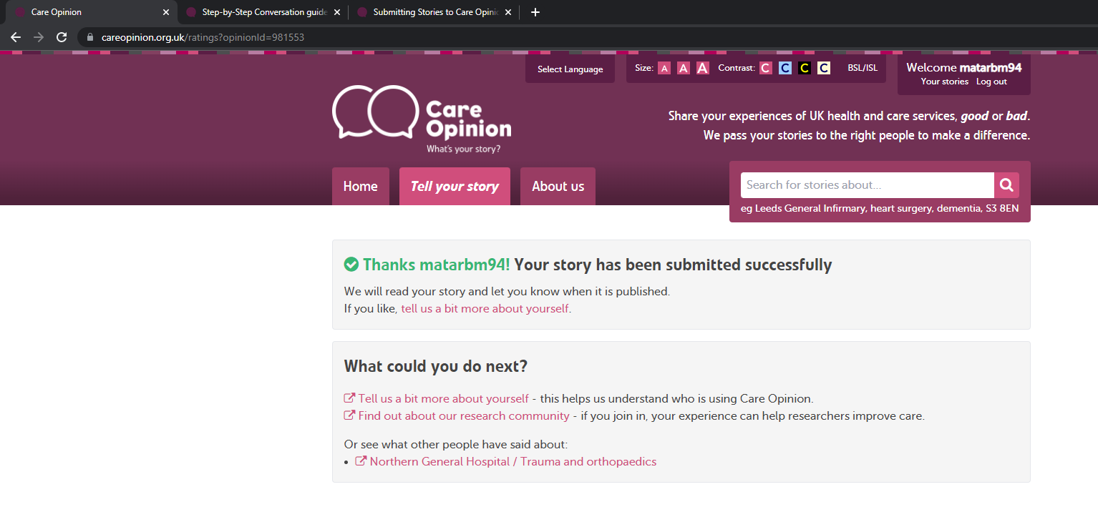
This is the posting ID

Slide 20
The link to share is https://www.careopinion.org.uk/981553
Where the number in red is the story id shown in the URL after the story is submitted.
Currently authors cannot search by username or title to find a story. There is a risk these will also be changed in moderation. ID number is the one thing that does not change on any story

