Slide 1
#COconf22
The Use of Care Opinion in the Radiology Service, WHSCT
Aisling Howell
Assistant Radiology Service Manager
Western Health & Social Care Trust

Slide 2
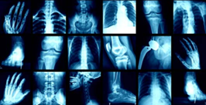
About us....
Diagnostic Radiology Service
Providing over 300,000 imaging
investigations per annum
Imaging underpins virtually every
patient pathway

Slide 3
With so many patients….
We’d know if something wasn’t right
We already get feedback
We don’t get many complaints

Slide 4
Quality
Its everyone's business
vision that we should provide a patient and client focused health care service with well trained and highly motivated staff.
Accreditation will allow us here in radiology to manage the quality of our services and make continuous improvements

Slide 5
Quality
“Quality is meeting and exceeding the customer’s needs and expectations and then continuing to improve.”
W. Edwards Deming

Slide 6
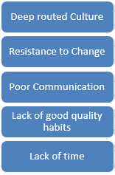
Introducing something new…
So many reasons why not!

Slide 7
Patient Feedback
Care Opinion has been chosen by the Public Health Agency (PHA) in Northern Ireland as the Online User Feedback (OUF) platform for Health and Social Care services across the region.
The aim is to ensure patients, carers and service users can share their experiences of health and care in ways which are safe, simple, and lead to learning and change.

Slide 8
Starting out….
Pilot on one site
Engaged with Trust Lead
Responder Training from Care Opinion

Slide 9
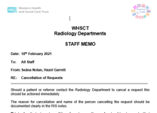
Ensure everyone is informed….
For staff
Communication via
Staff Briefs/Memos
Newsletters
Continuous Training and Learning
Share feedback with staff

Slide 10
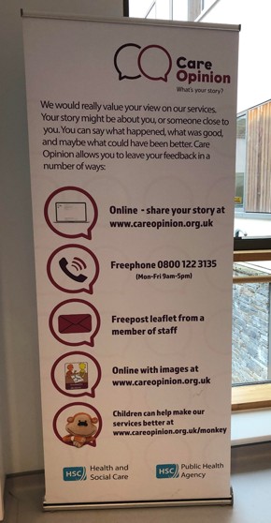
For patients…. Communication via
Patient appointment letters
Information Leaflets
Radiology QR Codes now available for each site

Slide 11
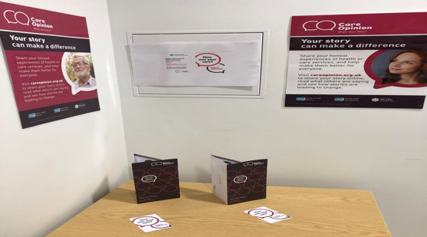
Posters
Social Media Campaign

Slide 12
WHSCT Radiology Using Care Opinion

Slide 13
WHSCT Radiology Using Care Opinion
Continue to promote use of the platform
Train more responders – timely interaction
Make changes based on feedback
Take positive and negative

Slide 14
CONTACT DETAILS
Email: aisling.howell@westerntrust.hscni.net
Twitter:@ashmchow

