Slide 1
The Impact of Patient Opinion in an Acute Trust
Dr Ben Mearns
Clinical Lead for Acute & Elderly Medicine
Surrey & Sussex Healthcare NHS Trust
5th November 2014

Slide 2
Not our finest hour
My Father needs to go on Warfarin (2 weeks ago) and keeps getting told a different story. ESH Hospital said local doctors surgery will do it, then doctors said they will not, then told East Surrey will do it, then get Crawley ring to say East Surrey Can not do it but they can do it at Crawley.
My parents and especially my father is in a state still not got the drug he needs!
Nobody will help and a different story is told every time.

Slide 3
Nobody will help

Slide 4
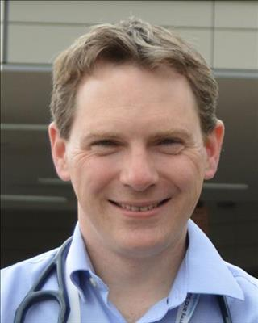
I'm very sorry that your father has not received the warfarin treatment yet. Please could you contact me if you would like me to sort this out. My email is ben.mearns@sash.nhs.uk and my secretary can be contacted via switchboard on 01737 768511 x2994. If you would rather speak to our PALS department please do so via the switchboard, but it is important that we ensure his treatment is correct and safely administered.

Slide 5
All sorted…

Slide 6
Totaly let down again, sorry we just do not belive anything the hopsital or NHS says any more. The nurse did not turn up for Dad as promised yesterday and when we rang the hospital the secretary is not available to Monday! So another week goes by with no help or treatment. Is this a way of saving money not treating patients?
I think we need to take this higher

Slide 7
Is this a way of saving money not treating patients

Slide 8
Phoned relative & patient
Invited to clinic
Started medication
Counselled patient
Drafting new patient centred guidelines
Lessons learned
carthorse thinks this response is helpful 14 of 14 other people think so too

Slide 9
Phoned relative & patient
Invited to clinic
Started medication
Counselled patient
Drafting new patient centred guidelines
Lessons learned
This story has been viewed by public users on this site 1,371 times

Slide 10
Moving from blame
to responsibility

Slide 11
Moving from confrontation
to problem solving

Slide 12
What’s the difference?
confrontation
problem solving
Negative
Threatening
High thresholds
Feels wrong
Takes time
Explanatory
Lack of trust
“No winners”
Positive
Conversation
Lower thresholds
Feels right
Faster response
Call to action
Trust can be earned
“…this was helpful”

Slide 15
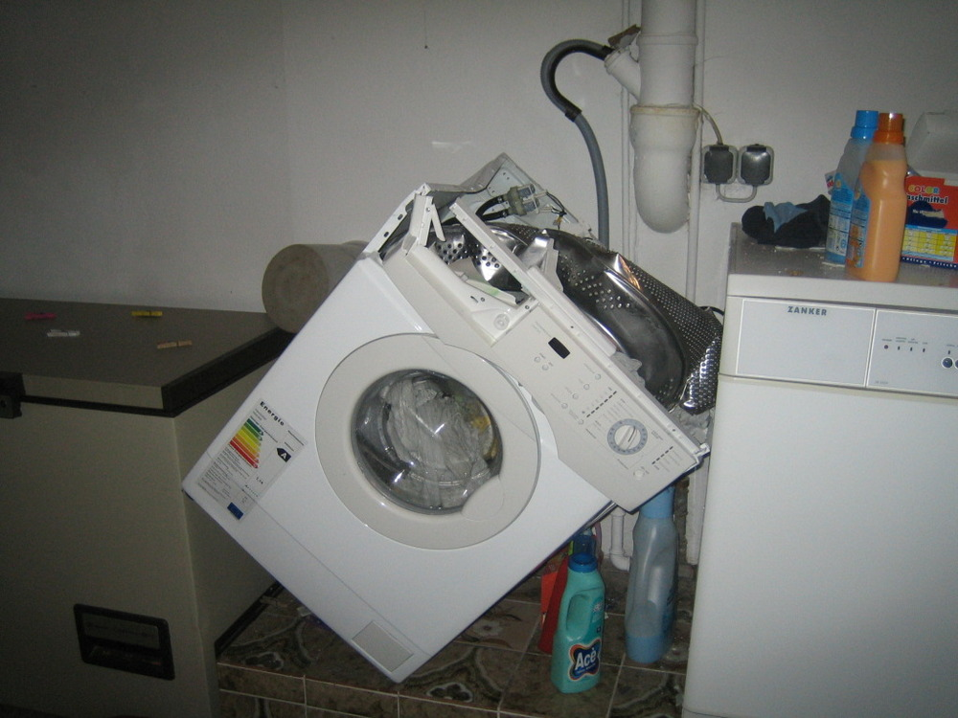
If all of your laundry is dirty… you probably should start by fixing the machine!

Slide 16
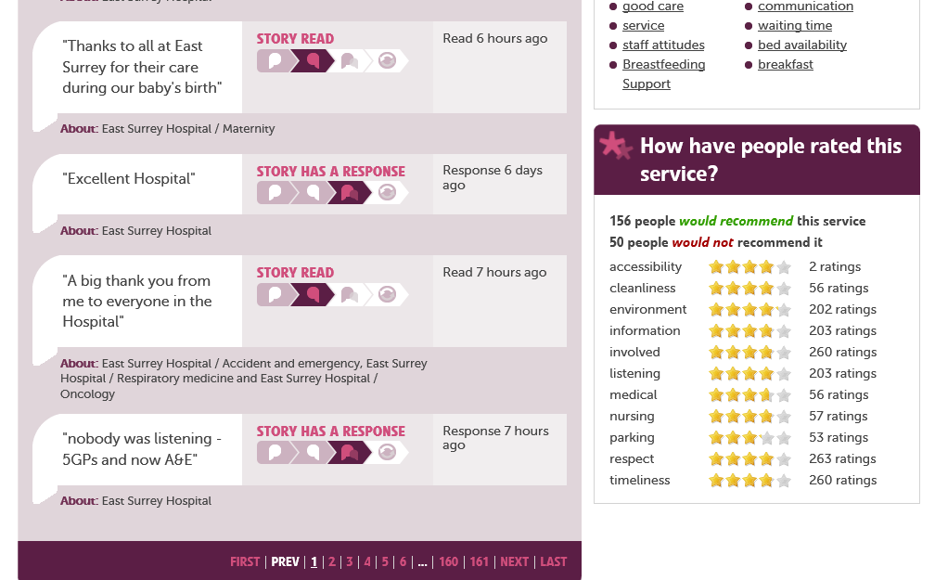

Slide 17
Transparency
Honesty
Peer review
Acceptance of imperfection
Confidence
Respect

Slide 18
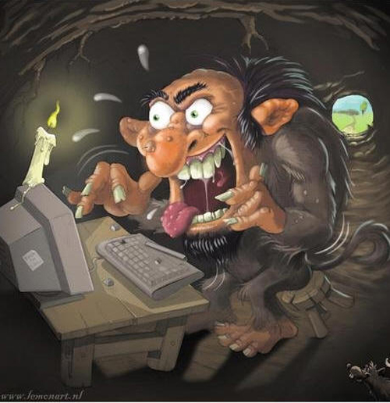
Anonymity

Slide 19
My favourite post…
After attending a&e on a number of occasions recently I am pleased to see how much the department has improved and how much more effective the new admission process is if you come in via ambulance! After spending many years in and out of the department I would like to spend some time complimenting the department. And give my gratitude to the staff for dealing with me, as I know at times I can be a difficult patient. I would also like to extend my views on AMU, which is a fantastic unit and is effectively run by a committed team. It's always clean the staff are friendly. And all staff have compassion especially when it comes to dealing with patients with mental health difficulties, to which who they never judge and are very understanding of every patients each individual need. Once again I would like to thank the staff from a&e and AMU for their fantastic treatment of myself.

Slide 20
I know at times I can be a difficult patient

Slide 21
AMU briefing
A real impact on staff
Empathy
A desire to do better
Awareness of future patients
Direct anonymous feedback

Slide 22
To make it work
Trust the patients and carers
Trust the staff to respond (clinical leadership)
Accept imperfection as normal
Try to solve each problem as they arise
Use positive feedback widely to empower staff and give confidence to patients/carers
Spot patterns and act to change the system
The Trust’s reputation will take care of itself
Executive have to let go and empower their team
Patients and carers are our best cheerleaders and expect the best
Prevent confrontation and work together to solve problems

Slide 23
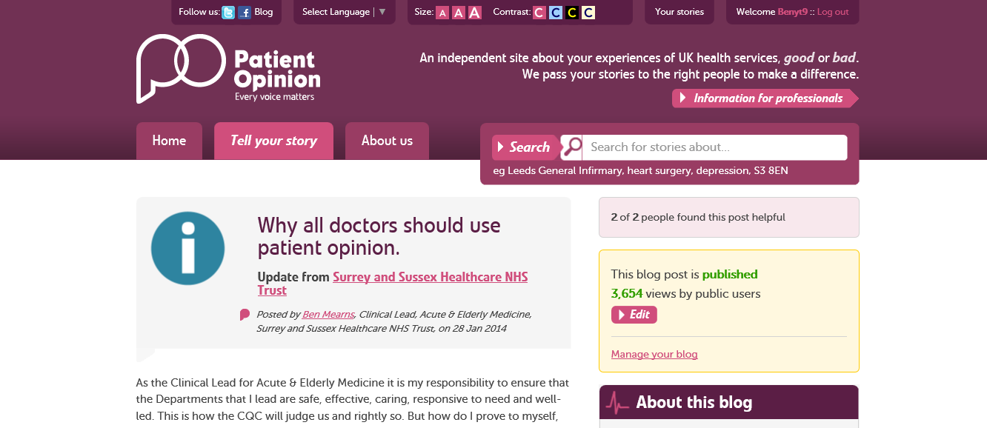

Slide 24
Changing culture
Patient Opinion takes the control of the publication of information away from those of us that run the service.
It made me uncomfortable at first, because when we didn't do our best it was plain for all to see.
In fact I told our Chief Executive that I was concerned about morale when he decided to put patient opinion's feed on our intranet homepage.

Slide 25
Changing culture
I see hospitals like I see patients now. If the results look abnormal, you need to diagnose the problem and give the right treatment.
And if the treatment doesn't work, guess what, the results don't get better. Patient Opinion is like one a the hospital's physiological observations - like a blood pressure chart. And when we made our hospital's diagnosis and put in the right treatment the results stabilized and got better and better. That was the best feeling in the world.

Slide 26
The End
Dr Ben Mearns
Clinical Lead for Acute & Elderly Medicine
Surrey & Sussex Healthcare NHS Trust
ben.mearns@sash.nhs.uk
@BenMearns
@sashnhs

