Slide 1
Care Opinion: supporting local voice
Gina Alexander
@careopinionscot
@ginaaalexander

Slide 2
Agenda
Refresh
Some stats & annual review
Link with Our Voice
Supporting improvement
Q & A

Slide 3
Our vision
We want people to be able to share their experiences of health and care in ways which are safe, simple, and lead to learning and change.

Slide 4
Innovation
Transparency
Positivity
Inclusivity
Humanity

Slide 5
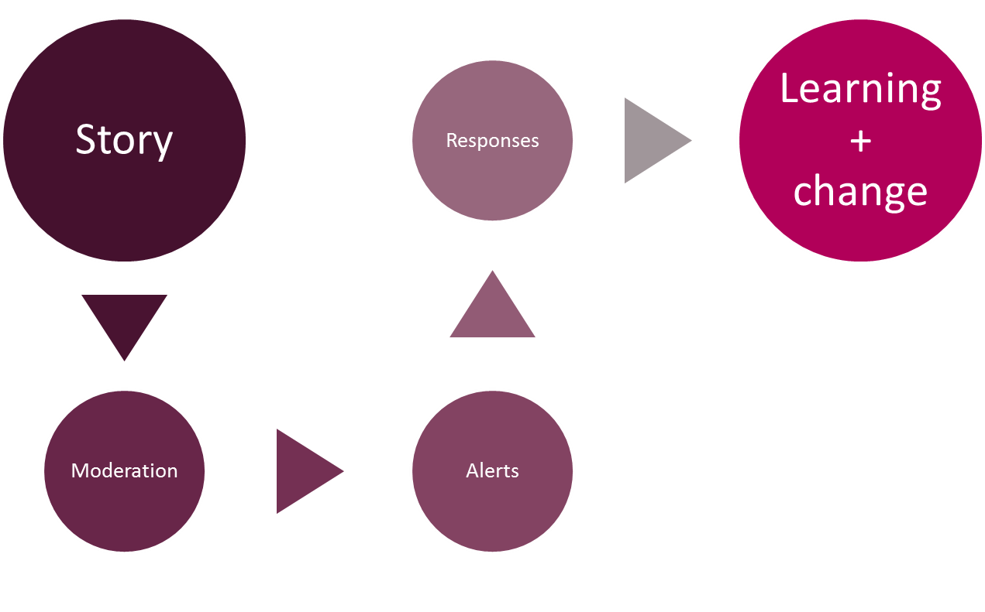

Slide 6
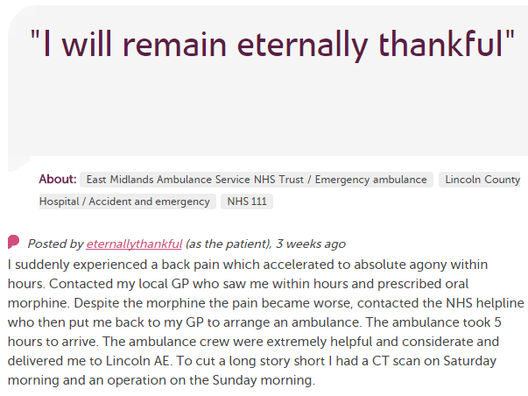
In each provider
Moderation
Clinical/care staff
Porters, reception, catering…
Feedback, comms teams
Alerting
CEO
Health boards
Health & care students/trainees
HSCPs
Interest groups
Researchers
Our Voice leads (SHC)
Local authority
Regulators (HIS, CI)
Elected officials

Slide 7
331 stories
(12 months to 28.2.18)
70% positive
99% response rate!
Grampian
3128 stories
66% positive
97% response rate
Scotland

Slide 9
Enabling people to share their experience of integrated care
Health Boards
Health and Social Care Partnerships
Independent providers of health and care
Person
Alcohol and Drug Partnerships
General practice
Third Sector providers of health and care

Slide 10
Our Voice seeks | Care Opinion enables
My Voice | People to share their stories
Community Voice | Local providers to see how their services are being experienced
National Voice | A national perspective on topics and issues

Slide 11
Notes:
We can become immune to patients, clients, customers in the everyday practice of our jobs and responsibilities.
Care Opinion helps using the Hovis principle …. New stories fresh every day helping us to see the world through the eyes of others,

Slide 12
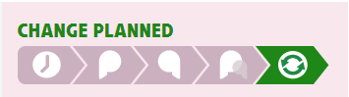
Notes:
Individual stories lead to change
No themes required
Every story has the potential to encourage improvement

Slide 13
People told us:-
They would like staff & managers to read and respond to their story (90%)
It’s important for them to share stories in their own words (90%)
They want to be able to share their story at a time that suits them (85%)
Notes:
Recent survey
Feedback teams – yes but not exclusively
Not box ticking – though it can be helpful
Not in a timescale that suits us – took the person a year to share their exp

Slide 14
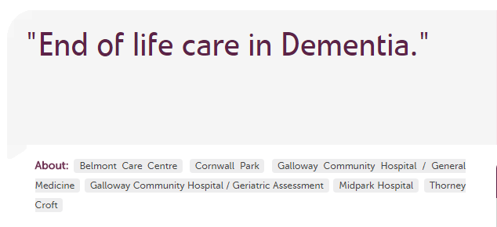
Notes:
Community voice
How are services near us being experienced?

Slide 15
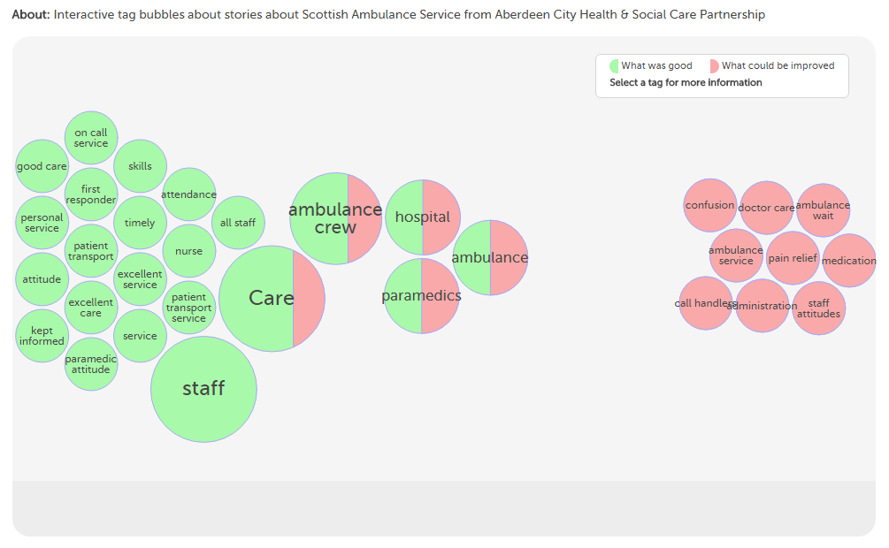
Notes:
Community voice
This visual shows how Ambulance service being experienced by people who live in Aberdeen

Slide 16
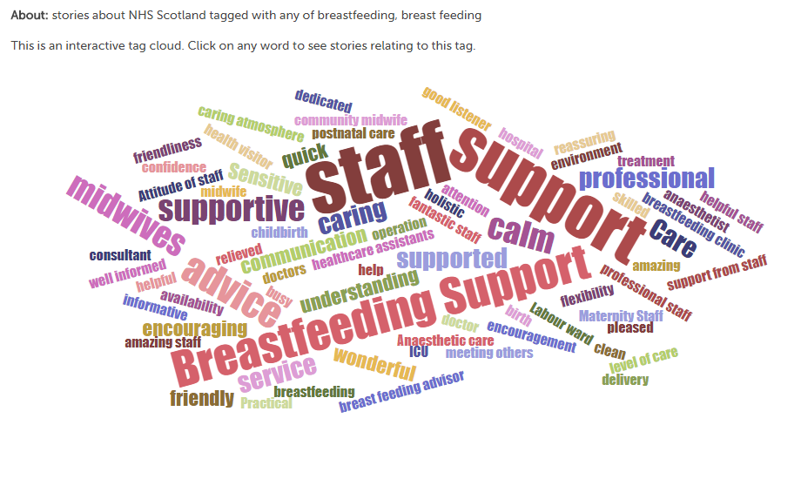
What was good?
Notes:
National voice
An example of stories viewed at national level
Example used is breastfeeding but you could use any tag or specialty:-
Eg End of life care, dementia, endoscopy,
These help you drill into individual stories
The bigger the word the more it’s been tagged as “what was good”
Drilling down might enable identification examples or areas of good practice

Slide 17
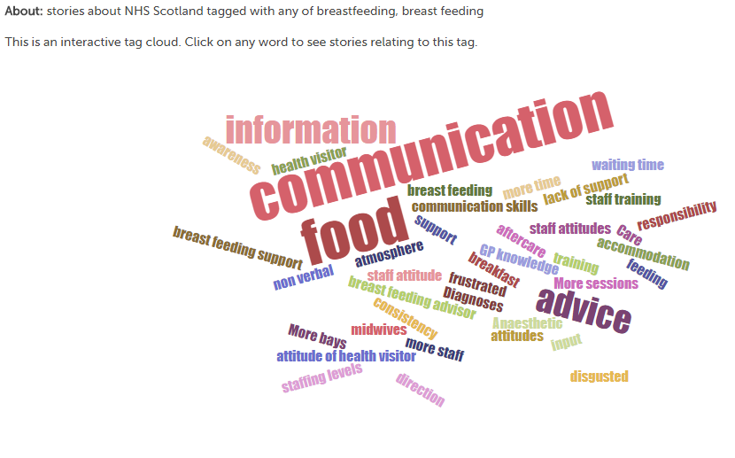
What could be improved?
Notes:
National Voice
Similarly but help drill down into “what could be improved”
This is a national picture

Slide 18
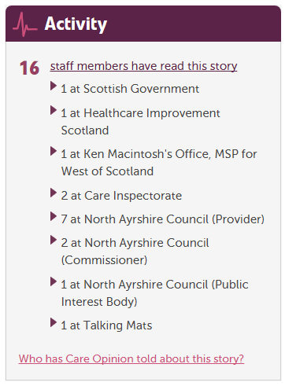
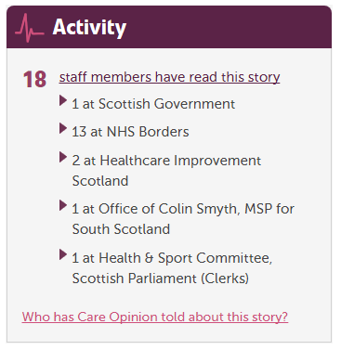

Slide 19
Notes:
One story, many listeners

