Slide 1
New Care Opinion Features to Support QI Work
Cally Bowman, Subscriber & Social Media Officer @callytweets

Slide 2
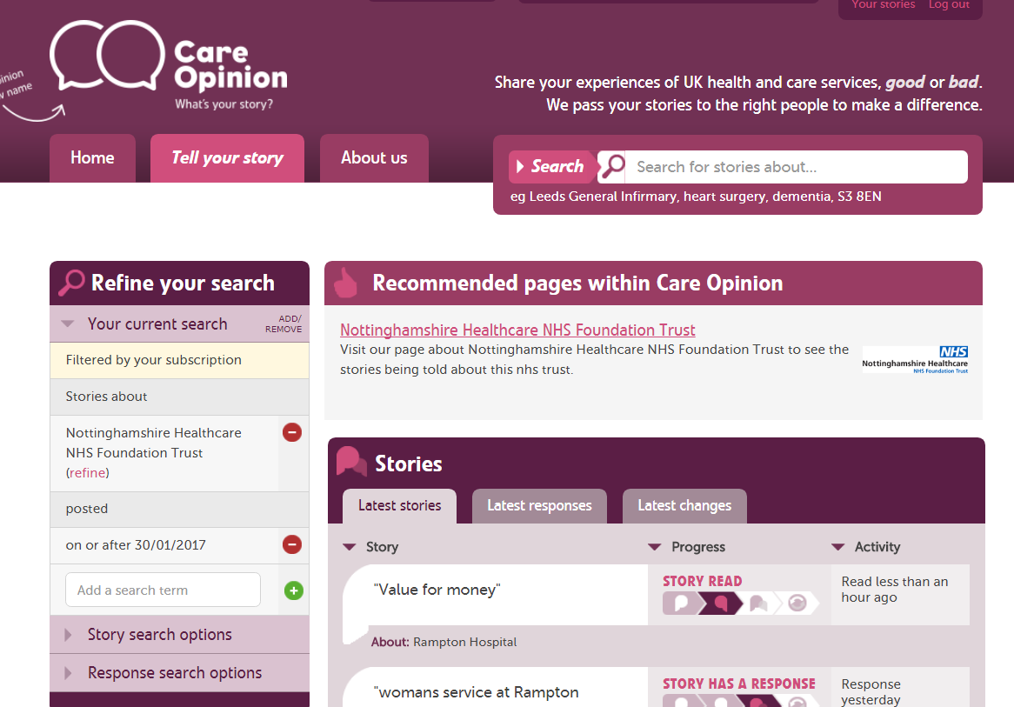
Use your specific requirements to create a report, e.g. an annual report 2017-2018

Slide 3
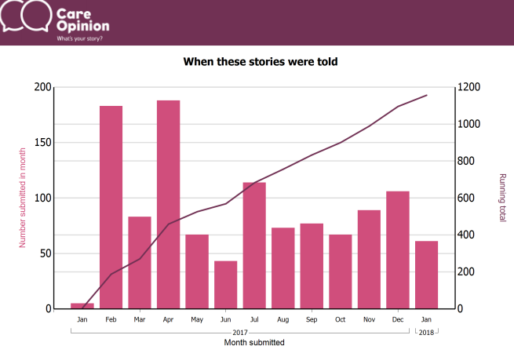

Slide 4
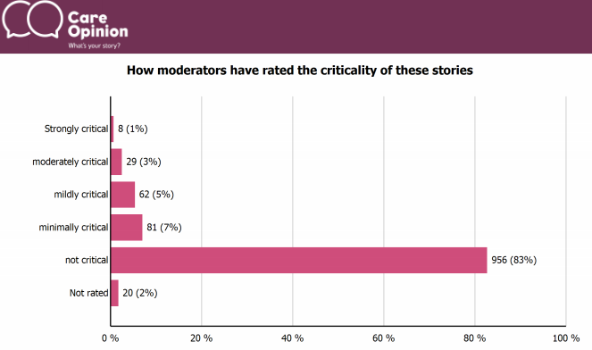

Slide 5
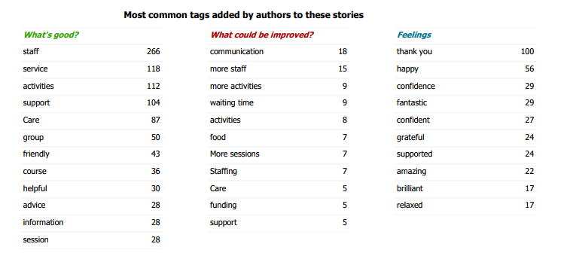

Slide 6
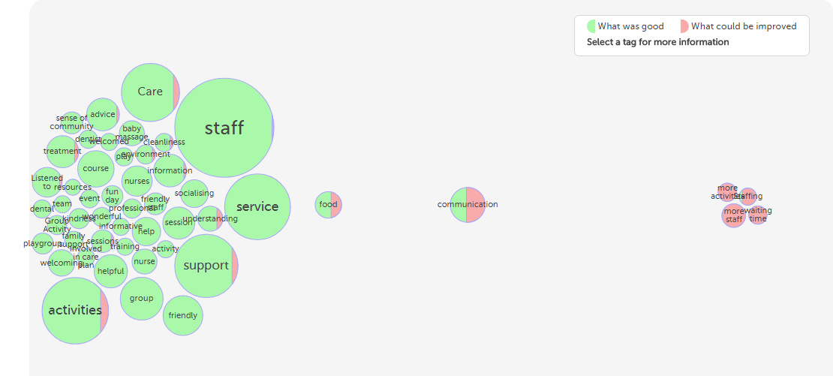
Interactive tag bubbles about All stories about Nottinghamshire Healthcare NHS Foundation Trust 2017-2018

Slide 7
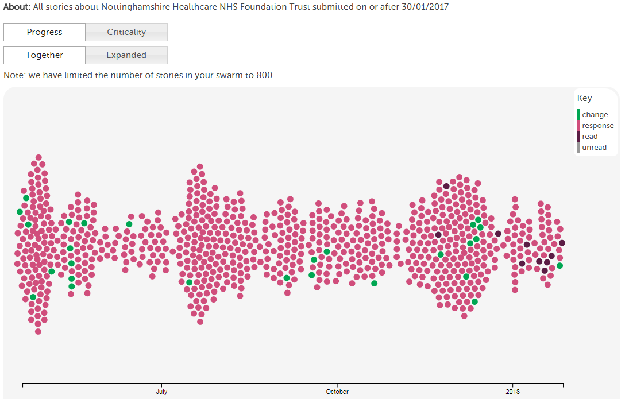

Slide 8
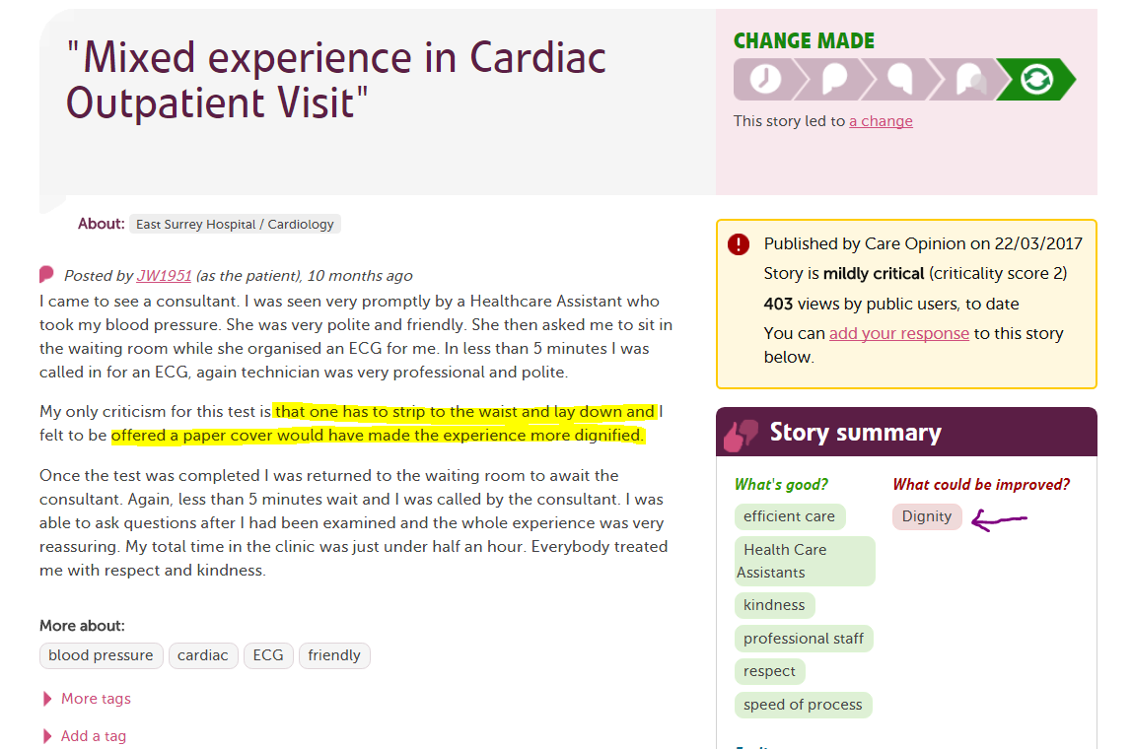

Slide 9
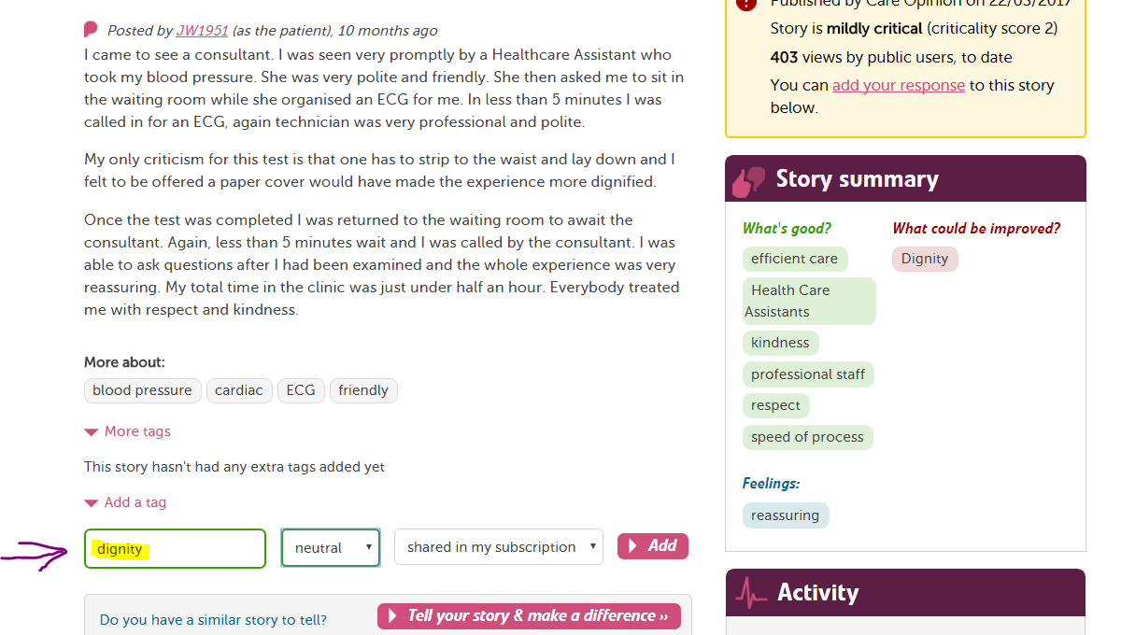

Slide 10
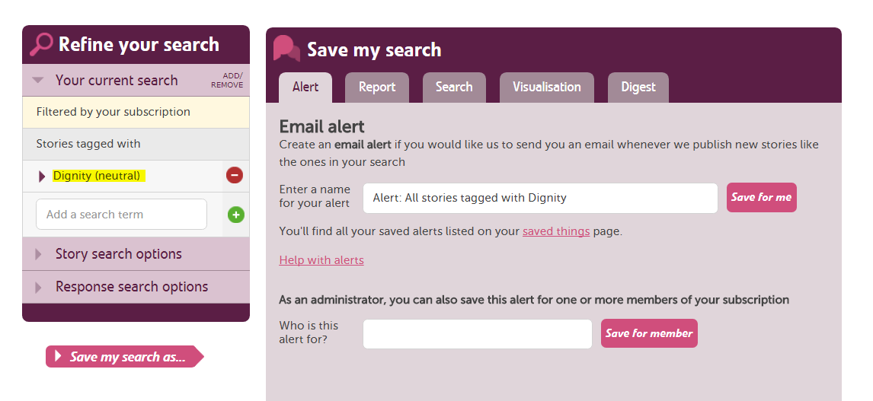

Slide 11
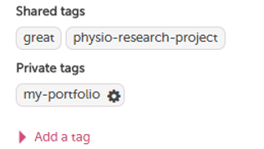
Tags can be added as public, private, or exclusively for people within your subscription.
Subscriber tagging allows for collaborative learning from stories.
Examples of tags that you could add: - CQC domain names - Stories that require a further response - Names of projects - Keeping track of examples you wish to use in meetings, reports, classes or case studies. Then, use the specific tag that you created to generate & schedule reports, digests and visulations.

Slide 12
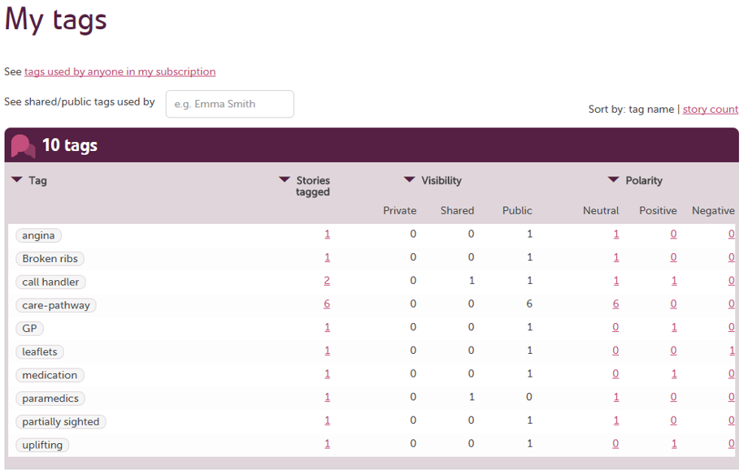

Slide 13
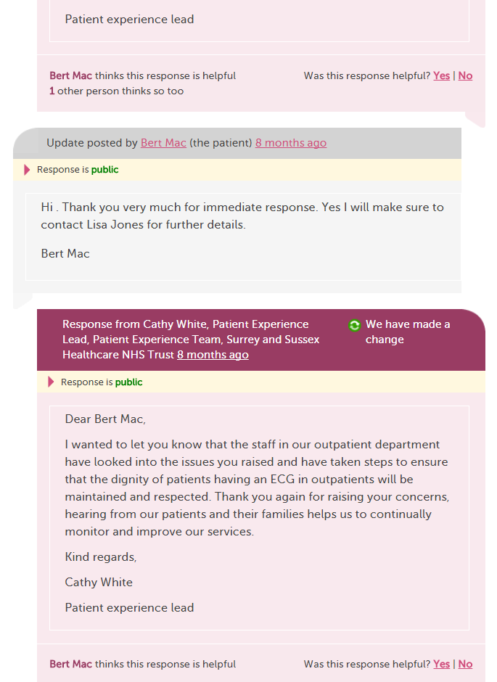

Slide 14
Any questions?
To find out more about these features & how to use them, join our webinar Wednesday, February 7th 11am.
A link to register for this webinar will be sent to all delegates following today’s workshop

